Slide 1
Python
TTT

Slide 2
Jupyter – Conda or Colab
In Colab, mounting command:
from google.colab import drive
drive.mount('/content/drive')

Slide 3
Basic Command
a=1
a=1.68
a="hello“
a=[1,3,4,6]
print(a[2])
print("the array is : ", a)
name = input("Please enter your name : ")
print("Your name is ", name)
a = 1
while a < 5:
print(a)
a = a+1
a=3
if a==1:
print("a is 1")
elif a==2:
print("a is 2")
else:
print("a is not 1 or 2")

Slide 4
Python for Analytics

Slide 5
Database CRUD Create, Read, Update, Delete
https://docs.python.org/3/library/sqlite3.html
https://likegeeks.com/python-sqlite3-tutorial/#:~:text=To%20list%20all%20tables%20in,SQLite3%2C%20which%20stores%20all%20tables.
#Create, Read, Insert
import sqlite3
c = sqlite3.connect(“MyFirstDB.db")
c.execute("create table DBS_t (DBS float, SingDollar float)")
c.execute("insert into DBS_t(DBS, SingDollar) values (31.35,1.38)")
for row in c.execute("select * from DBS_t"):
print(row)
c.execute("insert into DBS_t(DBS, SingDollar) values (31,1.39)")
c.execute("insert into DBS_t(DBS, SingDollar) values (30,1.4)")
for row in c.execute("select * from DBS_t"):
print(row)
c.commit()
c.close()
#Delete
c = sqlite3.connect("MyFirstDB.db")
c.execute("delete from DBS_t where SingDollar=1.38")
for row in c.execute("select * from DBS_t"):
print(row)
c.commit()
c.close()
#update
c = sqlite3.connect("MyFirstDB.db")
c.execute("update DBS_t set DBS = 32 where SingDollar=1.39")
for row in c.execute("select * from DBS_t"):
print(row)
c.commit()
c.close()

Slide 6
Database using csv Create, Read, Update, Delete
https://docs.python.org/3/library/sqlite3.html
c.execute('''CREATE TABLE DBS (
DBS FLOAT,
SingDollar FLOAT
);''')
c.execute("SELECT * FROM DBS")
rows = c.fetchall()
for row in rows:
print(row)
#Create, Read, Update
import sqlite3
import pandas as pd
df = pd.read_csv("DBS.csv")
c = sqlite3.connect("DBS.db")
df = df.iloc[:,2:4]
df.to_sql(name=‘DBS_t', con=c)
for row in c.execute("select * from DBS_t"):
print(row)
c.close()
c.execute('DROP TABLE DBS')
c.execute("insert into DBS (DBS, SingDollar) values (20,1.3)")
for row in c.execute("select * from DBS"):
print(row)
c.execute("DELETE FROM DBS")
c.execute("DELETE FROM DBS WHERE …..")
c.execute("Update DBS set DBS = ? where SingDollar = ?"

Slide 7
Read from Database
import sqlite3
import pandas as pd
c = sqlite3.connect("DBS.db")
df = pd.read_sql("select * from DBS", con=c)
c.close()

Slide 8
AI model
df = pd.read_csv("DBS_SingDollar.csv")
X = df.loc[:,["SGD"]]
Y = df.loc[:,['DBS']]
print(X)
from sklearn import linear_model
model = linear_model.LinearRegression()
model.fit(X,Y)
pred = model.predict(X)
from sklearn.metrics import mean_squared_error
rmse = mean_squared_error(Y,pred)**0.5
print(rmse)
#print(rmse/Y.mean(axis=0)*100)
#to add polynomial
df["SGD2"] = df["SGD"] ** 2

Slide 9
Dump parameter to external file and load
from joblib import dump
dump(model, 'Regression.joblib’)
from joblib import load
model = load("Regression.joblib")
X = [[1.4]]
pred = model.predict(X)
print(pred)
import pandas as pd
df = pd.read_csv("C:/Users/Teoh Teik Teo/OneDrive - TSS Global Pte. Ltd/TT Library/AI Model/Data/DBS_SingDollar.csv")
X = df.loc[:, ["SGD"]]
pred = model.predict(X)
print(pred)

Slide 10
Other models
From sklearn import tree
model = tree.DecisionTreeRegressor()
From sklearn import neural_network
model = neural_network.MLPRegressor(solver="lbfgs", hidden_layer_sizes=(12,2))

Slide 11
Optional

Slide 12
Flask (Back End)
Check port number : netstat
from flask import Flask
app = Flask(__name__)
from flask import request, render_template
import joblib
@app.route("/", methods = ["GET", "POST"])
def i():
if request.method == "POST":
num = request.form.get("rates")
print(num)
model = joblib.load("DBS Regression Model")
pred = model.predict([[num]])
print(pred)
s = "Predicted DBS Share Price : " + str(pred)
print(s)
return(render_template(“main.html", result = s))
else:
return render_template(“main.html", result ="DBS Share Price Prediction")
#change port number
if __name__ == '__main__':
app.run(host="127.0.0.1", port=int("80"))
# for mac, you may want to try port number 1111
https://stackoverflow.com/questions/60020472/kill-process-on-a-given-port-prior-to-running-a-flask-app
#if run on command line
if __name__=="__main__":
app.run(debug=True)
f __name__=="__main__":
app.run()

Slide 13
Front End HTML
<html>
<body>
<form action = "/" method = "post">
<p>Enter Sing to US:</p>
<p><input type = "number" step="0.01" name = "num"></p>
<p><input type = "submit" value = "submit"></p>
</form>
{{result}}
</body>
</html>

Slide 14
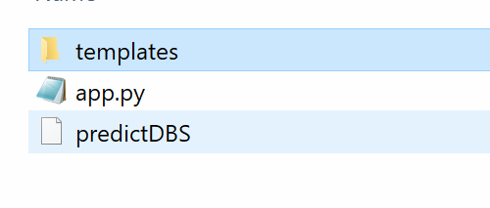
Github and Heroku Step 1 Create app.py, MLmodel and templates

Slide 15
Heroku
Edit Procfile using notepad. In Procfile: web: gunicorn main:app
<form action="http://127.0.0.1:5000" method="POST"> change to / instead of <form action="/" method="POST">
Download requirements.txt (remove the last statement – Keras CPU if you are not using Keras)
3.. Upload to github
– Create a new repository (go to repository and press new)
– Remember to use drag and drop (so that subdirectory can work)
- Remember to download to app.py and upload app.py if you are using Jupyter (DO NOT UPLOAD .ipynb)
4.Go to Heroku Dashboard (top left) – New
5. Go to setting – Add buildpack – Select Python
6. Go to deploy – Connect to GitHub and Deloy branch

Slide 16
Virtual Environment (Optional)
1. Create virtual environment using cmd
python -m venv v09021930
v09021930\Scripts\activate.bat
2. pip install gunicorn, flask, joblib, sklearn
3. pip freeze > requirements.txt
4. Edit requirements.txt (if needed, usually no)

Slide 17
Examples of requirements.txt
absl-py==1.0.0
astunparse==1.6.3
cachetools==5.0.0
certifi==2021.10.8
charset-normalizer==2.0.11
click==8.0.3
colorama==0.4.4
Flask==2.0.2
flatbuffers==2.0
gast==0.5.3
google-auth==2.6.0
google-auth-oauthlib==0.4.6
google-pasta==0.2.0
grpcio==1.43.0
gunicorn==20.1.0
h5py==3.6.0
idna==3.3
importlib-metadata==4.10.1
itsdangerous==2.0.1
Jinja2==3.0.3
joblib==1.1.0
keras==2.8.0
Keras-Preprocessing==1.1.2
libclang==13.0.0
Markdown==3.3.6
MarkupSafe==2.0.1
numpy==1.22.2
oauthlib==3.2.0
opt-einsum==3.3.0
protobuf==3.19.4
pyasn1==0.4.8
pyasn1-modules==0.2.8
requests==2.27.1
requests-oauthlib==1.3.1
rsa==4.8
scikit-learn==1.0.2
scipy==1.8.0
six==1.16.0
sklearn==0.0
tensorboard==2.8.0
tensorboard-data-server==0.6.1
tensorboard-plugin-wit==1.8.1
tensorflow-io-gcs-filesystem==0.24.0
termcolor==1.1.0
tf-estimator-nightly==2.8.0.dev2021122109
threadpoolctl==3.1.0
typing_extensions==4.0.1
urllib3==1.26.8
Werkzeug==2.0.3
wrapt==1.13.3
zipp==3.7.0
click==8.1.3
colorama==0.4.6
Flask==2.2.2
importlib-metadata==5.0.0
itsdangerous==2.1.2
Jinja2==3.1.2
joblib==1.2.0
MarkupSafe==2.1.1
numpy==1.23.4
scikit-learn==1.1.3
scipy==1.9.3
sklearn==0.0
threadpoolctl==3.1.0
Werkzeug==2.2.2
zipp==3.10.0
Procfile (MUST NOT HAVE .txt EXTENSION)
web: gunicorn app:app

Slide 18
Python with Data Wrangling & Visualization & Feature Selection & Data Balancing
Feature Selection
Cleaning –
Remove NA
Remove Non-Numeric
Remove Outlier
Normalization
Data Visualization

Slide 19
Import data & Feature Selection
import pandas as pd
df = pd.read_csv("Equity.csv")
pd.set_option("display.max_columns", None)
pd.set_option("display.max_rows", None)
#feature selection
cor = df.corr()
cor_target = abs(cor["Class"])
#Selecting highly correlated features
features = cor_target[cor_target>0.1]
print(features.sort_values()))
print(df.isnull().sum().sort_values())
df = df.loc[:, ["Class", "Dividend per Share", "10Y Net Income Growth (per Share)", "10Y Shareholders Equity Growth (per Share)"]]
#replace word with number if needed
df['default'] = df["default"].replace(("Yes", "No"), (0,1))
from sklearn.feature_selection import SelectKBest, f_regression
features = SelectKBest(score_func=f_regression, k=5)
fit = features.fit(X, Y)
print(data.columns, fit.scores_)
mask = fit.get_support()
print(mask)
new_features = X.columns[mask]
print(new_features[:])

Slide 20
Data Cleaning and Split X,Y
#remove outlier
import numpy as np
from scipy import stats
z = stats.zscore(df.astype(np.float)) #zscore conversion need float
z = np.abs(z) #convert all to positive because the parity is not important
f = (z < 3).all(axis=1) #3 is your choice, axis =1 means by columns, f is a flag
df = df[f]
#Data Cleaning
df = df.dropna()
#split X,Y
Y = df.iloc[:, 0]
X = df.iloc[:, 1:4]
#remove not a number
for i in df.columns:
df1 = pd.to_numeric(df[i], errors='coerce’)
df=df[df1.notnull()] #make it to null then remove null
print(df)

Slide 21
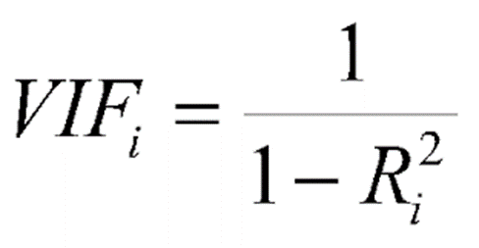
Check Collinearity
#vif to check collinearity
#1 = not correlated.
#Between 1 and 5 = moderately correlated.
#Greater than 5 = highly correlated.
from statsmodels.stats.outliers_influence import variance_inflation_factor
vif_data = pd.DataFrame()
vif_data["feature"] = X.columns
vif_data["VIF"] = [variance_inflation_factor(X.values, i) for i in range(len(X.columns))]
print(vif_data)

Slide 22
Data Visualization
df.hist()
import seaborn as sns
sns.heatmap(df.corr())

Slide 23
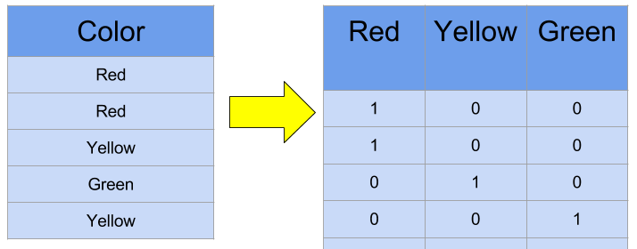
Normalization & Create Dummy for Categorical X
#normalization
from scipy import stats
import numpy as np
pd.set_option('display.max_rows', 10)
for i in X.columns:
X[i]=stats.zscore(X[i].astype(np.float))
print(X)
#X is categorical
dummy=pd.get_dummies(X["rating"])
X=X.merge(dummy, left_index=True, right_index=True)
X=X.drop("rating", axis="columns")

Slide 24
Balance the data
from collections import Counter
from imblearn.over_sampling import SMOTE
from imblearn.under_sampling import RandomUnderSampler
Counter(df["Class"])
counter = Counter(Y_train[:])
print(counter)
oversample = SMOTE()
X_train, Y_train = oversample.fit_resample(X_train, Y_train)
# summarize the new class distribution
counter = Counter(Y_train[:])
print(counter)

Slide 25
Split train test, train, predict
from sklearn.model_selection import train_test_split
X_train, X_test, Y_train, Y_test = train_test_split(X,Y, test_size=0.3)
print(X_train, X_test, Y_train, Y_test )
from sklearn import linear_model
model = linear_model.LogisticRegression()
model.fit(X_train, Y_train)
pred = model.predict(X_train)
from sklearn.metrics import confusion_matrix
cm = confusion_matrix(Y_train, pred)
print(cm)
accuracy = (cm[0,0]+cm[1,1])/sum(sum(cm))
print(accuracy)
pred = model.predict(X_test)
cm = confusion_matrix(Y_test, pred)
print(cm)
accuracy = (cm[0,0]+cm[1,1])/sum(sum(cm))
print(accuracy)

Slide 26
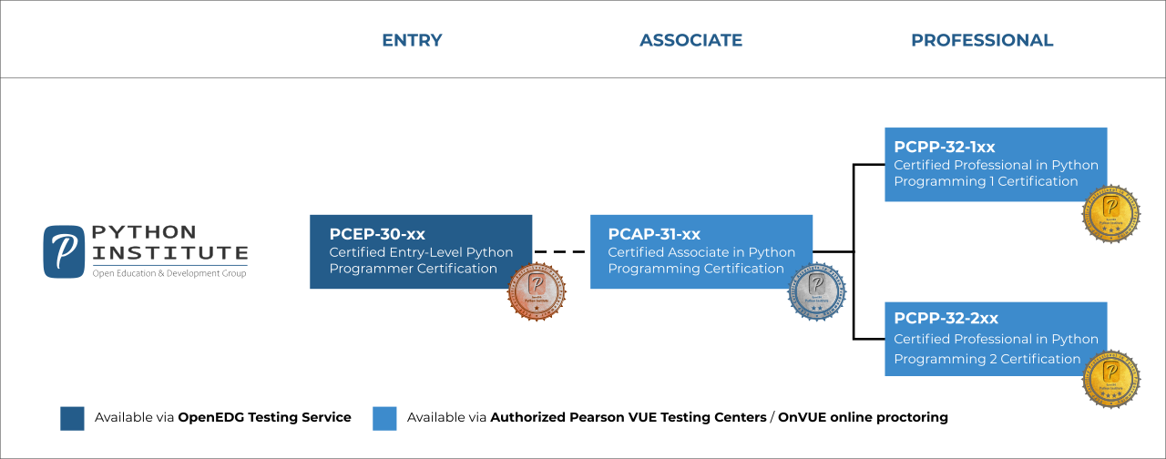
https://pythoninstitute.org/certification/

Slide 27
Finally - CEPP

Slide 28
Python
Basic Python – Variable, control flow, function
Data Structure – Array, list, dictionary, stack, queue
OOP – Class, subclass, instance, object, constructor, methods, private, static, abstract
SQL – CRUD
Network – Socket, REST API, json & json-server, XML, request, configuration file
Others – Decorator, Generator, Lamba, Exception, PIP, PYC, PyPI, Namespace, Virtual Environment, Multiple Variable, configuration, Multi-threading, Pipe, file, Magic, tktinker, Pickle & Shelve
AI – Regression and Decision Tree
Excel Using Python

Slide 29
Python
Day 1
Variable – Naming Convention, Assignment, Type (int, float, double, sequence: string, list, tuple), Operator (+ - / *)
control flow – If, elif, for, while
Day 2
Function
Data Structure – Array, list, dictionary, stack, queue
Advanced Python

Slide 30
Ide (try print hello)
Anaconda https://www.anaconda.com/products/individual
Colab https://colab.research.google.com/

Slide 31
Basic

Slide 32
Variable Type

Slide 33
Basic Datatypes
Integers (default for numbers)
z = 5 / 2 # Answer 2, integer division
Floats
x = 3.456
Strings
Can use “” or ‘’ to specify with “abc” == ‘abc’

Slide 34
Always Try DIR() then Internet Help

Slide 35
Naming Rules
There are some reserved words:
and, assert, break, class, continue, def, del, elif, else, except, exec, finally, for, from, global, if, import, in, is, lambda, not, or, pass, print, raise, return, try, while
Dunder or magic methods in Python are the methods having two prefix and suffix underscores in the method name. Dunder here means “Double Under (Underscores)”. These are commonly used for operator overloading. Few examples for magic methods are: __init__, __add__, __len__, __repr__ etc.

Slide 36
Assignment
You can assign to multiple names at the same time
>>> x, y = 2, 3
>>> x
2
>>> y
3
This makes it easy to swap values
>>> x, y = y, x
Assignments can be chained
>>> a = b = x = 2

Slide 37
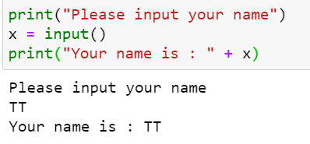
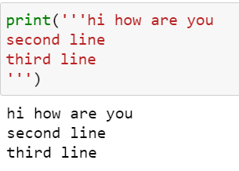
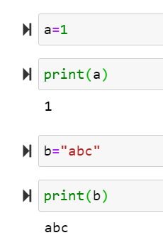
Python Simple Syntax (Variable, assign or input) Refer to textbook page …
print("hello")

Slide 38
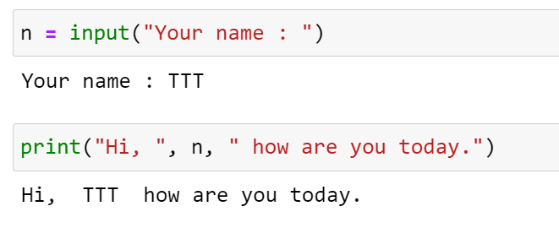
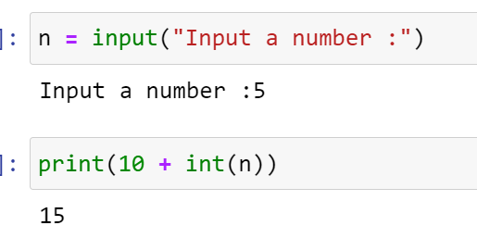
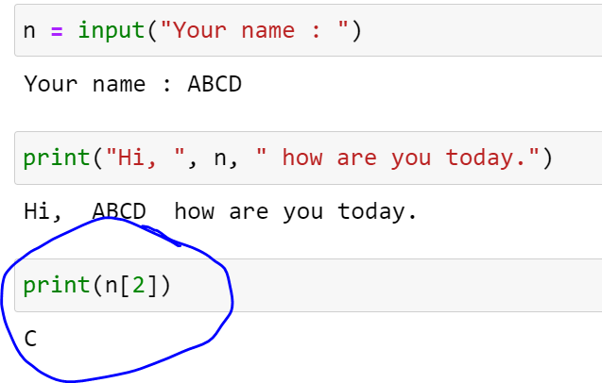
Input default is string

Slide 39
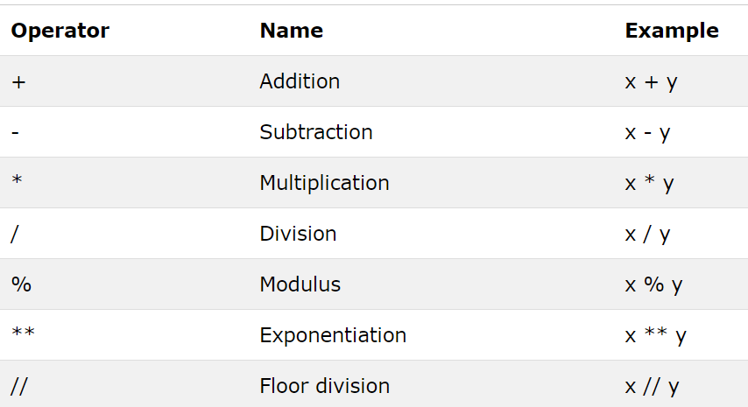
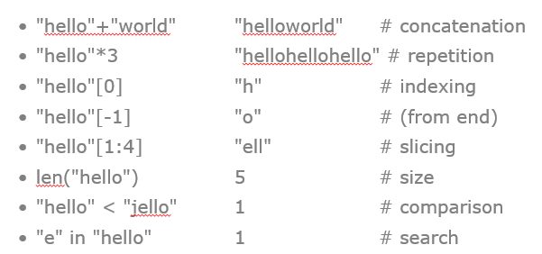
Operator : Number & String

Slide 40
Sequence Types
Tuple: (‘john’, 32)
A simple immutable ordered sequence of items
Items can be of mixed types, including collection types
Strings: “John Smith”
Immutable
Conceptually very much like a tuple
List: [1, 2, ‘john’]
Mutable ordered sequence of items of mixed types

Slide 41
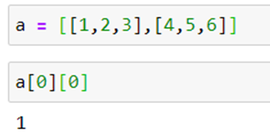
Sequence Types
Access individual members of a tuple, list, or string using square bracket “array” notation
Note that all are 0 based…
>>> tu = (23, ‘abc’, 4.56, (2,3), ‘def’)
>>> tu[1] # Second item in the tuple.
‘abc’
>>> li = [“abc”, 34, 4.34, 23]
>>> li[1] # Second item in the list.
34
>>> st = “Hello World”
>>> st[1] # Second character in string.
‘e’

Slide 42
Operations on Lists
>>> li = [5, 2, 6, 8]
>>> li.reverse() # reverse the list *in place*
>>> li
[8, 6, 2, 5]
>>> li.sort() # sort the list *in place*
>>> li
[2, 5, 6, 8]

Slide 43
Operations on Lists
Lists have many methods, including index, count, remove, reverse, sort
>>> li = [‘a’, ‘b’, ‘c’, ‘b’]
>>> li.index(‘b’) # index of 1st occurrence
1
>>> li.count(‘b’) # number of occurrences
2
>>> li.remove(‘b’) # remove 1st occurrence
>>> li
[‘a’, ‘c’, ‘b’]

Slide 44
Sequence Types
Define tuples using parentheses and commas
>>> tu = (23, ‘abc’, 4.56, (2,3), ‘def’)
Define lists are using square brackets and commas
>>> li = [“abc”, 34, 4.34, 23]
Define strings using quotes (“, ‘, or “““).
>>> st = “Hello World”
>>> st = ‘Hello World’
>>> st = “““This is a multi-line
string that uses triple quotes.”””

Slide 45
Positive and negative indices
>>> t = (23, ‘abc’, 4.56, (2,3), ‘def’)
Positive index: count from the left, starting with 0
>>> t[1]
‘abc’
Negative index: count from right, starting with –1
>>> t[-3]
4.56

Slide 46
Slicing: return copy of a subset
>>> t = (23, ‘abc’, 4.56, (2,3), ‘def’)
Return a copy of the container with a subset of the original members. Start copying at the first index, and stop copying before second.
>>> t[1:4]
(‘abc’, 4.56, (2,3))
Negative indices count from end
>>> t[1:-1]
(‘abc’, 4.56, (2,3))

Slide 47
Slicing: return copy of a =subset
>>> t = (23, ‘abc’, 4.56, (2,3), ‘def’)
Omit first index to make copy starting from beginning of the container
>>> t[:2]
(23, ‘abc’)
Omit second index to make copy starting at first index and going to end
>>> t[2:]
(4.56, (2,3), ‘def’)

Slide 48
The ‘in’ Operator
Boolean test whether a value is inside a container:
>>> t = [1, 2, 4, 5]
>>> 3 in t
False
>>> 4 in t
True
>>> 4 not in t
False
For strings, tests for substrings
>>> a = 'abcde'
>>> 'c' in a
True
>>> 'cd' in a
True
>>> 'ac' in a
False
Be careful: the in keyword is also used in the syntax of for loops and list comprehensions

Slide 49
The + Operator
The + operator produces a new tuple, list, or string whose value is the concatenation of its arguments.
>>> (1, 2, 3) + (4, 5, 6)
(1, 2, 3, 4, 5, 6)
>>> [1, 2, 3] + [4, 5, 6]
[1, 2, 3, 4, 5, 6]
>>> “Hello” + “ ” + “World”
‘Hello World’

Slide 50
The * Operator
The * operator produces a new tuple, list, or string that “repeats” the original content.
>>> (1, 2, 3) * 3
(1, 2, 3, 1, 2, 3, 1, 2, 3)
>>> [1, 2, 3] * 3
[1, 2, 3, 1, 2, 3, 1, 2, 3]
>>> “Hello” * 3
‘HelloHelloHello’

Slide 51
Operations on Lists Only
>>> li = [1, 11, 3, 4, 5]
>>> li.append(‘a’) # Note the method syntax
>>> li
[1, 11, 3, 4, 5, ‘a’]
>>> li.insert(2, ‘i’)
>>>li
[1, 11, ‘i’, 3, 4, 5, ‘a’]

Slide 52
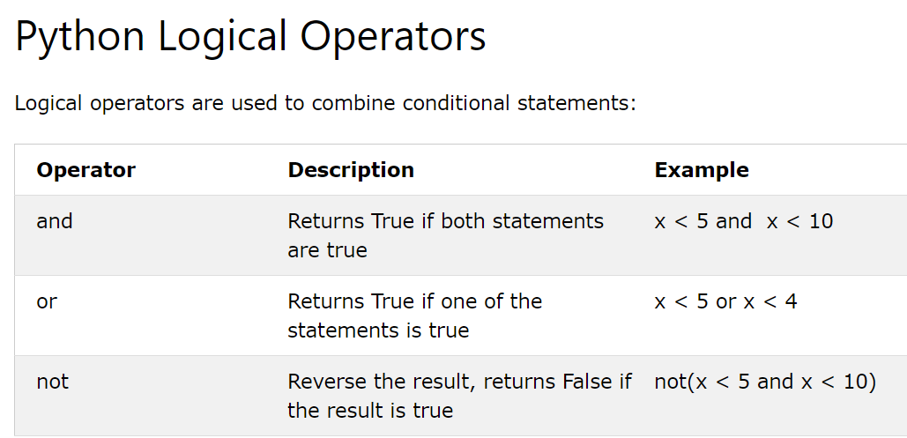
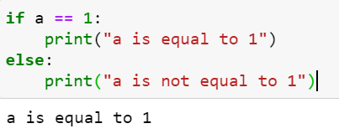
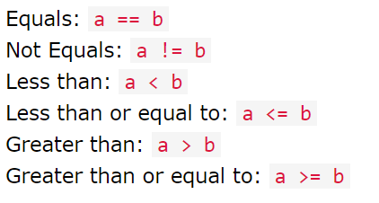
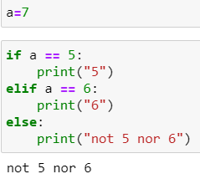
If else

Slide 53
And equivalent
if c == 5 and d ==6:
print("c is 5 and d is 6")
else:
print("c is not 5 or d is not 6")
if c == 5:
if d == 6:
print("c is 5 and d is 6")
else:
print("c is not 5 or d is not 6")
else:
print("c is not 5 or d is not 6")

Slide 54
Or Equivalent
if x==4 or y==5:
print("x is 4 or y is 5")
else:
print("x is not 4 and y is not 5")
if x==4:
print("x is 4 or y is 5")
elif y==5:
print("x is 4 or y is 5")
else:
print("x is not 4 and y is not 5")

Slide 55
A Code Sample (in IDLE)
x = 34 - 23 # A comment.
y = "Hello" # Another one.
z = 3.45
if z == 3.45 or y == "Hello":
x = x + 1
y = y + "World" # String concat.
print(x)
print(y)
Logical operators are words (and, or, not) not symbols

Slide 56
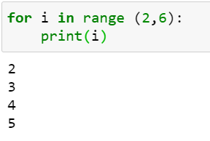
For Loop
i = 1
while i <10:
print(i)
i = i+1
i = 1
while 1==1:
print(i)
i = i+1
if i == 10:
break

Slide 57
While loop
a = 0
while a != 10:
a = a+1
print(a)
a = 0
while a != 10:
if a == 9:
break
print(a)
a = a+1
for i in range(1,10):
print(i)

Slide 58
File – read write and append
f = open(filename[, mode[, buffersize])
mode can be "r", "w", "a" (like C stdio); default "r"
append "b" for text translation mode
append "+" for read/write open
buffersize: 0=unbuffered; 1=line-buffered; buffered
methods:
read([nbytes]), readline(), readlines()
write(string), writelines(list)
seek(pos[, how]), tell()
flush(), close()
fileno()
f = open("C:/Users/Teoh Teik Teo/OneDrive - TSS Global Pte. Ltd/TT Library/AI Model/Python/Test.txt")
s = f.read()
f.close()
print(s)
f = open("C:/Users/Teoh Teik Teo/OneDrive - TSS Global Pte. Ltd/TT Library/AI Model/Python/Test.txt", "a")
f.writelines(“\nHi Python")
f.close()
f = open("C:/Users/Teoh Teik Teo/OneDrive - TSS Global Pte. Ltd/TT Library/AI Model/Python/Test.txt", "w")
f.writelines("Hi Python")
f.close()

Slide 59
Simple task
Write a Python program which accepts the radius of a circle from the user and compute the area.

Slide 60
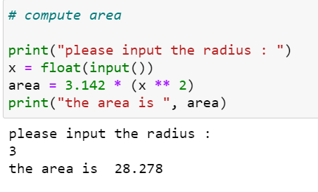
Simple task Solution
Write a Python program which accepts the radius of a circle from the user and compute the area.

Slide 61
Creating a function
def first():
print("My first function")
first()

Slide 62
Creating function with argument
def second(a,b):
print(a+b)
second(5,10)
def second(a,b):
print(a/b)
second(a=5,b=10)

Slide 63
Return the value in functio
def division(a,b):
return(a/b)
d = division(10,2)
print(d)

Slide 64
2 simple function
Given radius, calculate area, perimeter
cal_area(radius)
cal_perimeter(radius)

Slide 65
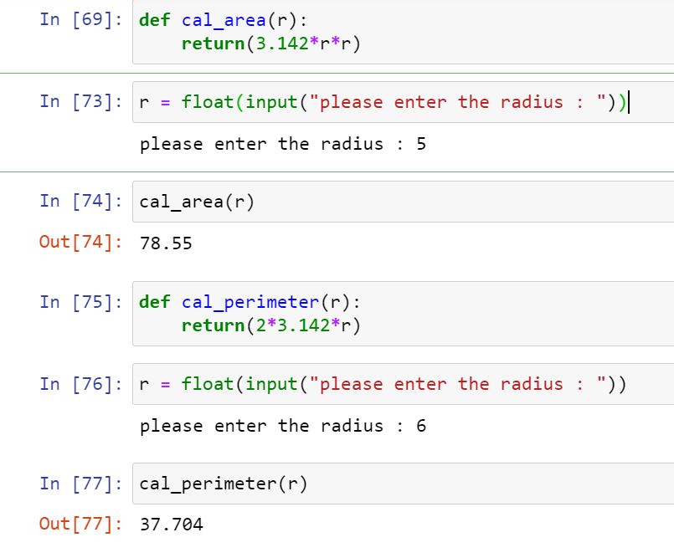

Slide 66
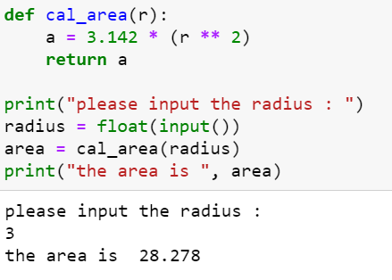
Creating a function

Slide 67
OOP

Slide 68
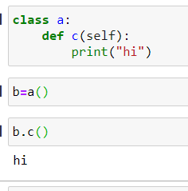
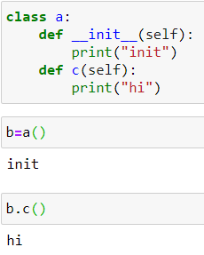
Class and OOP & __init__

Slide 69
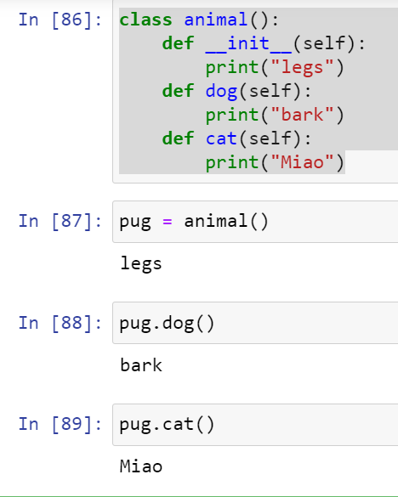

Slide 70
Object
Create 1 Object with 2 function, with __init__ as welcome notes
cal.area()
cal.perimeter()

Slide 71
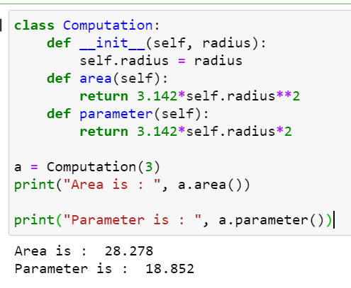
Object Oriented Programming: Creating a class
Write a Python Class which accepts the radius of a circle from the user and compute the area and parameter.
class Computation:
def __init__(self, radius):
self.radius = radius
def area(self):
return 3.142*self.radius**2
def parameter(self):
return 3.142*self.radius*2
a = Computation(3)
print("Area is : ", a.area())
print("Parameter is : ", a.parameter())

Slide 72
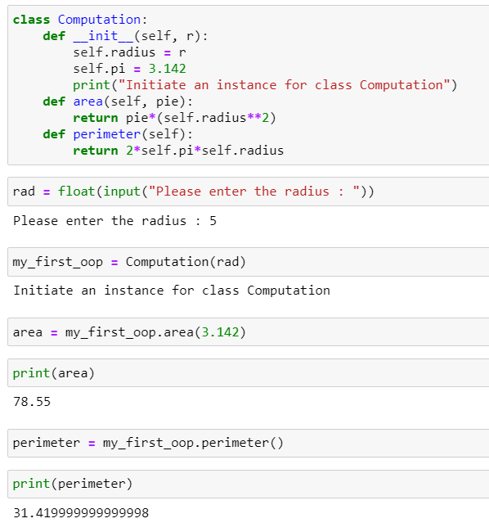

Slide 73
Graph
j = [1,2,3,4,5]
r = [6,7,8,9,10]
import matplotlib.pyplot as plt
plt.plot(j, r)
plt.xlabel('parameter')
plt.ylabel('rmse')
plt.title('rmse')
plt.show()

Slide 74
Question
Create a program that asks the user to enter their name and their age. Print out a message addressed to them that tells them the year that they will turn 100 years old.

Slide 75
Solution
name = input("What is your name: ")
age = int(input("How old are you: "))
year = str((2014 - age)+100)
print(name + " will be 100 years old in the year " + year)

Slide 76
Question
Ask the user for a number. Depending on whether the number is even or odd, print out an appropriate message to the user.

Slide 77
Solution
num = input("Enter a number: ")
mod = num % 2
if mod > 0:
print("You picked an odd number.")
else:
print("You picked an even number.")

Slide 78
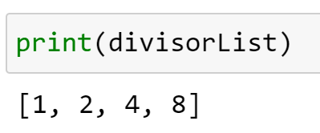
Question
Create a program that asks the user for a number and then prints out a list of all the divisors of that number. (If you don’t know what a divisor is, it is a number that divides evenly into another number. For example, 13 is a divisor of 26 because 26 / 13 has no remainder.)

Slide 79
Answer
num = int(input("Please choose a number to divide: "))
listRange = list(range(1,num+1))
divisorList = []
for number in listRange:
if num % number == 0:
divisorList.append(number)
print(divisorList)

Slide 80
Palindromes
The word “dad” and the number “1881” are palindromes.

Slide 81
Question
wrd=input("Please enter a word")
wrd=str(wrd)
rvs=wrd[::-1]
print(rvs)
if wrd == rvs:
print("This word is a palindrome")
else:
print("This word is not a palindrome")
What does :: -1 mean in Python?
It means, "start at the end; count down to the beginning, stepping backwards one step at a time.“
::2 means count forward 2 => abcde -> ace
Wrd = 1234567890
wrd[0:3:1] = 123
Try…..

Slide 82
Question
Let’s say I give you a list saved in a variable: a = [1, 4, 9, 16, 25, 36, 49, 64, 81, 100]. Take this list a and makes a new list that has only the even elements of this list in it.

Slide 83
Answer
a = [1, 4, 9, 16, 25, 36, 49, 64, 81, 100]
b=[]
for i in a:
if i % 2 == 0:
b.append(i)
print(b)
a = [1, 4, 9, 16, 25, 36, 49, 64, 81, 100]
b = [number for number in a if number % 2 == 0]
print(b)

Slide 84
Question
Make a two-player Rock-Paper-Scissors game. (Hint: Ask for player plays (using input), compare them, print out a message of congratulations to the winner, and ask if the players want to start a new game)

Slide 85
Answer
import sys
user1 = input("What's your name?")
user2 = input("And your name?")
user1_answer = input("%s, do yo want to choose rock, paper or scissors?" % user1)
user2_answer = input("%s, do you want to choose rock, paper or scissors?" % user2)
def compare(u1, u2):
if u1 == u2:
return("It's a tie!")
elif u1 == 'rock':
if u2 == 'scissors':
return("Rock wins!")
else:
return("Paper wins!")
elif u1 == 'scissors':
if u2 == 'paper':
return("Scissors win!")
else:
return("Rock wins!")
elif u1 == 'paper':
if u2 == 'rock':
return("Paper wins!")
else:
return("Scissors win!")
else:
return("Invalid input! You have not entered rock, paper or scissors, try again.")
sys.exit()
print(compare(user1_answer, user2_answer))

Slide 86
Question
Generate a random number between 1 and 9 (including 1 and 9). Ask the user to guess the number, then tell them whether they guessed too low, too high, or exactly right.

Slide 87
Answer
import random
rd = random.randint(1,9)
guess = 0
c = 0
while guess != rd:
guess = input("Enter a guess between 1 to 9")
guess = int(guess)
c += 1
if guess < rd:
print("Too low")
elif guess > rd:
print("Too high")
else:
print("Right!")
print("You took only", c, "tries!")
print(rd)

Slide 88
Question
Ask the user for a number and determine whether the number is prime or not. (For those who have forgotten, a prime number is a number that has no divisors.).

Slide 89
Solution
n = input("enter ")
n = int(n)
flag = 0
for i in range(2,n-1):
if n%i == 0:
flag = 1
if flag == 0:
print("This is a prime number")
elif flag == 1:
print("This is not a prime number")

Slide 90
Question
Write a program that asks the user how many Fibonacci numbers to generate and then generates them. Take this opportunity to think about how you can use functions. Make sure to ask the user to enter the number of numbers in the sequence to generate.(Hint: The Fibonacci seqence is a sequence of numbers where the next number in the sequence is the sum of the previous two numbers in the sequence. The sequence looks like this: 1, 1, 2, 3, 5, 8, 13, …)

Slide 91
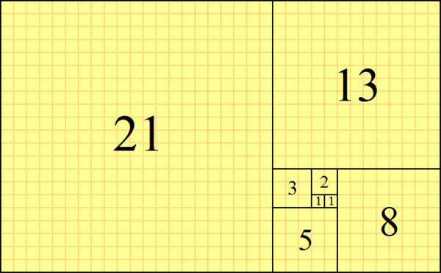
Solution
f=[1,1]
n = input("please enter number : ")
n = int(n)
for i in range(0,n-2):
f.append(f[i]+f[i+1])
print(f)

Slide 92
Question
Write a password (length of 8) generator in Python. The passwords should be random, generating a new password every time the user asks for a new password.
s = "abcdefghijklmnopqrstuvwxyz01234567890ABCDEFGHIJKLMNOPQRSTUVWXYZ!@#$%^&*()?"

Slide 93
Solution
import random
s = "abcdefghijklmnopqrstuvwxyz01234567890ABCDEFGHIJKLMNOPQRSTUVWXYZ!@#$%^&*()?"
"".join(random.sample(s,8))

Slide 94
Question
Take the code from the How To Extract data from website.

Slide 95
Solution
import requests
from bs4 import BeautifulSoup
base_url = 'http://www.nytimes.com'
r = requests.get(base_url)
soup = BeautifulSoup(r.text)
print(soup)

Slide 96
Optional

Slide 97
Question
Create a program that will play the “cows and bulls” game with the user. The game works like this:
Randomly generate a 4-digit number. Ask the user to guess a 4-digit number. For every digit that the
user guessed correctly in the correct place, they have a “cow”. For every digit the user guessed
correctly in the wrong place is a “bull.” Every time the user makes a guess, tell them how many
“cows” and “bulls” they have. Once the user guesses the correct number, the game is over. Keep track
of the number of guesses the user makes throughout teh game and tell the user at the end.
Say the number generated by the computer is 1038. An example interaction could look like this:
Welcome to the Cows and Bulls Game!
Enter a number:
>>> 1234
2 cows, 0 bulls
>>> 1256
1 cow, 1 bull

Slide 98
Solution
import random
def compare_numbers(number, user_guess):
cowbull = [0,0] #cows, then bulls
for i in range(len(number)):
if number[i] == user_guess[i]:
cowbull[1]+=1
else:
cowbull[0]+=1
return cowbull
if __name__=="__main__":
playing = True #gotta play the game
number = str(random.randint(0,9999)) #random 4 digit number
guesses = 0
print("Let's play a game of Cowbull!") #explanation
print("I will generate a number, and you have to guess the numbers one digit at a time.")
print("For every number in the wrong place, you get a cow. For every one in the right place, you get a bull.")
print("The game ends when you get 4 bulls!")
print("Type exit at any prompt to exit.")
while playing:
user_guess = input("Give me your best guess!")
if user_guess == "exit":
break
cowbullcount = compare_numbers(number,user_guess)
guesses+=1
print("You have "+ str(cowbullcount[0]) + " cows, and " + str(cowbullcount[1]) + " bulls.")
if cowbullcount[1]==4:
playing = False
print("You win the game after " + str(guesses) + "! The number was "+str(number))
break #redundant exit
else:
print("Your guess isn't quite right, try again.")

Slide 99
Others
https://www.practicepython.org/

Slide 100
Advance Python

Slide 101
Data Structure

Slide 102
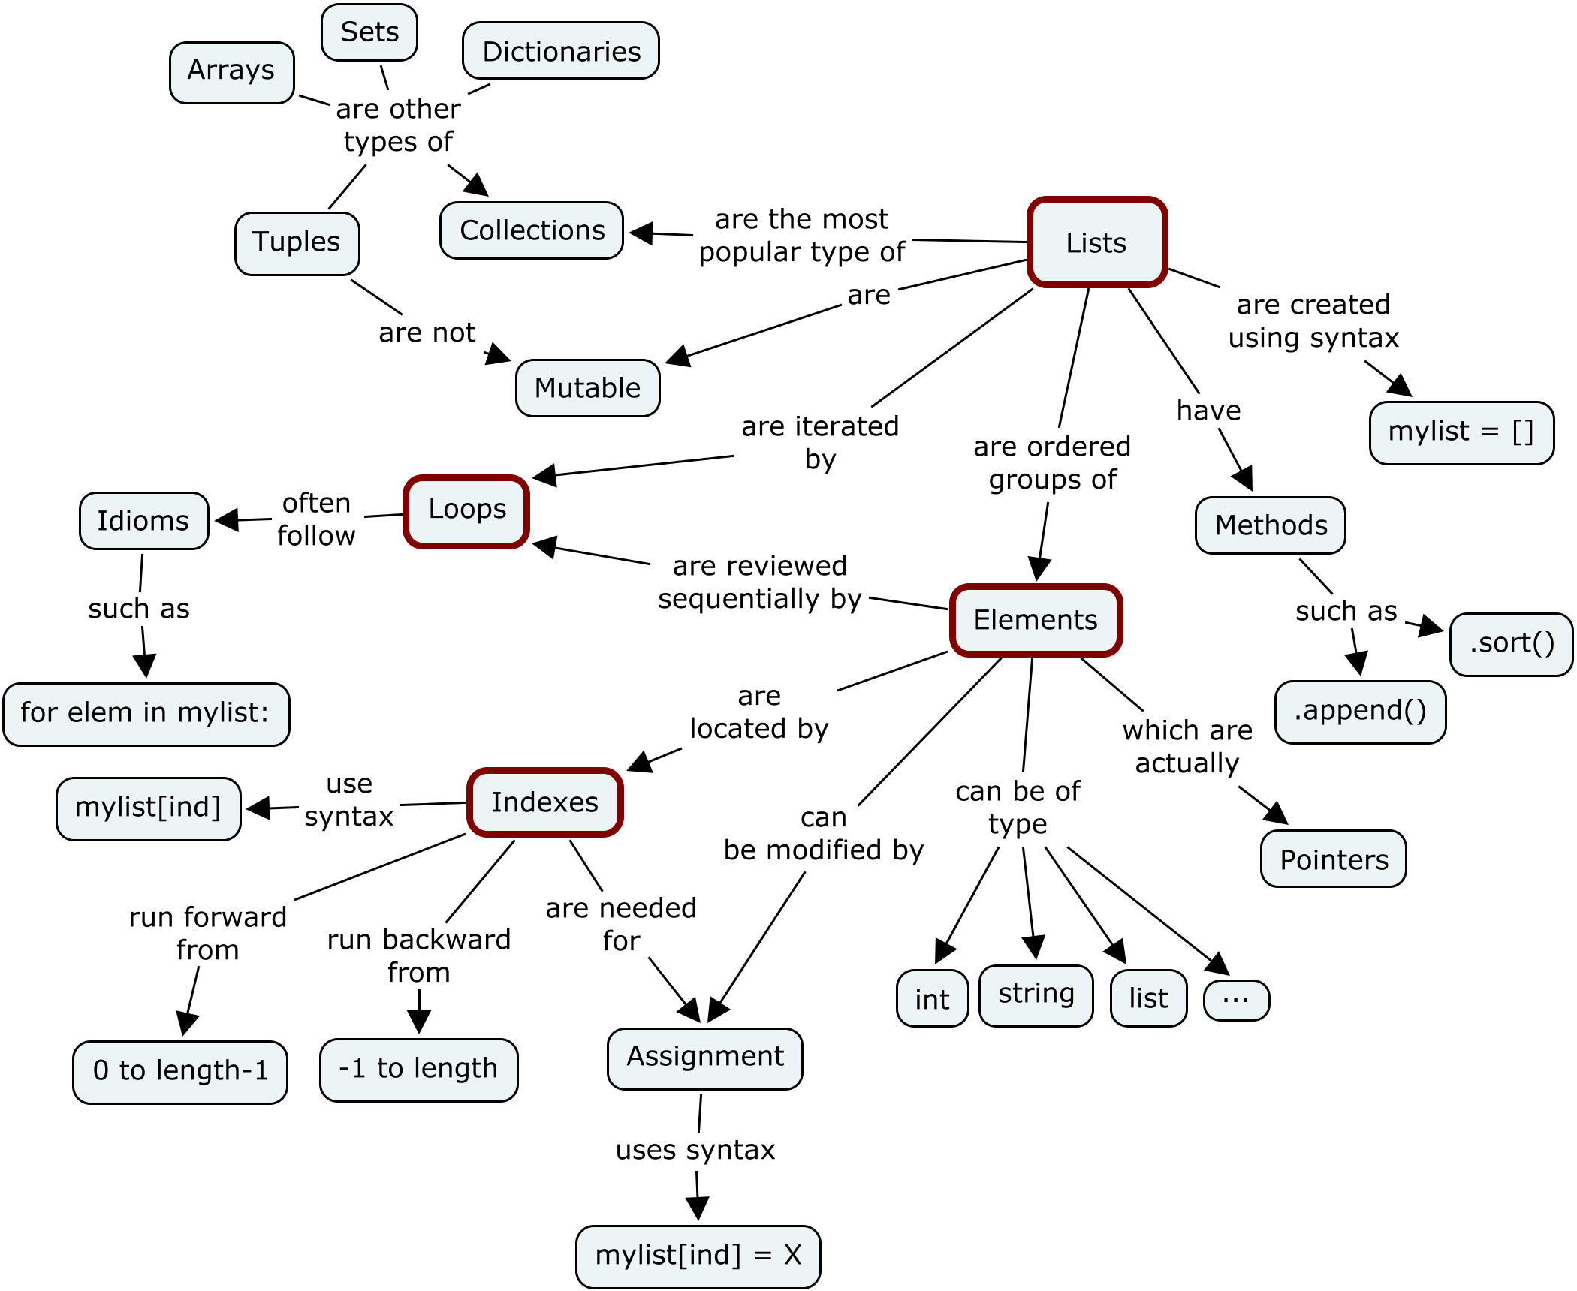
Mutable & Unmutable

Slide 103
Python Data Structure
Dictionaries, Maps, and Hash Tables
Array
Sets
Stacks (LIFOs)
Queues (FIFOs)

Slide 104
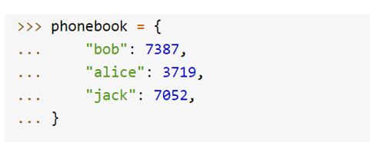
Dictionary

Slide 105
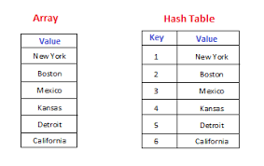
Dictionary Operator
Hash tables, "associative arrays"
d = {"duck": "eend", "water": "water"}
Lookup:
d["duck"] -> "eend"
d["back"] # raises KeyError exception
Delete, insert, overwrite:
del d["water"] # {"duck": "eend", "back": "rug"}
d["back"] = "rug" # {"duck": "eend", "back": "rug"}
d["duck"] = "duik" # {"duck": "duik", "back": "rug"}
Keys, values, items:
d.keys() -> ["duck", "back"]
d.values() -> ["duik", "rug"]
d.items() -> [("duck","duik"), ("back","rug")]
Presence check:
d.has_key("duck") -> 1; d.has_key("spam") -> 0

Slide 106
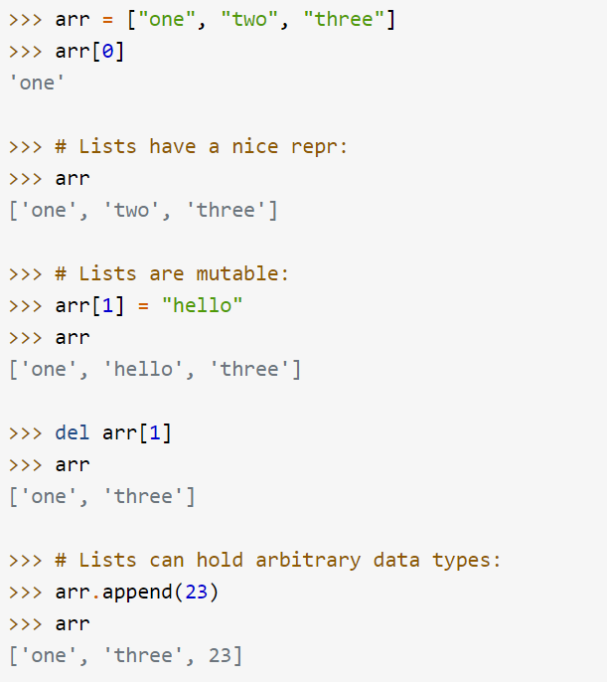
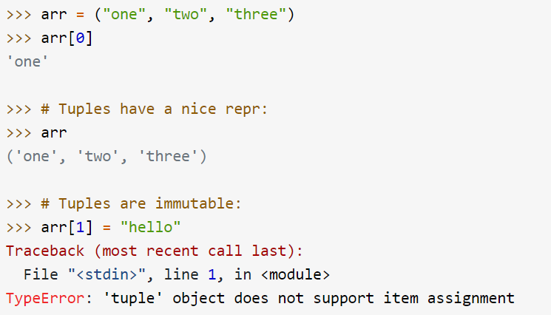
Array
Types of Array
List (Mutable)
Tuple (Immutable)

Slide 107
Operator for lists
Flexible arrays, not Lisp-like linked lists
a = [98, "bottles of beer", ["on", "the", "wall"]]
Item and slice assignment
a[0] = 98
a[1:2] = ["bottles", "of", "beer"] -> [98, "bottles", "of", "beer", ["on", "the", "wall"]]
del a[-1] -> [98, "bottles", "of", "beer"]
>>> a = range(5) # [0,1,2,3,4]
>>> a.append(5) # [0,1,2,3,4,5]
>>> a.insert(0, 42) # [42,0,1,2,3,4]
>>> a.reverse() # [4,3,2,1,0]
>>> a.sort() # [0,1,2,3,4]

Slide 108
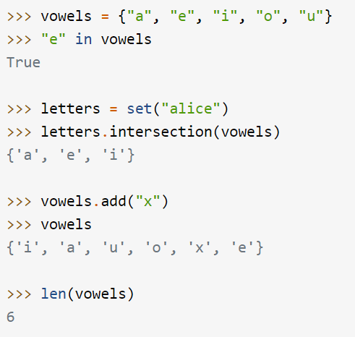
Sets
Sets are used to store multiple items in a single variable.
Set is one of 4 built-in data types in Python used to store collections of data, the other 3 are List, Tuple, and Dictionary, all with different qualities and usage.
A set is a collection which is both unordered and unindexed.
Sets are written with curly brackets.

Slide 109
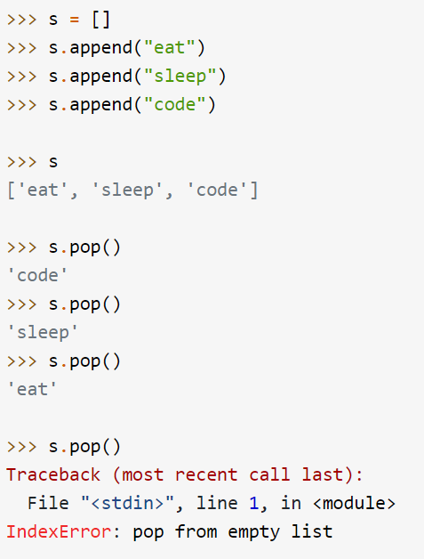
Stack (LIFO)

Slide 110
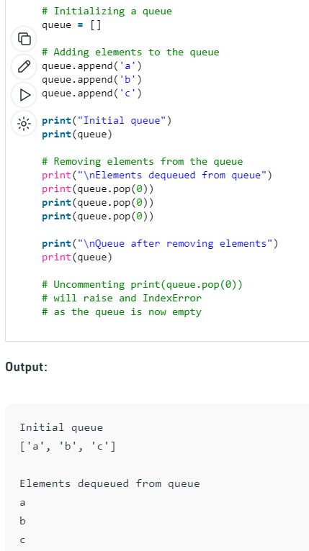
Queue (FIFO)

Slide 111
OOP

Slide 112
Class and OOP & __init__

Slide 113
Object Oriented Programming: Creating a class
Write a Python Class which accepts the radius of a circle from the user and compute the area and parameter.
class Computation:
def __init__(self, radius):
self.radius = radius
def area(self):
return 3.142*self.radius**2
def parameter(self):
return 3.142*self.radius*2
a = Computation(3)
print("Area is : ", a.area())
print("Parameter is : ", a.parameter())

Slide 114
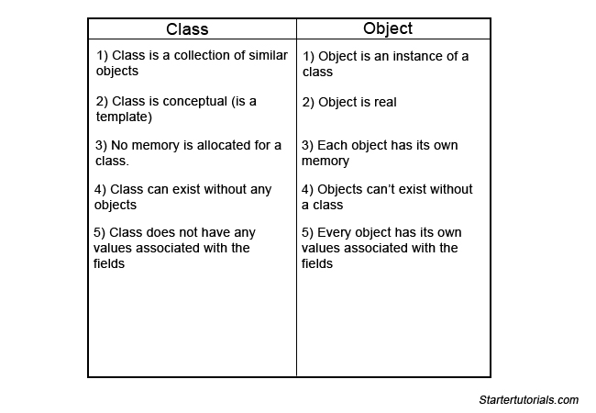
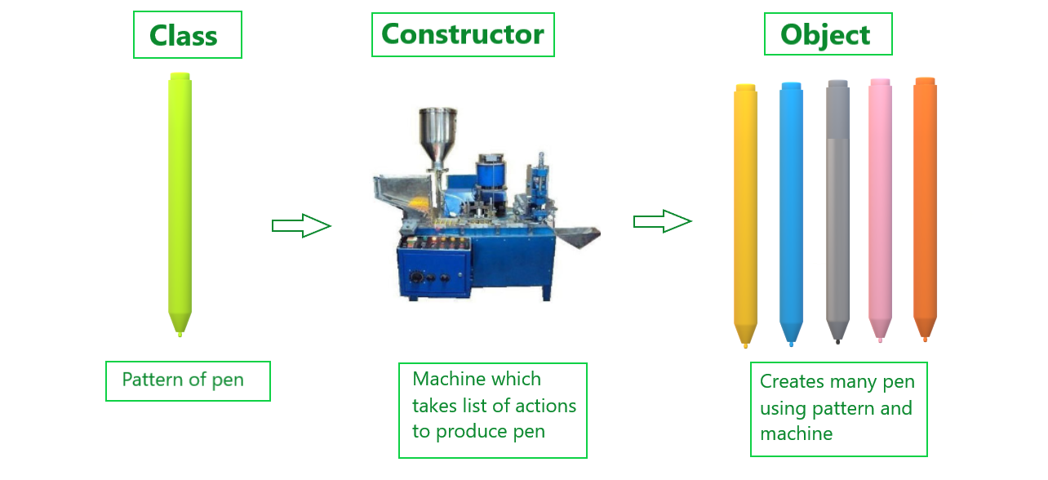
Class, Object (Instance), Constructor

Slide 115
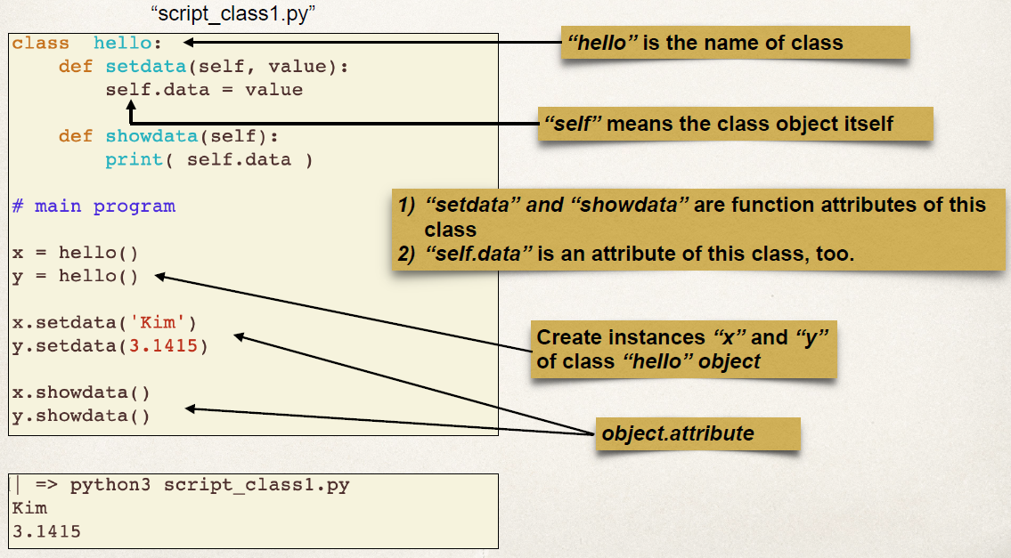
Class, Object, Instance

Slide 116
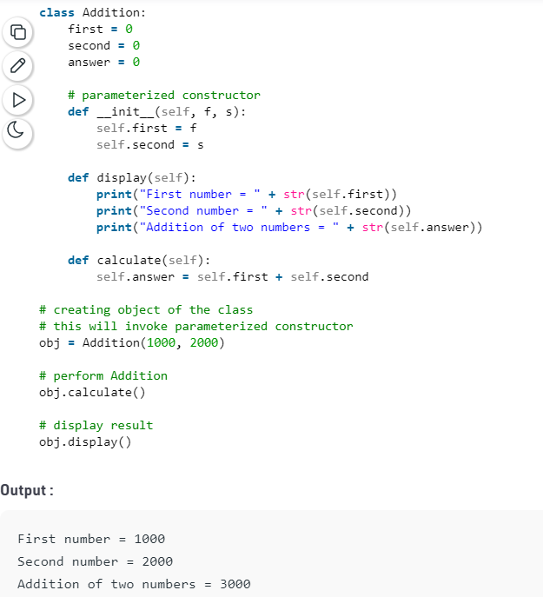
Constructor in Python Code

Slide 117
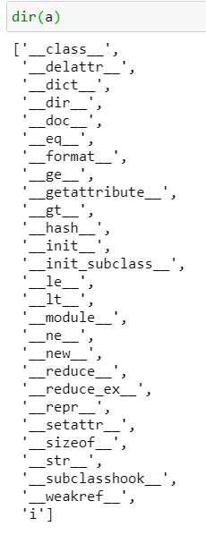
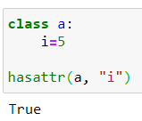
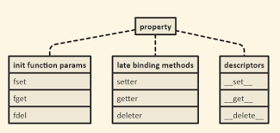
Property – hasattr() to check

Slide 118
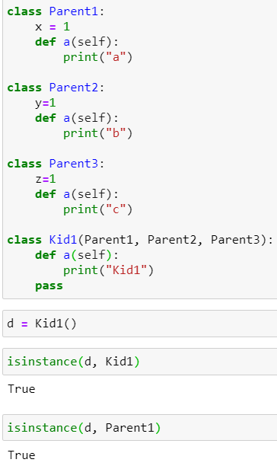
isinstance

Slide 119
Methods vs Function
https://techvidvan.com/tutorials/python-methods-vs-functions/

Slide 120
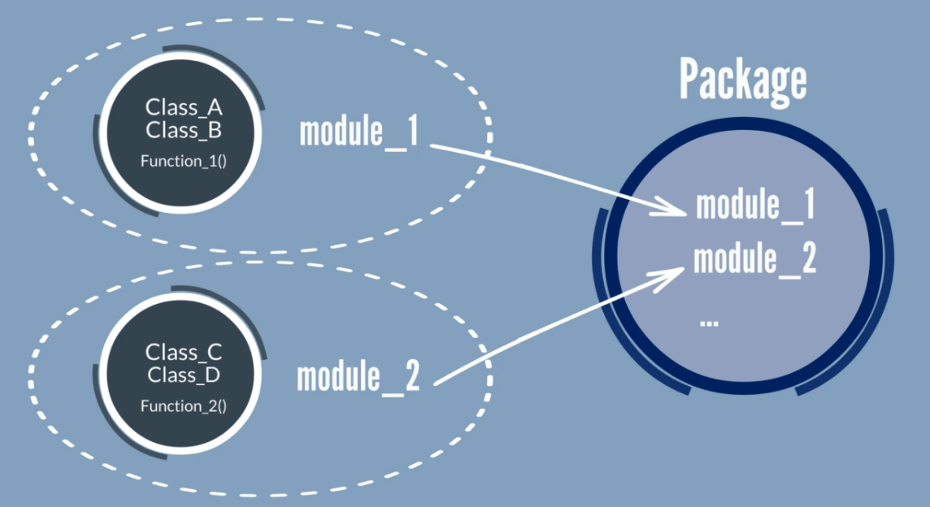
Package vs Module vs Class vs Method

Slide 121
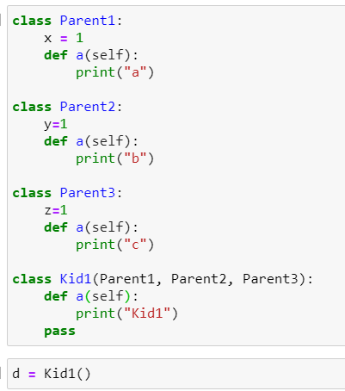
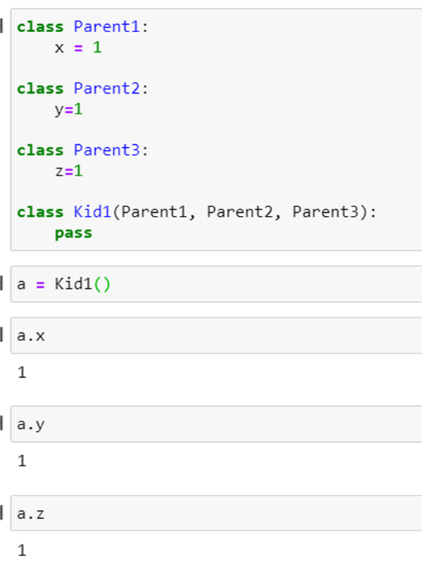
Subclass, Polymorphism & inheritance
Polymorphism lets us define methods in the child class that have the same name as the methods in the parent class. In inheritance, the child class inherits the methods from the parent class

Slide 122
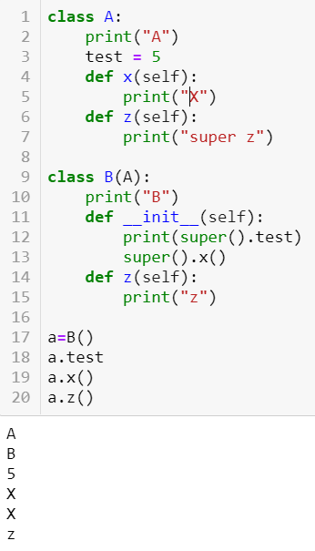
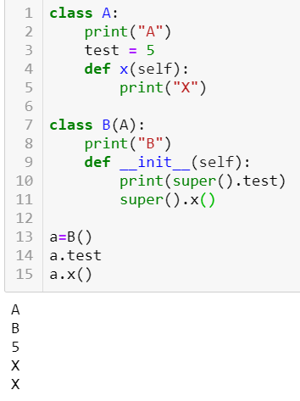
Polymorphism & inheritance

Slide 123
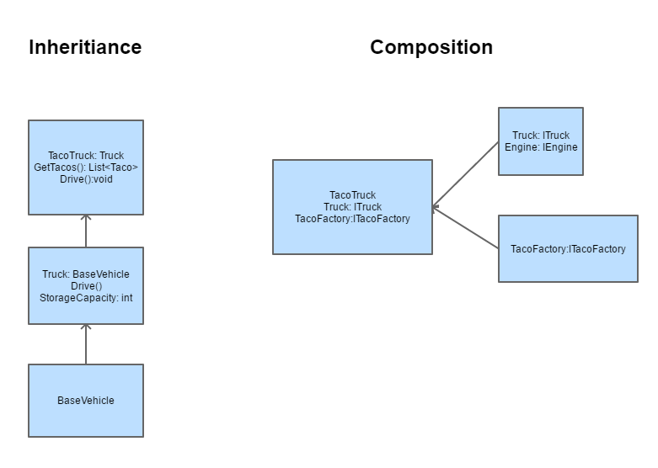
Composition (has, use abc) vs Inheritance (belong to)

Slide 124
Private vs Protected vs Public

Slide 125
Private vs Protected vs Public

Slide 126
Public, Protected, Private

Slide 127
Encapsulation: How to access private variable. __object or setter and getter

Slide 128
Multiple Superclass Attribute

Slide 129
MRO — Method Resolution Order

Slide 130
Multiple Superclass Methods – Same name then depends on mro (Method Resolution Order)

Slide 131
Passing class as argument

Slide 132
__class__

Slide 133
__dict__

Slide 134
Super()

Slide 135
Polymorphism
In Python, polymorphism is the provision of a single interface to objects of different types. In other words, it is the ability to create abstract methods from specific types in order to treat those types in a uniform way.

Slide 136
dir() module in a object

Slide 137
Static vs class methods
# Python program to demonstrate
# use of class method and static method.
from datetime import date
class Person:
def __init__(self, name, age):
self.name = name
self.age = age
# a class method to create a Person object by birth year.
@classmethod
def fromBirthYear(cls, name, year):
return cls(name, date.today().year - year)
# a static method to check if a Person is adult or not.
@staticmethod
def isAdult(age):
return age > 18
person1 = Person('mayank', 21)
person2 = Person.fromBirthYear('mayank', 1996)
print (person1.age)
print (person2.age)
# print the result
Person.isAdult(22)
static method can be called without an object for that class.

Slide 138
Static vs class

Slide 139
Abstract base class (Interface)
By defining an abstract base class, you can define a common Application Program Interface(API) for a set of subclasses.
Triangle is composed of polygon.

Slide 140
Overloading and Overriding

Slide 141
Interface vs Abstract

Slide 142
SQL & XML

Slide 143
Create DB, Table, Insert, Select
import sqlite3
c = sqlite3.connect("First.db")
c.execute('''CREATE TABLE tasks (
id INT PRIMARY KEY,
name TEXT
);''')
This must be single code

Slide 145
Multiple SQL

Slide 146
Select statement (where condition)

Slide 147
Update

Slide 148
delete

Slide 149
xml
<?xml version="1.0"?>
<data>
<book title = "Hi">
<author>TT</author>
<year>1968</year>
</book>
<book title = "Hi2">
<author>TT2</author>
<year>1978</year>
</book>
</data>
import xml.etree.ElementTree as ET
t = ET.parse("C:/Users/User/OneDrive - TSS Global Pte. Ltd/TT Library/AI Model/Python/book.xml")

Slide 150
Xml elements : Select (tag, child, text)

Slide 151
Find and get

Slide 152
Root, child, sub child

Slide 153
remove

Slide 154
Set (updates)

Slide 155
write

Slide 156
Network Programming

Slide 157
Network Programming: REST API using Request & json

Slide 158
Json & xml format

Slide 159
Request HTTP method

Slide 160
request

Slide 161
Cars.json

Slide 162
Request for specific information

Slide 163
Socket Programming

Slide 164
Socket Programming
sock.send(b"GET / HTTP/1.1\r\nHost: www.google.com \r\nConnection: close\r\n\r\n")

Slide 165
Socket – Server Client
import socket
HOST = '127.0.0.1'
PORT = 9999
with socket.socket() as s:
s.bind((HOST, PORT))
s.listen()
conn, addr = s.accept()
with conn:
print('Connected by', addr)
while True:
data = conn.recv(1024)
if not data:
break
conn.sendall(data)
import socket
HOST = '127.0.0.1'
PORT = 9999
with socket.socket() as s:
s.connect((HOST, PORT))
s.sendall(b'Hello, world')
data = s.recv(1024)
print('Received', repr(data))

Slide 166
Configuration File

Slide 167
Others

Slide 168
pipe

Slide 169
Pickle & Shelve (store variable in file)

Slide 170
Decorator

Slide 171
Decorator
def make_bold(fn):
return lambda : "<b>" + fn() + "</b>"
def make_italic(fn):
return lambda : "<i>" + fn() + "</i>"
@make_bold
@make_italic
def hello():
return "hello world"
helloHTML = hello()

Slide 172
Generator & Yield (multiple return function)

Slide 173
Pass multiple argument *args and **kwargs
def adder(*num):
sum = 0
for n in num:
sum = sum + n
print("Sum:",sum)
adder(3,5)
adder(4,5,6,7)
adder(1,2,3,5,6)

Slide 174
Pass Multiple Argument
def intro(**data):
print("Data type of argument:",type(data))
for key, value in data.items():
print("{} is {}".format(key,value))
intro(Firstname="Sita", Lastname="Sharma", Age=22, Phone=1234567890)
intro(Firstname="John", Lastname="Wood", Email="johnwood@nomail.com", Country="Wakanda", Age=25, Phone=9876543210)

Slide 175
Except & Raise Exception

Slide 176
Types of exception & Raise
https://docs.python.org/3/library/exceptions.html
https://docs.python.org/3/library/exceptions.html

Slide 177
Assertion

Slide 178
Lambda vs function

Slide 179
__name__ is the name of a module

Slide 180
pip https://pip.pypa.io/en/stable/cli/

Slide 181
Pypi https://pypi.org/search/?c=Programming+Language+%3A%3A+Python+%3A%3A+3
Including

Slide 182
Pyc file
pyc files are created by the Python interpreter when a . py file is imported. They contain the "compiled bytecode" of the imported module/program so that the "translation" from source code to bytecode (which only needs to be done once) can be skipped on subsequent imports if the . pyc is newer than the corresponding .

Slide 183
Name space

Slide 184
Buildin Namespace

Slide 185
Platform : Enquiry on the system

Slide 186
Predefine Function

Slide 187
Create Virtual Environment
python -m venv project_env

Slide 188
Activate the Environment
project_env\Scripts\activate.bat

Slide 189
Pip list (nothing inside)

Slide 190
Try install one packages (say numpy)

Slide 191
Magic method
https://www.tutorialsteacher.com/python/magic-methods-in-python

Slide 192
Log
Logging is a means of tracking events that happen when some software runs. The software’s developer adds logging calls to their code to indicate that certain events have occurred.
fh = logging.FileHandler('spam4.log')
logger.addHandler(fh)
logger.debug('This message should go to the log file')
logger.warning('And this, too')

Slide 193
Log

Slide 194
Multi-Threading
import threading
from random import randint
from time import sleep
def print_number(number):
# Sleeps a random 1 to 10 seconds
rand_int_var = randint(1, 10)
sleep(rand_int_var)
print("Thread " + str(number) + " slept for " + str(rand_int_var) +"\n")
thread_list = []
for i in range(1, 10):
t = threading.Thread(target=print_number, args=(i,))
# Sticks the thread in a list so that it remains accessible
thread_list.append(t)
# Starts threads
for thread in thread_list:
thread.start()
print("Done")

Slide 195
Window GUI - tkinter
from tkinter import *
window = Tk()
window.title("Welcome to tkinter")
Label(window, text="hello").grid(column=1,row=1)
window.mainloop()

Slide 196
PEP Python Enhancement Proposals

Slide 197
PEP8 Style

Slide 198
Shallow and Deep Copy

Slide 199
INI file
default_path = "/path/name/"
default_file = "file.txt"
[DEFAULT]
ServerAliveInterval = 45
Compression = yes
CompressionLevel = 9
ForwardX11 = yes
[bitbucket.org]
User = hg
[topsecret.server.com]
Port = 50022
ForwardX11 = no
# Read file and and create if it not exists
config = iniFile( 'FILE.INI' )
# Get "default_path"
config.default_path
# Print (string)/path/name
print config.default_path
# Create or Update
config.append( 'default_path', 'var/shared/' )
config.append( 'default_message', 'Hey! help me!!' )

Slide 200
Excel with Python

Slide 201
Importing the library
Python uses openpyxl library to work with Excel spreadsheets
Install the library if you havent done so, then import it:
pip install openpyxl
import openpyxl

Slide 202
Creating our first workbook
from openpyxl import Workbook workbook = Workbook() # Create workbook instance sheet = workbook.active # Initiate active sheet sheet["A1"] = "hello" # Fill cell A1 with 'hello' sheet["B1"] = "world!" # Fill cell B1 with 'world!' workbook.save(filename="hello_world.xlsx")

Slide 203
Reading in Excel files
1. The workbook is read using load_workbook() function
- Additional arguments we can pass:
read_only: Loads a spreadsheet in read-only mode
data_only: Ignores loading formulas and intead only loads the values
2. workbook.sheetnames is used to view all the sheets in our file
3. workbook.active selects the first available sheet
4. Sheet.title allows us to view the title of the selected sheet
For this example we will ues TSS Customer data, but convert it from csv to xlsx format
from openpyxl import load_workbook
workbook = load_workbook(filename="TSS Customer.xlsx") # Load in the excel file
print(workbook.sheetnames) # Print out all sheet names
Output: ['Tss Customer']
sheet = workbook.active
Sheet.title
Output: 'TSS Customer'

Slide 204
Retrieving data from spreadsheet
Option 1:
sheet['A1'].value
Output: 'Co_Name'
Option 2:
Sheet.cell(row = 1, column = 2).value
Output: 'Reg_No'
To retrieve data, we select the cell we want using [ ], followed by .value to retrieve the value in the cell
Alternate way is to use .cell method, and specify row = x, column = y to get the value in row x and column y

Slide 205
Accessing Excel data

Slide 206
Iterating through our data by slicing
All outputs are in tuple form
Selecting a range of data
sheet["A1:C2"] -> selects all data from A1 to C2
Getting ranges of rows or columns
sheet['A'] -> Gets all cells from column A
sheet['A:B'] -> Gets all cells from column A and B
sheet[5] -> Gets all cells from row 5
sheet[5:6] Gets all cells from row 5 and 6
((<Cell 'TSS Customer'.A1>, <Cell 'TSS Customer'.B1>, <Cell 'TSS Customer'.C1>), (<Cell 'TSS Customer'.A2>, <Cell 'TSS Customer'.B2>, <Cell 'TSS Customer'.C2>))
((<Cell 'TSS Customer'.A1>, <Cell 'TSS Customer'.A2>),
(<Cell 'TSS Customer'.B1>,
(<Cell 'TSS Customer'.B2>))

Slide 207
Iterating through our data by looping
We can further access each element of a cell to retrieve its cell coordinates, content, row number or column number:
for row in sheet.rows:
for val in row:
print(val.coordinate, val.value, val.row, val.column)

Slide 208
Managing rows and columns
Managing rows and columns can be achieved through 4 methods:
.insert_rows(), .delete_rows(), .insert_cols(), .delete_cols()
Every method takes in 2 arugments:
idx,
Amount
^idx argument is to specify a reference point from which a row or column should be created from
Example: idx = 3 when creating new columns
Go to the third column, and create new columns to the left of it
Example: idx = 3 when deleting columns
Delete the third column
Example: idx = 3 when creating new rows
Go to the third row, and create new rows above it
Example: idx = 3 when deleting rows
Delete the third row
Inserting 1 column at the start
sheet.insert_cols(idx = 1)
Inserting 5 columns between column 2 ("B") and 3 ("C")
sheet.insert_cols(idx=3, amount=5)
Delete our created columns
sheet.delete_cols(idx=3, amount=5)
sheet.delete_cols(idx=1)

Slide 209
Creating, deleting & duplicate sheets
my_new_sheet = workbook.create_sheet("TSS Customers 2.0") # Create new sheet called 'TSS Customers 2.0'
Workbook.sheetnames
Can also specify which position the new sheet should be created at
another_sheet = workbook.create_sheet('TSS Customers 3.0', 0) # Creates new sheet at position 0 of workbook
Removing our sheets
workbook.remove(my_new_sheet)
workbook.remove(another_sheet)
Workbook.sheetnames
duplicate_sheet = workbook['Tss Customer'] # Selecting our TSS Customer sheet
workbook.copy_worksheet(duplicate_sheet) # Create a copy
Workbook.sheetnames # View updated sheet names

Slide 210
Adding formulas to worksheet
from openpyxl.utils import FORMULAE
FORMULAE # View list of formulas supported by openpyxl
sheet["N194"] = "=SUM(N2:N193)" # Column N is CorpSec column
workbook.save(filename="Customera.xlsx")

Slide 211
Adding new entries to TSS customer sheet
import pandas as pd
data = {
"Co_Name": ["New company 1", "New company 2"],
"Reg_No": [1234, 6789]
}
df = pd.DataFrame(data)
df
We store the raw data in dictionary format, with the excel column names we want to update as keys and its column values as dictionary values

Slide 212
Adding new entries to TSS customer sheet
from openpyxl.utils.dataframe import dataframe_to_rows
for row in dataframe_to_rows(df, index=False, header=False):
print(row)
sheet.append(row)
workbook.save("Customersxlsx")

Slide 213
Import module
Create a filename.py
Import filename

Slide 214
Python for AI (Loan Default)
TTT

Slide 215
Basic Command
a=1
a=1.68
a="hello“
a=[1,3,4,6]
print(a[2])
print("the array is : ", a)
name = input("Please enter your name : ")
print("Your name is ", name)
a = 1
while a < 5:
print(a)
a = a+1
a=3
if a==1:
print("a is 1")
elif a==2:
print("a is 2")
else:
print("a is not 1 or 2")

Slide 216
Library
Pandas
numpy
scipy
sklearn

Slide 217
Check Data Imbalance
=COUNTIF(A2:A10001, "No")
Use Smote to make the data balance
pd.set_option('display.max_rows', None, 'display.max_columns', None)
pd.set_option('display.max_rows', 10, 'display.max_columns', 10)
Or
pd.set_option('display.max_rows', 500)
pd.set_option('display.max_columns', 500)
pd.set_option('display.width', 1000)

Slide 218
from collections import Counter
from imblearn.over_sampling import SMOTE
from imblearn.under_sampling import RandomUnderSampler
import pandas
df=pandas.read_csv("C:/Users/Teoh Teik Teo/OneDrive - TSS Global Pte. Ltd/TT Library/AI Model/Data/LoanDefault.csv")
print(df)
Counter(df["default"])
df = df.replace(("Yes", "No"), (1,0))
X=df
X=df.drop("default", axis=1)
print(X)
y=df.loc[:, "default"]
print(y)
counter = Counter(y)
print(counter)
oversample = SMOTE()
X, y = oversample.fit_resample(X, y)
# summarize the new class distribution
counter = Counter(y)
print(counter)
df=pandas.concat([X, y], axis=1)
df.to_csv("LoanDefault (balance).csv", index=0)

Slide 219
import pandas as pd
df = pd.read_csv("LoanDefault (balance).csv")
#select column
df = df.loc[:, ["default", "student", "balance", "income"]]
print(df)
Alternatively
#select column
df = df.iloc[:, 0:4]
print(df)
#remove na
df=df.dropna()
print(df)
#Optional replace with number
df['default'] = df["default"].replace(("Yes", "No"), (1,0))
print(df)
#remove not a number
for i in df.columns:
df1 = pd.to_numeric(df[i], errors='coerce’) #this is to force any non-numeric to null
f = df1.notnull() #to set the flag false if it is a null
df=df[f] #copy only not null to df, or remove null
print(df)
Data Wrangling

Slide 220
#remove outlier
import numpy as np
from scipy import stats
z = stats.zscore(df.astype(np.float)) #zscore conversion need float
z = np.abs(z) #convert all to positive because the parity is not important
f = (z < 3).all(axis=1) #3 is your choice, axis =1 means by columns, f is a flag
df = df[f]
Data Wrangling
Data Visualization (Not all column are applicable, depends on library)
df.describe()
#import matplotlib.pyplot as plt
df.hist()
df.boxplot()
Double precision numbers have 53 bits (16 digits) of precision and regular floats have 24 bits (8 digits) of precision.
df.corr()
import seaborn as sns
sns.heatmap(df.corr())
axis=1 (or axis='columns') is vertical axis

Slide 221
X = df.loc[:,["student", "balance", "income"]]
Y = df.loc[:, "default"]
print(X,Y)
Alternatively:
X=df
X=df.drop("default", axis=1)
Or:
X=df.iloc[:,1:4]
#normalization
from scipy import stats
import numpy as np
pd.set_option('display.max_rows', 10)
for i in X.columns:
X[i]=stats.zscore(X[i].astype(np.float))
print(X)
Data Wrangling
https://www.andreaamico.eu/data-analysis/2019/12/10/pandas_merge.html
#for categorical input, dummy or one hot encoding
dummy=pd.get_dummies(X["student"])
X=X.merge(dummy, left_index=True, right_index=True)
X=X.drop("student", axis="columns")

Slide 222
#vif to check colinearlity
#1 = not correlated.
#Between 1 and 5 = moderately correlated.
#Greater than 5 = highly correlated.
from statsmodels.stats.outliers_influence import variance_inflation_factor
vif_data = pd.DataFrame()
vif_data["feature"] = X.columns
vif_data["VIF"] = [variance_inflation_factor(X.values, i) for i in range(len(X.columns))]
print(vif_data)

Slide 223
#split train test
from sklearn.model_selection import train_test_split
X_train, X_test, Y_train, Y_test = train_test_split(X, Y, test_size=0.3)
print(X_train, X_test, Y_train, Y_test)
Regression
from sklearn import linear_model
from sklearn.metrics import confusion_matrix
model=linear_model.LogisticRegression()
model.fit(X_train, Y_train)
pred=model.predict(X_train)
cm = confusion_matrix(Y_train, pred)
print(cm)
accuracy = (cm[0,0] + cm[1,1])/sum(sum(cm))
print(accuracy)
pred=model.predict(X_test)
cm = confusion_matrix(Y_test, pred)
print(cm)
accuracy = (cm[0,0] + cm[1,1])/sum(sum(cm))
print(accuracy)

Slide 224
from sklearn import linear_model
from sklearn.metrics import confusion_matrix
import numpy as np
model=linear_model.LogisticRegression()
model.fit(X_train, Y_train)
THRESHOLD = 0.45
pred = model.predict_proba(X_train)
# [:,1] taking all rows (:) but keeping the second column (1) proba return 2 columns
pred = np.where(pred[:,1] > THRESHOLD, 1, 0)
cm = confusion_matrix(Y_train, pred)
print(cm)
accuracy = (cm[0,0] + cm[1,1])/sum(sum(cm))
print(accuracy)
pred=model.predict(X_test)
pred = model.predict_proba(X_test)
# [:,1] taking all rows (:) but keeping the second column (1) proba return 2 columns
pred = np.where(pred[:,1] > THRESHOLD, 1, 0)
cm = confusion_matrix(Y_test, pred)
print(cm)
accuracy = (cm[0,0] + cm[1,1])/sum(sum(cm))
print(accuracy)
If you need to set threshold, use predict_prob

Slide 225
Decision Tree
from sklearn import tree
model=tree.DecisionTreeClassifier(max_depth=4)
model.fit(X_train, Y_train)
pred=model.predict(X_train)
cm = confusion_matrix(Y_train, pred)
print(cm)
accuracy = (cm[0,0] + cm[1,1])/sum(sum(cm))
print(accuracy)
pred=model.predict(X_test)
cm = confusion_matrix(Y_test, pred)
print(cm)
accuracy = (cm[0,0] + cm[1,1])/sum(sum(cm))
print(accuracy)

Slide 226
Feature Ranking
fr = model.feature_importances_
print(fr)

Slide 227
Naïve Bayesian
from sklearn.naive_bayes import GaussianNB
model=GaussianNB()
model.fit(X_train, Y_train)
pred=model.predict(X_train)
cm = confusion_matrix(Y_train, pred)
print(cm)
accuracy = (cm[0,0] + cm[1,1])/sum(sum(cm))
print(accuracy)
pred=model.predict(X_test)
cm = confusion_matrix(Y_test, pred)
print(cm)
accuracy = (cm[0,0] + cm[1,1])/sum(sum(cm))
print(accuracy)

Slide 228
Feature Engineering (important for linear regression)

Slide 229
import pandas as pd
import numpy as np
data = pd.read_csv("C:/Users/Teoh Teik Teo/OneDrive - TSS Global Pte. Ltd/TT Library/AI Model/Data/Diabetes.csv")
data.columns
X = data.iloc[:,0:8]
Y = data.iloc[:,8]
from sklearn.feature_selection import SelectKBest, chi2
features = SelectKBest(score_func=chi2, k=5)
fit = features.fit(X, Y)
print(data.columns, fit.scores_)
mask = fit.get_support()
print(mask)
new_features = X.columns[mask]
print(new_features[:])
X = data.loc[:,['Number of times pregnant', 'Plasma glucose concentration a 2 hours ', '2-Hour serum insulin ', 'Body mass index ', 'Age']]

Slide 230
from sklearn import linear_model
model = linear_model.LogisticRegression()
model.fit(X,Y)
pred = model.predict(X)
from sklearn.metrics import confusion_matrix
cm = confusion_matrix(Y, pred)
accuracy = (cm[0,0] + cm[1,1])/sum(sum(cm))
Print(accuracy)
print(model.coef_)

Slide 231
Select Features (Continuous)
import pandas as pd
import numpy as np
data = pd.read_csv("Treynor.csv")
data.columns
data = data.dropna()
X = data.iloc[:,16:30]
Y = data.iloc[:,-1]
from sklearn.feature_selection import SelectKBest, f_regression
features = SelectKBest(score_func=f_regression, k=5)
fit = features.fit(X, Y)
print(data.columns, fit.scores_)
mask = fit.get_support()
print(mask)
new_features = X.columns[mask]
print(new_features[:])

Slide 232
# print more columns, rpows
import pandas as pd
pd.set_option('display.max_rows', 500)
pd.set_option('display.max_columns', 500)
pd.set_option('display.width', 1000)

