Slide 1
MM Day 1 – Python, R, Excel, Orange, Flask, HTML, Cloud
Teoh Teik Toe
ITOM/NBS
ttteoh@ntu.edu.sg
97905202

Slide 2
Case study on DBS share price prediction
Objective: A financial institution aims to predict the future prices of a particular stock to support investment decisions and optimize portfolio management.
Reasoning: By accurately predicting share prices, the institution can identify potential buying and selling opportunities, determine optimal entry and exit points, and allocate resources effectively.
Methodology: The institution collects and analyzes vast amounts of historical stock data, including price movements. They employ advanced machine learning algorithms and statistical models to generate accurate predictions.
Results: The share price prediction model enables the institution to make informed investment decisions, optimize their portfolio allocation, manage risk effectively, and potentially generate higher returns for their clients. This approach enhances their competitiveness in the financial market and strengthens their reputation as a trusted investment advisor.

Slide 3
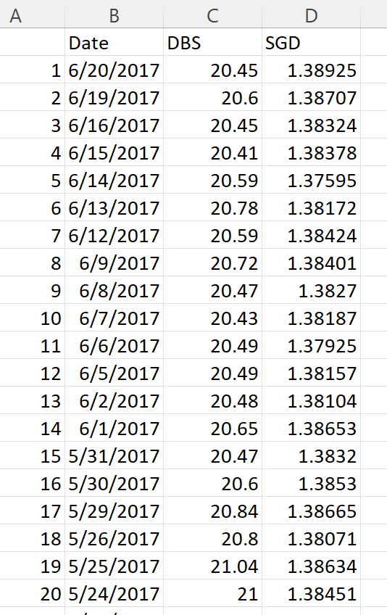
Data

Slide 4
Python
#save model
import joblib
joblib.dump(model,”dbs.jl”)
#load model
model = joblib.load(“dbs.jl”)
df = pd.read_csv("DBS_SingDollar.csv")
X = df.loc[:,["SGD"]]
Y = df.loc[:,['DBS']]
print(X)
from sklearn import linear_model
model = linear_model.LinearRegression()
model.fit(X,Y)
pred = model.predict(X)
from sklearn.metrics import mean_squared_error
rmse = mean_squared_error(Y,pred)**0.5
print(rmse)
#print(rmse/Y.mean(axis=0)*100)
#to add polynomial
df["SGD2"] = df["SGD"] ** 2

Slide 5
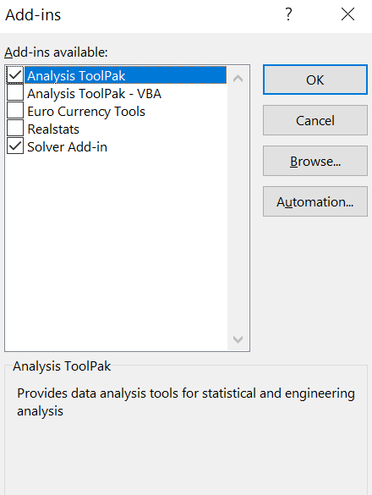
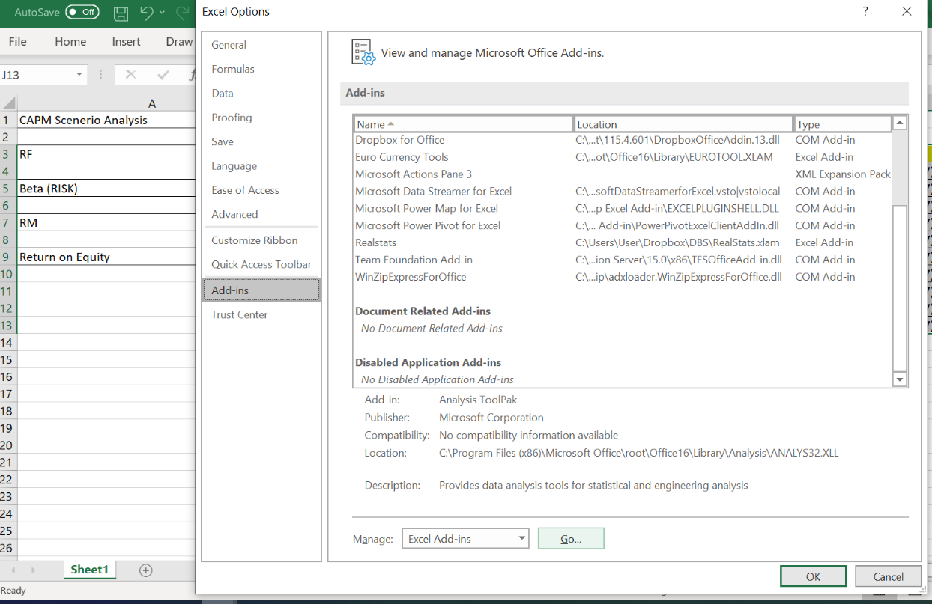
File -> Option -> Add-ins -> Manage -> Excel Add-ins - Go

Slide 6
Regression on Loan Default

Slide 7
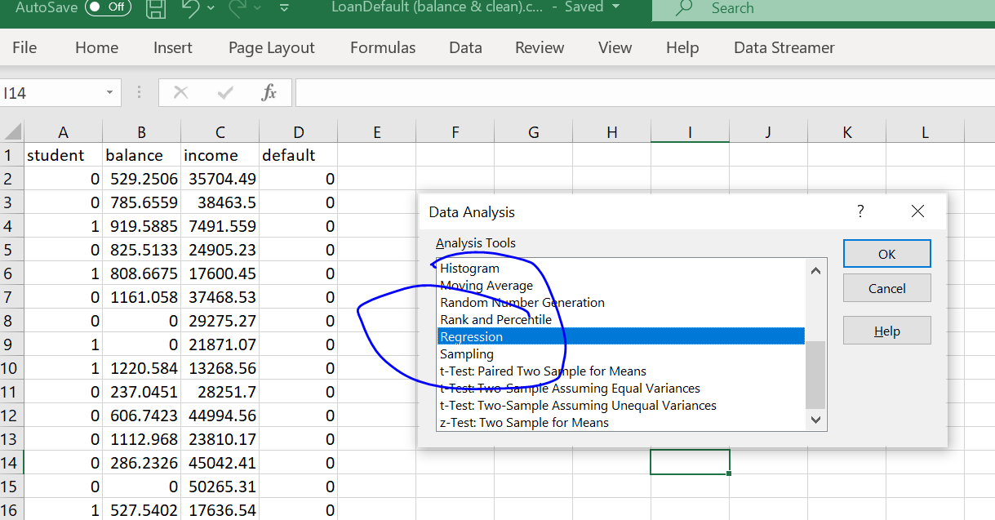
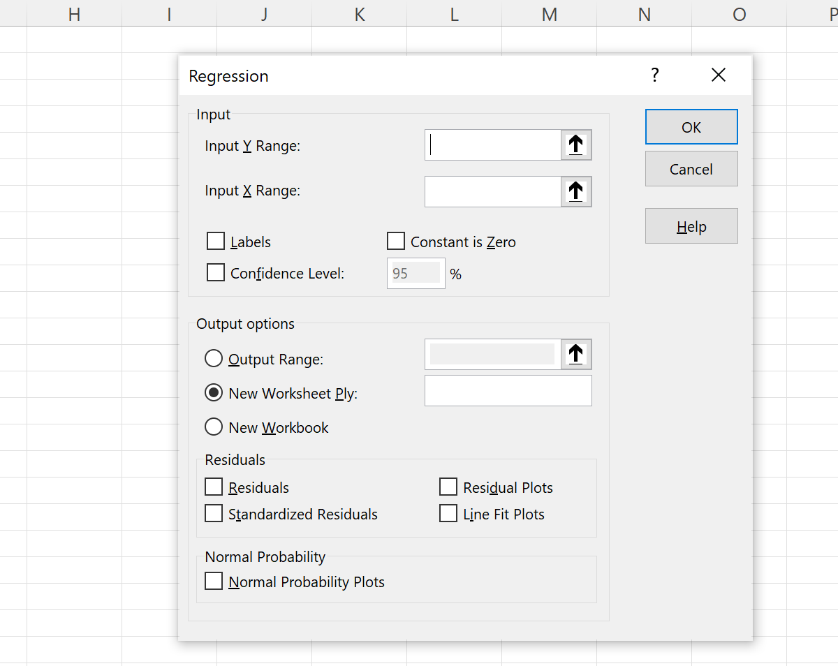
Select the range
Result will appear on new sheet

Slide 9
R
dt = read.csv("C:/Users/Teoh Teik Teo/OneDrive - TSS Global Pte. Ltd/TT Library/AI Model/Data/DBS_SingDollar.csv") #alternatively read.csv
model=lm(dt$DBS ~ dt$SGD)
summary(model)
pred = predict(model)
err = dt$DBS - pred
rmse=(mean(err^2)^0.5)
print(rmse)
dt$SGD2 = dt$SGD^2
model=lm(dt$DBS ~ dt$SGD + dt$SGD2)
summary(model)
pred = predict(model, newdata = dt)
err=dt$DBS - pred
rmse = (mean(err^2)^0.5)
print(rmse)
plot(dt$SGD, dt$DBS, main="Regression", xlab = "SGD", ylab="DBS")
abline(model)

Slide 10
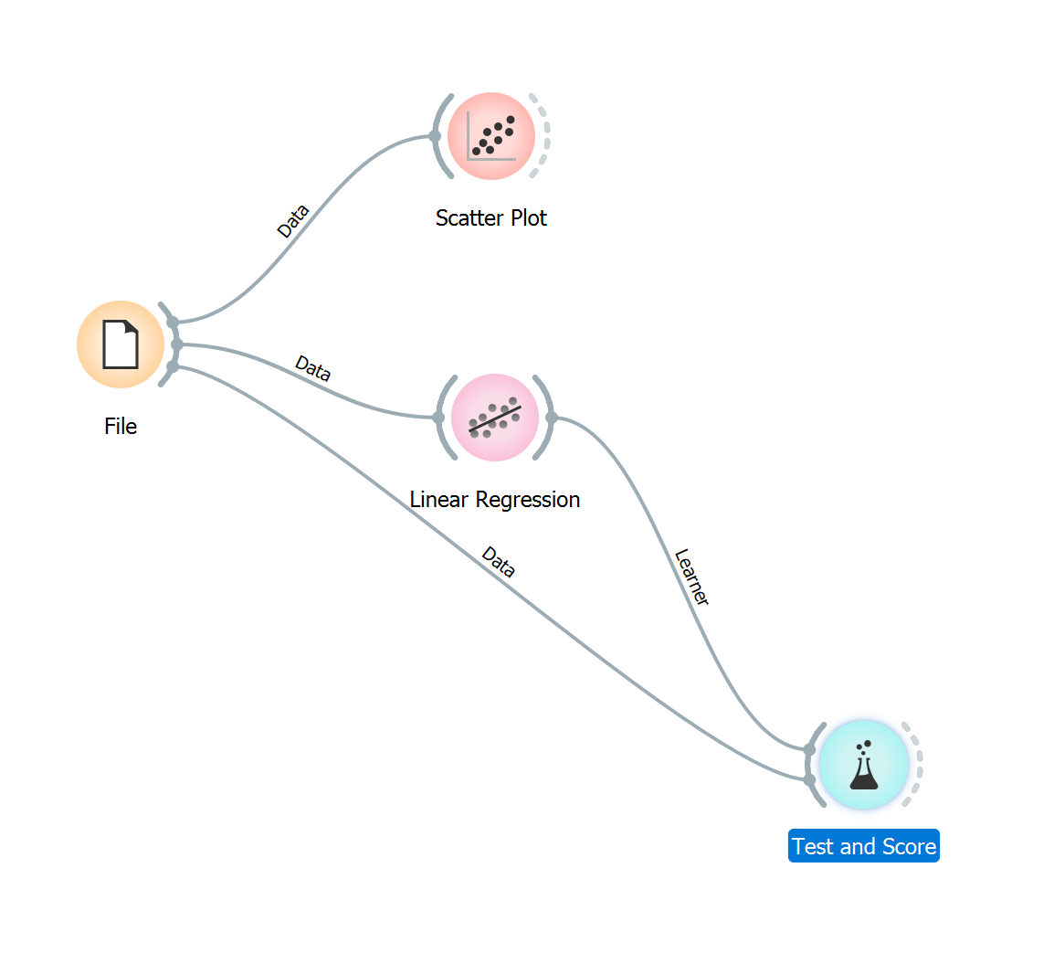
Orange

Slide 11
Flask (Back End)
from flask import Flask
app = Flask(__name__)
from flask import request, render_template
@app.route("/", methods = ["GET", "POST"])
def i():
if request.method == "POST":
num = float(request.form.get("rates"))
return(render_template(“main.html", result = 90.2-(50.6*num)))
else:
return render_template(“main.html", result =“Waiting……….")
f __name__=="__main__":
app.run()

Slide 12
Front End HTML
<html>
<body>
<form action = "/" method = "post">
<p>Enter Sing to US:</p>
<p><input type = "number" step="0.01" name = "num"></p>
<p><input type = "submit" value = "submit"></p>
</form>
{{result}}
</body>
</html>

Slide 13
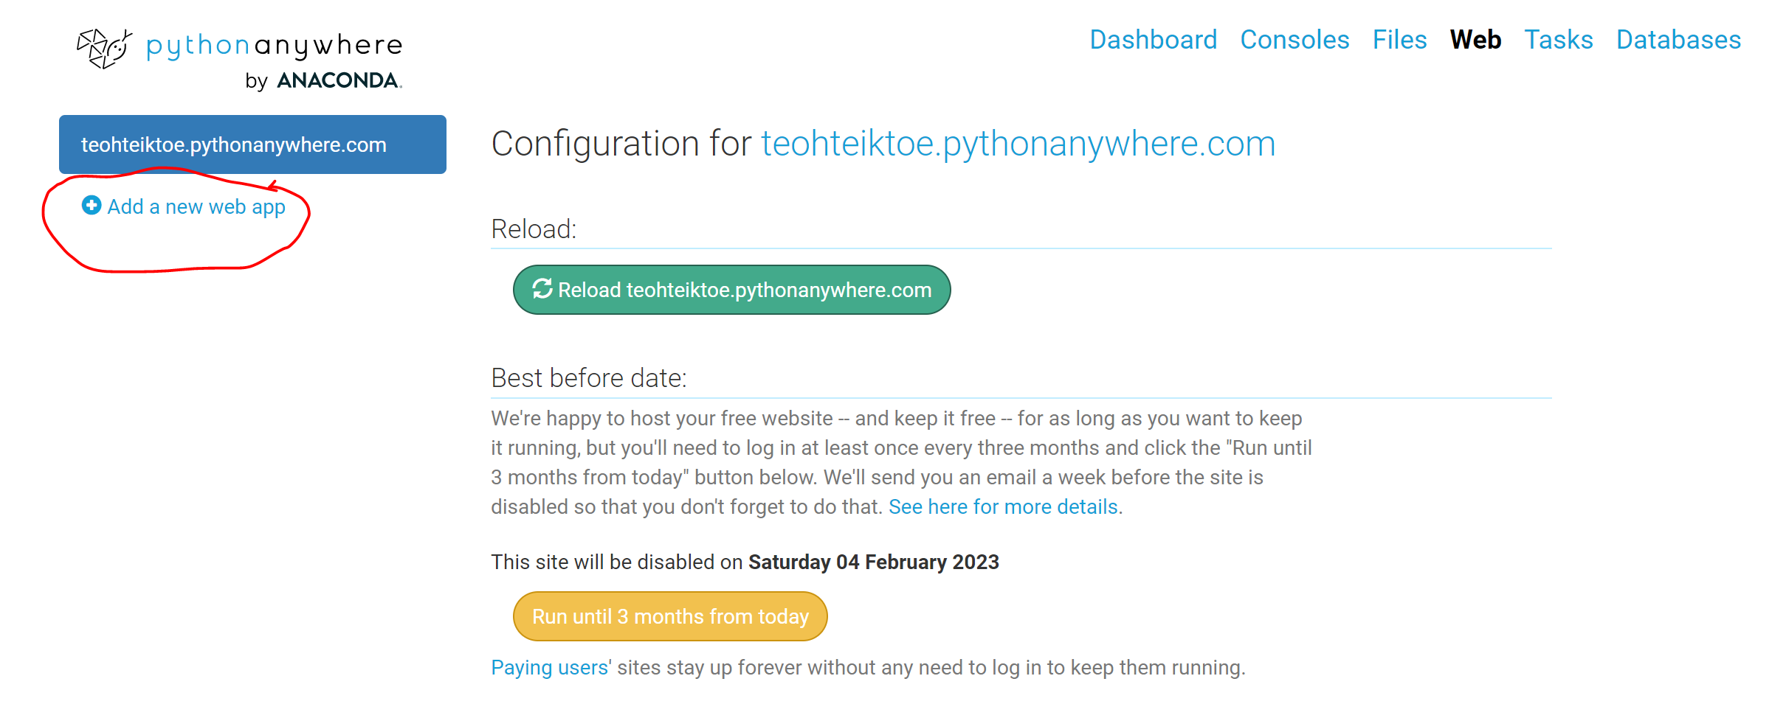
Add your new app to PythonAnyWhere:
Click on Add a New Web App button
Next -> Flask -> Python 3.10

Slide 14
Virtual environment
To remove: rmvirtualenv myvirtualenv
Go to bash
mkvirtualenv myvirtualenv --python=/usr/bin/python3.10
pip install flask
pip install textblob

Slide 15
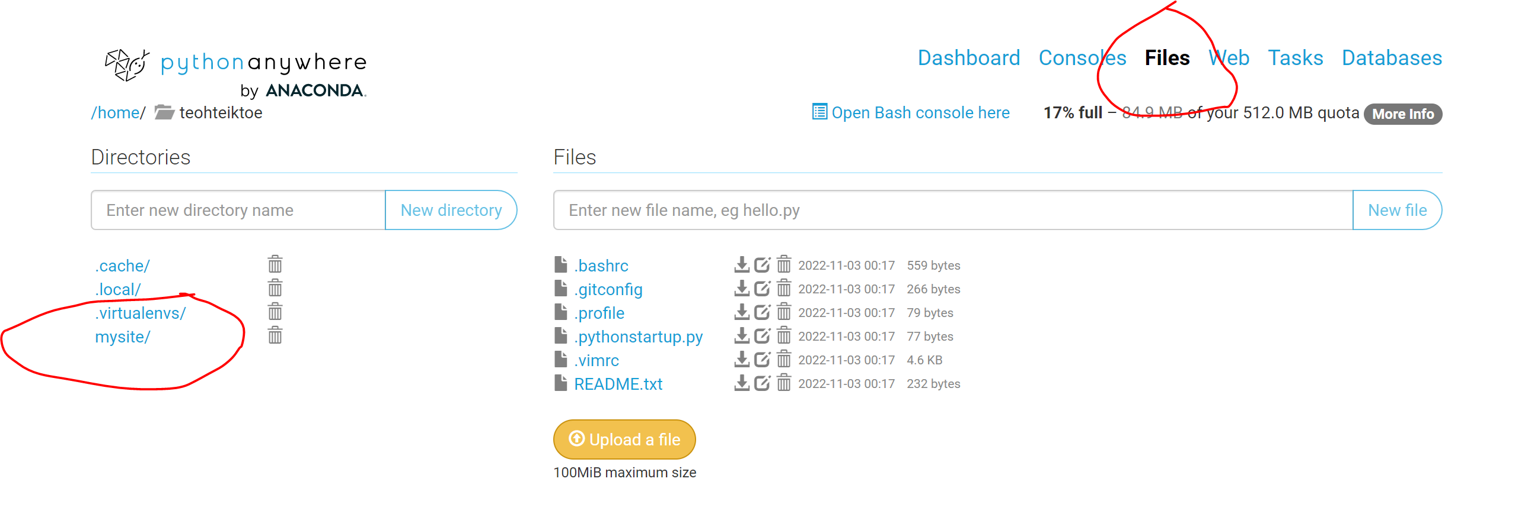
Upload your file

Slide 16
Upload your file Change flask_app.py – cut and paste your python program Create Directory call templates Upload index.html in templates directory

Slide 17
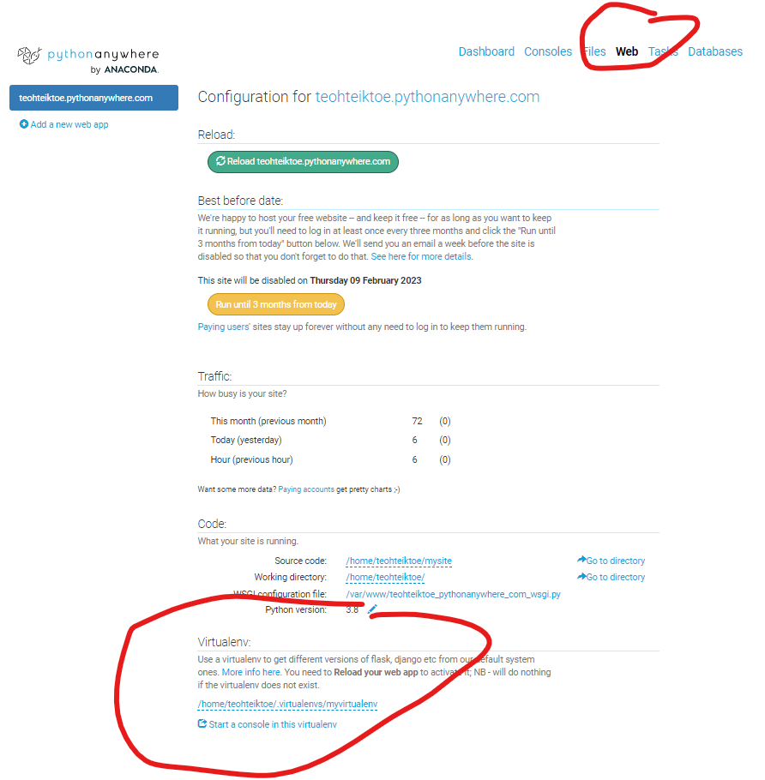
myvirtualenv

Slide 18
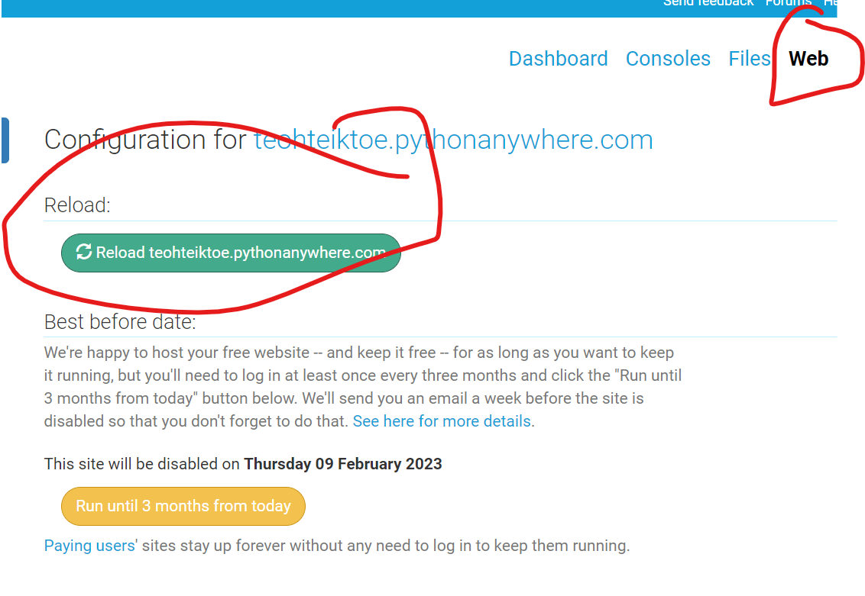
Run the program https://teohteiktoe.pythonanywhere.com/

