Slide 1

Machine Learning & MLOps
Teoh Teik Toe
ITOM/NBS
ttteoh@ntu.edu.sg
97905202

Slide 2
Recording https://1drv.ms/v/s!Aik2a4x7tvLyi_A_o8htYjf03yP_pQ?e=cQRP29

Slide 3
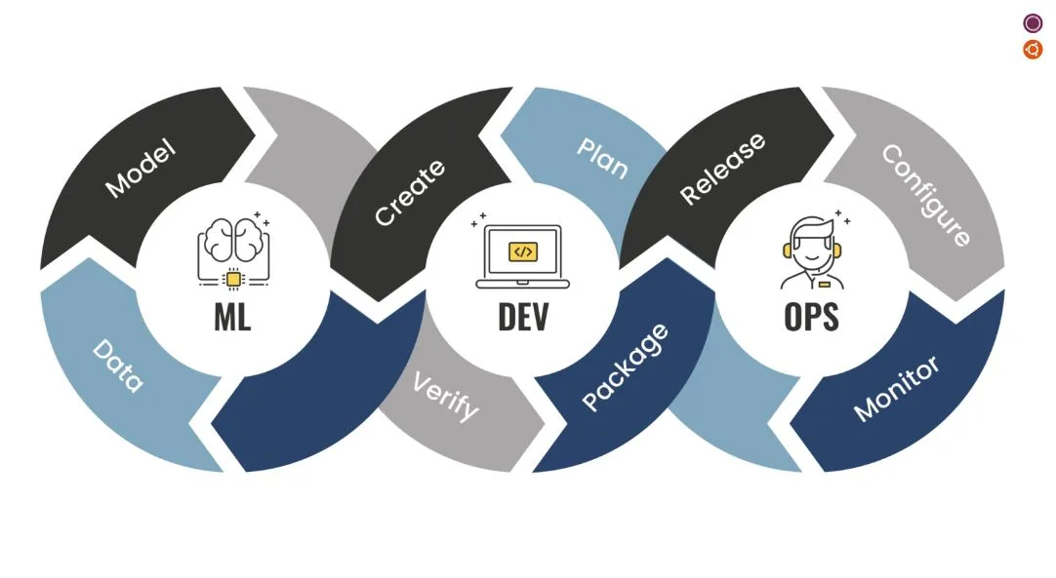
MLOps

Slide 4
Case study on DBS share price prediction
Objective: A financial institution aims to predict the future prices of a particular stock to support investment decisions and optimize portfolio management.
Reasoning: By accurately predicting share prices, the institution can identify potential buying and selling opportunities, determine optimal entry and exit points, and allocate resources effectively.
Methodology: The institution collects and analyzes vast amounts of historical stock data, including price movements. They employ advanced machine learning algorithms and statistical models to generate accurate predictions.
Results: The share price prediction model enables the institution to make informed investment decisions, optimize their portfolio allocation, manage risk effectively, and potentially generate higher returns for their clients. This approach enhances their competitiveness in the financial market and strengthens their reputation as a trusted investment advisor.

Slide 5
Mind map
Download data (DBS.csv)
Upload to cloud #1 PythonAnywhere
Upload to cloud #2 render.com
Create Machine Learning Model (using Python Colab)
Create front end using HTML (using VS Code)
Create backend using Python Flask Framework (using Conda)
Upload data to github for cloud 2 render.com

Slide 6
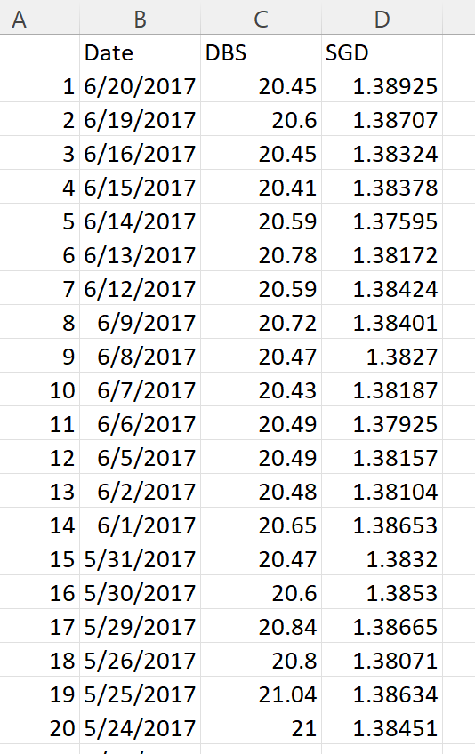
Data

Slide 7
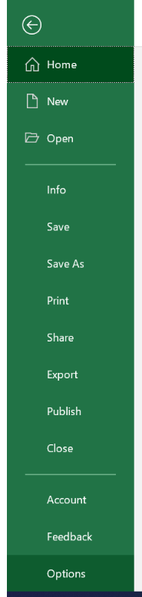
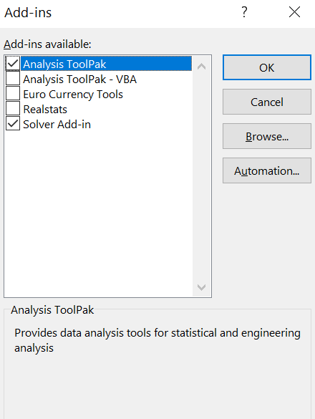
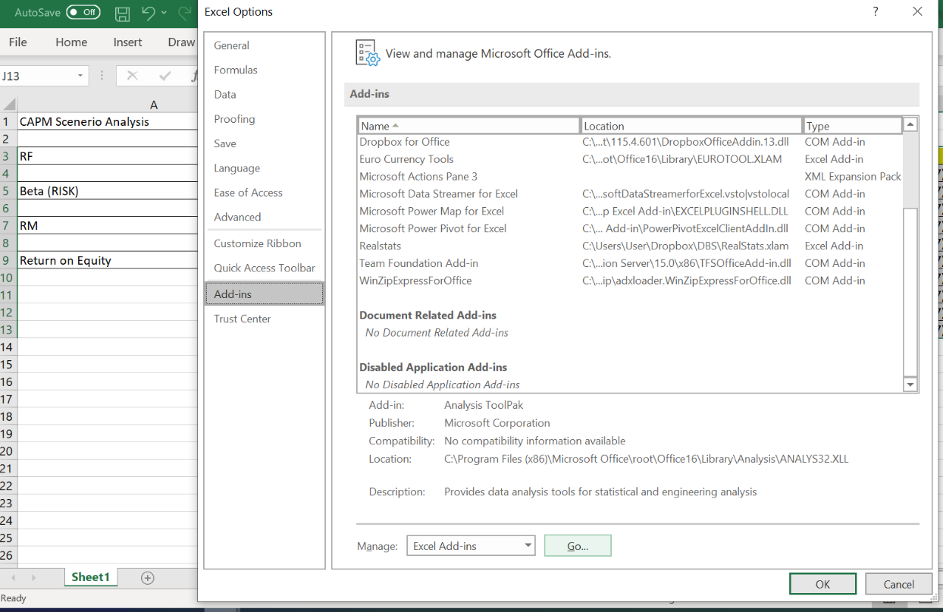
File -> Option -> Add-ins -> Manage -> Excel Add-ins - Go
Excel

Slide 8
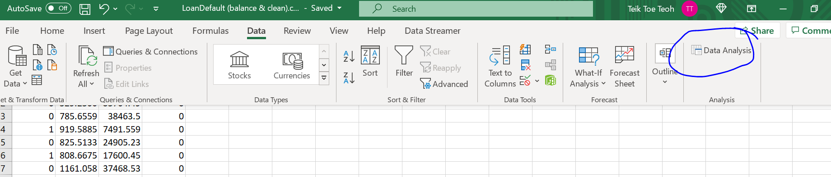
Regression on Loan Default

Slide 9
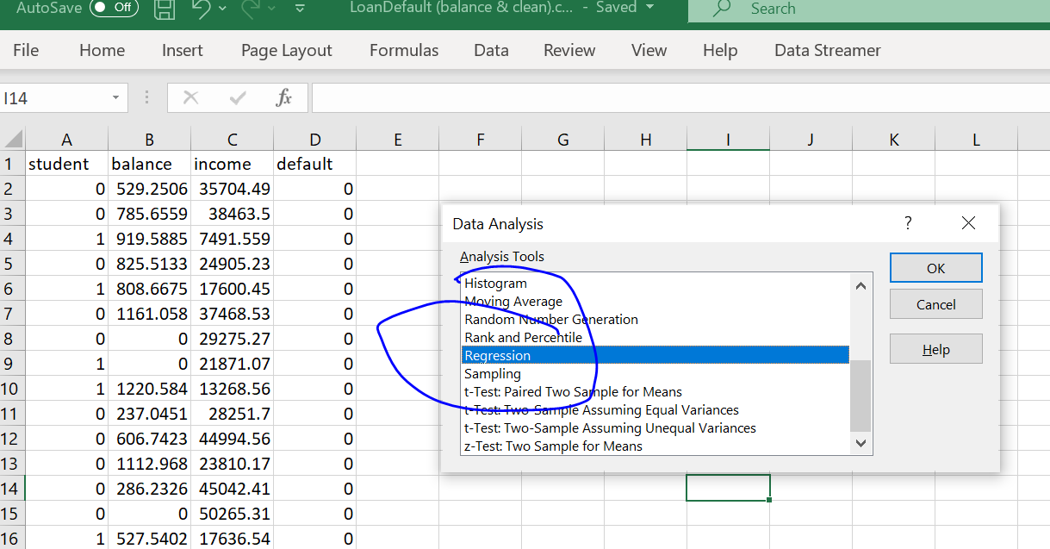
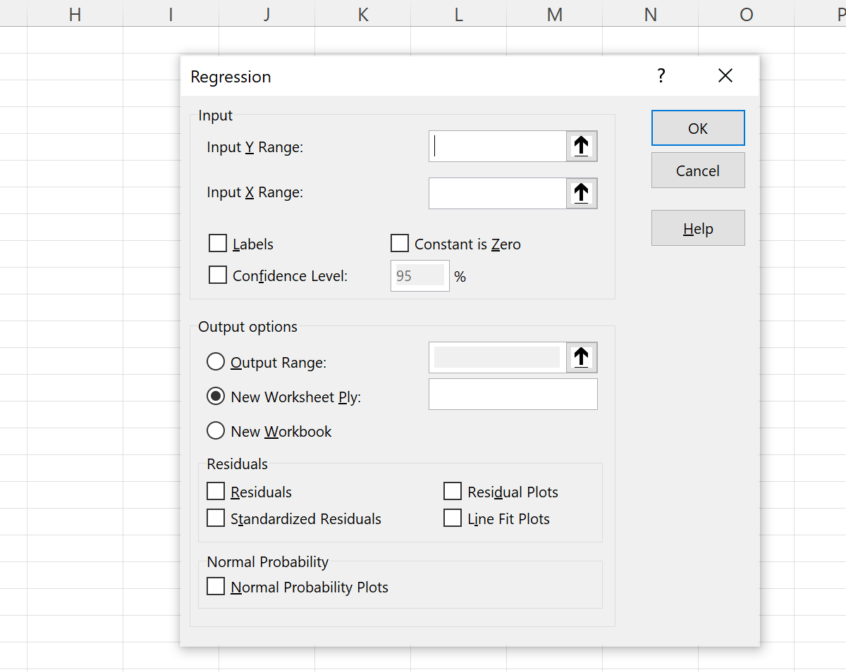
Select the range
Result will appear on new sheet

Slide 10
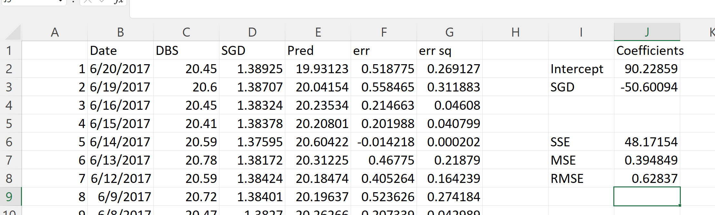
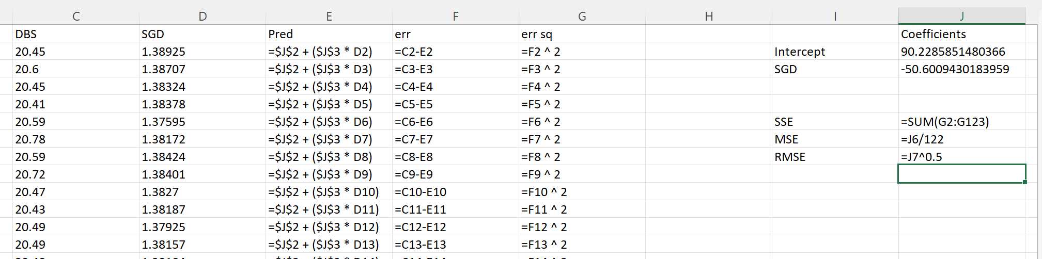

Slide 11
R
dt = read.csv("C:/Users/Teoh Teik Teo/OneDrive - TSS Global Pte. Ltd/TT Library/AI Model/Data/DBS_SingDollar.csv") #alternatively read.csv
model=lm(dt$DBS ~ dt$SGD)
summary(model)
pred = predict(model)
err = dt$DBS - pred
rmse=(mean(err^2)^0.5)
print(rmse)
dt$SGD2 = dt$SGD^2
model=lm(dt$DBS ~ dt$SGD + dt$SGD2)
summary(model)
pred = predict(model, newdata = dt)
err=dt$DBS - pred
rmse = (mean(err^2)^0.5)
print(rmse)
plot(dt$SGD, dt$DBS, main="Regression", xlab = "SGD", ylab="DBS")
abline(model)

Slide 12
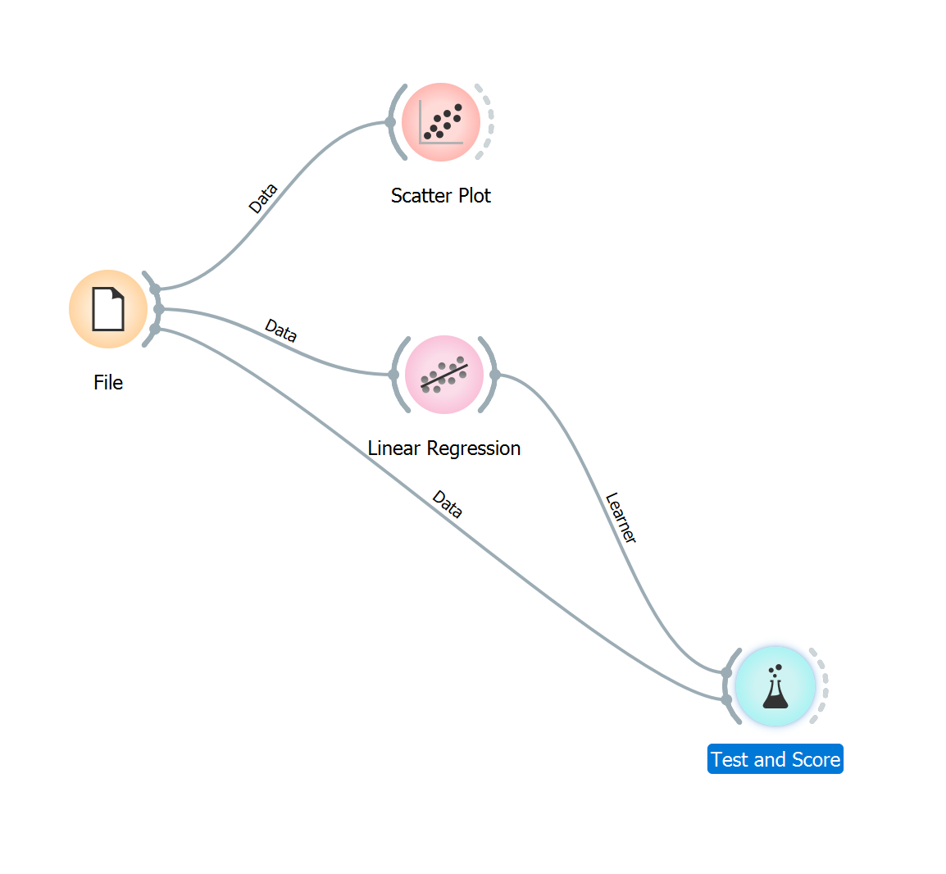
Orange

Slide 13
Python
#save model
import joblib
joblib.dump(model,”dbs.jl”)
#load model
model = joblib.load(“dbs.jl”)
import pandas as pd
df = pd.read_csv("DBS_SingDollar.csv")
X = df.loc[:,["SGD"]]
Y = df.loc[:,['DBS']]
print(X)
from sklearn import linear_model
model = linear_model.LinearRegression()
model.fit(X,Y)
pred = model.predict(X)
from sklearn.metrics import mean_squared_error
rmse = mean_squared_error(Y,pred)**0.5
print(rmse)
#print(rmse/Y.mean(axis=0)*100)
model.coef_
model.intercept_
#to add polynomial
df["SGD2"] = df["SGD"] ** 2

Slide 14
Front End HTML
<html>
<body>
<form action = "/" method = "post">
<p>Enter Sing to US:</p>
<p><input type = "number" step="0.01" name = "rates"></p>
<p><input type = "submit" value = "submit"></p>
</form>
<p> the predicted DBS share price is {{result}} </p>
</body>
</html>

Slide 15
Flask (Back End)
from flask import Flask
app = Flask(__name__)
from flask import request, render_template
@app.route("/", methods = ["GET", "POST"])
def i():
if request.method == "POST":
num = float(request.form.get("rates"))
return(render_template("index.html", result = 90.2-(50.6*num)))
else:
return render_template("index.html", result ="Waiting……….")
if __name__=="__main__":
app.run()

Slide 16
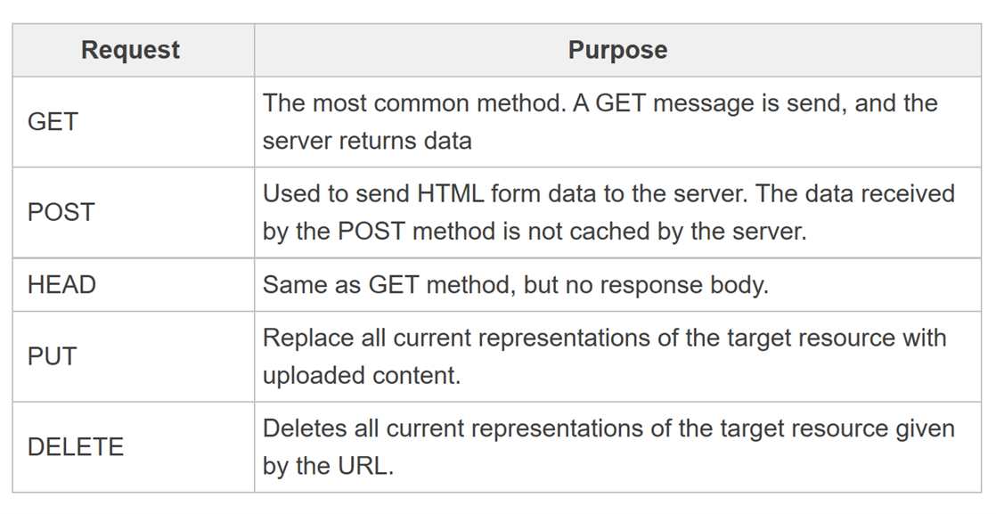
GET and POST

Slide 17
If you wanted to split into form and result 2 pages
Index.html remove local host when in cloud “/result”:
<html>
<h1>My First Machine Learning Model in Cloud: DBS price prediction</h1>
<form action="http://localhost:5000/result" method="post">
<p>Please enter the exchange rate usd to sgd (eg 1.34)</p>
<p><input type="number" step="0.01" name="rate"></p>
<p><input type="submit" value="Enter"></p>
</form>
</html>
from flask import Flask, request, render_template
app = Flask(__name__)
@app.route("/",methods=["GET","POST"])
def index():
return(render_template("index.html",result="index: waiting for rate..........."))
@app.route("/result",methods=["GET","POST"])
def result():
r = float(request.form.get("rate"))
return(render_template("result.html",result=-50.6*r + 90.2))
if __name__ == "__main__":
app.run()
Result.html:
<html>
<h1>Result</h1>
<p>The predicted DBS share price is {{result}}</p>
</html>

Slide 18
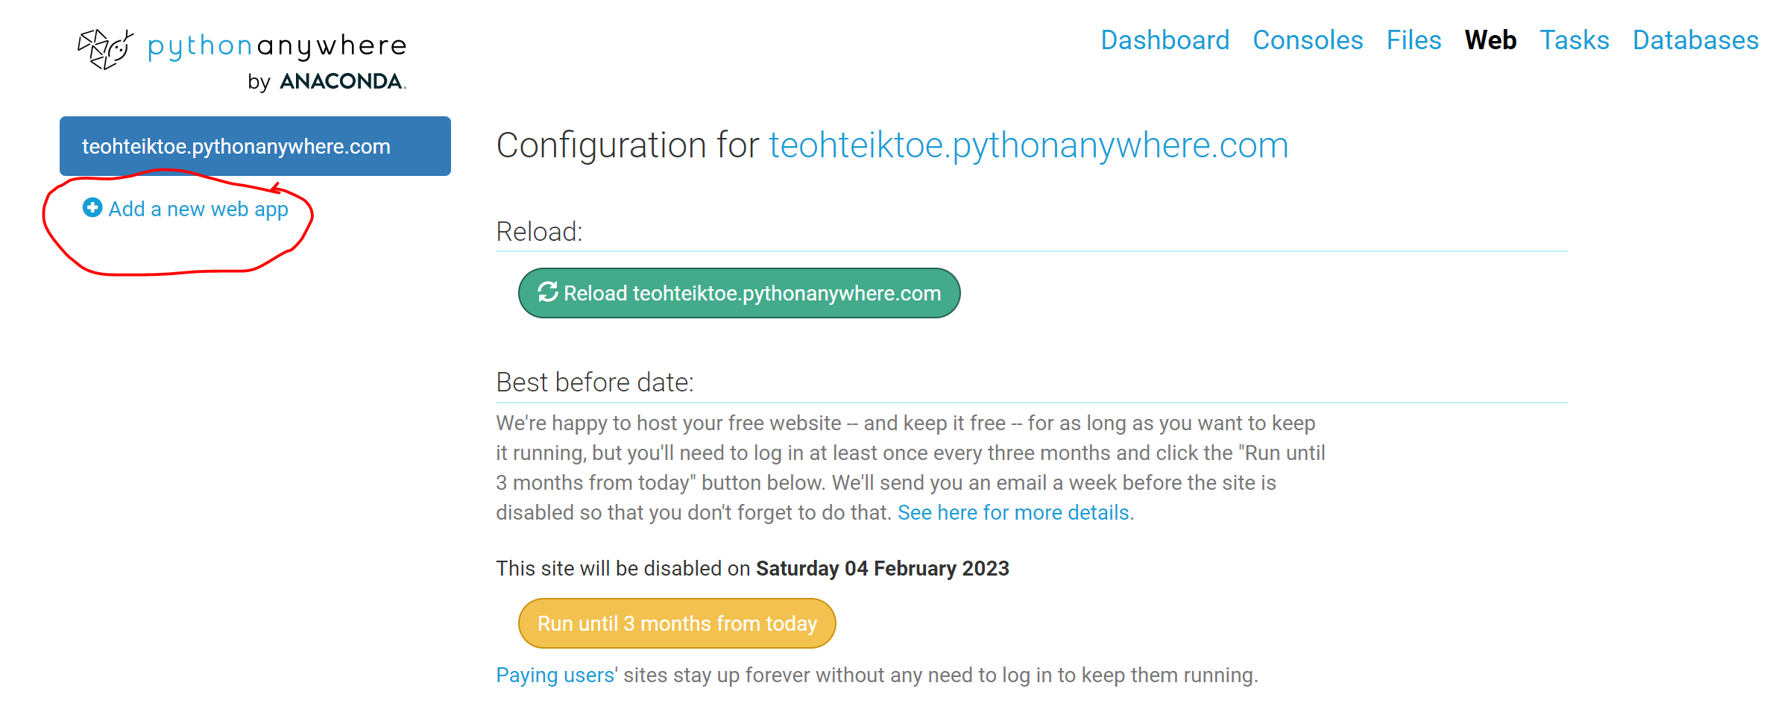
Cloud: PythonAnywhere
Add your new app to PythonAnyWhere:
Click on Add a New Web App button
Next -> Flask -> Python 3.10

Slide 19
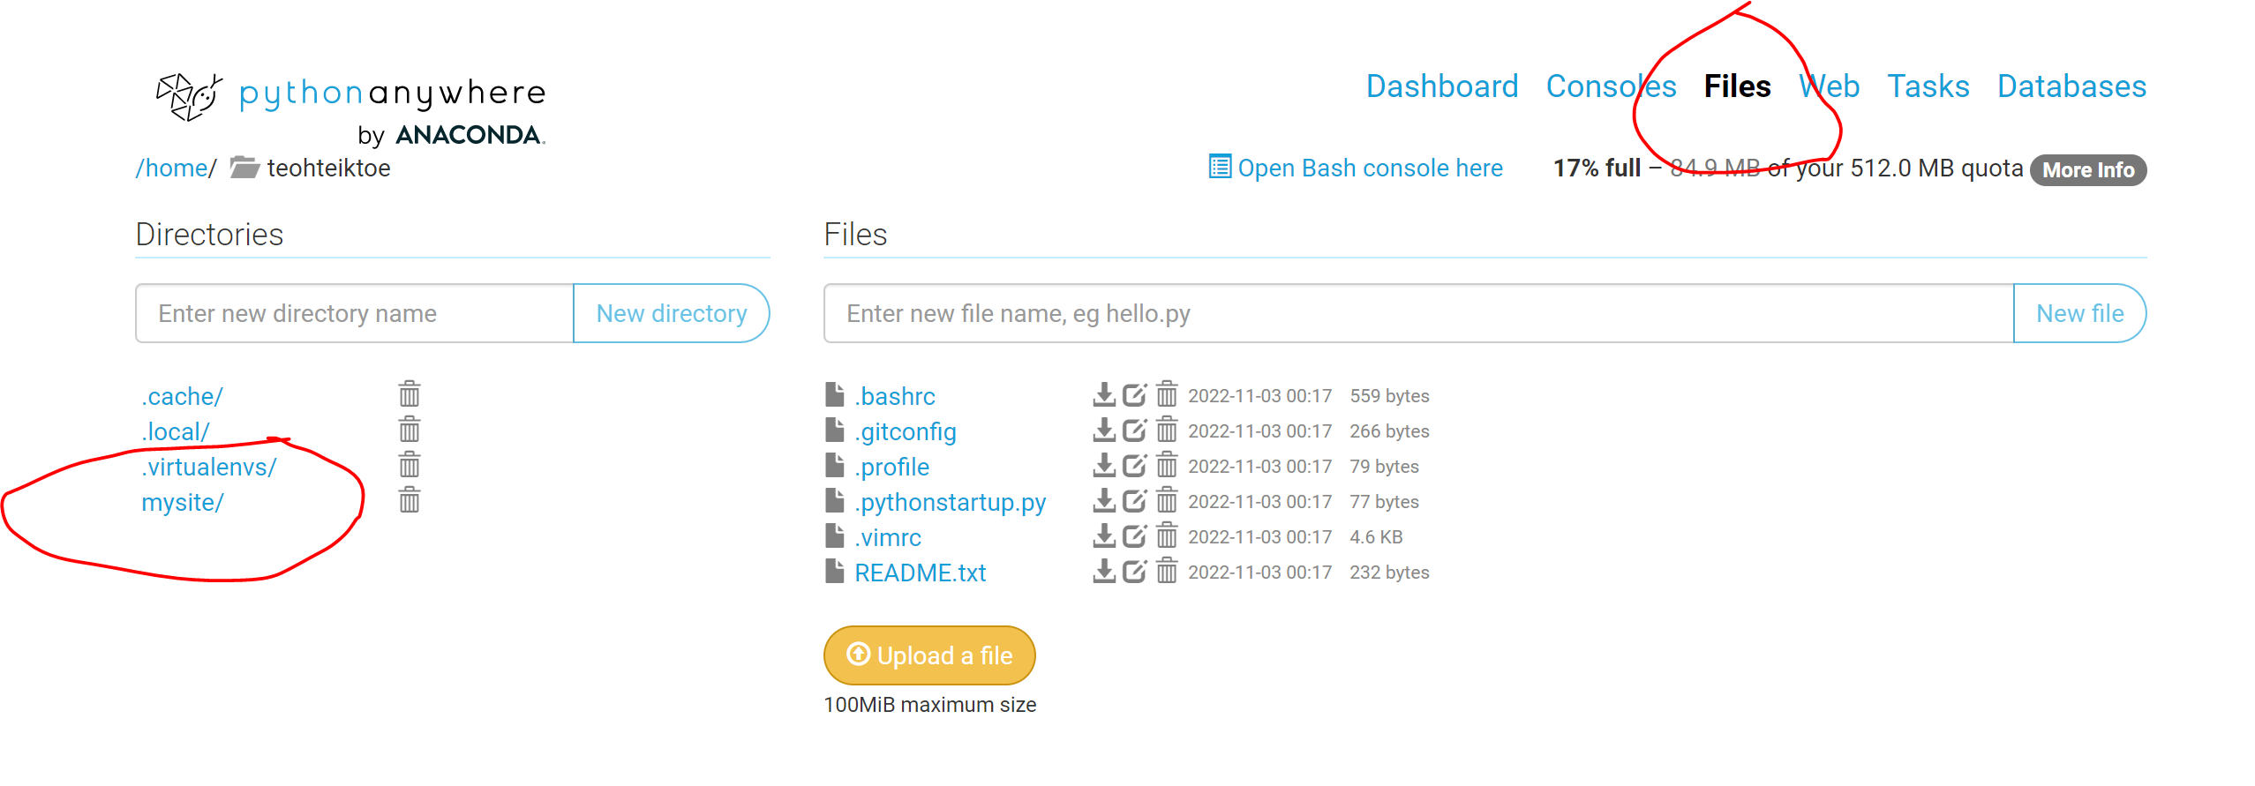
Upload your file

Slide 20
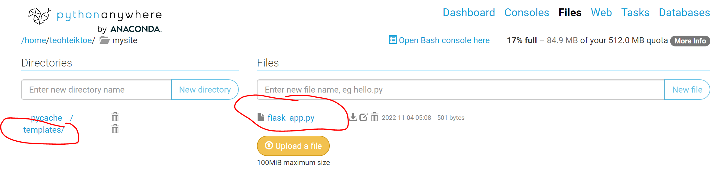
Upload your file
Change flask_app.py – cut and paste your python program
Create Directory call templates
Upload index.html in templates directory

Slide 21
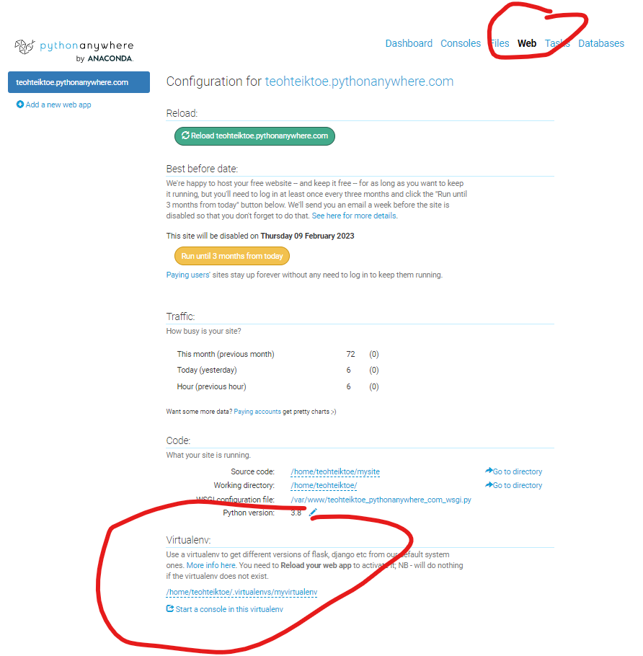
myvirtualenv

Slide 22
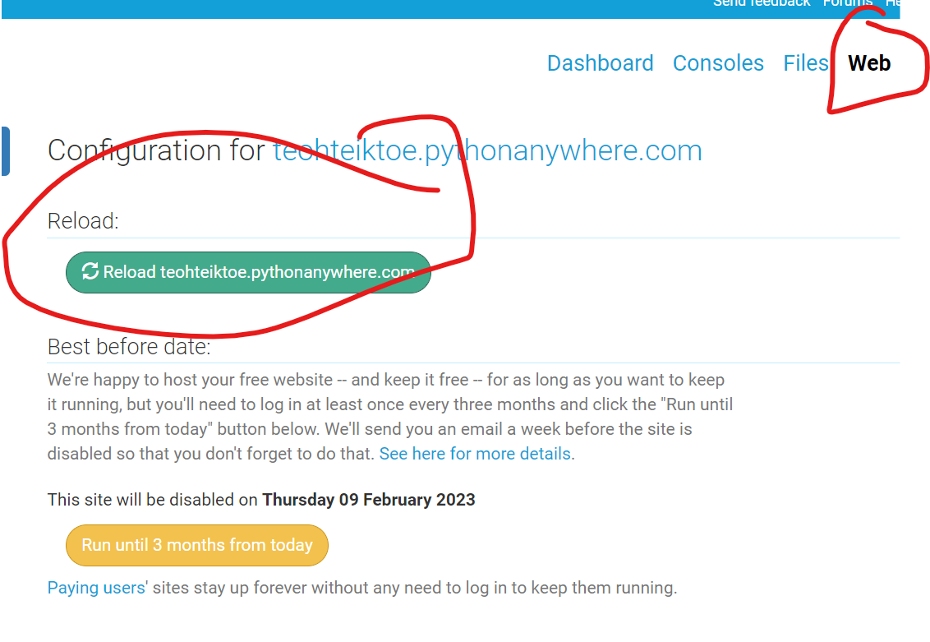

Run the program https://teohteiktoe.pythonanywhere.com/

Slide 23
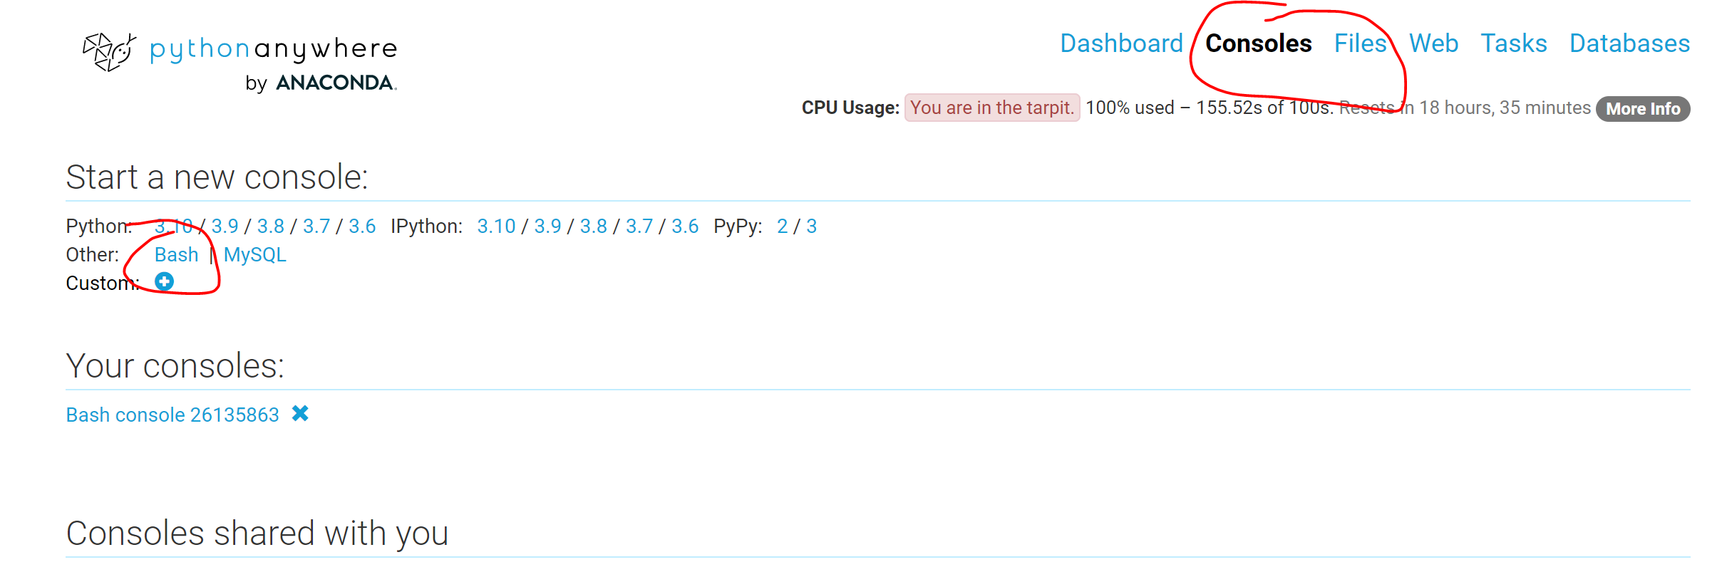
Virtual environment
To remove: rmvirtualenv myvirtualenv
Go to bash
mkvirtualenv myvirtualenv --python=/usr/bin/python3.10
pip install flask
pip install textblob

Slide 24
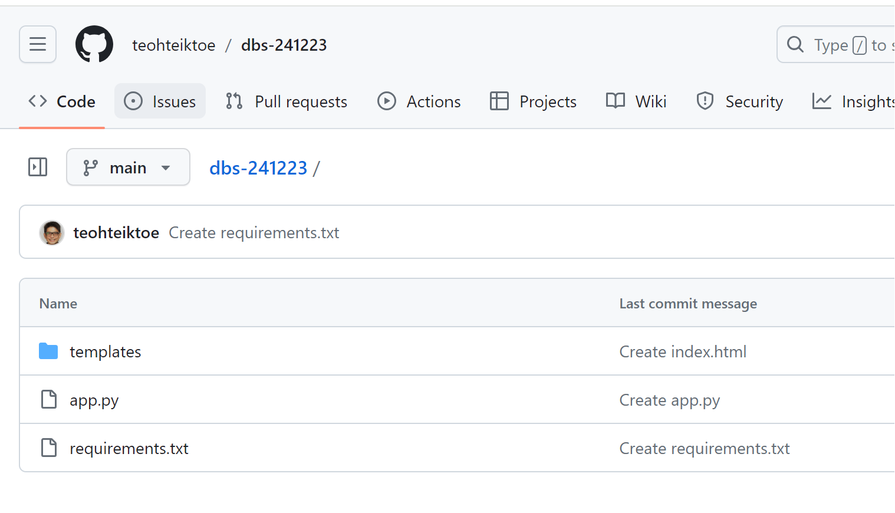
Github – create repository
requirements.txt
gunicorn
flask

Slide 25
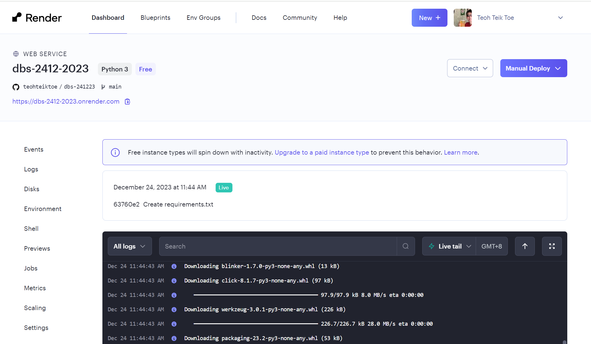
Render.com – create web services

