Slide 1
CNN
Teoh Teik Toe
ITOM/NBS
ttteoh@ntu.edu.sg
97905202

Slide 2
Recording:
https://1drv.ms/v/s!Aik2a4x7tvLyi_EwvxD43UPaiwJGmg?e=fU99Yo
Data:
Pneumonia:
https://www.kaggle.com/datasets/paultimothymooney/chest-xray-pneumonia
https://www.kaggle.com/search?q=image+classification+in%3Adatasets

Slide 3
Part I – Theory Agenda
What is Imagenet (Pre-train)
What is Neural Network
What is CNN
How does Filter and Convolution work
What is embedding

Slide 4
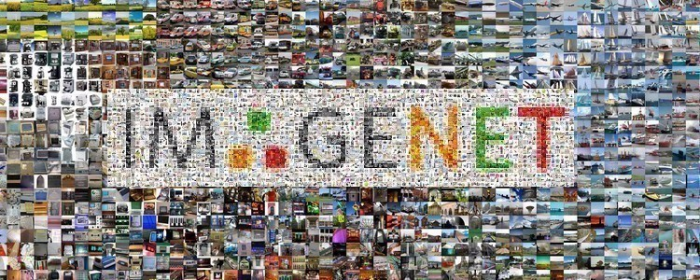
ImageNet – Pre-train model
Imagenet data base: 14 mil labeled images, 20K categories

Slide 5
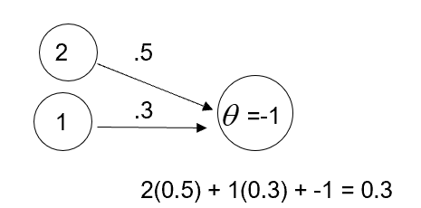
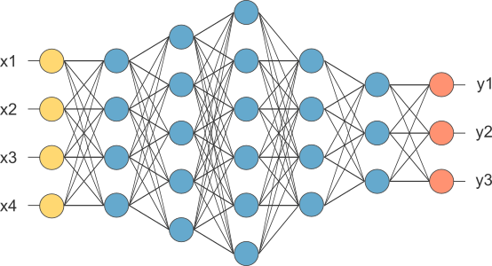
Multi Layer Perceptron
This is our fully connected network. If x_{1 .}... x_{n}, n is very large and growing,
this network would become too large. We now will input one x_{i} at a time,
and re-use the same edge weights.

Slide 6
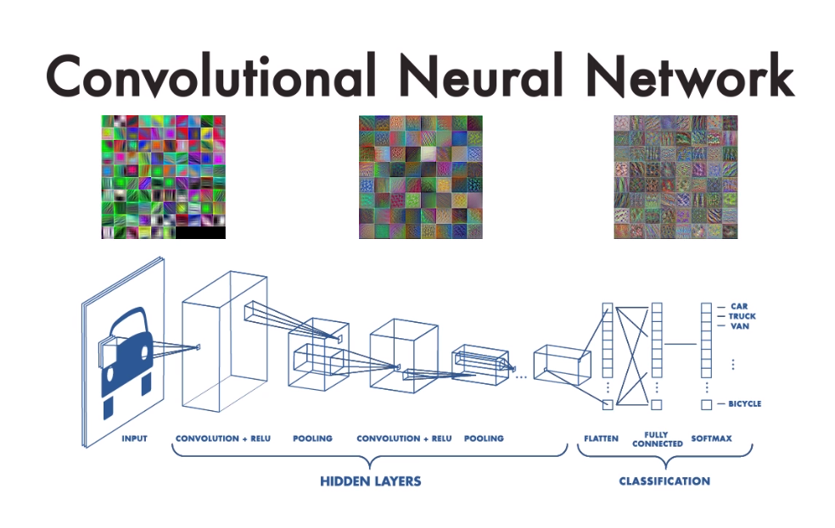

Slide 7
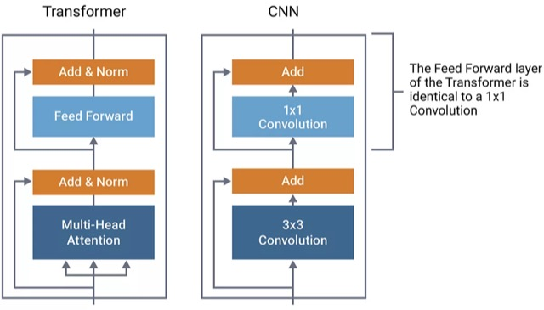
Transformer vs CNN

Slide 8
Feature | CNNs | Transformers
Architecture | Layers of convolution, pooling, and fully connected neurons. | Based on self-attention mechanism without convolutional layers.
Processing Method | Sequential processing with convolutional filters. | Parallel processing with attention mechanism across all input elements.
Primary Application | Image and video recognition, image classification, medical image analysis. | NLP tasks (translation, text summarization), increasingly used in computer vision and other areas.
Data Handling | Effective at processing spatial hierarchies in visual data. | Capable of handling sequential and non-sequential data, excelling in capturing long-range dependencies.
Efficiency & Scalability | Efficient for tasks with local spatial relationships, scalability can be challenged by deep architectures for long-range dependencies. | Highly scalable, efficient for parallel processing, and effective in capturing complex data relationships.
Performance | Excellent for visual tasks requiring feature extraction and spatial hierarchies. | Demonstrated superior performance in tasks requiring understanding of complex relationships and context.

Slide 9
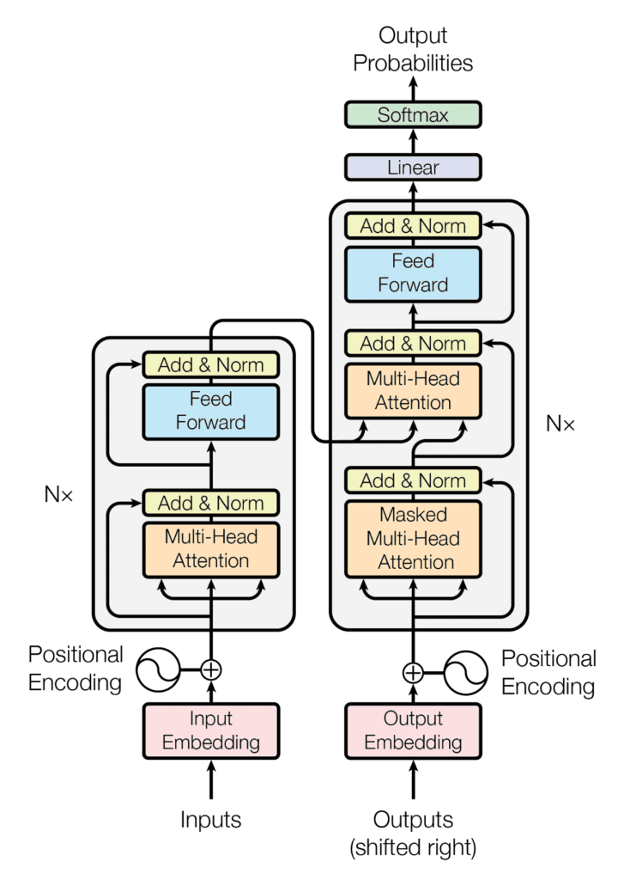
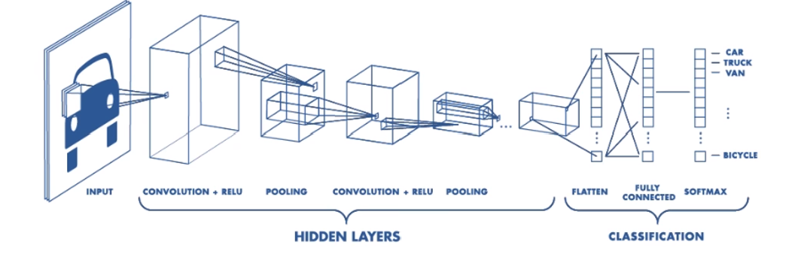
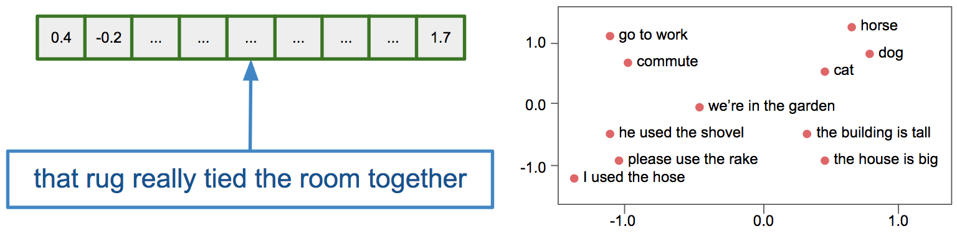
CNN vs Transformer : ChatGPT example

Slide 10
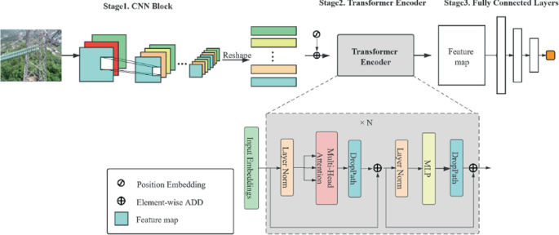
Combining CNN and Transformer

Slide 11

What is Convolutional NN ?
2x2
Convolution + NL
Sub-sampling
Convolution + NL

Slide 12
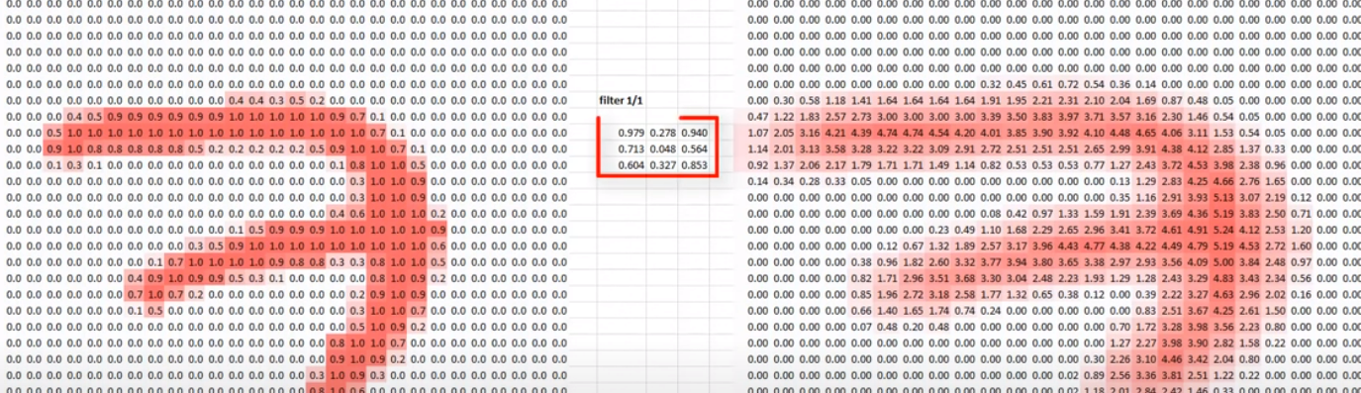
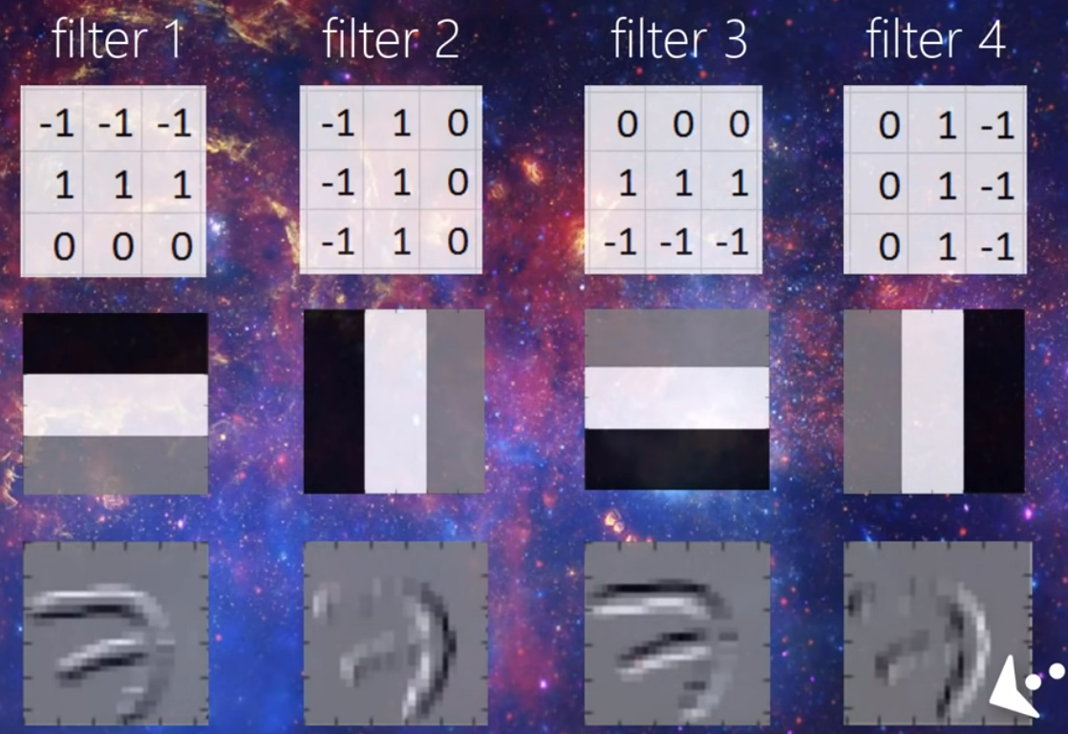
How CNN works

Slide 13
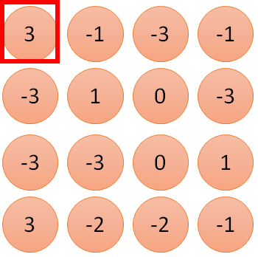
1 | -1 | -1
-1 | 1 | -1
-1 | -1 | 1
1:
1
Filter 1
2:
0
3:
0
3
4:
0
1 | 0 | 0 | 0 | 0 | 1
0 | 1 | 0 | 0 | 1 | 0
0 | 0 | 1 | 1 | 0 | 0
1 | 0 | 0 | 0 | 1 | 0
0 | 1 | 0 | 0 | 1 | 0
0 | 0 | 1 | 0 | 1 | 0
…
7:
0
8:
1
9:
0
10:
0
…
13:
0
6 x 6 image
14:
0
Less parameters!
15:
Only connect to 9 input, not fully connected
1
16:
1
…

Slide 14
Convolution - stride
1 | -1 | -1
-1 | 1 | -1
-1 | -1 | 1
Filter 1
stride=1
1 | 0 | 0 | 0 | 0 | 1
0 | 1 | 0 | 0 | 1 | 0
0 | 0 | 1 | 1 | 0 | 0
1 | 0 | 0 | 0 | 1 | 0
0 | 1 | 0 | 0 | 1 | 0
0 | 0 | 1 | 0 | 1 | 0
1 | 0 | 0 | 0 | 0 | 1
0 | 1 | 0 | 0 | 1 | 0
0 | 0 | 1 | 1 | 0 | 0
1 | 0 | 0 | 0 | 1 | 0
0 | 1 | 0 | 0 | 1 | 0
0 | 0 | 1 | 0 | 1 | 0
3
-1
6 x 6 image
6 x 6 image
Stride is 2 means move 2 steps

Slide 15
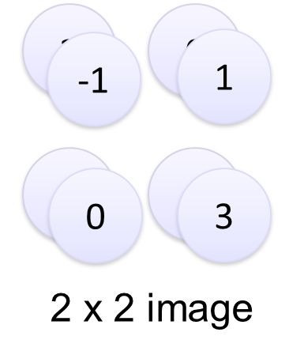
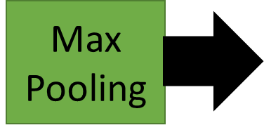
Max Pooling 2x2 stride=2
-1 | 1 | -1
-1 | 1 | -1
-1 | 1 | -1
Filter 2
-1
-1
-1
-1
-1
-1
-2
1
-1
-1
-2
1
-1
0
-4
3

Slide 16
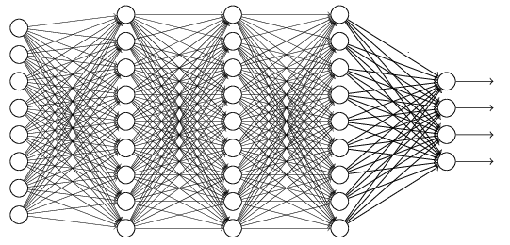
Flattening
3
0
1
3
0
-1
1
3
3
1
-1
0
3
Flattened
1
Fully Connected Feedforward network
0
3

Slide 17
Conv NN: Detection
Sermanet, CVPR 2014

Slide 18
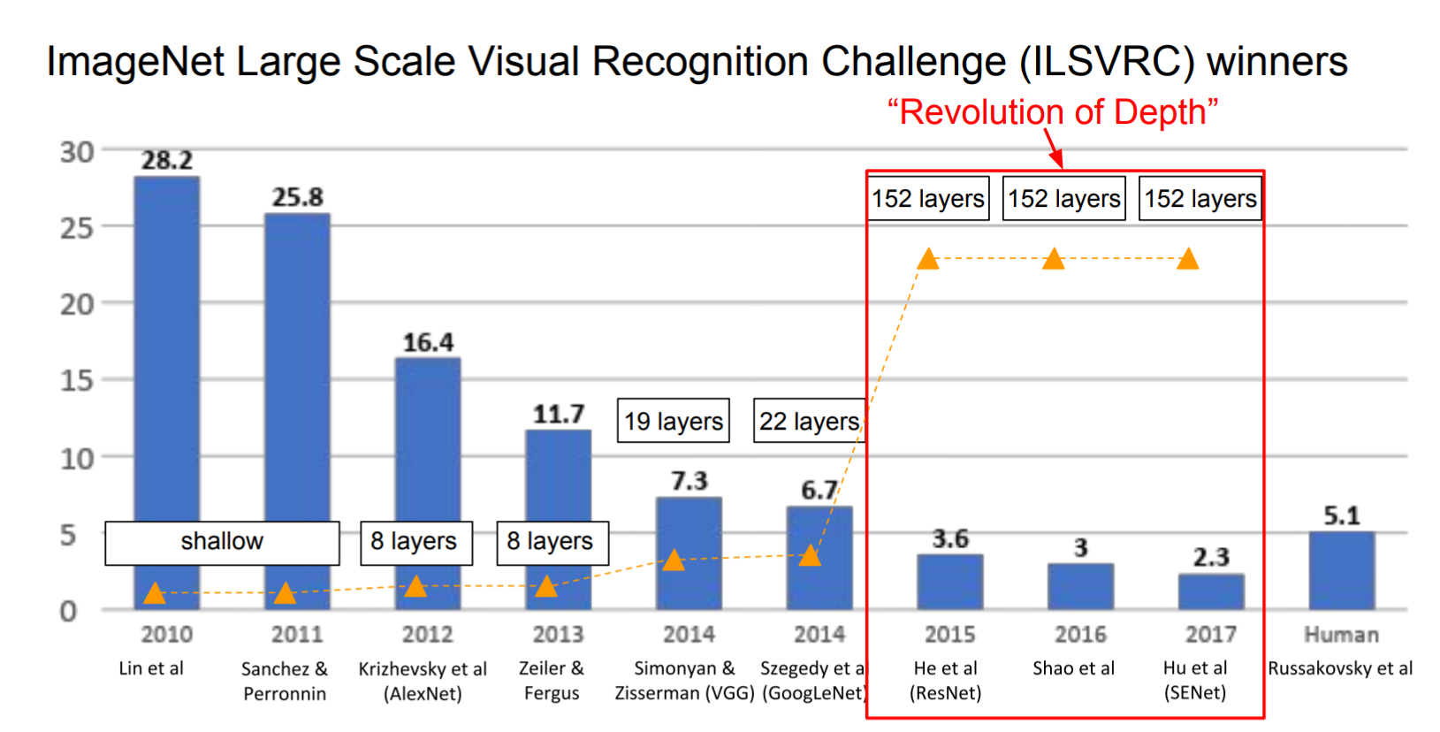
The popular CNN
LeNet, 1998
AlexNet, 2012
VGGNet, 2014
ResNet, 2015
Notes:
http://cs231n.github.io/neural-networks-1/

Slide 19
Image Classification & Clustering
Orange – Inception v3 (2048)
CNN Customized (32,32,64,64|128 dim3136)
Embedding Resnet50 (2048)
Transformer – Google ViT
Embedding – Models
Code: https://drive.google.com/drive/folders/1fXjR7HWQVDvW4b_UwFmEM_NymlOo4Wbw?usp=sharing
Data:
https://drive.google.com/drive/folders/1DWSSkL9zMwXktar8rxC_3rUGqxwNNTrR?usp=sharing

Slide 20
Part II – Programming Agenda
Classification using Kaggle data
  CNN customized
  RESTNET, VIT Image Embedding
  Orange Inception V3
Transformer -VIT

Slide 21
Example from Kaggle
#random state
import random
random.seed(1)
import numpy as np
np.random.seed(1)
import tensorflow as tf
tf.random.set_seed(1)

Slide 22
Data from Kaggle
https://www.kaggle.com/datasets/paultimothymooney/chest-xray-pneumonia
https://www.kaggle.com/datasets/nazmul0087/ct-kidney-dataset-normal-cyst-tumor-and-stone
https://www.kaggle.com/datasets/tourist55/alzheimers-dataset-4-class-of-images
https://www.kaggle.com/datasets/aryashah2k/breast-ultrasound-images-dataset?resource=download
https://www.kaggle.com/datasets/andrewmvd/medical-mnist
Cat and Dog: https://www.kaggle.com/datasets/samuelcortinhas/cats-and-dogs-image-classification
Apple and tomato: https://www.kaggle.com/datasets/samuelcortinhas/apples-or-tomatoes-image-classification
(optional)
Covid: https://tssglobalsingapore-my.sharepoint.com/:f:/g/personal/teohteiktoe_tssglobalsingapore_onmicrosoft_com/EtgAbDvO-HVFi91b7McMxCgBhKIpe2bOU0HIJ_KuIJ6giw?e=0U98mX)

Slide 23
Split train test (if needed)
import splitfolders
input_folder = "C:/Users/Teoh Teik Teo/OneDrive - TSS Global Pte. Ltd/TT Library/AI Model/Data/Breast Illness"
output = "C:/Users/Teoh Teik Teo/OneDrive - TSS Global Pte. Ltd/TT Library/AI Model/Data/Breast Illness (train test split)" #where you want the split datasets saved. one will be created if it does not exist or none is set
splitfolders.ratio(input_folder, output=output, seed=42, ratio=(.7, .1, .2)) # ratio of split are in order of train/val/test. You can change to whatever you want. For train/val sets only, you could do .75, .25 for example.
!pip install split-folders

Slide 24
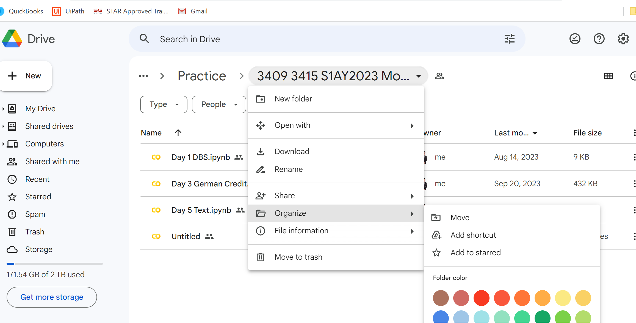
Join my google drive data
COLAB:
You need to go to tt drive
Click organize -> Add shortcut

Slide 25
CNN 4 Layers
from PIL import Image
img = Image.open(r"C:\Users\teoht\OneDrive\Library\AI\Data\Pneumonia\train\NORMAL\IM-0115-0001.jpeg")
img.histogram (size)
from google.colab import drive
drive.mount('/content/drive')
#for colab
pip install keras
pip install tensorflow
from keras.preprocessing.image import ImageDataGenerator
#import tensorflow
#from tensorflow.keras.preprocessing.image import ImageDataGenerator
train = r"/content/drive/MyDrive/TT Library/AI Model/Data/Pneumonia/train"
train_data = ImageDataGenerator().flow_from_directory(train, (150, 150), batch_size=5, shuffle= False)
test = r"/content/drive/MyDrive/TT Library/AI Model/Data/Pneumonia/test"
test_data = ImageDataGenerator().flow_from_directory(test, (150, 150), batch_size=5, shuffle= False)
https://colab.research.google.com/drive/1bMEc9Qu9d8WRkAnCV79hliEXqCS5sjW2?usp=drive_link

Slide 26
from keras.models import Sequential
from keras.layers import Dense, Dropout, Flatten, Conv2D, MaxPooling2D
model = Sequential()
model.add(Conv2D(32, (3, 3), input_shape=(150, 150, 3), activation='relu'))
model.add(MaxPooling2D(pool_size=(2, 2), strides=2))
model.add(Dropout(0.05))
model.add(Conv2D(32, (3, 3), activation='relu'))
model.add(MaxPooling2D(pool_size=(2, 2), strides=2))
model.add(Dropout(0.05))
model.add(Conv2D(64, (3, 3),activation='relu'))
model.add(MaxPooling2D(pool_size=(2, 2), strides=2))
model.add(Dropout(0.2))
model.add(Conv2D(64, (3, 3), activation='relu'))
model.add(MaxPooling2D(pool_size=(2, 2), strides=2))
model.add(Dropout(0.2))
model.add(Flatten())
model.add(Dense(128, activation='relu’))
model.add(Dropout(0.1))
model.add(Dense(2, activation="softmax")) #depends on class
model.summary()

Slide 27
#remove optimizer if needed
model.compile(loss="categorical_crossentropy",optimizer="adam",metrics=['accuracy'])
h = model.fit(train_data, batch_size = 5, epochs=5)
import matplotlib.pyplot as plt
plt.plot(h.history['loss'])
#plt.plot(h.history['val_loss'])
plt.title('model loss')
plt.ylabel('loss')
plt.xlabel('epoch')
plt.legend(['train', 'val'], loc='upper left')
plt.show()

Slide 28
import seaborn as sns
pred = model.predict(test_data)
import numpy as np
pred=np.argmax(pred,axis=1)
from sklearn.metrics import confusion_matrix
cm = confusion_matrix(test_data.classes, pred)
sns.heatmap(cm, annot=True)
#Alternatively pred = pred >= 0.5
A DataFrame object has two axes: “axis 0” and “axis 1”. “axis 0” represents rows and “axis 1” represents columns
#depends on number of classes
print((cm[0,0]+cm[1,1])/(sum(sum(cm))))
from keras.models import save_model
save_model(model, "Pneumonia")
# score = model.evaluate(train_data)
# print(score)
score = model.evaluate(test_data)
print(score)

Slide 29
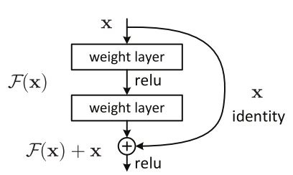
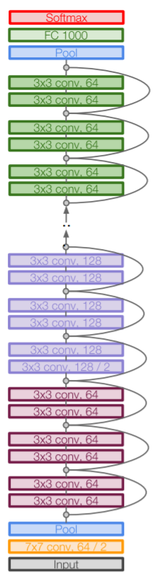
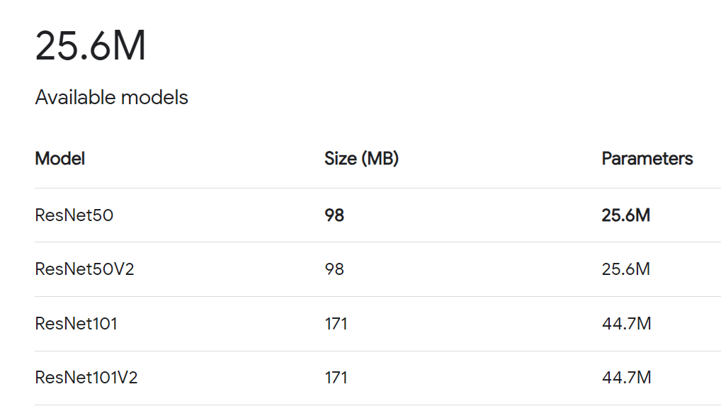
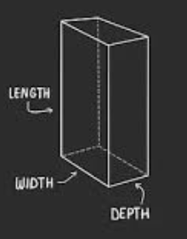
ResNet
5 x 5 x 2048 = 51200

Slide 30
pip install opencv-python
https://colab.research.google.com/drive/1q_VbKPc_ZaDkCP6ethHj4JNi5KhxKlow?usp=drive_link
pip install keras
pip install tensorflow
import cv2
import numpy as np
import os
# Libraries
from tensorflow.keras.applications import resnet50,ResNet50
from tensorflow.keras.preprocessing import image
model=ResNet50(weights='imagenet', include_top=False, input_shape=(150,150,3))
IMG_SIZE = 100​
photo_train = 300 # set 0 if no max​
photo_test = 150​

Slide 31
img = cv2.imread(r"/content/drive/MyDrive/TT Library/AI Model/Data/Pneumonia/train/NORMAL/IM-0115-0001.jpeg")
img = cv2.resize(img, (150,150))
img = image.img_to_array(img)
img = resnet50.preprocess_input(np.expand_dims(img.copy(),axis=0))
img = model.predict(img)
img = img.flatten()
img.shape
from google.colab.patches import cv2_imshow
cv2_imshow(img)
img.shape to see the dimension
One image to show the embedding
#installation in conda
conda config --add channels conda-forge
conda install libopencv opencv py-opencv
In conda:
import matplotlib.pyplot as plt
plt.imshow(img)
plt.show()

Slide 32
train_dir = r"/content/drive/MyDrive/TT Library/AI Model/Data/Pneumonia/train"
Y_train = []
X_train = []
# 2 for loop, 1 for classes and 1 for images in the class
for i in os.listdir(train_dir): #for class
for j in os.listdir(train_dir+'/'+i+"/"):
print(train_dir+'/'+i+'/'+j)
img=cv2.imread(train_dir+'/'+i+'/'+j)
img=cv2.resize(img,(150,150))
img = image.img_to_array(img)
img = resnet50.preprocess_input(np.expand_dims(img.copy(), axis=0))
img = model.predict(img)
X_train.append(img.flatten())
Y_train.append(i)
np.shape(X_train)
(5216, 51200)

Slide 33
train_dir = r"/content/drive/MyDrive/TT Library/AI Model/Data/Pneumonia/test"
Y_test = []
X_test = []
# 2 for loop, 1 for classes and 1 for images in the class
for i in os.listdir(test_dir): #for class
for j in os.listdir(test_dir+'/'+i+"/"):
print(test_dir+'/'+i+'/'+j)
img=cv2.imread(test_dir+'/'+i+'/'+j)
img=cv2.resize(img,(150,150))
img = image.img_to_array(img)
img = resnet50.preprocess_input(np.expand_dims(img.copy(), axis=0))
img = model.predict(img)
X_test.append(img.flatten())
Y_test.append(i)
from sklearn.metrics import confusion_matrix
from sklearn import linear_model
model = linear_model.LogisticRegression().fit(X_train,Y_train)
pred = model.predict(X_test)
cm = confusion_matrix(Y_test,pred)
print((cm[0,0]+cm[1,1]+cm[2,2])/(sum(sum(cm))))

Slide 34
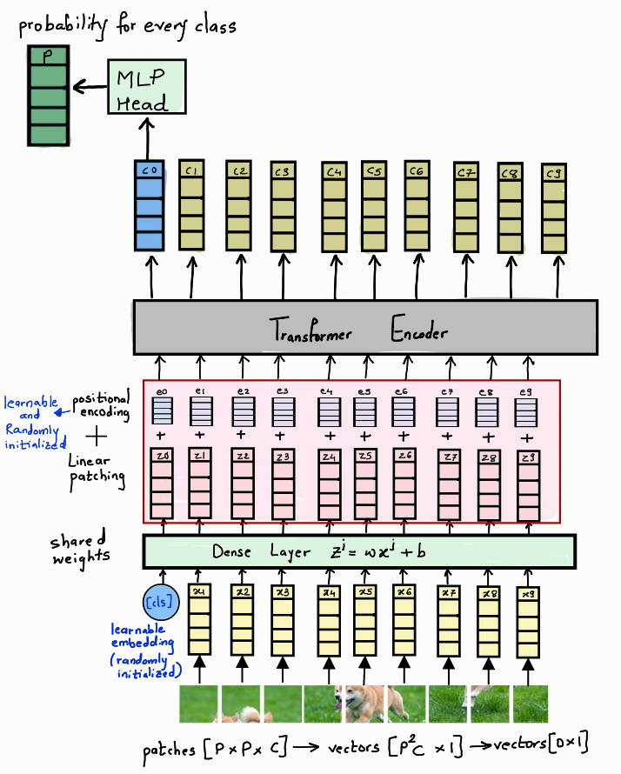
ViT Vision Transformer By Google –
ViT-base: it has 12 layers, hidden size of 768, and the total of 86M parameters.
ViT-large: it has 24 layers, hidden size of 1024, and the total of 307M parameters.
ViT-huge: it has 32 layers, hidden size of 1280, and the total of 632M parameters
(1, 3, 224, 224)

Slide 35
Classifier using ViT by Google
https://colab.research.google.com/drive/13V_sliAwlIz-HjKvk4YCZs5kFAXlED_N?usp=drive_link
from google.colab import drive
drive.mount('/content/drive’)
pip install keras
pip install tensorflow
pip install transformers
import numpy as np
from transformers import ViTFeatureExtractor
from PIL import Image,ImageOps
model = ViTFeatureExtractor.from_pretrained('google/vit-base-patch16-224')

Slide 36
Classifier using ViT by Google
img = Image.open(r"/content/drive/MyDrive/TT Library/AI Model/Data/Pneumonia/train/NORMAL/IM-0115-0001.jpeg")
img = img.resize((150,150))
img = ImageOps.colorize(img, black="black", white="white")
img =model(images=img)
img = img["pixel_values"]
img = np.array(img)
img = img.flatten()
img.shape
To see image, type img
To look at the size: print(img)
After numpy, can use img.shape to know the size
To check the brightness, img.mean()

Slide 37
train_dir = "/content/drive/MyDrive/TT Library/AI Model/Data/Pneumonia/train"
X_train = []
Y_train = []
counter=1
PIL.ImageOps.colorize() – covert to RGB - Colorize grayscale image. The black and white arguments should be RGB
MOST DATA NO NEED COLORIZE
Output Dimension 150528 – np.shape(X_train)
import os
import numpy as np
for i in os.listdir(train_dir):
print(i)
for j in os.listdir(train_dir + "/" + i ):
try:
print(train_dir + "/" + i + "/" + j)
img = Image.open(train_dir + "/" + i + "/" + j)
img = img.resize((150,150))
#img = ImageOps.colorize(img, black="black", white="white")
img =model(images=img)
img = img["pixel_values"]
img = np.array(img)
X_train.append(img.flatten())
Y_train.append(i)
except Exception as e:
print("error is ", e, "counter is ", counter)
counter = counter + 1
print(counter)

Slide 38
test_dir = "/content/drive/MyDrive/TT Library/AI Model/Data/Pneumonia/test"
X_test = []
Y_test = []
counter=1
import os
import numpy as np
for i in os.listdir(test_dir):
print(i)
for j in os.listdir(test_dir + "/" + i ):
try:
print(train_dir + "/" + i + "/" + j)
img = Image.open(test_dir + "/" + i + "/" + j)
img = img.resize((150,150))
#img = ImageOps.colorize(img, black="black", white="white")
img =model(images=img)
img = img["pixel_values"]
img = np.array(img)
X_test.append(img.flatten())
Y_test.append(i)
except Exception as e:
print("error is ", e, "counter is ", counter)
counter = counter + 1

Slide 39
from sklearn.metrics import confusion_matrix
from sklearn import linear_model
model = linear_model.LogisticRegression().fit(X_train,Y_train)
pred = model.predict(X_test)
cm = confusion_matrix(Y_test,pred)
print("accuracy is ", (cm[0,0]+cm[1,1])/(sum(sum(cm))))

Slide 40
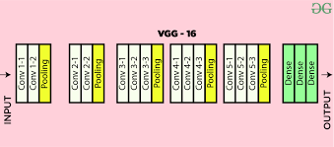
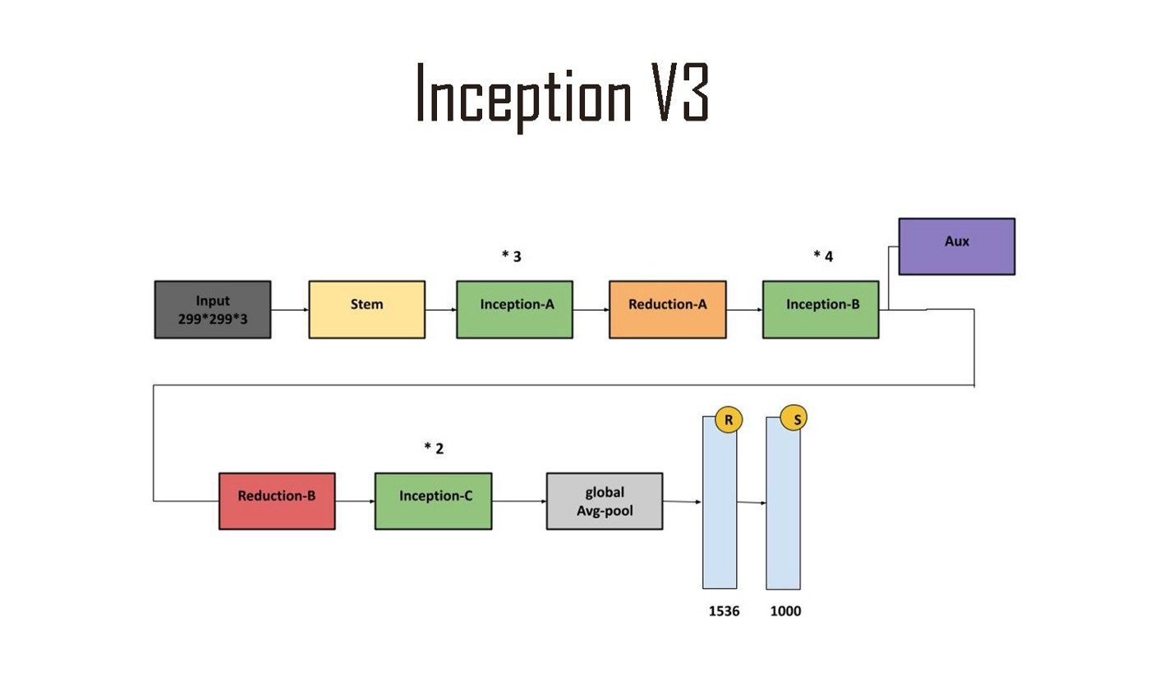
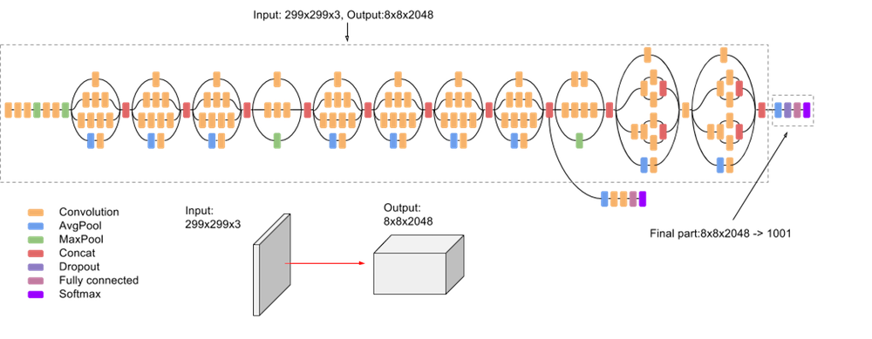
Orange – Inception v3 by Google (48 layers)

Slide 41
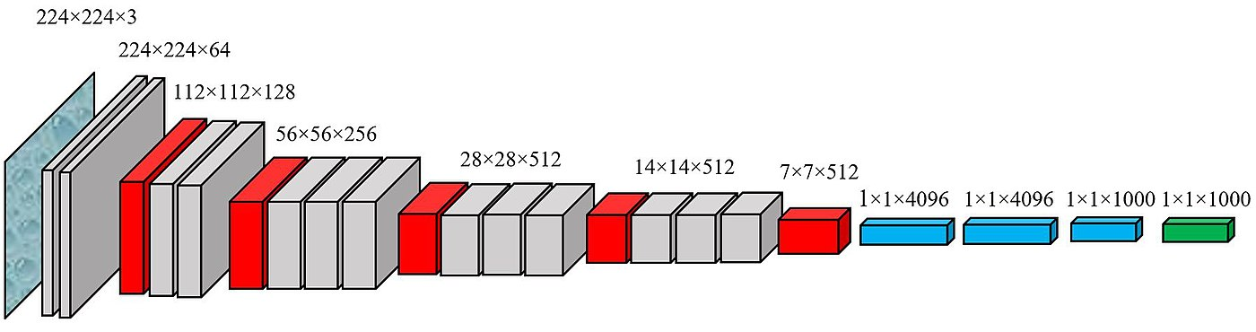
VGG
VGG Net is the name of a pre-trained convolutional neural network (CNN) invented by Simonyan and Zisserman from Visual Geometry Group (VGG) at University of Oxford,1st runner-up of the ILSVRC (ImageNet Large Scale Visual Recognition Competition) 2014 in the classification task.

Slide 42
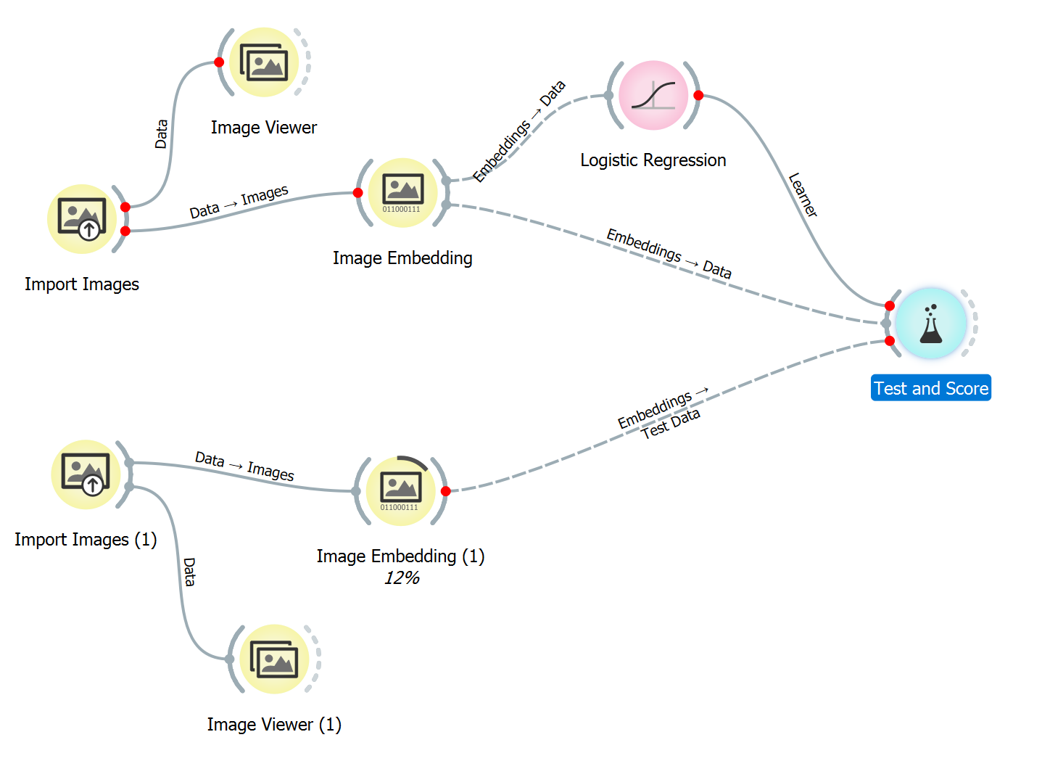
Orange:
Can CNN or Resnet do better ? Pneumonia Data

Slide 43
Transformer in General Image
https://colab.research.google.com/drive/1uTuVanVhOpVpG--wb8OU85aHxtKu1YEi?usp=drive_link
from transformers import ViTFeatureExtractor, ViTForImageClassification
from PIL import Image
import requests
#url = 'http://images.cocodataset.org/val2017/000000039769.jpg’
#image = Image.open(requests.get(url, stream=True).raw)
image = Image.open("/content/drive/MyDrive/TT Library/AI Model/Data/Pug.jpg")
feature = ViTFeatureExtractor.from_pretrained('google/vit-base-patch16-224')
model = ViTForImageClassification.from_pretrained('google/vit-base-patch16-224')
inputs = feature(images=image, return_tensors="pt")
pred = model(**inputs)
pred = pred.logits
# model predicts one of the 1000 ImageNet classes
pred = pred.argmax(-1).item()
print("Predicted class:", model.config.id2label[pred])

