Slide 1
AI
Teoh Teik Toe
ITOM/NBS
ttteoh@ntu.edu.sg
97905202

Slide 2
Web Portal
http://35.180.250.207/

Slide 3
Whatsapp: 65-97905202
Wechat: TeohTeikToe
LinkedIN https://www.linkedin.com/in/teohteiktoe

Slide 4
Download
https://1drv.ms/f/s!Aik2a4x7tvLylcgQYLRNs0F2fFKNSA?e=ZmWYZ3

Slide 5
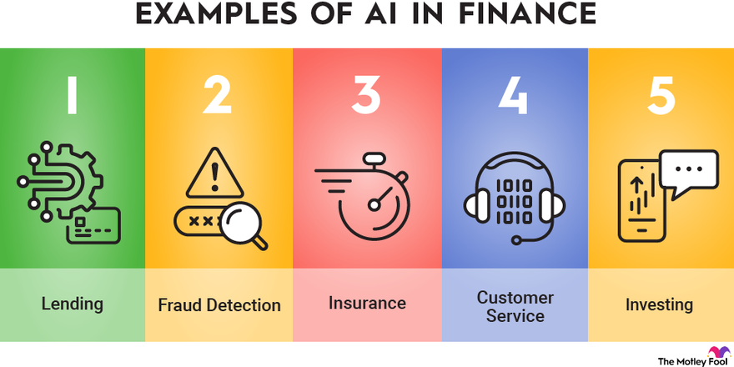

Slide 6
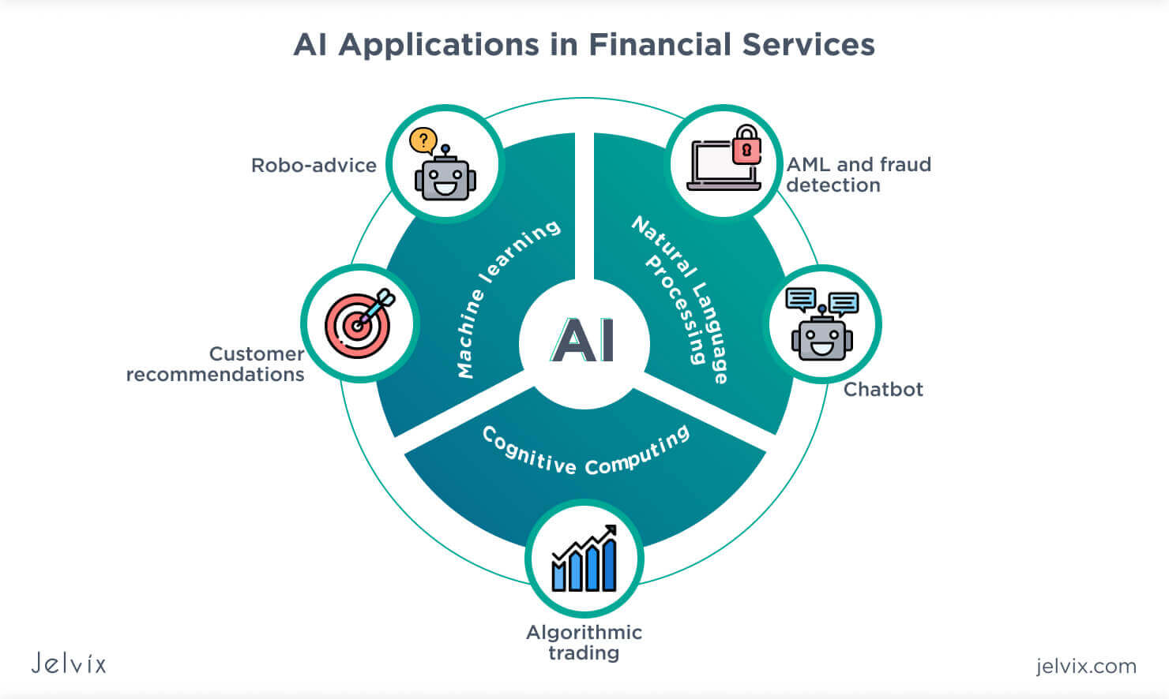

Slide 7
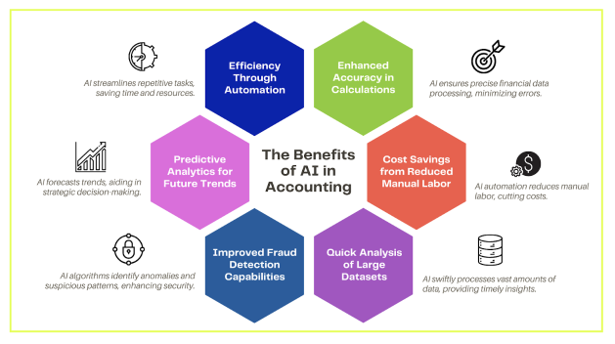

Slide 8
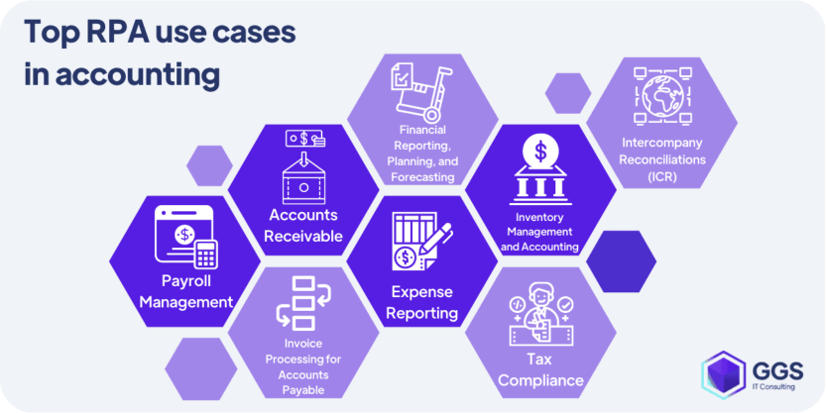

Slide 9
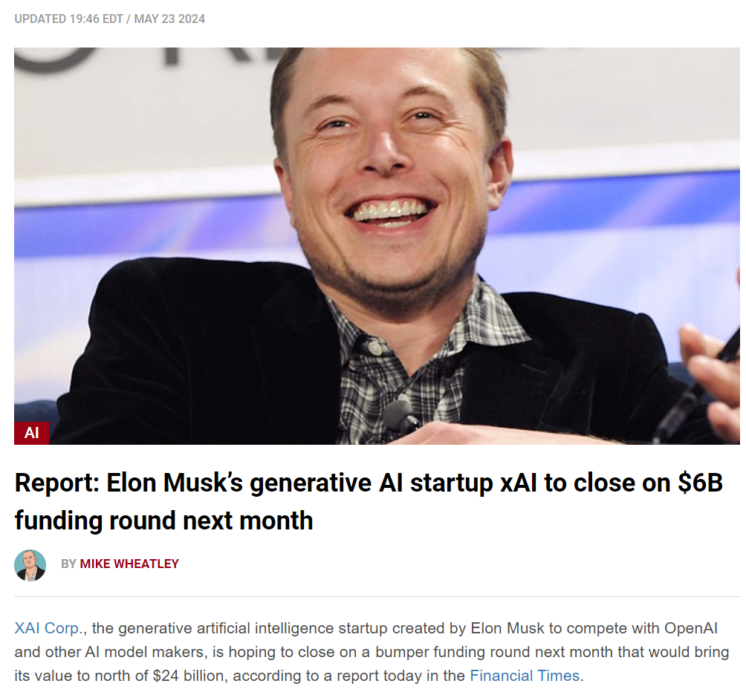
MAY 23 2024 - xAI
https://siliconangle.com/2024/05/23/report-elon-musks-generative-ai-startup-xai-close-6b-funding-round-next-month/

Slide 10
WASHINGTON – The country that gave the world the concept of a weekend is now hesitatingly auditioning a proposal for a four-day work week.
https://www.straitstimes.com/world/united-states/a-four-day-work-week-us-weighs-the-pros-and-cons

Slide 11
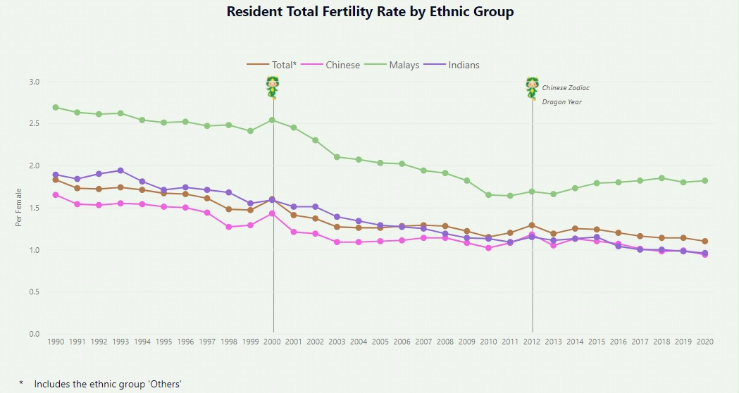
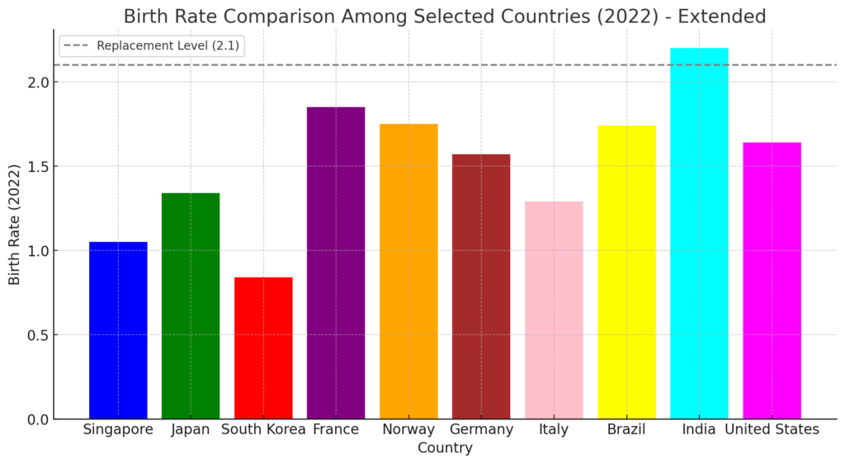
About Singapore 0.96 2023
PM: https://vt.tiktok.com/ZSYRjWsRe/

Slide 12
About Singapore

Slide 13
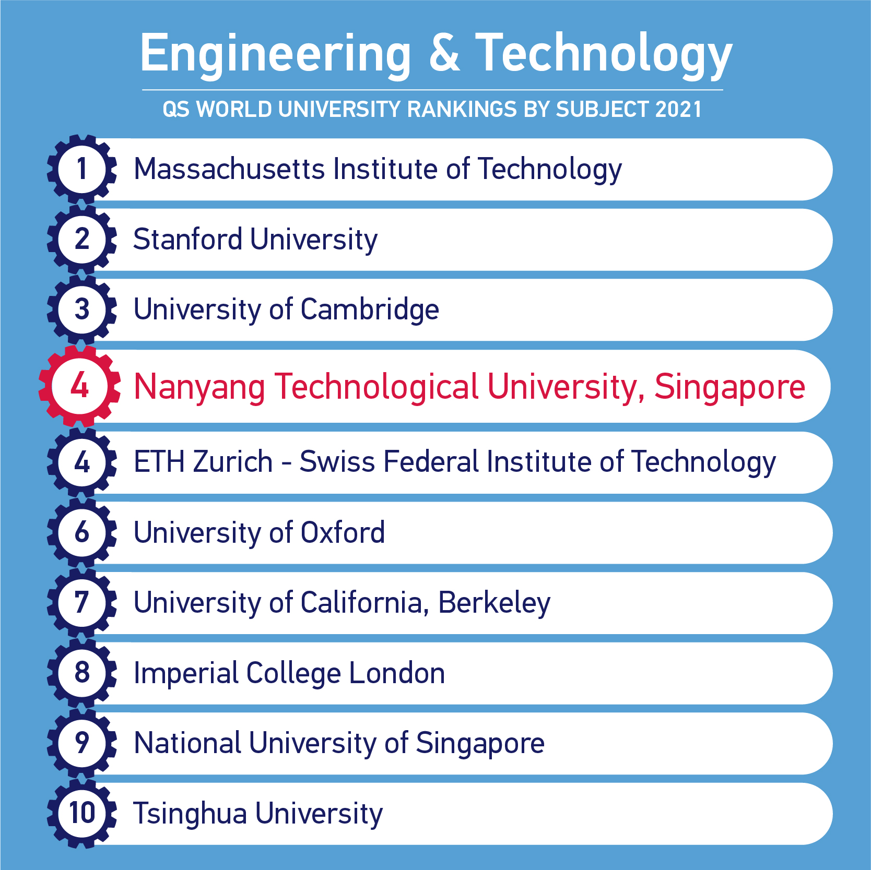
About NTU – 26 by QS, 32 by Times

Slide 14
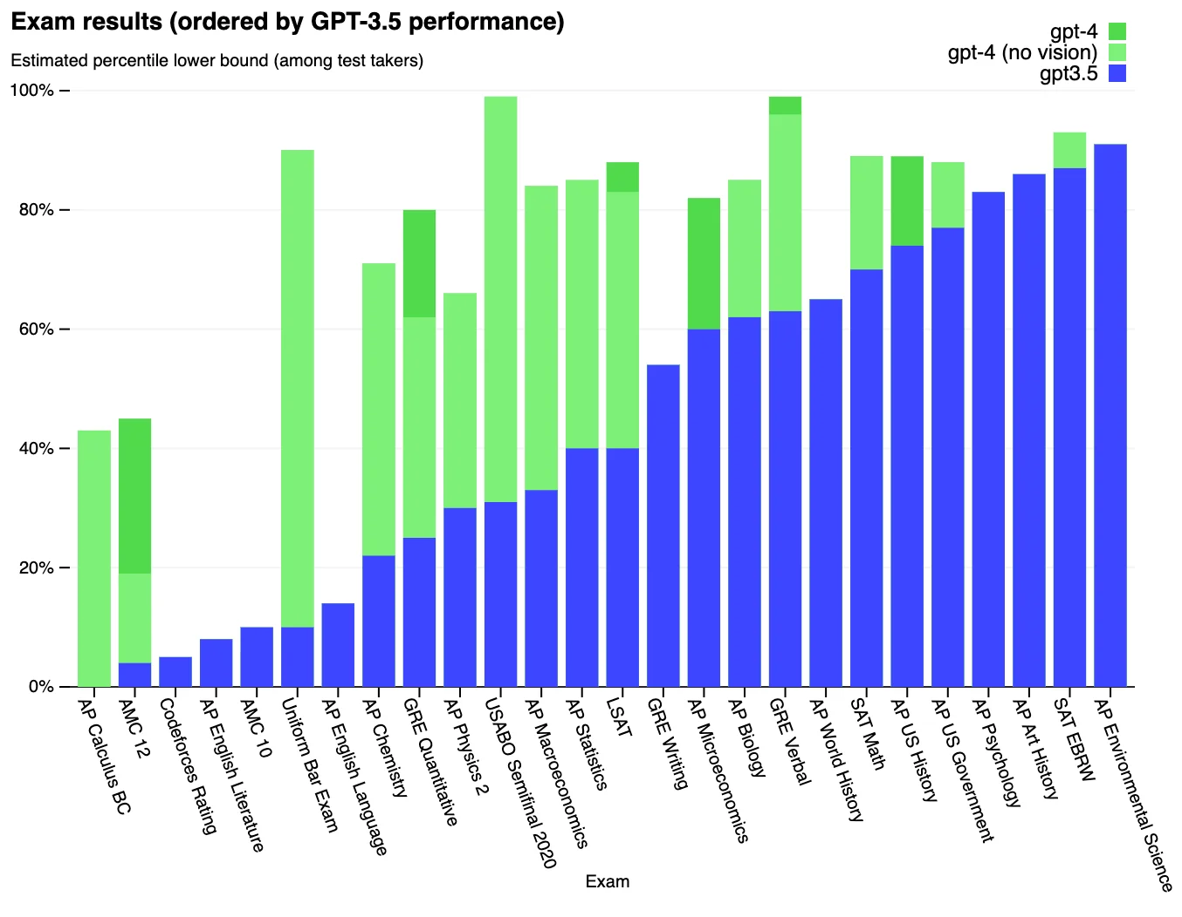
This is only the beginning

Slide 15
Evolution faster?

Slide 16
Recording
https://1drv.ms/v/s!Aik2a4x7tvLyi_YLBjRRJ-qBbuzc_A?e=CqVyj9
Library: https://1drv.ms/f/s!Aik2a4x7tvLygrcOVnorwa6X7zBxTg?e=g8dRKk
Google: https://drive.google.com/drive/folders/1fXjR7HWQVDvW4b_UwFmEM_NymlOo4Wbw?usp=drive_link

Slide 17
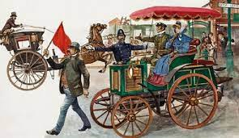
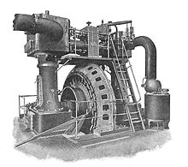
Evolution

Slide 19
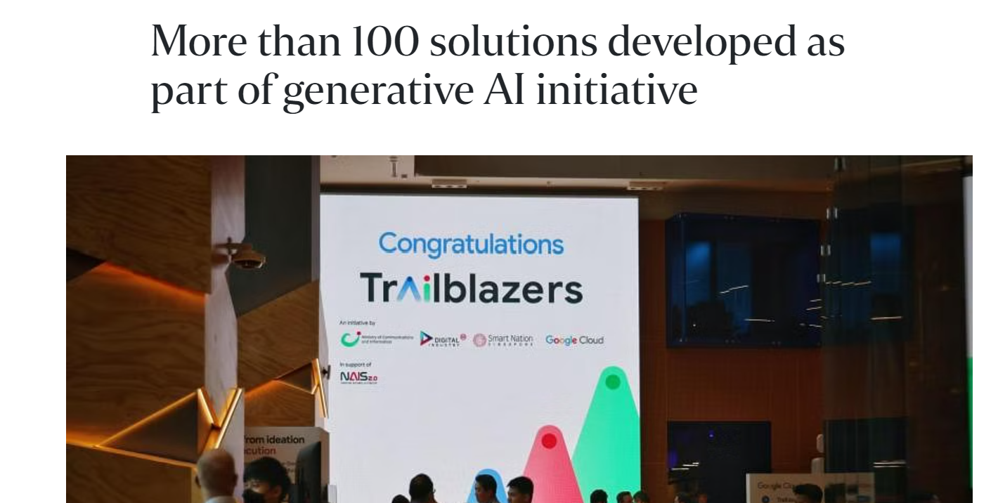
After the AI Trailblazers initiative was announced in July 2023, 84 businesses and government agencies here have developed more than 100 GenAI solutions.
https://www.straitstimes.com/tech/tech-news/more-than-100-solutions-developed-as-part-of-generative-ai-initiative

Slide 20
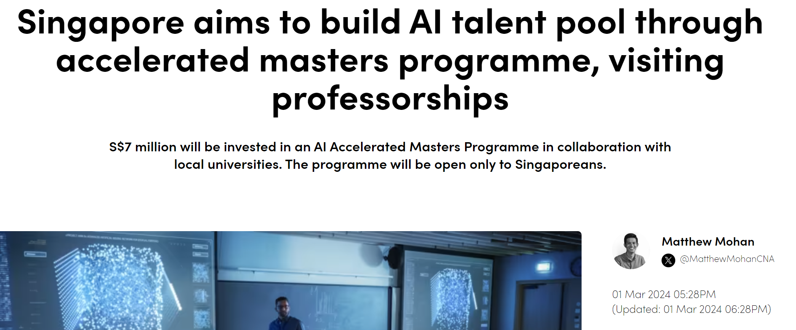
This follows Deputy Prime Minister Lawrence Wong’s announcement during his Budget 2024 speech earlier in February, that the government will invest more than S$1 billion (US$743.7 million) over the next five years in AI computing, talent and industry development.
https://www.channelnewsasia.com/singapore/singapore-artificial-intelligence-ai-talent-masters-programme-4162466

Slide 21
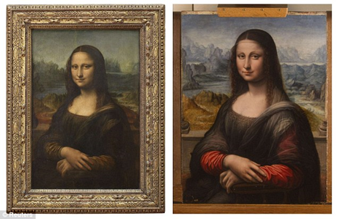
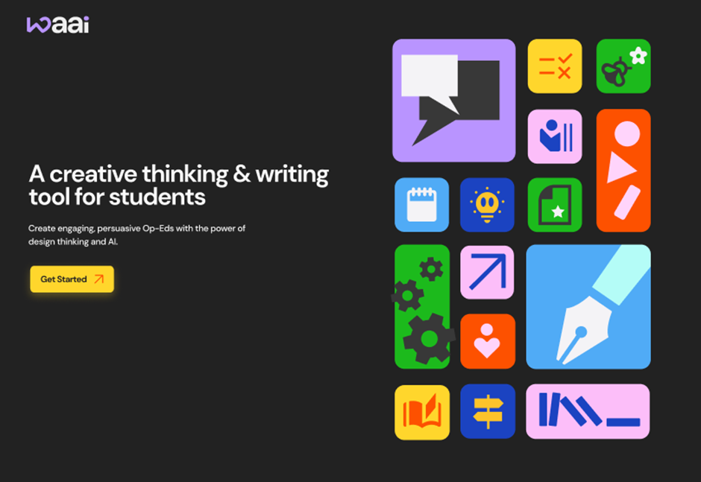
My Grant
Addressing Visual Plagiarism in Art & Design: A Multi-stakeholder Investigation
Op-Ed using Generative AI (opposite the editorial page)

Slide 22
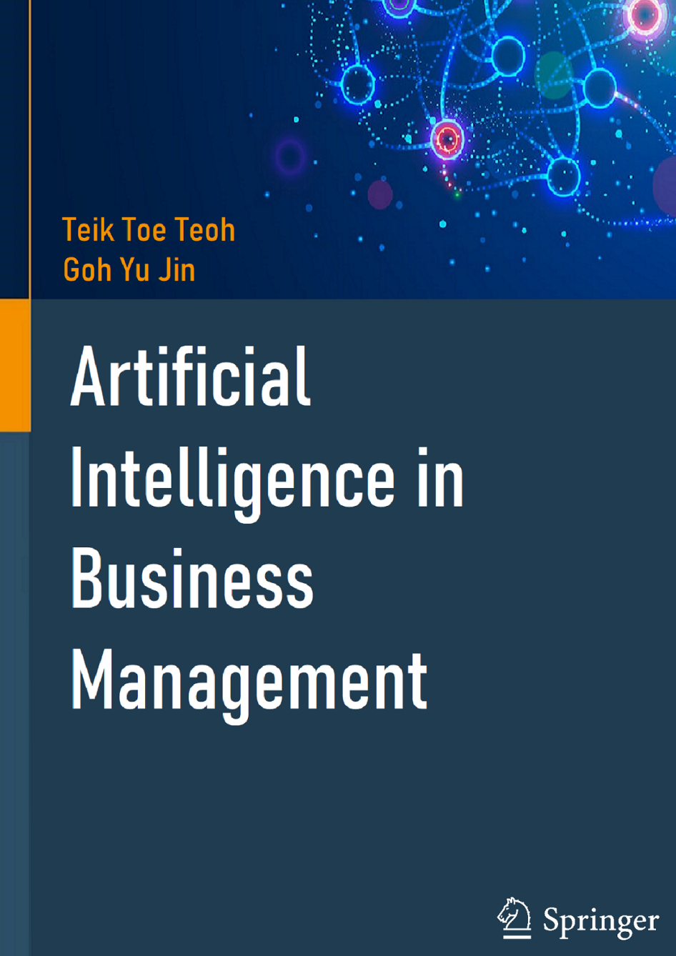
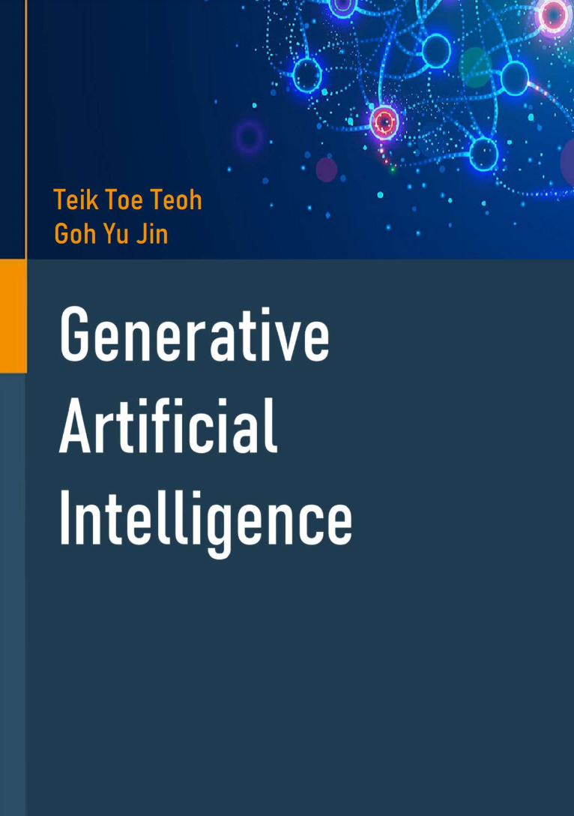
Book –Amazon and by Springer
https://1drv.ms/f/s!Aik2a4x7tvLygsc0TsKqobQ1l9P7tA?e=9oi38g

Slide 23
Video
Gemini: https://youtu.be/_TVnM9dmUSk?si=SV0RH8ikjfiKS0Qq
ChatGPT: https://youtu.be/BTwz-xtZVEI?si=kx-EgQ3JpQRA-4J5
Self Driving Car (2mins): https://www.youtube.com/watch?v=tlThdr3O5Qo
Co-pilot (1mins): https://www.microsoft.com/en-sg/microsoft-copilot#watchmecopilotvideo
Alphago (3mins): https://youtu.be/8tq1C8spV_g?si=4GCDaQCaezrkIGRf
AlphaZero (3mins): https://youtu.be/7L2sUGcOgh0?si=Ucft2caUCbrcaSkO
7 Stages of AI (10mins) : https://youtu.be/PG8vu0i5juY?si=VIR18qEn2dftZvOg
AI in 2030 (12mins): https://www.youtube.com/watch?v=XKMvk5hWDfo
ChatGPT (8mins) : https://youtu.be/Q07rFZtc2Ao?si=0t7n86MrDngOfXTm
CoPilot (2mins): https://youtu.be/S7xTBa93TX8?si=FcY5q0pUH3HcovkD
CoPilot: https://www.youtube.com/watch?v=Nuk3ADKC9Lw

Slide 24
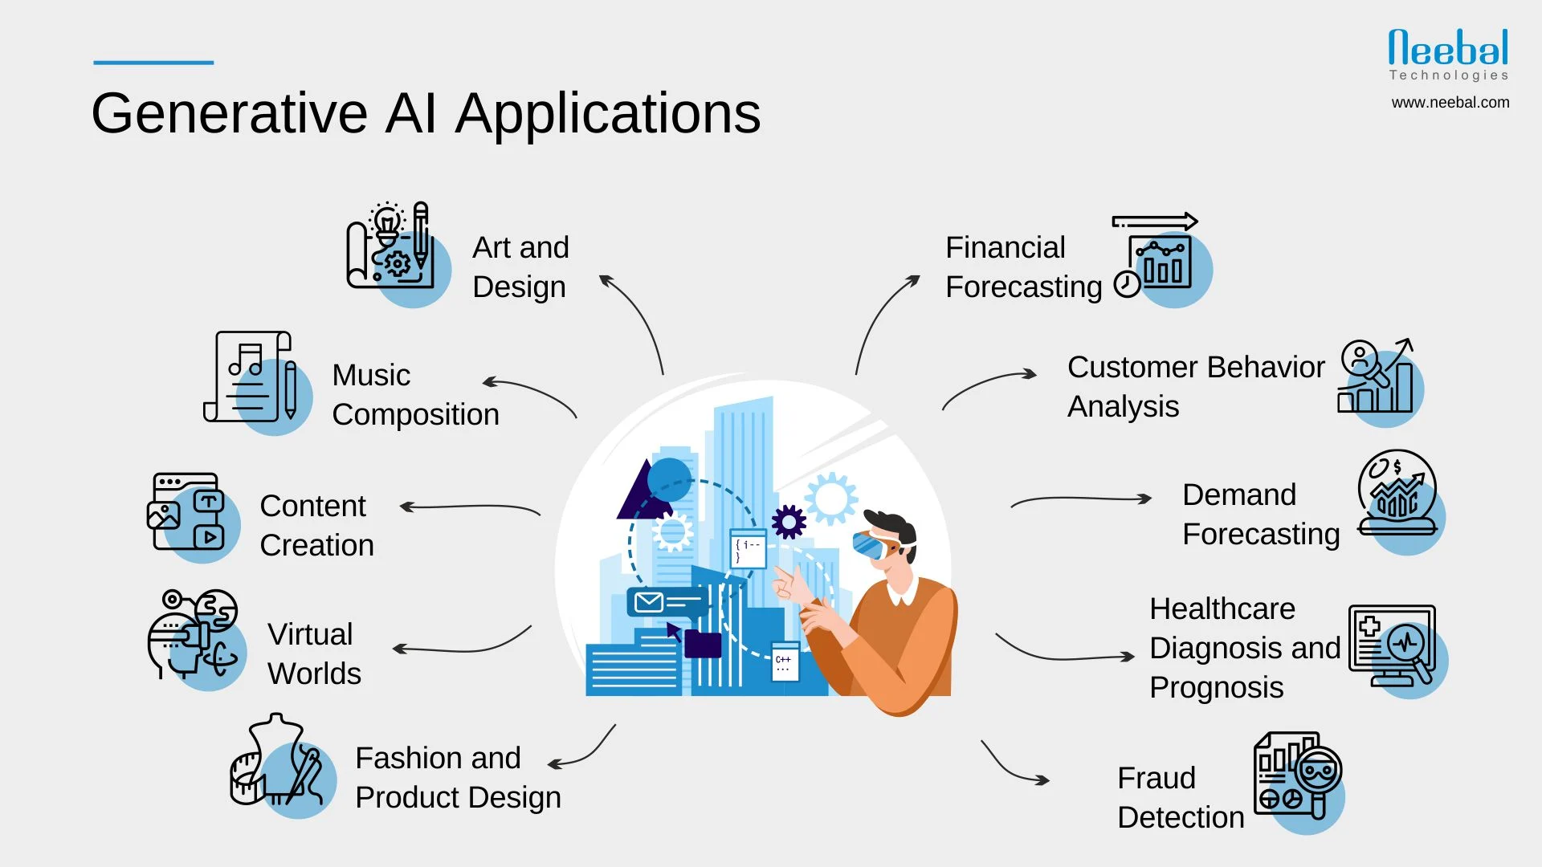
Generative AI – change the landscape

Slide 25
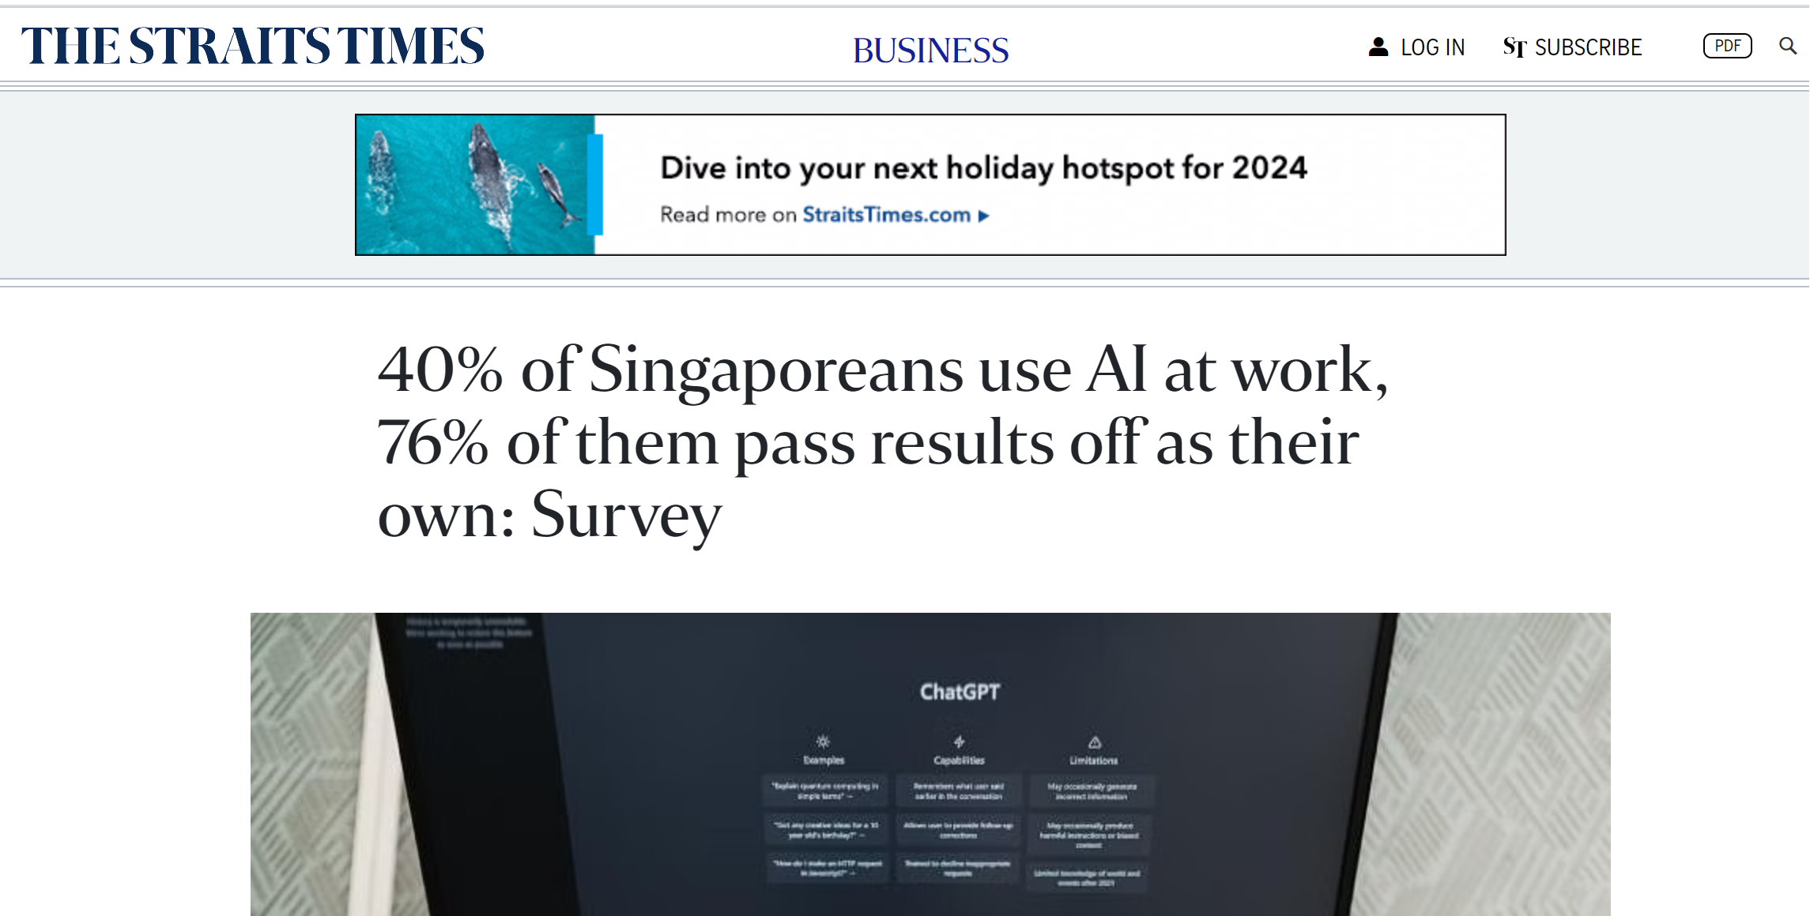
https://www.straitstimes.com/business/40-of-singaporeans-use-ai-at-work-75-of-them-pass-it-off-as-their-own-survey

Slide 26
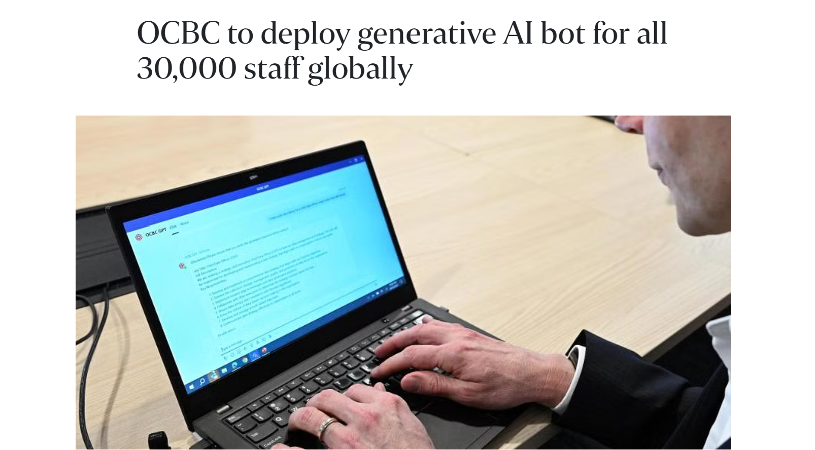
OCBC to deploy generative AI bot for all 30,000 staff globally
https://www.straitstimes.com/business/ocbc-to-deploy-generative-ai-bot-for-all-30000-staff-globally

Slide 27
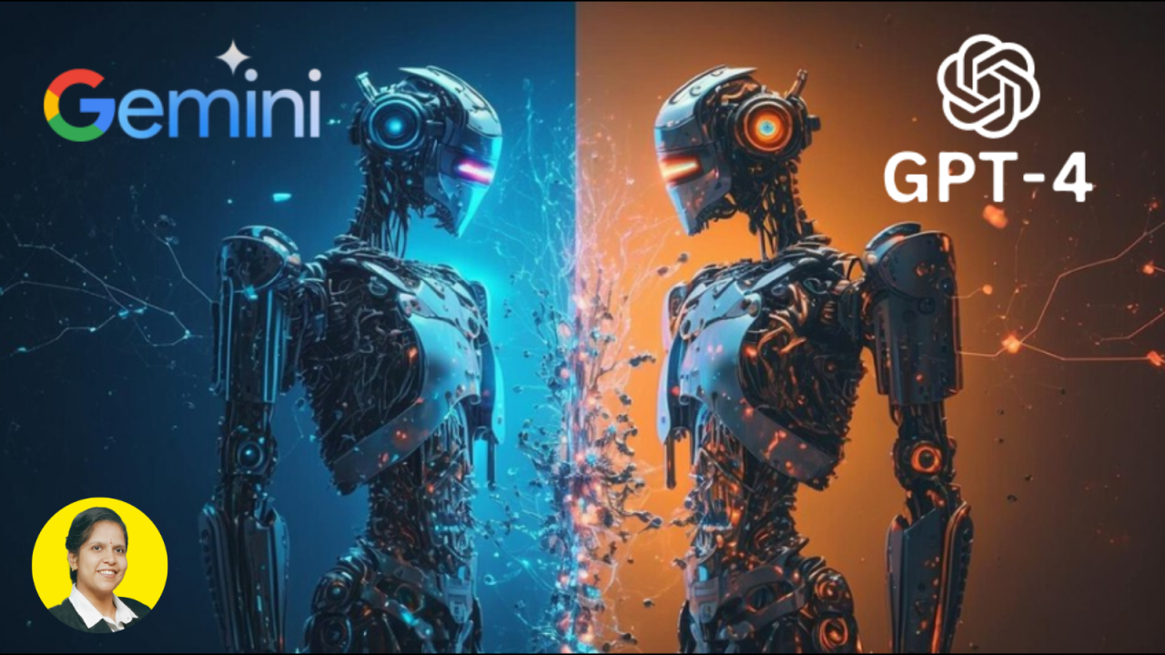

Slide 28
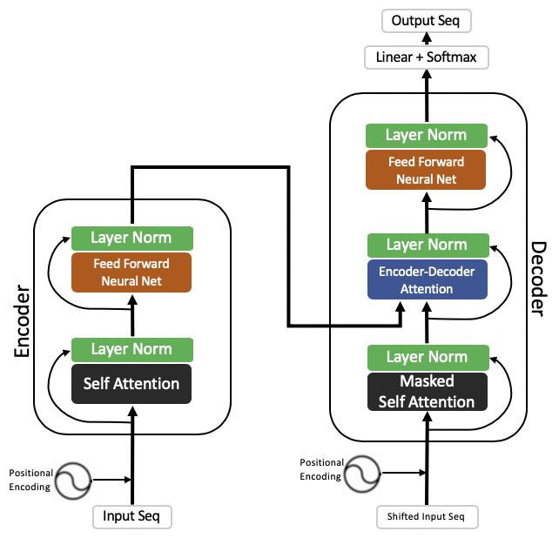
Transformer, Encoder, Attention
Text - LLM Large Language Model
How encoder decoder works in Transformer: https://jalammar.github.io/illustrated-transformer/
The transformer is the model, while the attention is a technique used by the model.

Slide 29
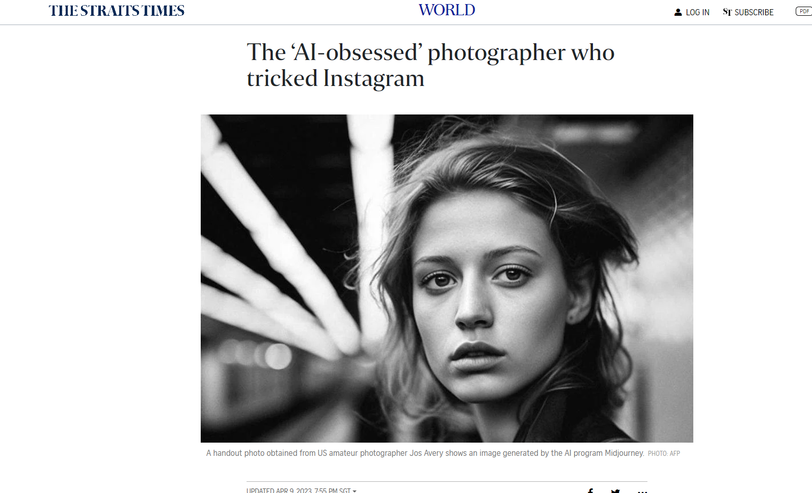
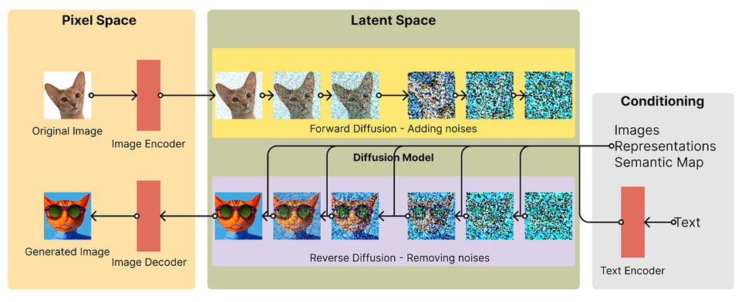
Image/Music/Video Diffusion
https://www.straitstimes.com/world/europe/the-ai-obsessed-photographer-who-tricked-instagram

Slide 30
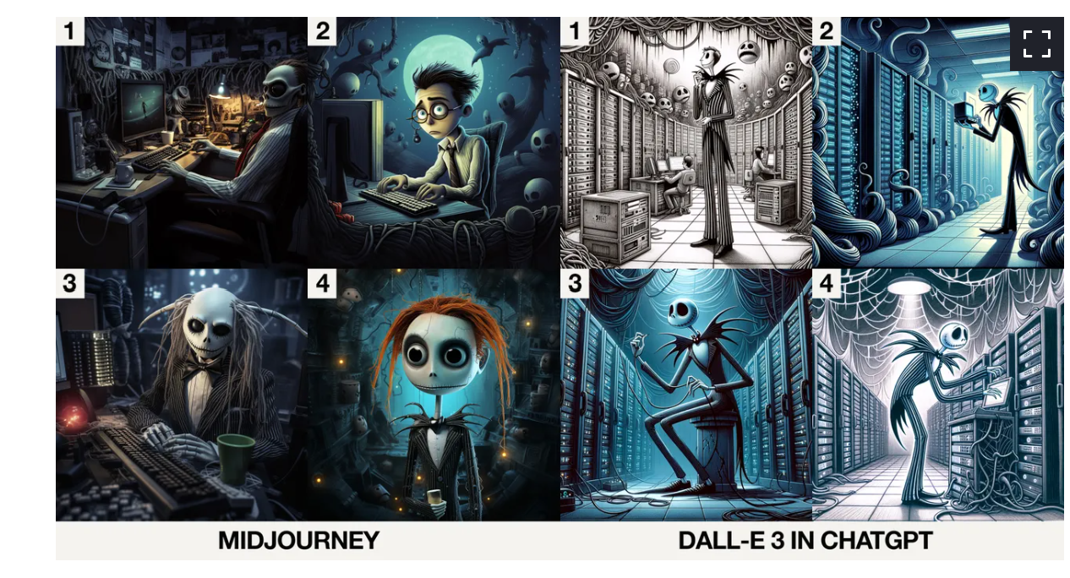
Image – Dalle vs MidJourney
https://www.google.com/amp/s/www.zdnet.com/google-amp/article/midjourney-vs-dall-e-3-in-chatgpt-which-ai-does-halloween-better/

Slide 31
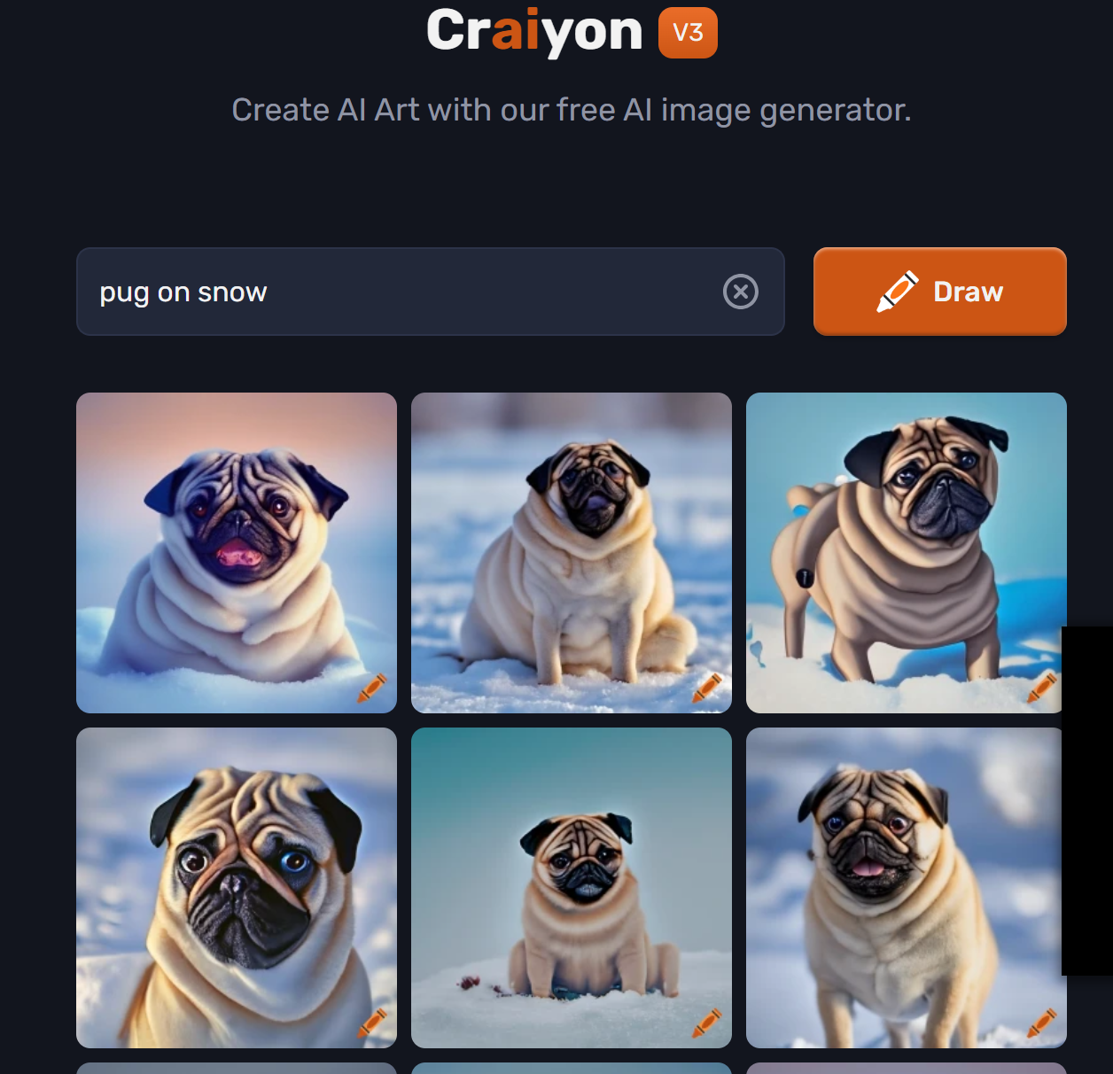
Try https://www.craiyon.com/

Slide 32
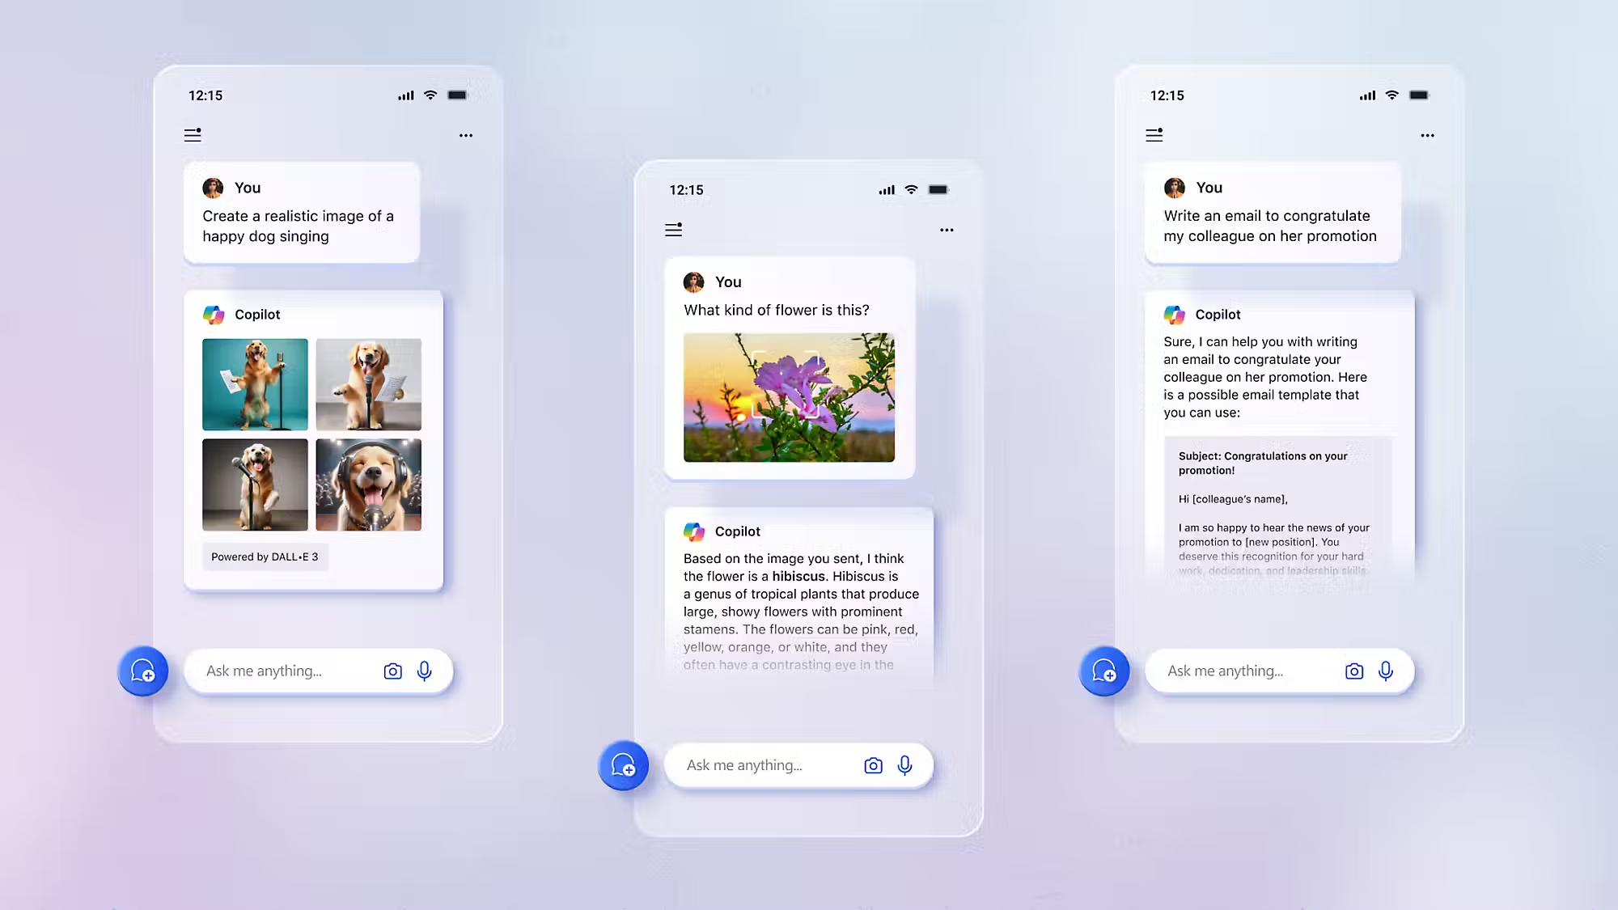
Co-pilot
https://www.microsoft.com/en-sg/microsoft-copilot#watchmecopilotvideo

Slide 34
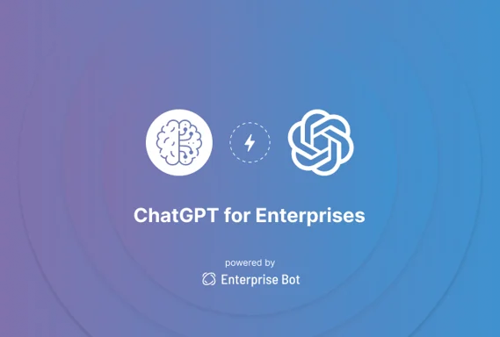
Fine Tuning
https://medium.com/@iryna230520/fine-tune-google-palm-2-with-scikit-llm-d41b0aa673a5

Slide 35
Top 3 interview questions on Generative AI
1. What are the ethical considerations and potential societal impacts of generative AI?
2. How does generative AI differ from other types of AI, and what are its unique strengths and limitations?
3. What are the current and potential future applications of generative AI across different industries?

Slide 36
pollev.com/teikteoh614 – Generative AI

Slide 37
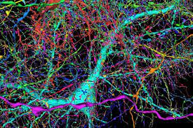
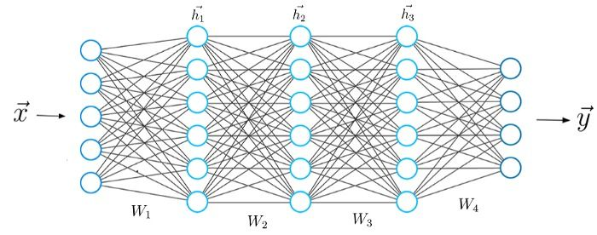
Machine (100 trillion) vs Human (0.086 trillion) => about 10,000 times more
GPT-4 parameter around 100 trillion (92 layers 12000 neurons each layer)
Human brain — Approximately 86 billion neurons
https://www.nature.com/scitable/blog/brain-metrics/are_thcere_really_as_many/

Slide 38
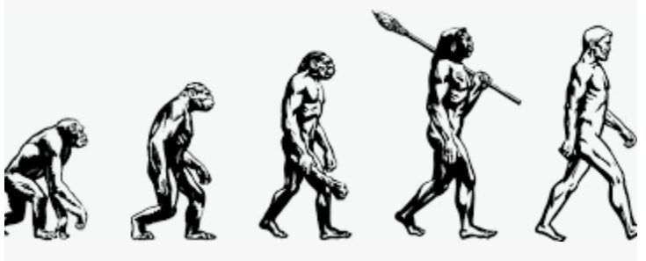
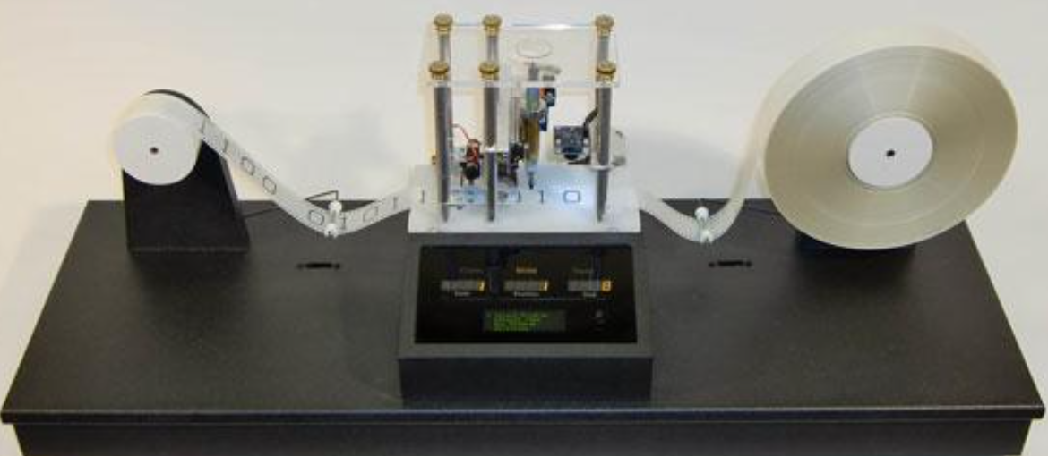
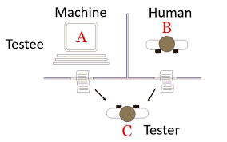
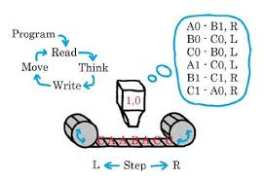
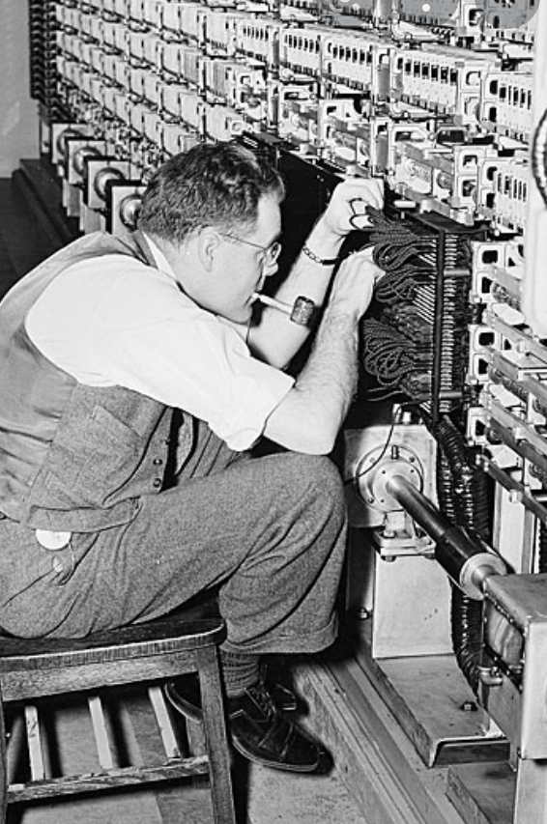
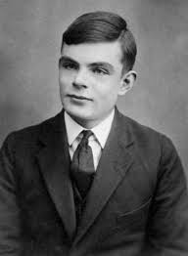
The beginning - Can machines think? 1936 Alan Turing – Turing Machine 1950 Turing Test
Turing test, in which a computer tries to fool the system into thinking that it is a human

Slide 39
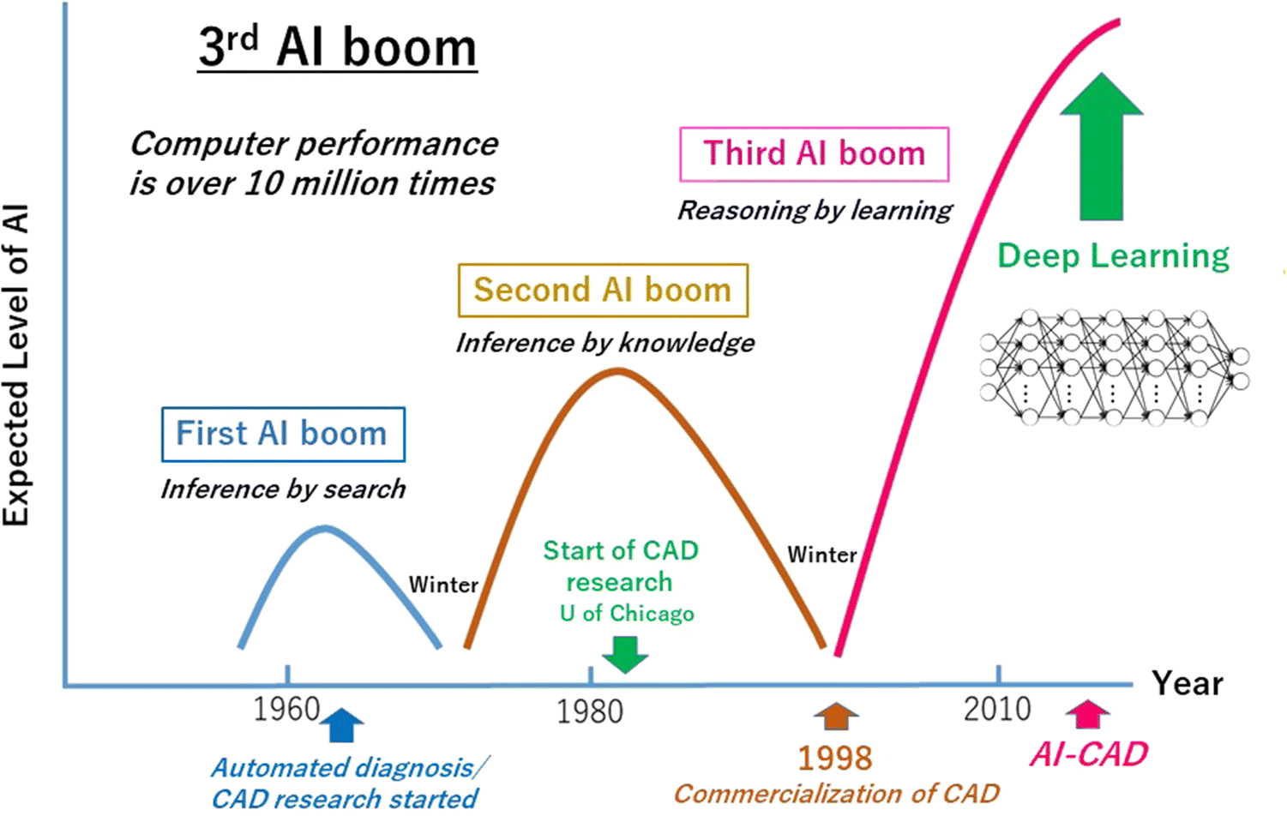
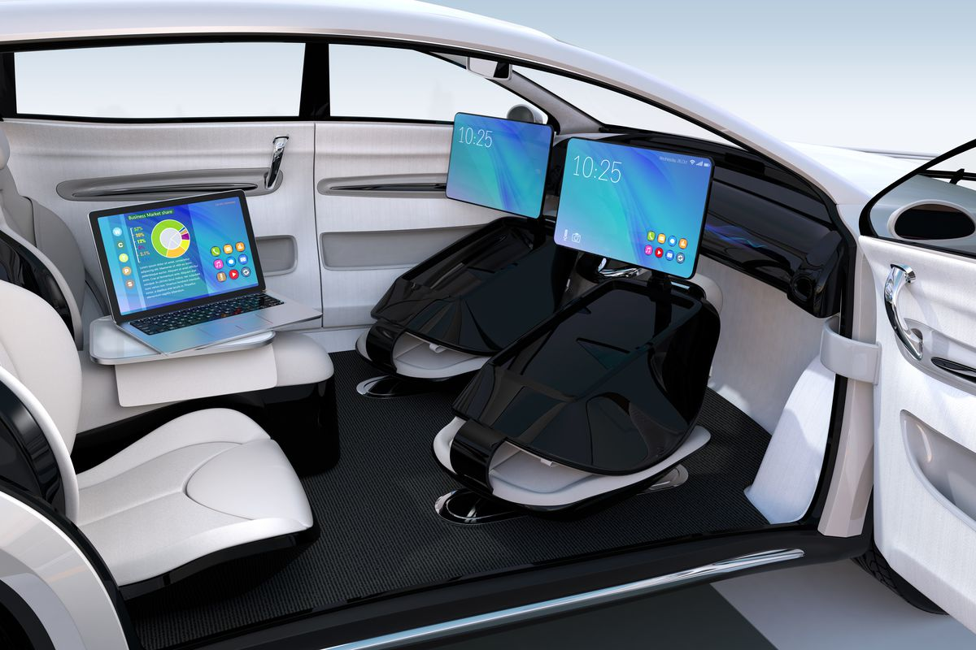
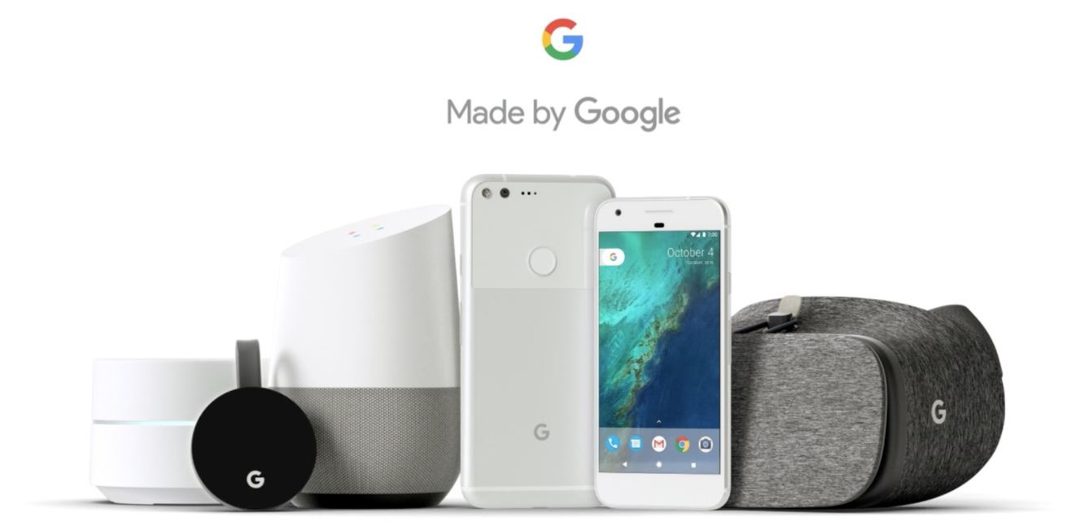
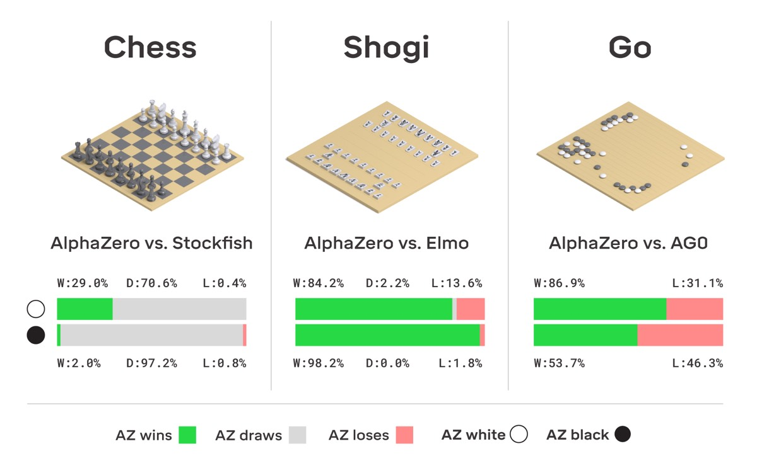
Now & Future

Slide 40
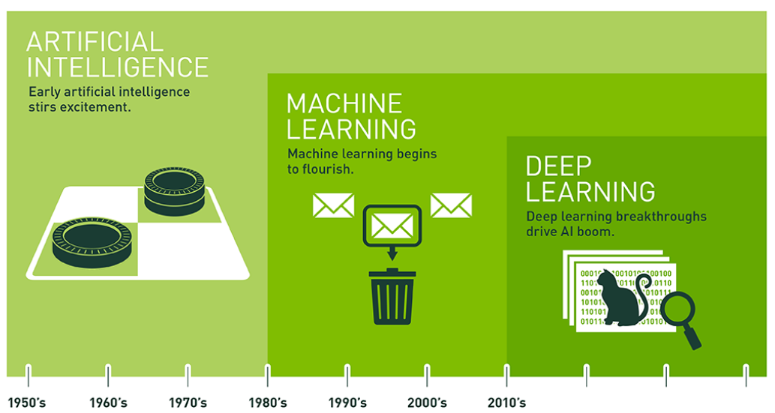
AI terminology
https://blogs.nvidia.com/blog/2016/07/29/whats-difference-artificial-intelligence-machine-learning-deep-learning-ai/

Slide 41
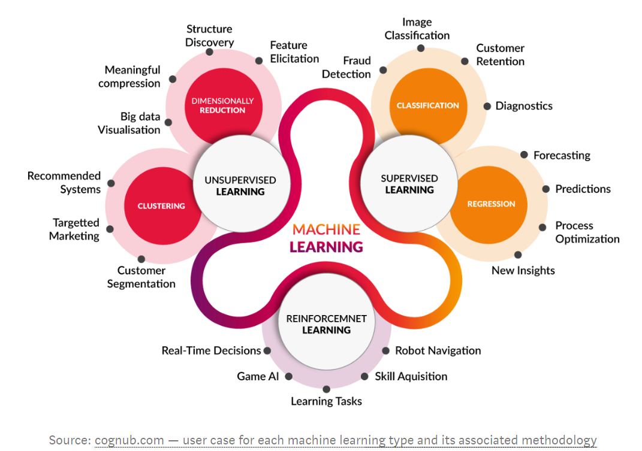
Machine Learning types

Slide 42
AI and other technology
AI and Big Data
Internet of Thing
Robotic Process Engineering
Block Chain
AI & Big Data
Cloud
Natural Language Processing
Web 3
Automation

Slide 43
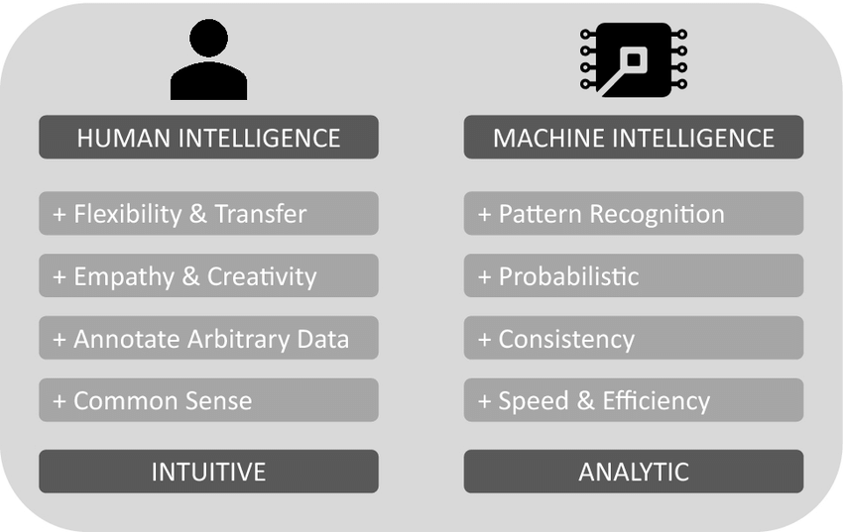
Human vs Machine

Slide 44
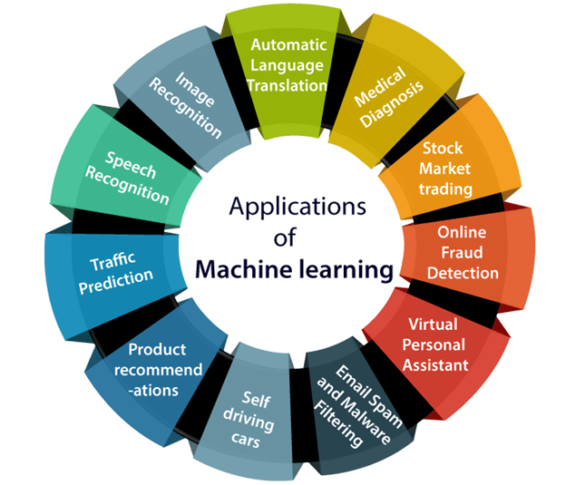

Slide 45
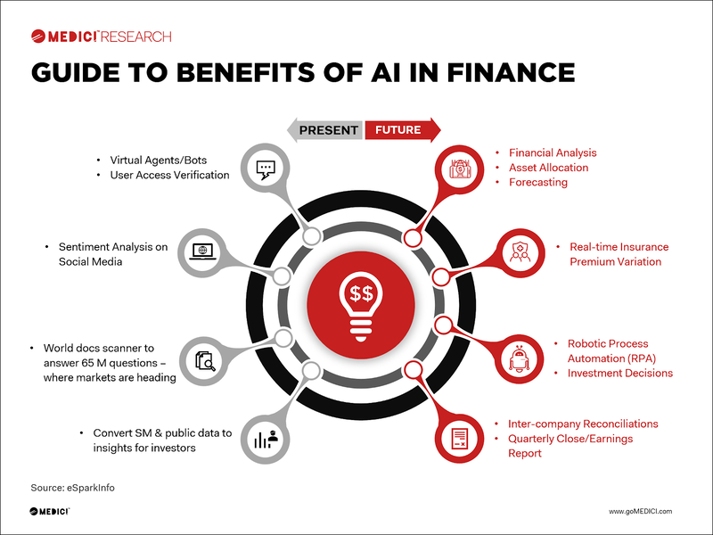

Slide 46
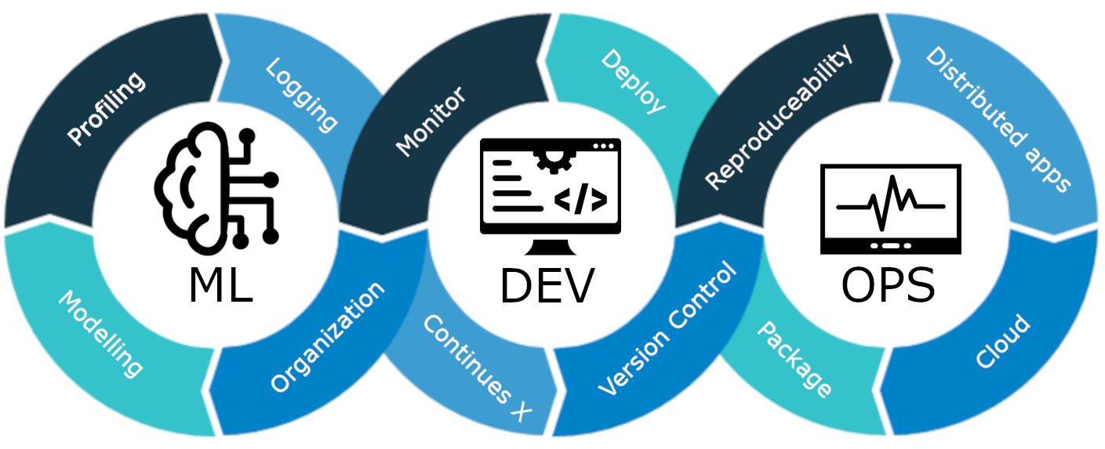
MLOps

Slide 47
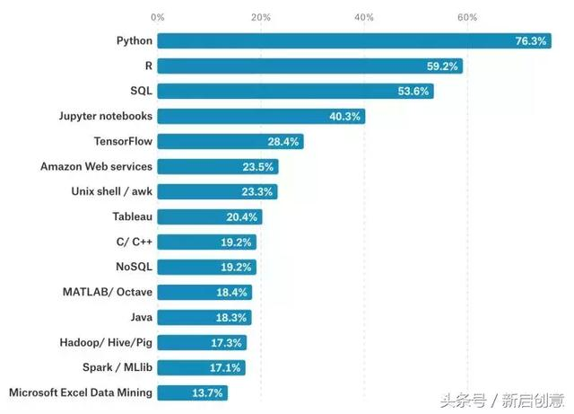
Programming Language for AI

Slide 48
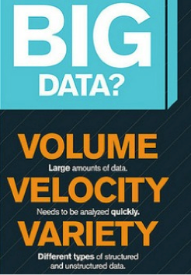
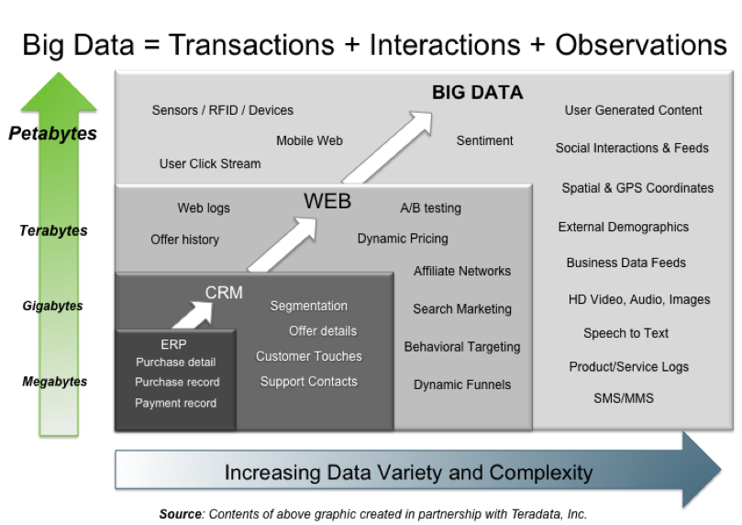
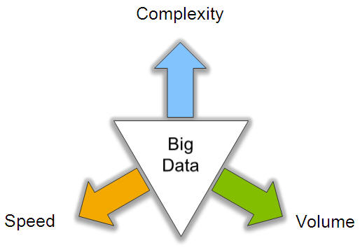
Big Data: 3V’s

Slide 49
State of the Art – 2022 - Transfer Learning

Slide 50
Reinforcement Learning

Slide 51
What can deep learning do (CNN)?

Slide 52
Kahoot

Slide 53
Survey
pollev.com/teikteoh614

Slide 54
Thank You

