Slide 1

AI Research Writing
人工智能论文写作
Teoh Teik Toe
ITOM/NBS
ttteoh@ntu.edu.sg
97905202

Slide 2
Agenda
20 April 技术创新 - Technology Innovation -Construction
12th May 人工智能和机器学习 - AI and machine learning
2nd June科学研究论文Scientific Research Paper – IMRAD
9th June 增强现实,虚拟现实, 元宇宙 – AR VR and Metaverse

Slide 3
video
【学渣发了SCI论文的经验丨如何撰写SCI论文(IMRD部分的写作顺序)】 https://www.bilibili.com/video/BV1tF411K74t/?share_source=copy_web
【IMRaD结构】 https://www.bilibili.com/video/BV1Ft4y1d7Vn/?share_source=copy_web
【如何为研究论文（research paper）撰写大纲】 https://www.bilibili.com/video/BV19a411n7LY/?share_source=copy_web

Slide 4
1. How do researchers perceive the impact of AI on the integrity and authenticity of scientific writing?
2. What ethical considerations do researchers identify when using AI for writing and publishing academic papers?
3. How has AI influenced the collaboration process among researchers in academic writing?
4. What are the primary concerns of academic institutions regarding the use of AI tools in research writing?
5. How do AI writing tools affect the skill development of new researchers in terms of critical thinking and original writing?
6. How do researchers adapt their writing process when incorporating AI tools, and what challenges do they encounter?
7. What potential does AI hold for addressing language barriers in international research collaboration?
8. How does the use of AI in research writing alter the peer review process and the standards of evaluating research quality?
9. In what ways can AI contribute to reducing biases in research writing, and what new biases might it introduce?
10. How do different disciplines within the academic community vary in their adoption and attitudes towards AI-assisted writing?

Slide 5
1. 研究者如何看待AI对科研写作的完整性和真实性的影响？
2. 当使用AI进行学术论文的写作和发布时，研究者认为有哪些伦理考量？
3. AI如何影响研究者在学术写作中的合作过程？
4. 学术机构对使用AI工具进行研究写作有哪些主要担忧？
5. AI写作工具对新研究者在批判性思维和原创写作技能发展方面有何影响？
6. 研究者在融合AI工具时如何调整他们的写作过程，以及他们遇到了哪些挑战？
7. AI在解决国际研究合作中的语言障碍方面有何潜力？
8. 在研究写作中使用AI如何改变同行评审过程和评估研究质量的标准？
9. AI在减少研究写作中的偏见方面能起到什么作用，它可能引入哪些新的偏见？
10. 学术界不同学科在采纳和态度上对AI辅助写作有何不同？

Slide 6
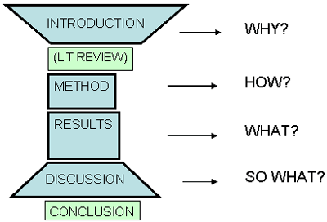
IMRAD

Slide 7
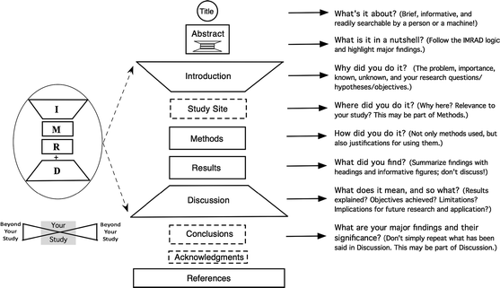
IMRAD

Slide 8
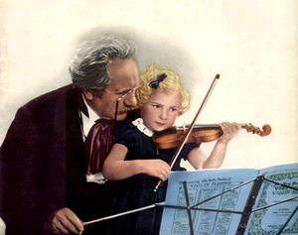
What is a noun?
Where you are:
Contents
Noun
Adjective
Syllable
Comparatives
Superlatives
Comparison
Practice
Help
Dictionary
Noun is a word which refers to a thing, person, activity, place etc.
car
reading
street
teacher
Back

Slide 9
What is an adjective?
Where you are:
Contents
Noun
Adjective
Syllable
Comparatives
Superlatives
Comparison
Practice
Help
Dictionary
Adjective is a word which describes a noun
adjectives
noun
big
car
fast
expensive
Back

Slide 10
General
Title
ABSTRACT
Literature Review – Minimum 3
Data preparation and experiment setup
Proposed Model
Experiment result
Format the report to IEEE

Slide 11
General
Writing is an art, you can learn
Read published manuscript and abstract carefully in major journals and focus on detail
Practice; practice; practice
Get help from your mentors and colleagues
Attend classes in writing skills/read books

Slide 12
Some Writing Tips
Active voice is preferable to passive voice
    “We studied 15 patients with ARDS.” is much better than “Fifteen patients with ARDS were studied.”
Always use the full term before you refer to it by acronym [for example, Orthotopic Liver Transplantation (OLT)]
Write only one thought per sentence.
Eliminate unnecessary words
Ensure that verb tenses are consistent and correct

Slide 13

Research Paper Writing Process
Assignment Clarification
Time Management
Topic Selection
Topic Brainstorm
Library Visit
Locate/Select Sources
Data Sources
Topic Focus
Read Articles
Preliminary Thesis
Outline
Draft Paper
Revise Paper
Sources of Help

Slide 14
Research Paper Writing Process
1. Identify and conceptualize the essential steps in the research paper writing process;
2. Access valuable campus resources to help at various stages of the writing process;
3. Use time management strategies to plan for the successful and timely completion of a research paper project.

Slide 15

Time Management
Write down all due dates.
Break down the research process into steps.
Assign a due date for each step.
Make weekly and daily priority lists.

Slide 16
Conference selection- IEEE china or International
- Conference selection- IEEE china or International
- Conference submissions
- Poster preparation
- Peer Review Feedback and Modification

Slide 17
IEEE
http://www.iccc.org/ IEEE 7th International Conference on COMPUTER AND COMMUNICATIONS ChengDu 10 Dec 2021 (Deadline 10 Aug 2021)
https://attend.ieee.org/ssci-2021/ Symposium Series on Computational Intelligence, Florida USA 4 Dec 2021 (Deadline 20 Aug 2021)
http://www.icucet.org/index.html International Conference on UK-China Emerging Technologies, Nov 6 ChengDu, Dealine 30 Aug 2021
https://conferences.ieee.org/conferences_events/conferences/conferencedetails/510892021 2nd China International SAR Symposium (CISS) Shanghai 3 Nov 2021, Deadline 30 Oct 2021
https://conferences.ieee.org/conferences_events/conferences/conferencedetails/53235 2021 IEEE 3rd International Conference on Civil Aviation Safety and InforWuhan Universitymation Technology (ICCASIT), Changsha 20 - 22 October 2021, Deadline 30 July 2021, by
https://conferences.ieee.org/conferences_events/conferences/conferencedetails/53927, 2022 IEEE International Conference on Electrical Engineering, Big Data and Algorithms (EEBDA), ChangChun 25 - 27 February 2022, 30 November 2021 by Wuhan University
https://conferences.ieee.org/conferences_events/conferences/search?q=china&virtualflag=B&virtualConfReadOnly=N

Slide 18
Data (Kaggle or Equivalent)
Flower: https://www.kaggle.com/c/tpu-getting-started
Covid Detection: https://www.kaggle.com/c/siim-covid19-detection
Pneumonia: https://www.kaggle.com/paultimothymooney/chest-xray-pneumonia
https://www.kaggle.com/crowww/a-large-scale-fish-dataset
Or any equivalent data of your choice.

Slide 19
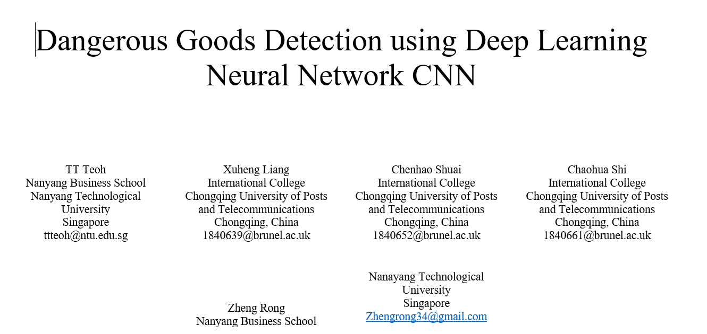

Slide 20
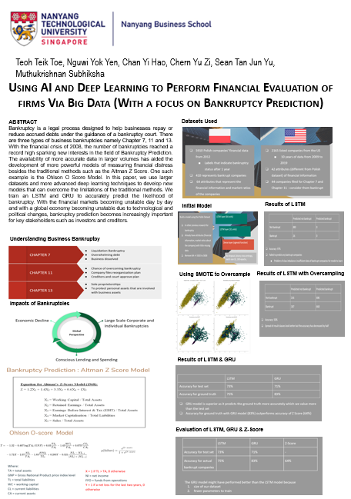
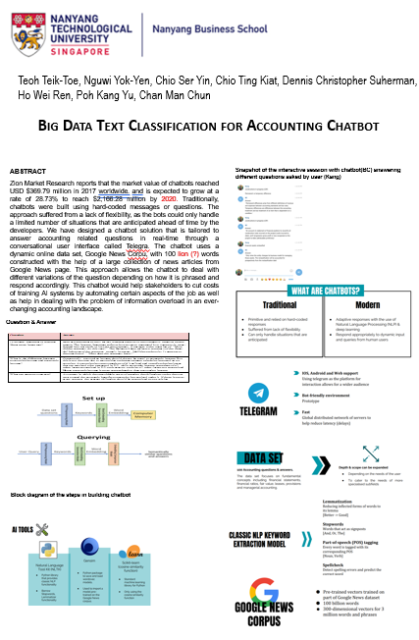
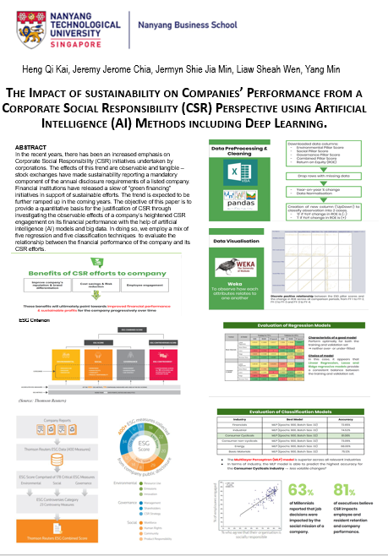
Poster preparation

Slide 21
Title & Author

Slide 22
Title and Author Information
Create a winning title
    Should be convincing
    Appealing
Format for the title
Following the title, the names of all authors and their institutional affiliations are listed

Slide 23
Topic Selection
Previous knowledge
Course content
Personal or professional experience/interests
Ask questions: who, what, where, when, why
Identify subtopics

Slide 24
Sources of Help
Professors
Librarians
Writing Tutors
Models of Successful Research Papers

Slide 25
Choosing Your Topic
Breadth. You may need to start broad and let your research take you narrower.
Originality. Choose a topic that will allow you to contribute to the field, rather than just regurgitate facts.
Sources. On the other hand, also choose a topic that has scholarly grounding.

Slide 26
Narrowing Your Topic
Use journalistic questions: who?, what?, when?, where?, why?
Review recent literature (journals, trade papers, etc.)
Recall questions asked in class.
Apply your paper to your career goals.
Talk to your professor.

Slide 27
Practice : Title

Slide 28
Abstract

Slide 29
What is an Abstract
An abstract is a very concise statement of the major elements of your research project. It states the purpose, methods, and findings of your research project.
An abstract is a condensed version of a full scientific paper.

Slide 30
Four C's of Abstract Writing
Complete — it covers the major parts of the project/case
Concise — it contains no excess wordiness or unnecessary information.
Clear — it is readable, well organized, and not too jargon-laden.
Cohesive — it flows smoothly between the parts.

Slide 31
Research Abstract
Suggested format
    Introduction
    Methods
    Results
    Conclusions

Slide 32
Prior to Submission
Check Yourself did you :
Follow the instructions!!!!
Use short, clear sentences; one idea per sentence?
Limit your abstract to the word count/character count requirement?
Check grammar, syntax and punctuation

Slide 33
Abstract Checklist
Due date for abstract is ____________.
Presenting author is listed as first author.
Presenting author meets eligibility requirements for the meeting.
Author affiliations are listed.
Abstract clearly organized into Introduction and Discussion.
Completed abstract meets word- limit requirements or fits into formatting box.
Abstract printed with correct font size and style (if stipulated).
Others have reviewed abstract for content, style, grammar, and spelling.

Slide 34
Why Abstracts Not Accepted
Most common deficiencies encountered (in order of frequency):
Poor presentation
Weak discussion
Lack of originality
Poor methods
Inappropriate statistical analysis
Inadequate results

Slide 35
Practice – Reinforcement Learning
Reinforcement Learning in Trading
In this paper, we present how reinforcement learning can be used to develop a good trading strategy that seeks to maximise profit. We will first introduce the background of reinforcement learning, followed by how Deep Q Learning (DQN) works, experiments on our training data followed by the conclusion. A model-free algorithm of DQN, which is an extension of Q learning, was primarily being employed for learning. This method was applied to the chosen stock, AAPL, Apple’s historical opening stock prices from 02-01-2013 to 29-3-2021. We were able to demonstrate that it is possible to apply reinforcement learning to develop a profitable trading strategy where Deep Q Network significantly outperforms a Random Decision Policy.
https://attend.ieee.org/ssci-2021/

Slide 36
Practice : Abstract

Slide 37
Introduction

Slide 38
Introduction
The introduction should provide the subject, purpose, and merit of the case report.
Present background information
Focused comprehensive literature review that corroborates the author’s claims.

Slide 39
Format of Introduction (1)
Present your topic and get the reader interested
Provide background or summarize existing research
Position your own approach
Detail your specific research problem
Give an overview of the paper’s structure

Slide 40
Format of Introduction (2)
Introduce your topic
Describe the background
Establish your research problem
Specify your objective(s)
Detail your specific research problem
Give an overview of the paper’s structure

Slide 41
Practice Introduction

Slide 42
Literature Review

Slide 43
Literature Review
Usually precedes a full-length original study as a way of introducing the general topic.
Its purpose: To help the reader understand the background to your study and see how it’s the next logical study to be conducted in this domain.
Necessarily, a good literature review requires a thoroughly researched topic.

Slide 44
Introduction & Conclusion
Introduction: Explain literature review structure.
  Thesis: Establish the logical progression.
Conclusion: Specifically identify the study that will follow (i.e., your original study!) as a result of this literature review.

Slide 45
Drafting: Pitfalls to Avoid
Unprofessional language: Avoid the appearance of cheekiness or emotional appeal.
Don’t plagiarize! Be extremely careful with your paraphrasing. In fact, attend or view online the writing center’s workshop, Writing Papers with a Good Conscience!
Too many quotations: Only quote those elements which need the utmost precision. In Dr. Fox’s class, one or two quotations max.
Lack of Fluency and Cohesiveness: Your literature review should not read like a list of facts.

Slide 46
What is a literature review (for)?
When thinking about what a literature review is, we need to think about what it is for. What is the purpose of a literature review?
In pairs, discuss what you think a literature review is for. Jot your ideas down on paper.

Slide 47
What is a literature review (for)?
Establishes the terms and context. How else will you define exactly what you’re looking at and where its limits are?
Presents a survey of preceding literature on the topic. How else will you know what’s been done already?
Explores ways that others have solved similar questions/problems. How else will you select an appropriate methodology and approach?
Outlines the relationship of these texts to each other. How else will you know what the different perspectives and debates are, and where you are coming from?
Evaluates the quality and relevance of the literature. How else will you be able to build on or reject it?
Establishes the gaps or inadequacies. How else will you justify your own contribution?
Demonstrates your scholarly rigor. How else can I have faith in your conclusions?

Slide 48
Literature Review
A critical analysis of existing research in your field; it highlights both the strengths and weaknesses of existing research
Allows you to gain a critical understanding of your field
Opportunity to think about what has been done in your field; opportunity to think about the similarities, patterns, trends and also differences across the existing research
By identifying strengths and weakness, you will be able to think about what has not/needs to be done in your field
The gap in the literature is your justification for your research

Slide 49
More than just a chapter…
A literature review is a process as well as an outcome!
Literature review as an outcome: appears in the final draft of your thesis as part of your introduction or as a separate chapter.
Literature review as a process: critical engagement (thinking, reading and writing) with relevant research on your topic. It is a crucial and formative stage of your thesis journey.

Slide 50
Reading critically
  What were the research aims of the paper/book?
  Is the research aim achieved? If so, how did they do it?
  Are there any problems with their methodology?
  Was it a strong or a weak research model?
  How will this research help with your own research?
  What can you take from it?
  What needs to be avoided?
  What are you doing differently?

Slide 51
What critical thinking can mean in terms of the literature review
Understanding research on its own terms – testing its viability
Understanding research in relation to other arguments
Critiquing research in relation to what you want to do

Slide 52
Starting to think about your own literature review
Who are the key players in my field? This could be anything from academics, medics, governing bodies, schools of thought etc. (Sources!)
What are the main ideas/debates in my field?
How have these ideas changed over time?
What are some of the problems with these ideas/debates? Is there a problem with the methodology?
What are you going to do differently?

Slide 53
Data Preparation and experiment setup

Slide 54
Data Source
Kaggle : https://www.kaggle.com/
Google: https://pub.towardsai.net/best-datasets-for-machine-learning-data-science-computer-vision-nlp-ai-c9541058cf4f
Data Integrity – Source of data reliable

Slide 55
Data
Attribute
Clean/Unclean
Balance/Imbalance
Structure/Unstructured
Imputation?
Label/Unlabeled
Time series/Sequential

Slide 56
Proposed Model

Slide 57
Top 10 Machine Learning Algorithms Every Engineer must know
Naive Bayes Classifier Algorithm
K Means Clustering Algorithm
Support Vector Machine Algorithm
Apriori Algorithm
Linear Regression
Logistic Regression
Decision Tree
Random Forest
Artificial Neural Networks
Nearest Neighbours
https://www.dezyre.com/article/top-10-machine-learning-algorithms/202

Slide 58
AI Model and Popular Application
Classifier (Supervised) – Machine Learning
Regression (Financial or Economic Prediction)
Decision Tree (Operation Research)
Random Forest (Operation Research)
XG-Boost (Operation Research)
SVM (Text, Handwriting and Biology Classification)
Naïve Bayesian (Document classification, Word Frequency)
Genetic Algorithm (Solar Collector, Antenna Location)
Multi-Layer Perceptron (General Classification)

Slide 59
Experiment result

Slide 60
Results
MAE, SSE, MSE, RMSE
Accuracy, Specificity
Confusion Metrics
ROC

Slide 61
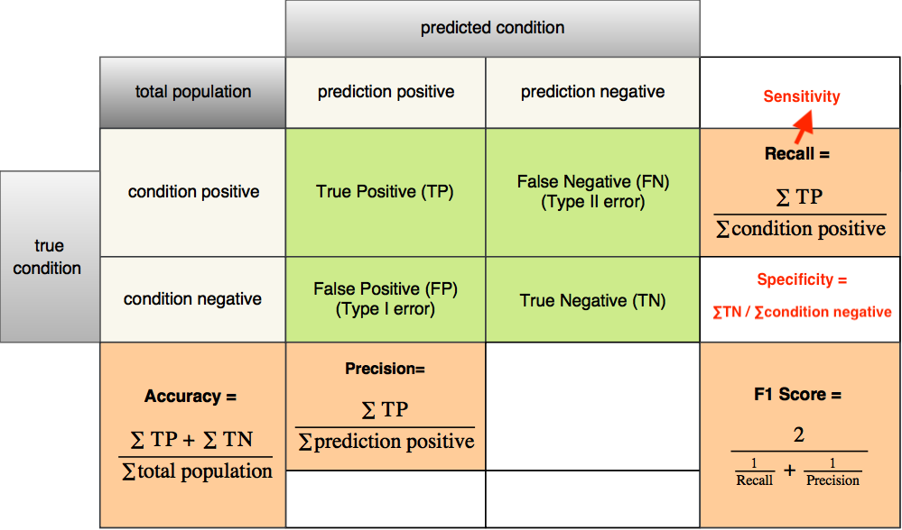
Classification Y: Accuracy
https://images.app.goo.gl/yGHjQrE27emHFTRd7

Slide 62
Format the report to IEEE: Refer to template

Slide 63
Peer Review Feedback and Modification

Slide 64
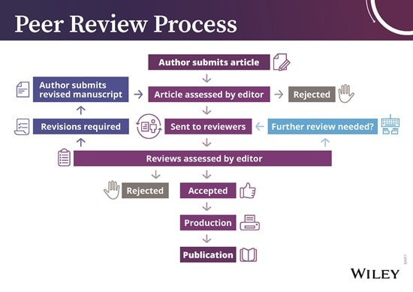
Peer Review Process

Slide 65
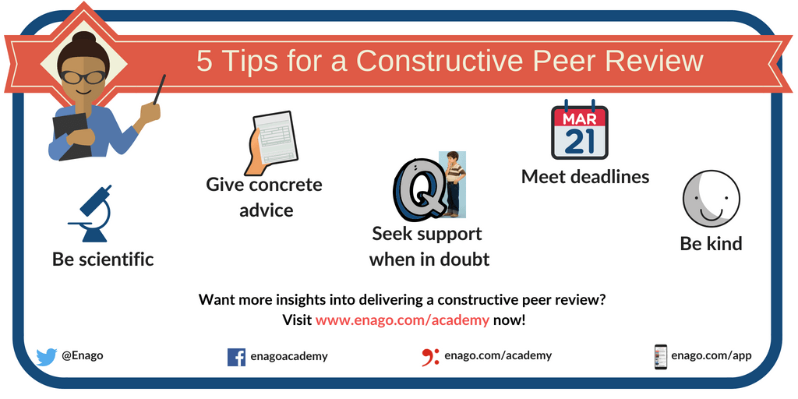
Peer Review

Slide 66
FULL SUBMISSION OF IEEE CONFERENCE

Slide 67
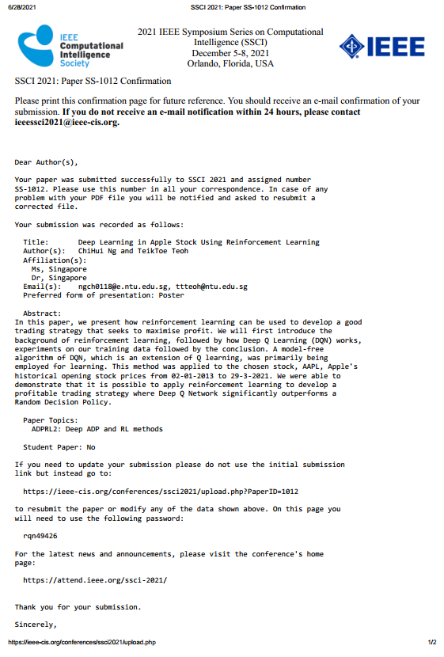
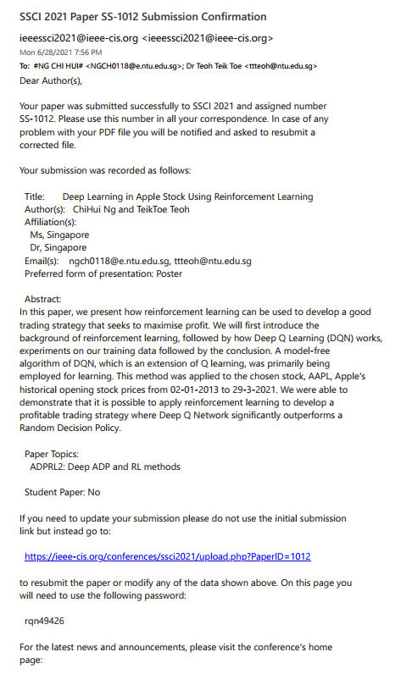

Slide 68
Thank You

