Slide 1
Day 2 人工智能和机器学习 - AI and machine learning
Teoh Teik Toe
ITOM/NBS
ttteoh@ntu.edu.sg
97905202

Slide 2
Agenda
20 April 技术创新 - Technology Innovation -Construction
12th May 人工智能和机器学习 - AI and machine learning
2nd June科学研究论文Scientific Research Paper – IMRAD
9th June 增强现实,虚拟现实, 元宇宙 – AR VR and Metaverse

Slide 3
Video
https://tv.sohu.com/v/dXMvMzM1OTQxODI1LzQ5MzE5Mjc3OS5zaHRtbA.html
人工智能必学概念——机器学习！ 就看机器怎么学！ - 发条AI笔记的视频 - 知乎https://www.zhihu.com/zvideo/1708839234071400449
【人工智能和机器学习的顶级开发板有哪些？】 https://www.bilibili.com/video/BV1t2421M7ax/?share_source=copy_web

Slide 4
1. How can we ensure that the development of AI benefits society as a whole rather than exacerbating existing inequalities?
2. What ethical considerations should be made when implementing machine learning algorithms in decision-making processes that affect human lives?
3. In what ways can machine learning transform industries that have been slow to adopt new technologies, like healthcare or education?
4. How should we address the potential for bias in AI, considering that machine learning models are often only as unbiased as the data they are trained on?
5. What roles should humans play in the age of AI, and how do we prepare the workforce for a future where many tasks are automated?
6. As AI systems become more advanced, how do we ensure transparency and explainability in their decisions?
7. What are the implications of AI in the creative industries, and can a machine truly be 'creative'?
8. How might AI change the landscape of personal privacy and data security?
9. Can machine learning contribute to solving large-scale problems like climate change, and if so, how?
10. What regulations, if any, should be implemented to govern the use of AI and machine learning, especially in sensitive areas like surveillance and personal data?

Slide 5
1. 我们如何确保人工智能的发展惠及全社会，而不是加剧现有的不平等？
2. 当将机器学习算法应用于影响人类生活的决策过程时，应考虑哪些伦理问题？
3. 机器学习将如何改变那些迟迟未采用新技术的行业，比如医疗保健或教育？
4. 我们如何解决AI可能带来的偏见问题，考虑到机器学习模型通常只能和它们所训练的数据一样无偏见？
5. 在AI时代，人类应该扮演什么角色，我们如何为一个许多任务都被自动化的未来准备劳动力？
6. 随着AI系统变得更加先进，我们如何确保它们决策的透明度和可解释性？
7. AI在创意产业中的应用将带来什么影响，机器能真正地“创造”吗？
8. AI可能如何改变个人隐私和数据安全的格局？
9. 机器学习是否能够帮助解决气候变化等大规模问题，如果可以，应如何贡献？
10. 是否应该实施一些规范，以治理AI和机器学习的使用，特别是在监控和个人数据这样的敏感领域？

Slide 6
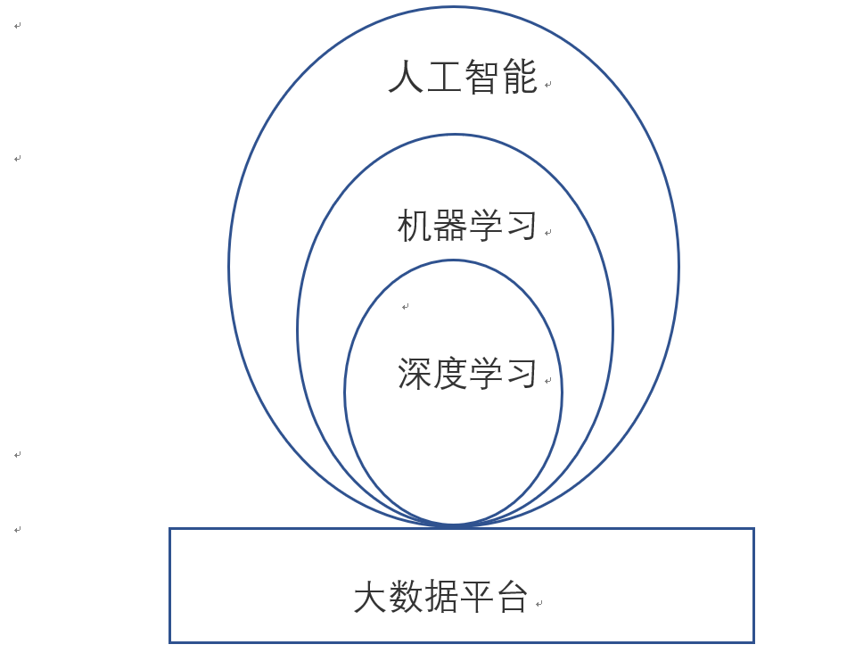

Slide 7
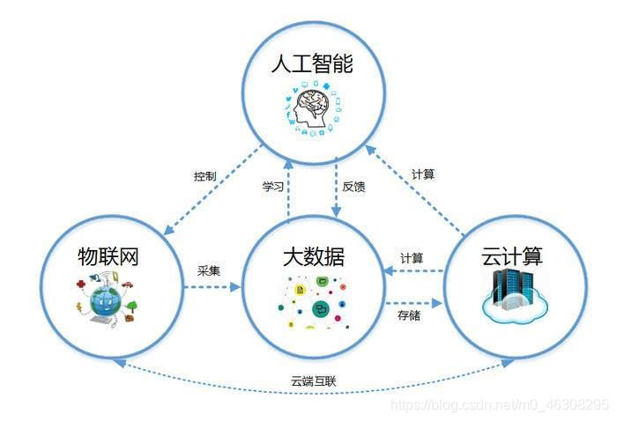

Slide 9
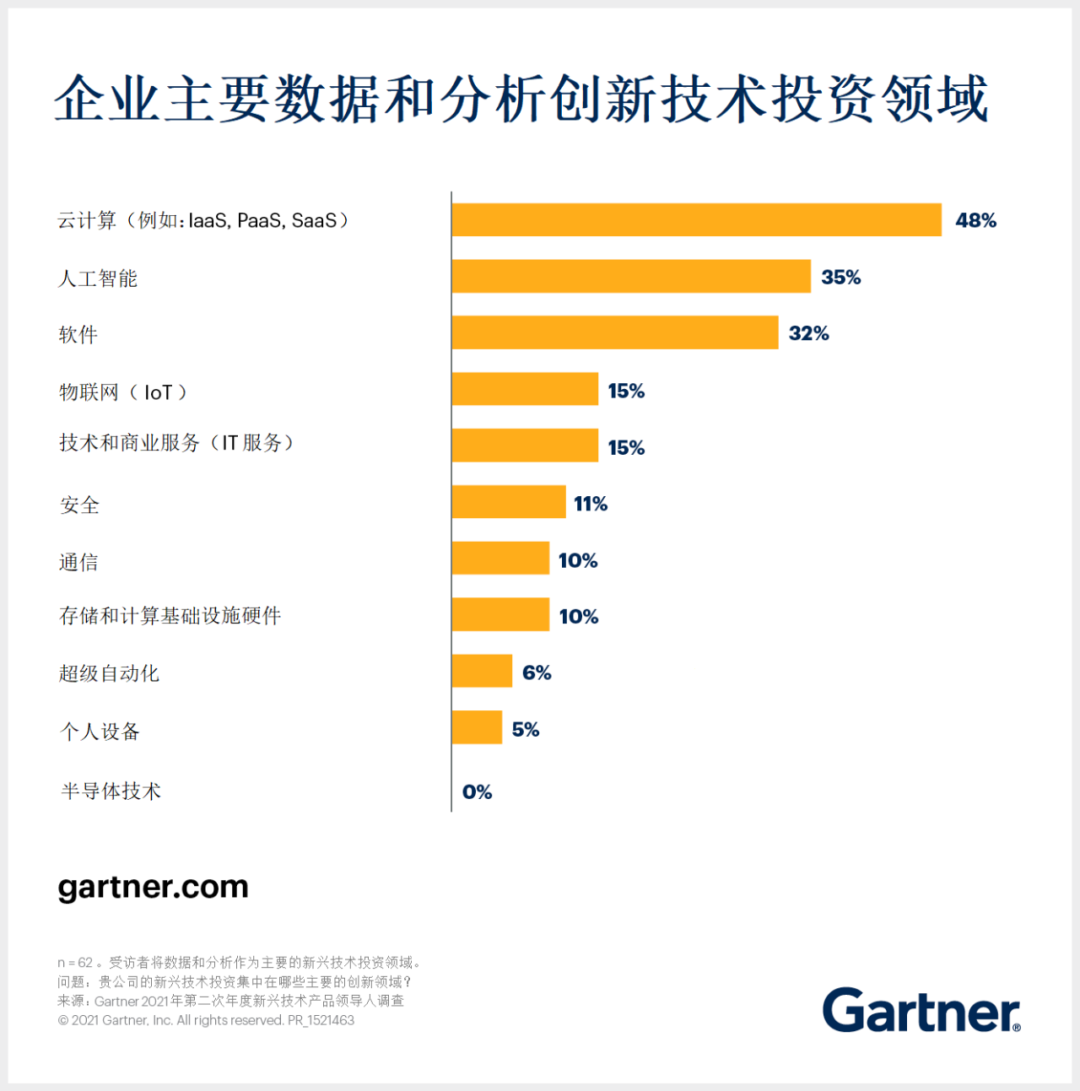

Slide 10
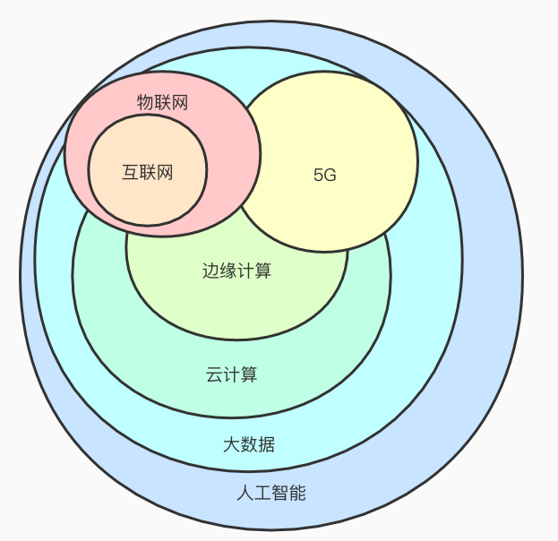

Slide 11
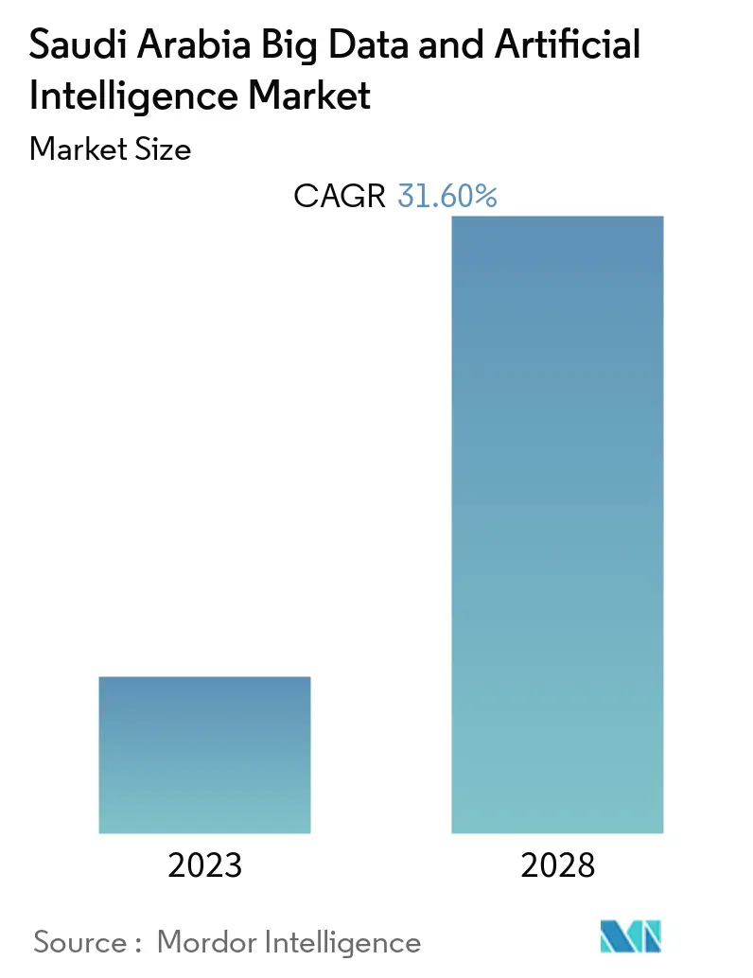

Slide 12
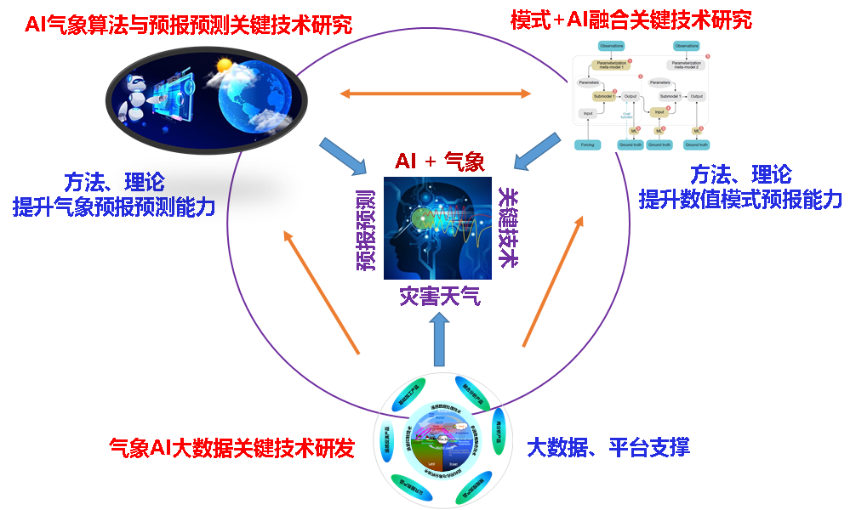

Slide 13
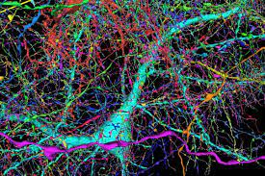
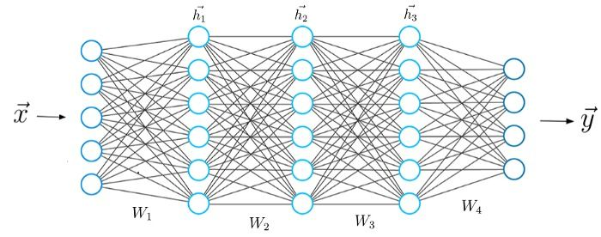
Machine (100 trillion) vs Human (0.086 trillion) => about 10,000 times more
GPT-4 parameter around 100 trillion
Human brain — Approximately 86 billion neurons
https://www.nature.com/scitable/blog/brain-metrics/are_thcere_really_as_many/

Slide 14
Agenda
Intro to AI
AI Models
Library: https://1drv.ms/f/s!Aik2a4x7tvLygrcOVnorwa6X7zBxTg?e=g8dRKk

Slide 15
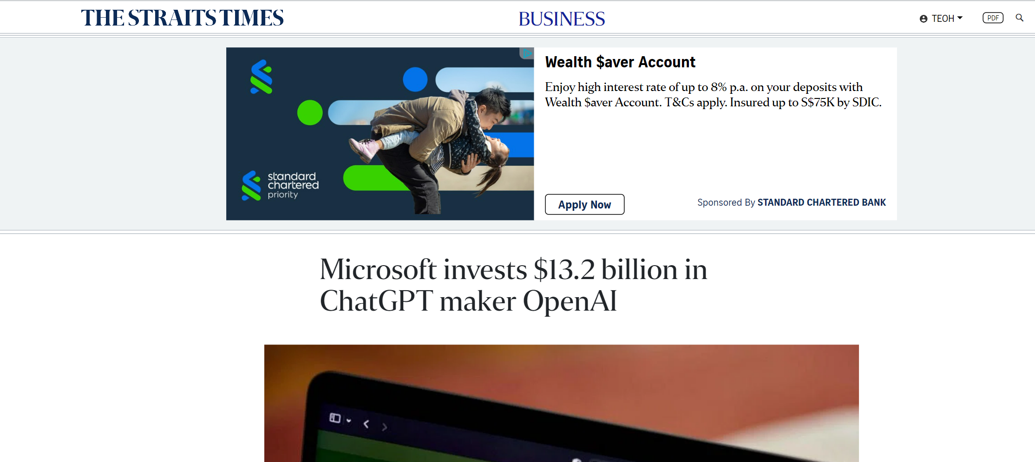
Microsoft 13.2 billion invest in openAI
https://www.straitstimes.com/business/microsoft-invests-13-billion-in-chatgpt-maker-openai

Slide 16
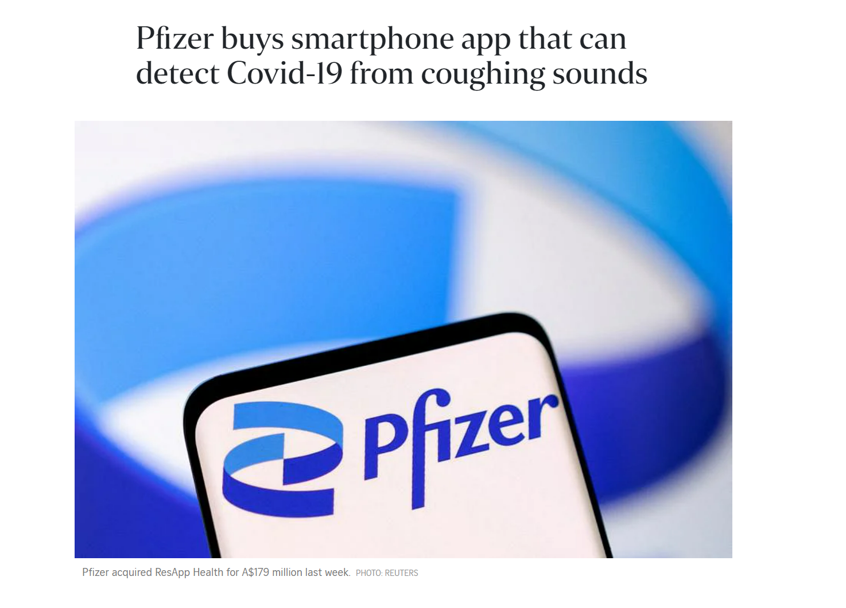
Pfizer bought Covid detection through cough sound 170million (Speech Detection)
https://www.straitstimes.com/asia/australianz/pfizer-buys-smartphone-app-that-can-detect-covid-19-from-coughing-sounds

Slide 17
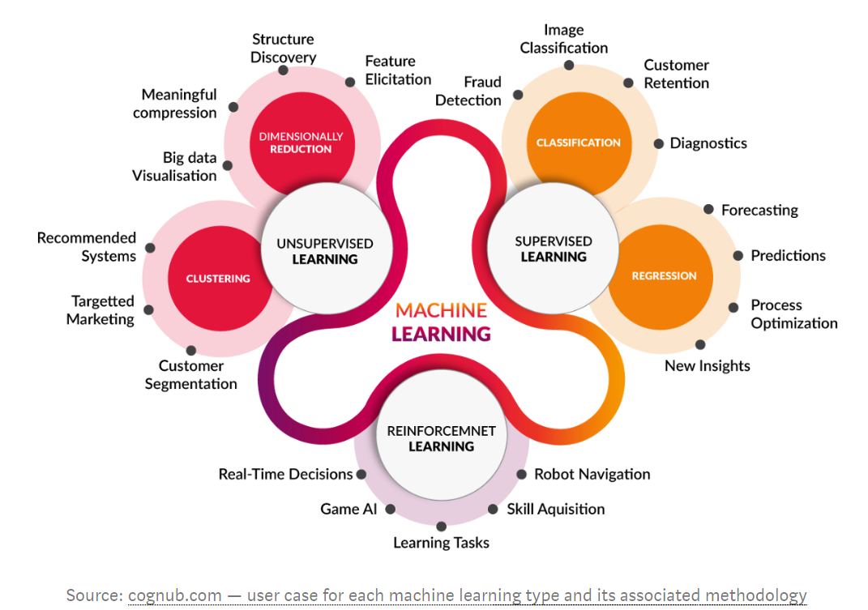
Machine Learning types

Slide 18
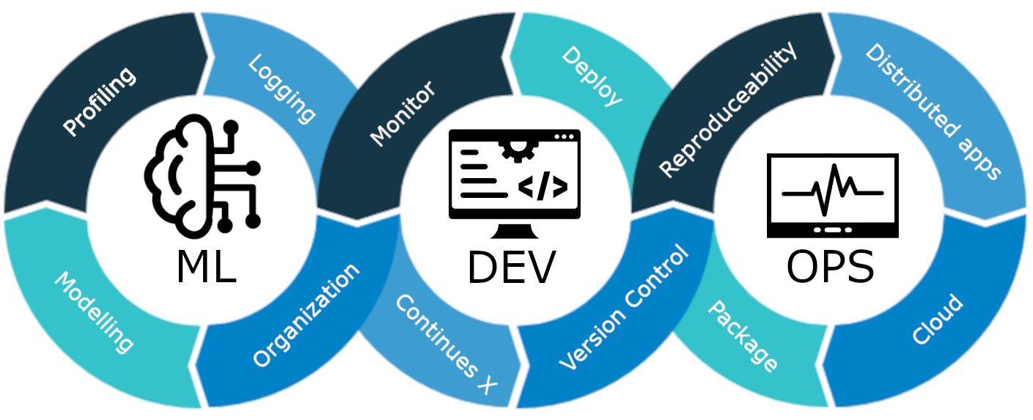
MLOps

Slide 19
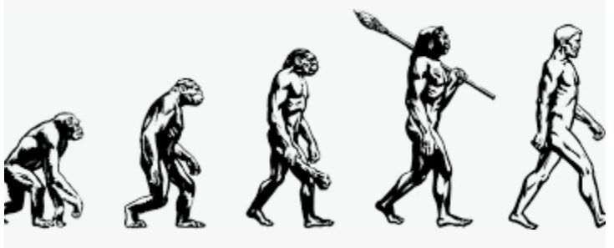
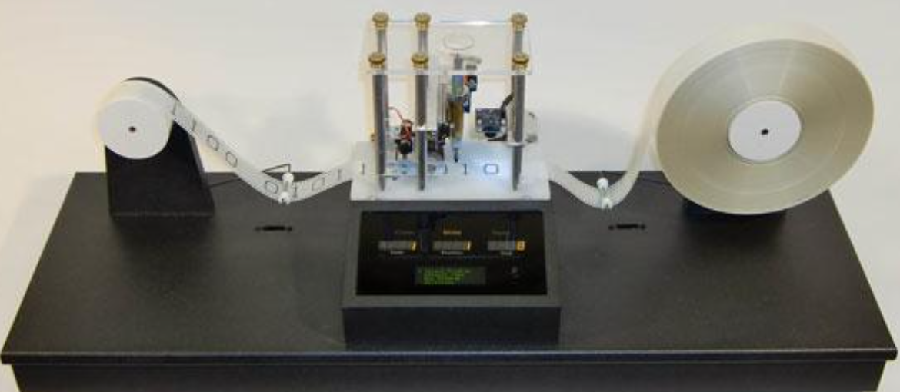
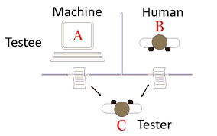
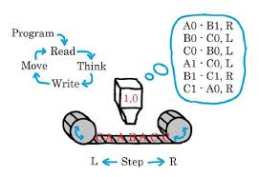
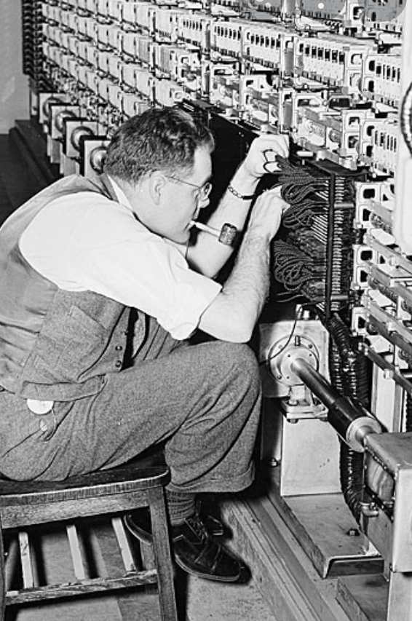
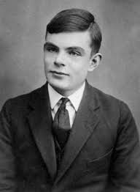
The beginning - Can machines think? 1936 Alan Turing – Turing Machine 1950 Turing Test
Turing test, in which a computer tries to fool the system into thinking that it is a human

Slide 20
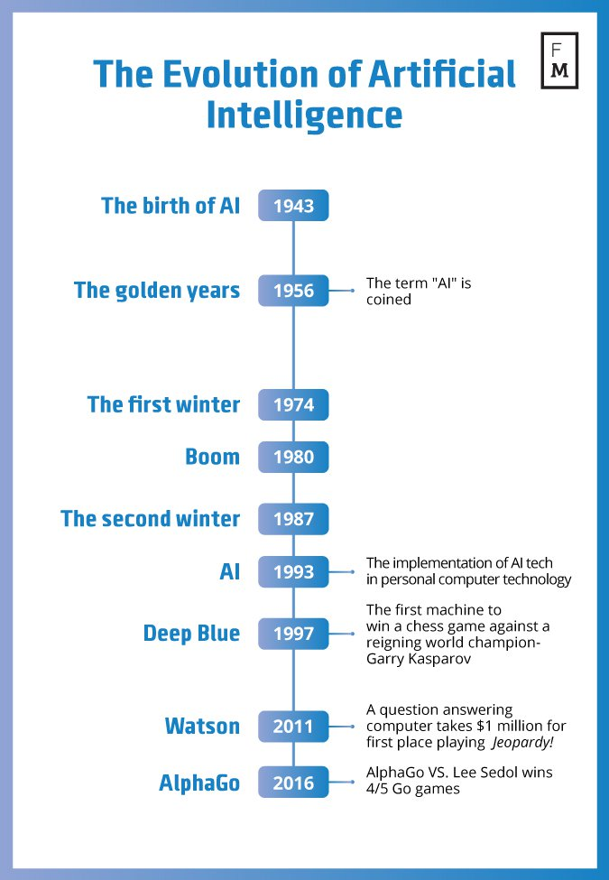
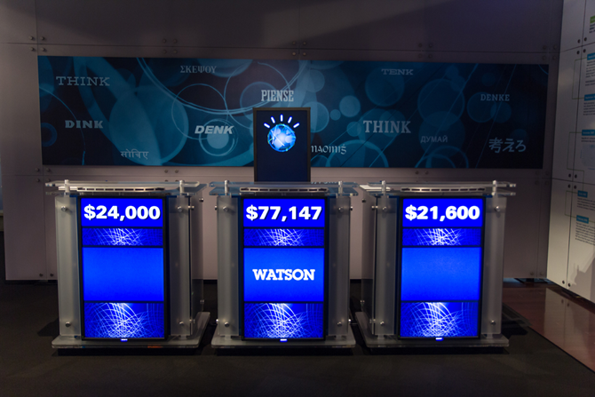
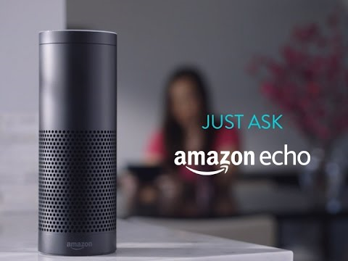
Evolution in AI
1950s, Minsky and McCarthy, described artificial intelligence as any task performed by a machine that would have previously been considered to require human intelligence.
Source: https://davidlecea.wordpress.com/2016/11/10/robots-on-the-rise-how-ai-can-change-the-financial-world/

Slide 21
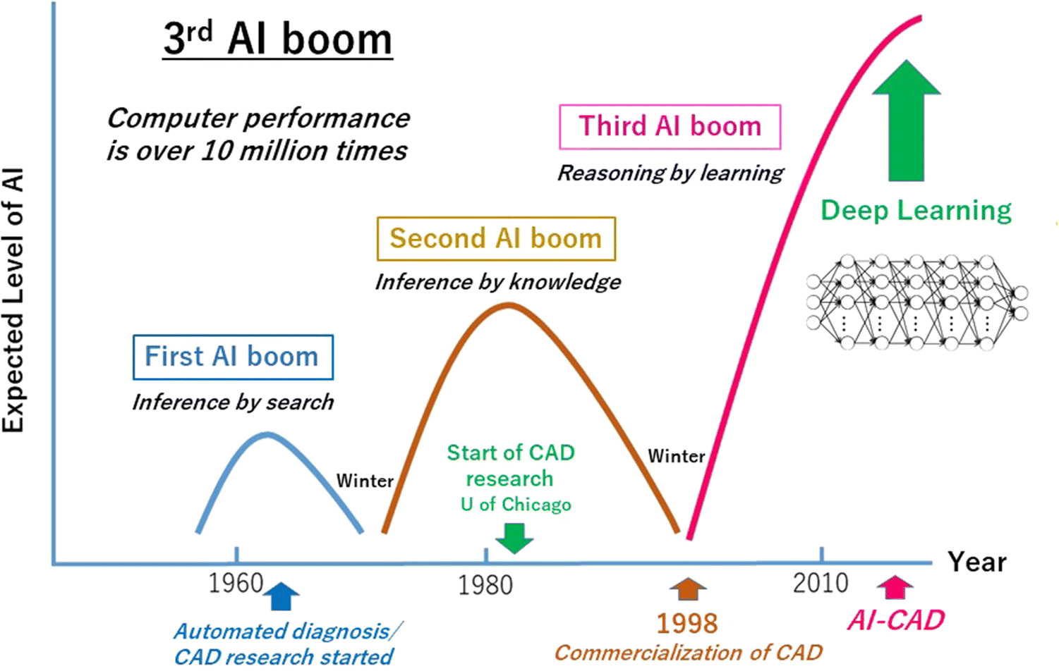
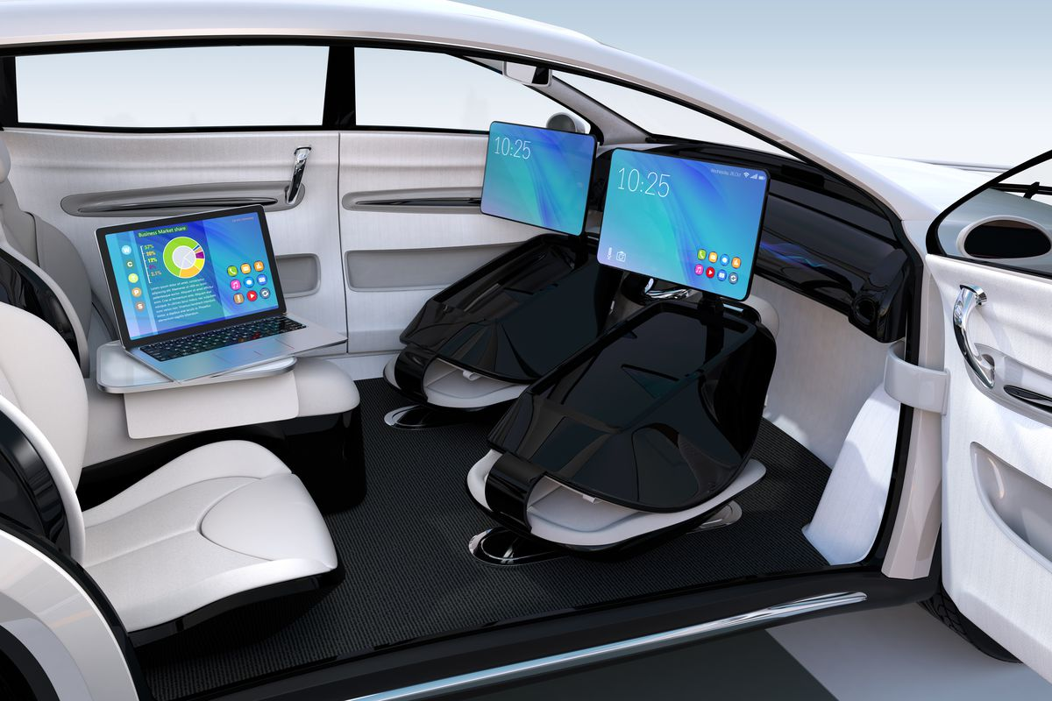
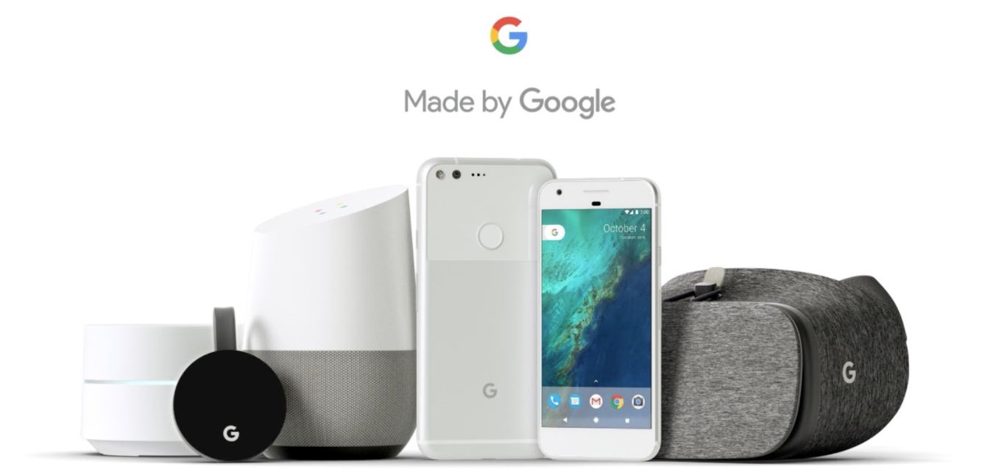
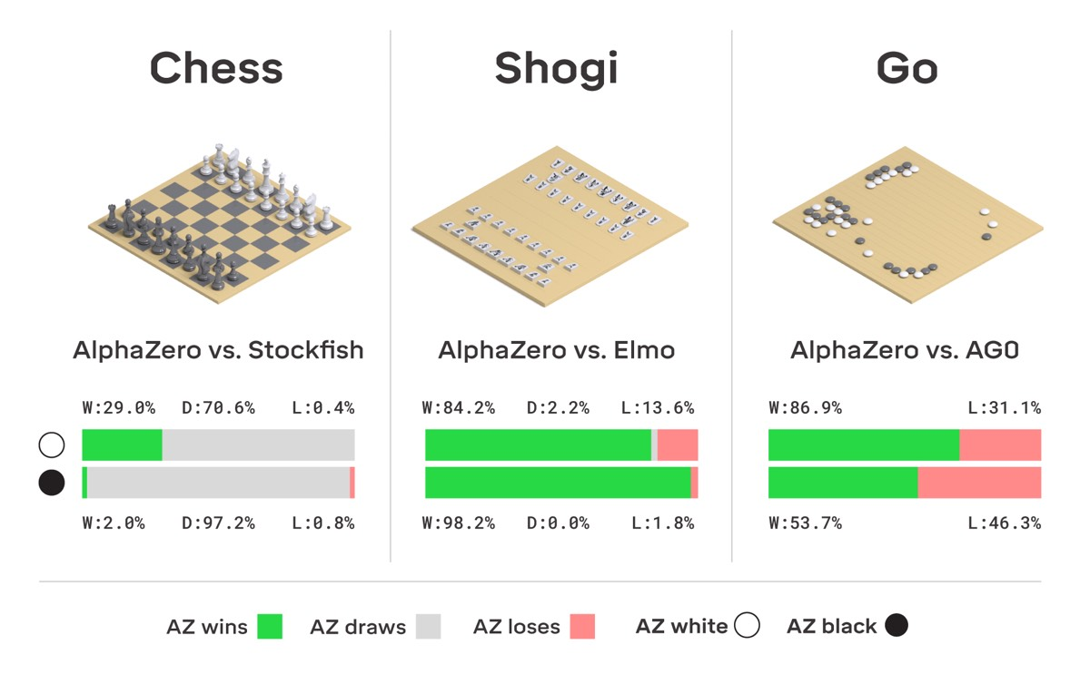
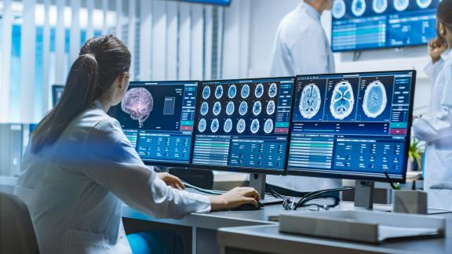
Now & Future

Slide 22
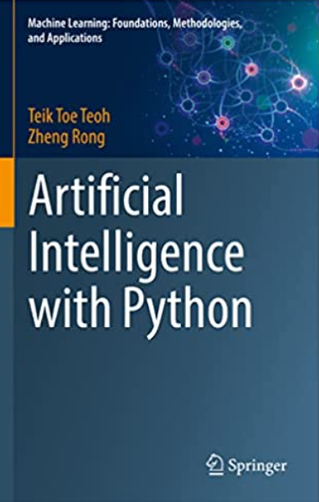
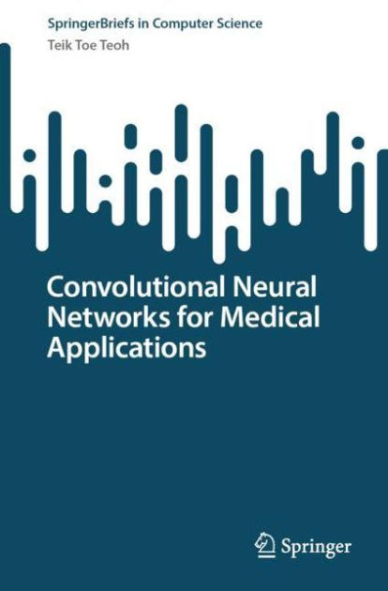
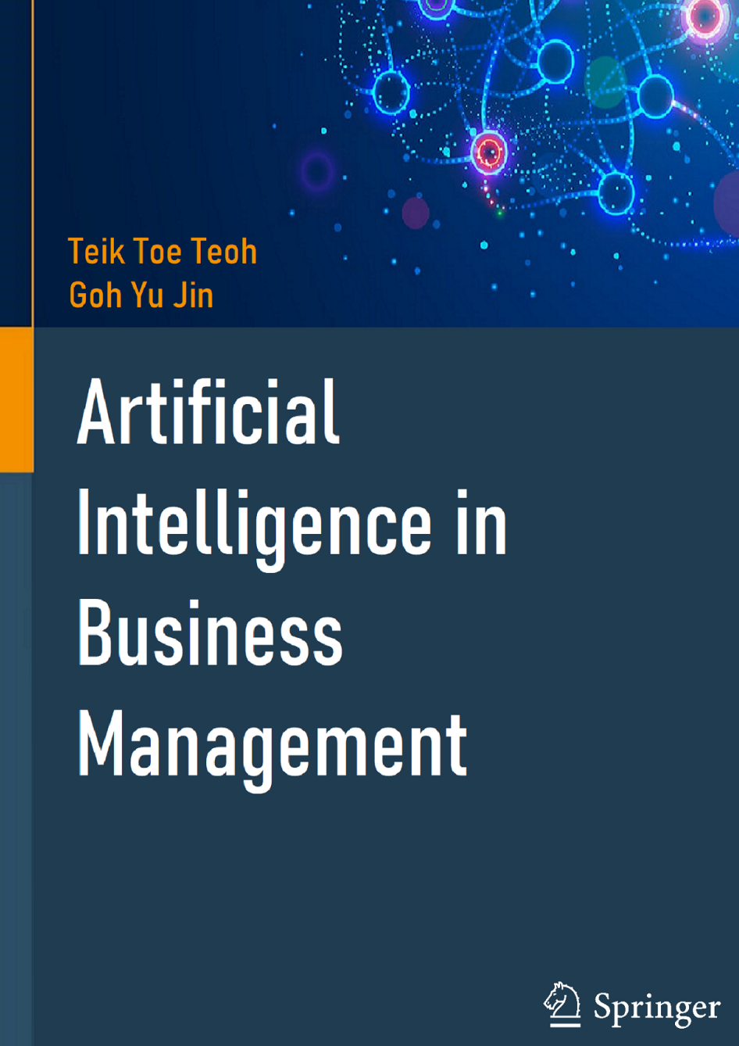
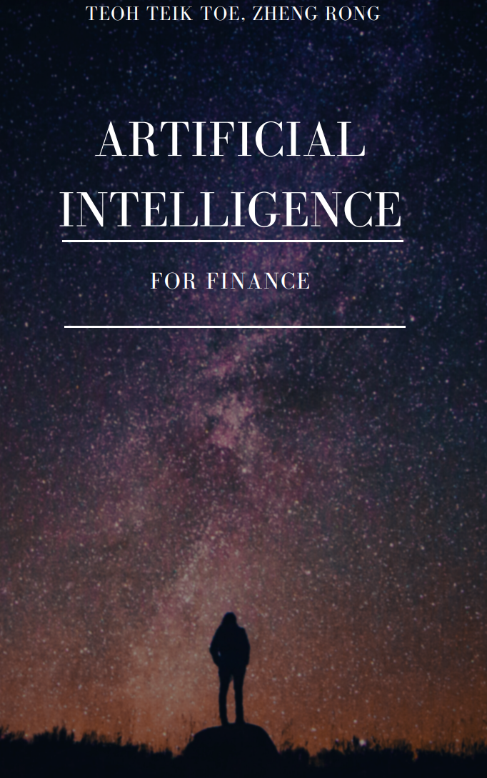
Book –Amazon and by Springer
https://tssglobalsingapore-my.sharepoint.com/:f:/g/personal/teohteiktoe_tssglobalsingapore_onmicrosoft_com/EuIUbA0qyvFOugKwzm5IKesB_qwPBHox0n9mnlGqaRZ_xg?e=R70M28

Slide 23
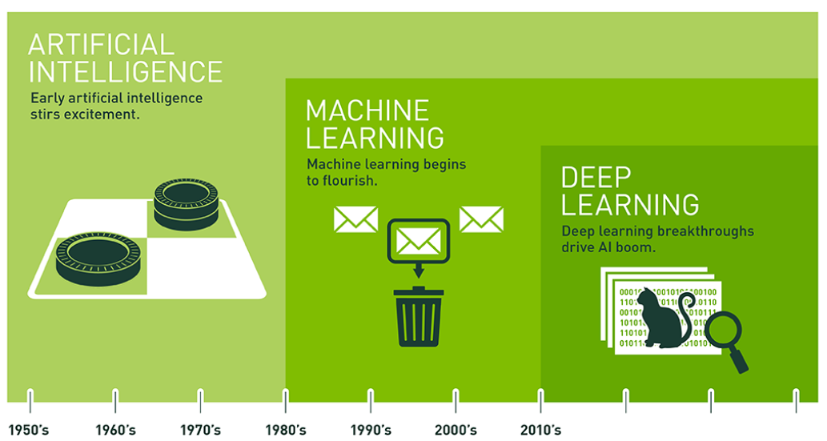
AI terminology
https://blogs.nvidia.com/blog/2016/07/29/whats-difference-artificial-intelligence-machine-learning-deep-learning-ai/

Slide 24
AI and other technology
AI and Big Data
Internet of Thing
Robotic Process Engineering
Block Chain
AI & Big Data
Cloud
Natural Language Processing
Web 3
Automation

Slide 25
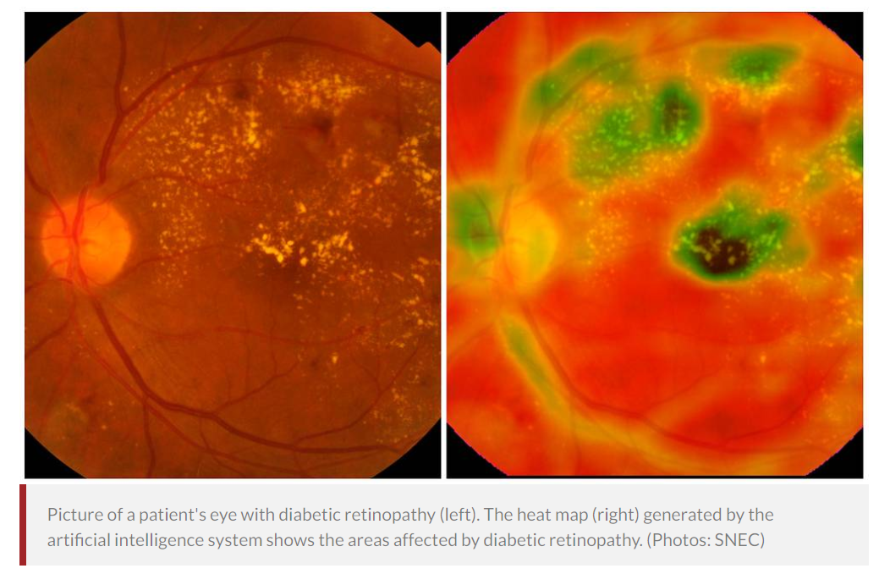
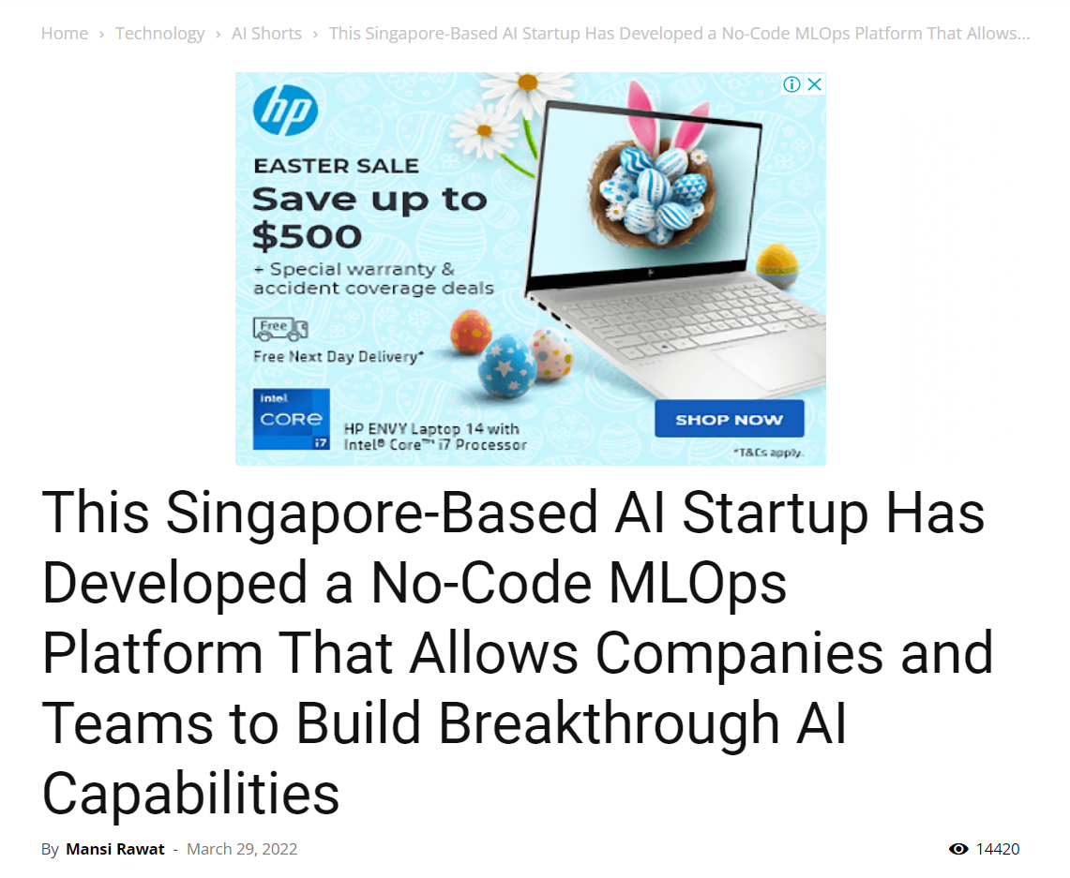
Singapore AI: Detect Eye Conditions
https://www.channelnewsasia.com/news/singapore/in-a-world-first-singapore-developed-artificial-intelligence-9498742

Slide 26
Cardiologist vs AI
Source: https://www.intel.com/content/www/us/en/healthcare-it/article/improved-diagnosis.html

Slide 27
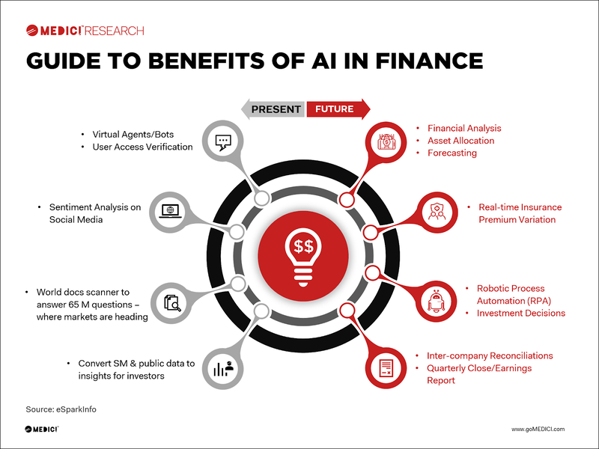

Slide 28
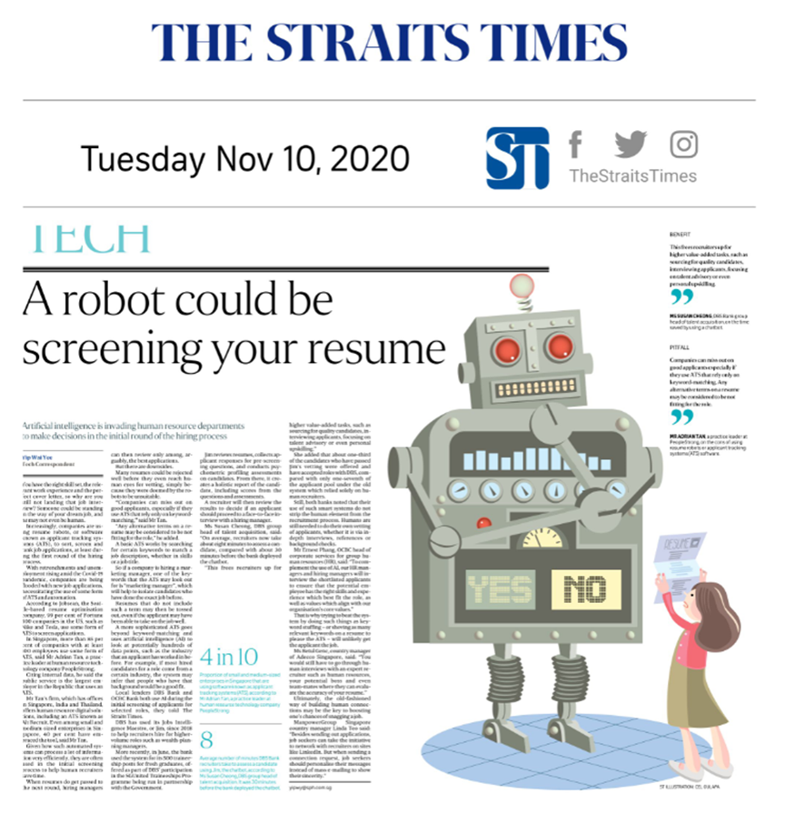
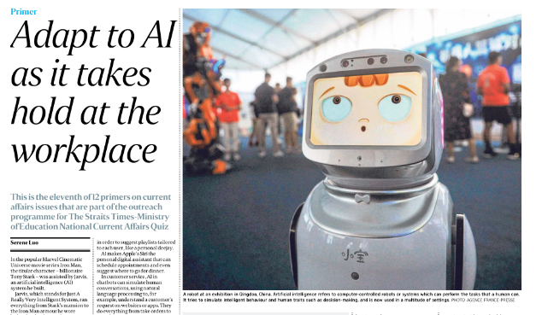
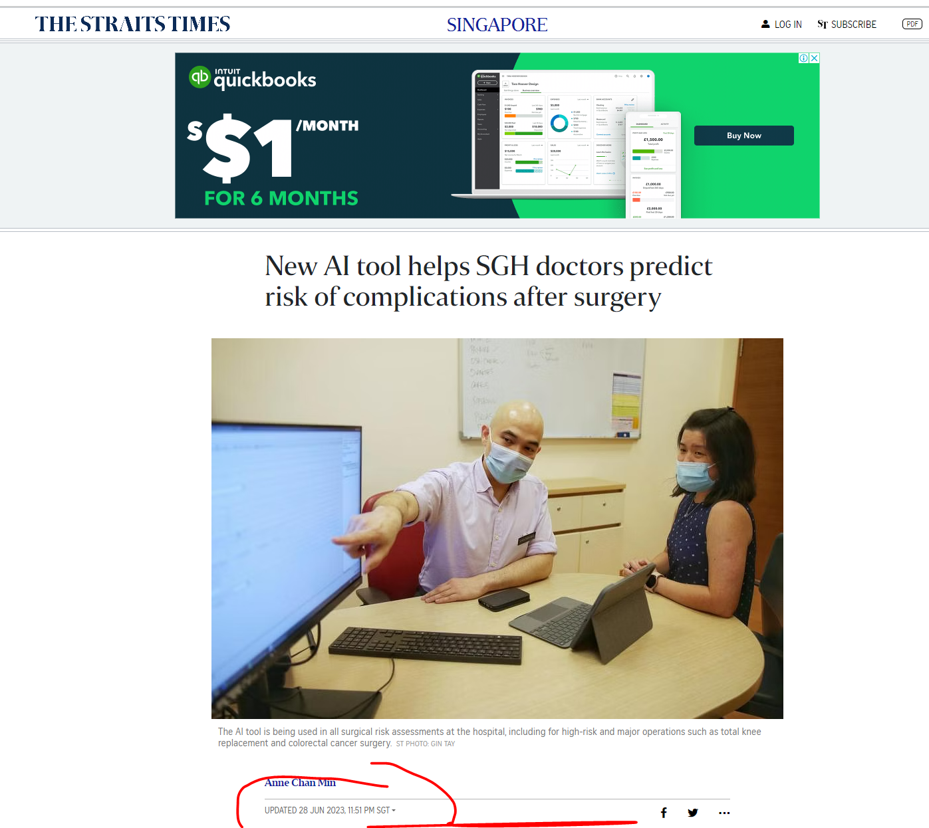
Why not hire a robot? Straits Times - 13 Aug 2019 Teachers Librarian Security Guard

Slide 29
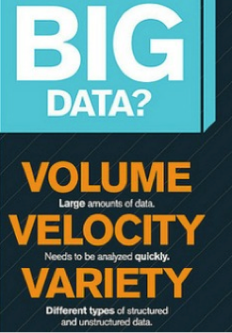
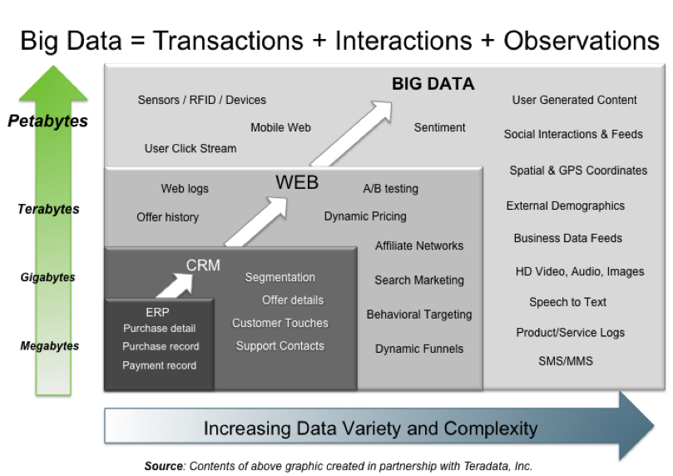
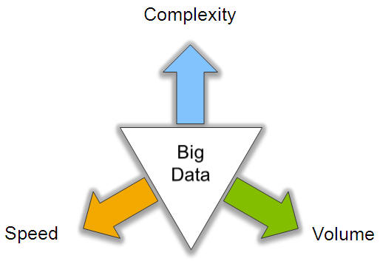
Big Data: 3V’s

Slide 30
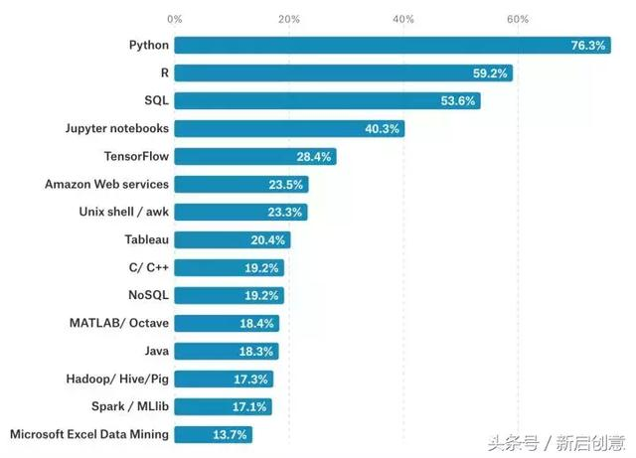
Programming Language for AI

Slide 31
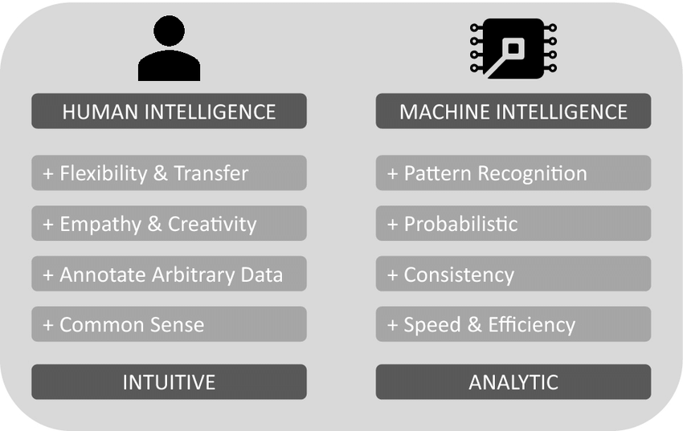
Human vs Machine

Slide 32
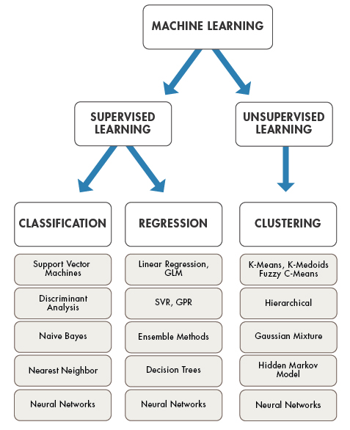

Slide 33
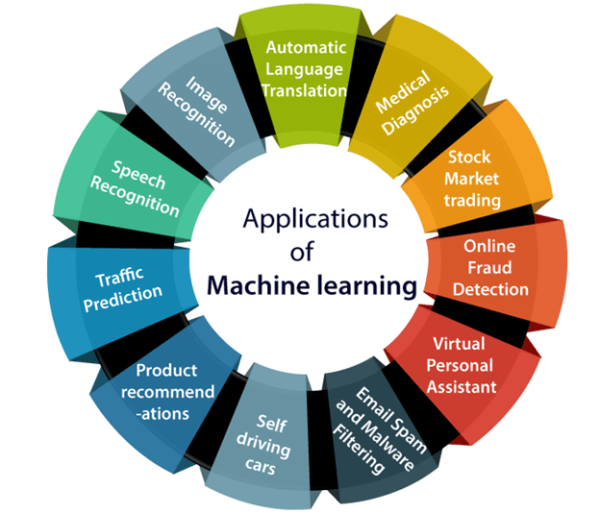

Slide 34
Deep Learning

Slide 35
State of the Art – 2022 - Transfer Learning

Slide 36
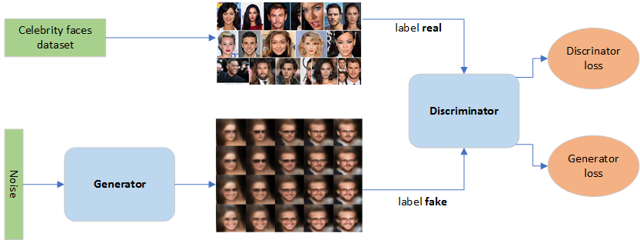
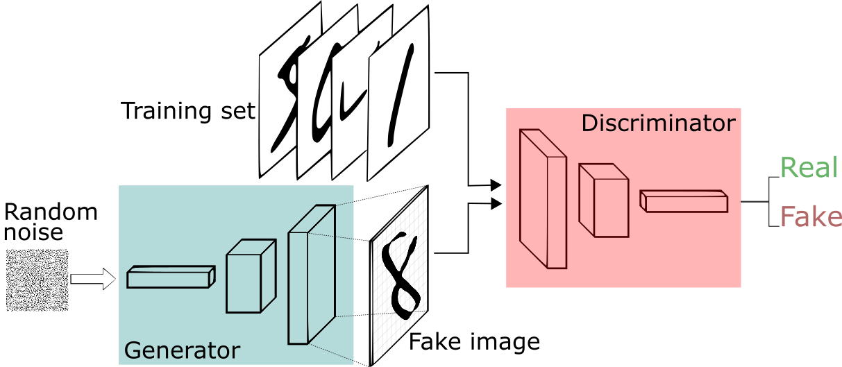
Dual Neural Network GAN – Generative Adversarial Network

Slide 37
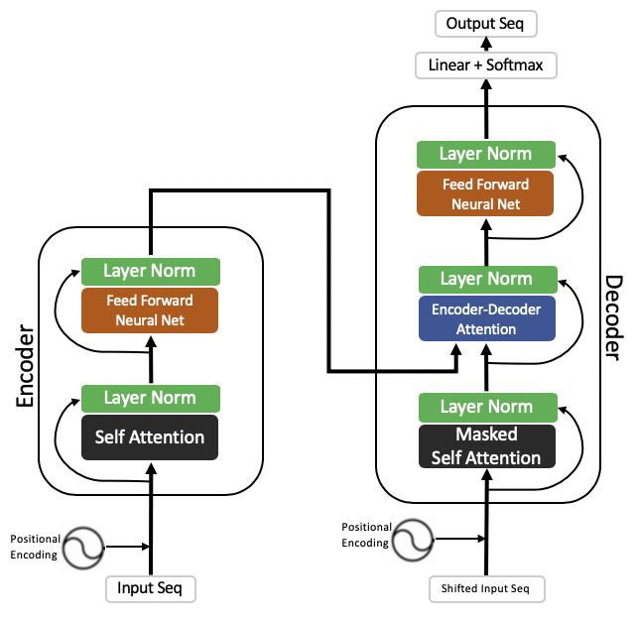
Transformer, Encoder, Attention RNN
The transformer is the model, while the attention is a technique used by the model.

Slide 38
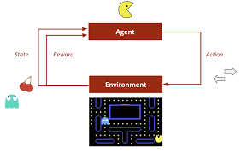
Reinforcement Learning

Slide 39
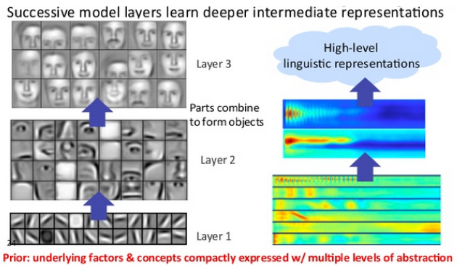
What can deep learning do (CNN)?

Slide 40
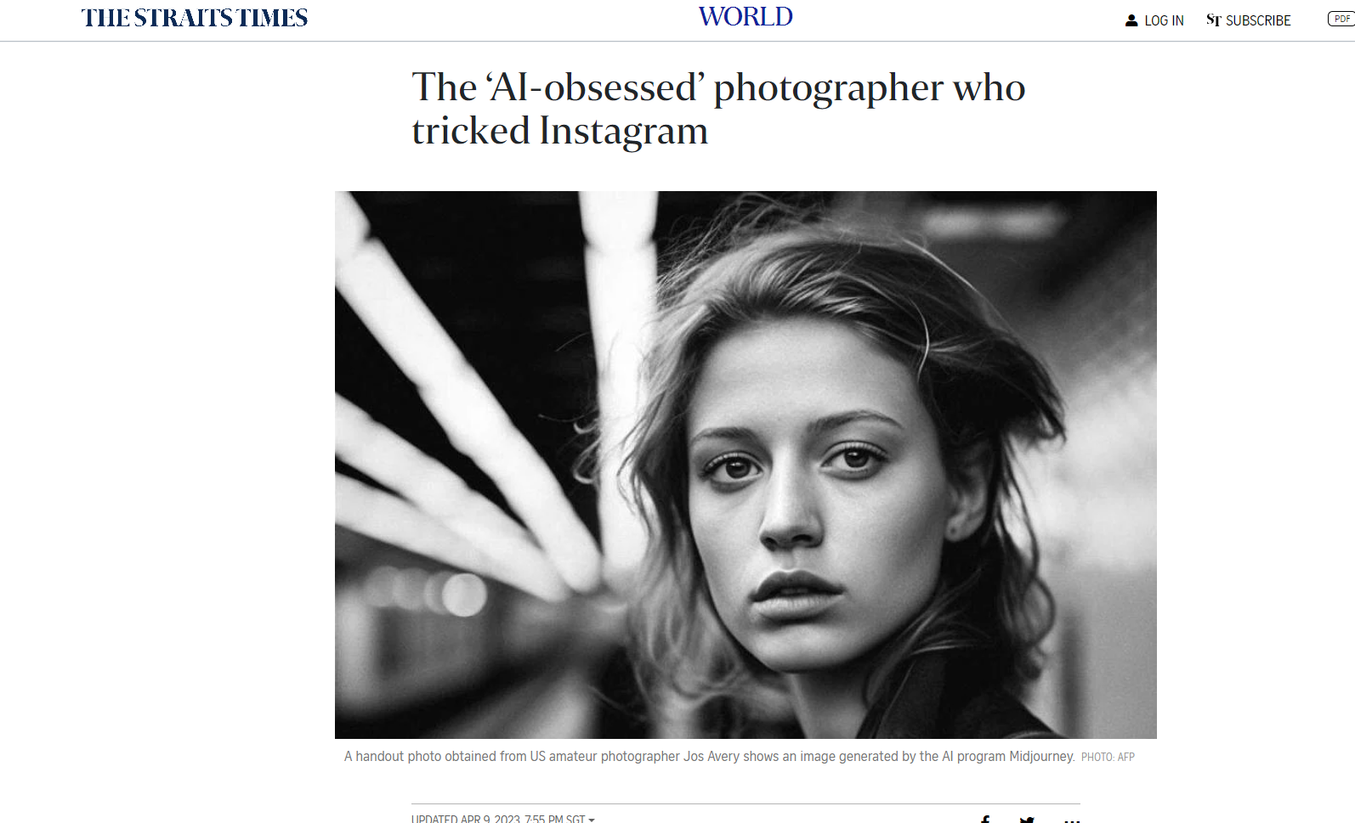
Midjourney (9th April)
https://www.straitstimes.com/world/europe/the-ai-obsessed-photographer-who-tricked-instagram

Slide 41
Image – Dalle vs MidJourney
https://www.google.com/amp/s/www.zdnet.com/google-amp/article/midjourney-vs-dall-e-3-in-chatgpt-which-ai-does-halloween-better/

Slide 42
Try https://www.craiyon.com/

Slide 44
Fine Tuning
https://medium.com/@iryna230520/fine-tune-google-palm-2-with-scikit-llm-d41b0aa673a5

Slide 45
AI and other technology
AI and Big Data
Internet of Thing
Robotic Process Engineering
Block Chain
AI & Big Data
Cloud
Natural Language Processing
Web 3
Automation

Slide 46
Human vs Machine

Slide 49
MLOps

Slide 50
GAN – Used by Midjourney
Midjourney is a new artificial intelligence (AI) art generator that can turn text into images. It is based on the principle of Generative Adversarial Networks (GANs), which are a type of neural network that can generate new data from scratch.
https://gratisgraphics.com/community/post/1030373305
Alternative to Midjourney:
Dall-E2 using GPT3
https://openai.com/product/dall-e-2

Slide 51
What can deep learning do (CNN)?

Slide 52
Thank You

