Slide 1
Machine Learning & MLOps
Teoh Teik Toe
ITOM/NBS
ttteoh@ntu.edu.sg
97905202

Slide 2
Recording https://1drv.ms/v/s!Aik2a4x7tvLyi_A_o8htYjf03yP_pQ?e=cQRP29

Slide 3
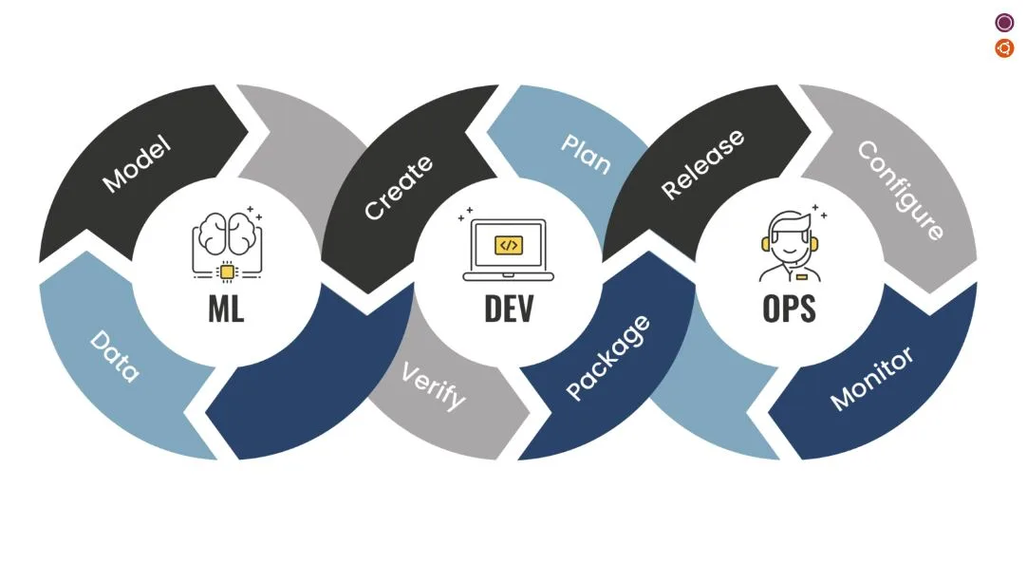
MLOps

Slide 4
Case study on DBS share price prediction
Objective: A financial institution aims to predict the future prices of a particular stock to support investment decisions and optimize portfolio management.
Reasoning: By accurately predicting share prices, the institution can identify potential buying and selling opportunities, determine optimal entry and exit points, and allocate resources effectively.
Methodology: The institution collects and analyzes vast amounts of historical stock data, including price movements. They employ advanced machine learning algorithms and statistical models to generate accurate predictions.
Results: The share price prediction model enables the institution to make informed investment decisions, optimize their portfolio allocation, manage risk effectively, and potentially generate higher returns for their clients. This approach enhances their competitiveness in the financial market and strengthens their reputation as a trusted investment advisor.

Slide 5
Mind map
Download data (DBS.csv)
Upload to cloud #1 PythonAnywhere
Upload to cloud #2 render.com
Create Machine Learning Model and Validation (using Python Colab)
Create front end using HTML (using VS Code)
Create backend using Python Flask Framework (using Conda)
Upload data to github for cloud 2 render.com

Slide 6
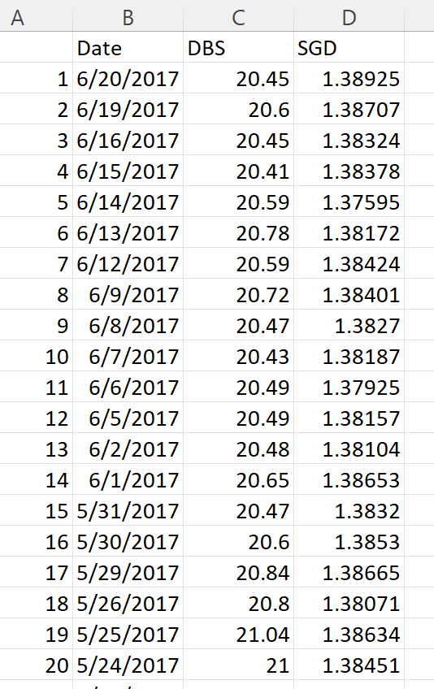
Data

Slide 7
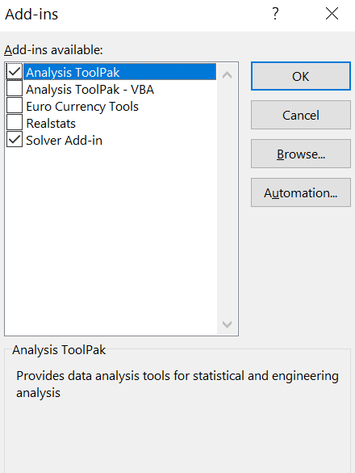
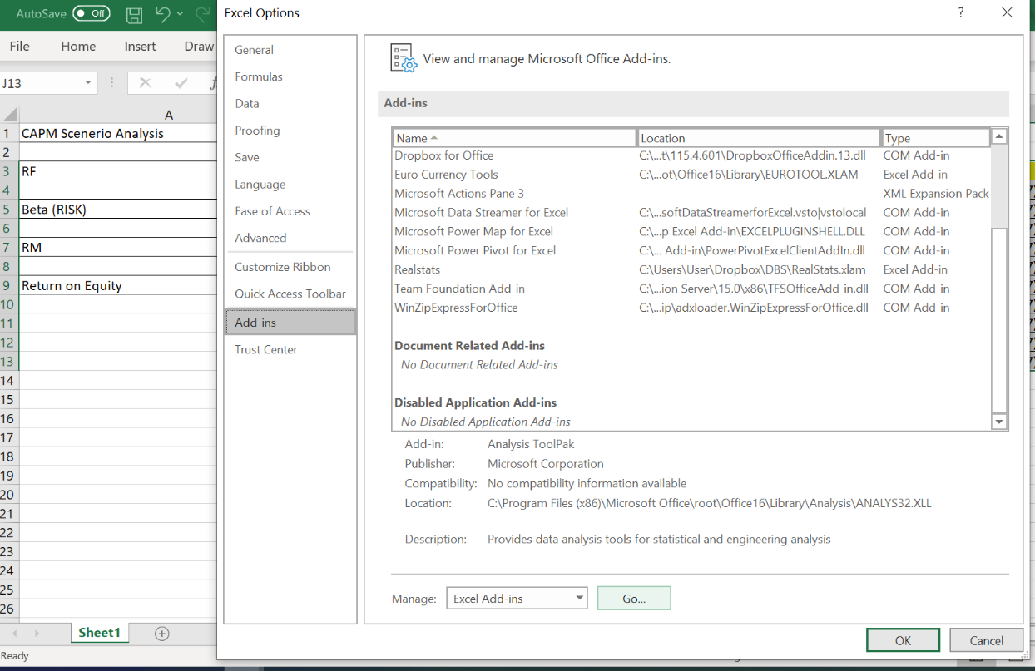
File -> Option -> Add-ins -> Manage -> Excel Add-ins - Go
Excel

Slide 8
Regression on Loan Default

Slide 9
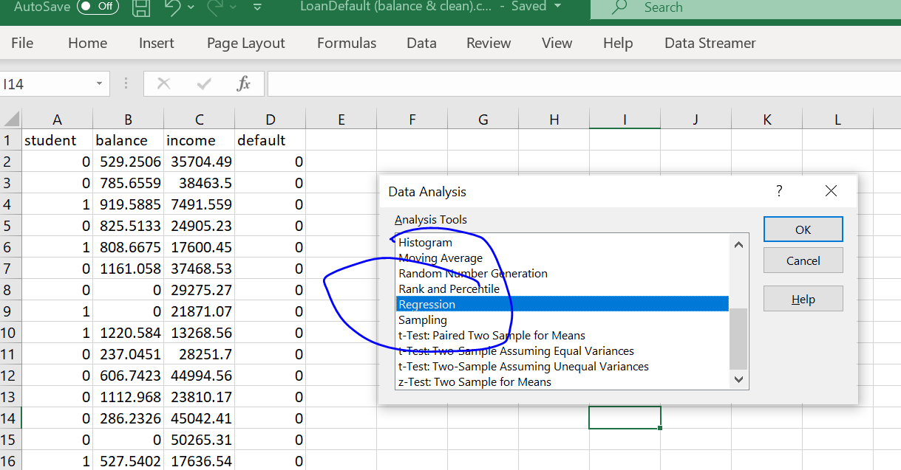
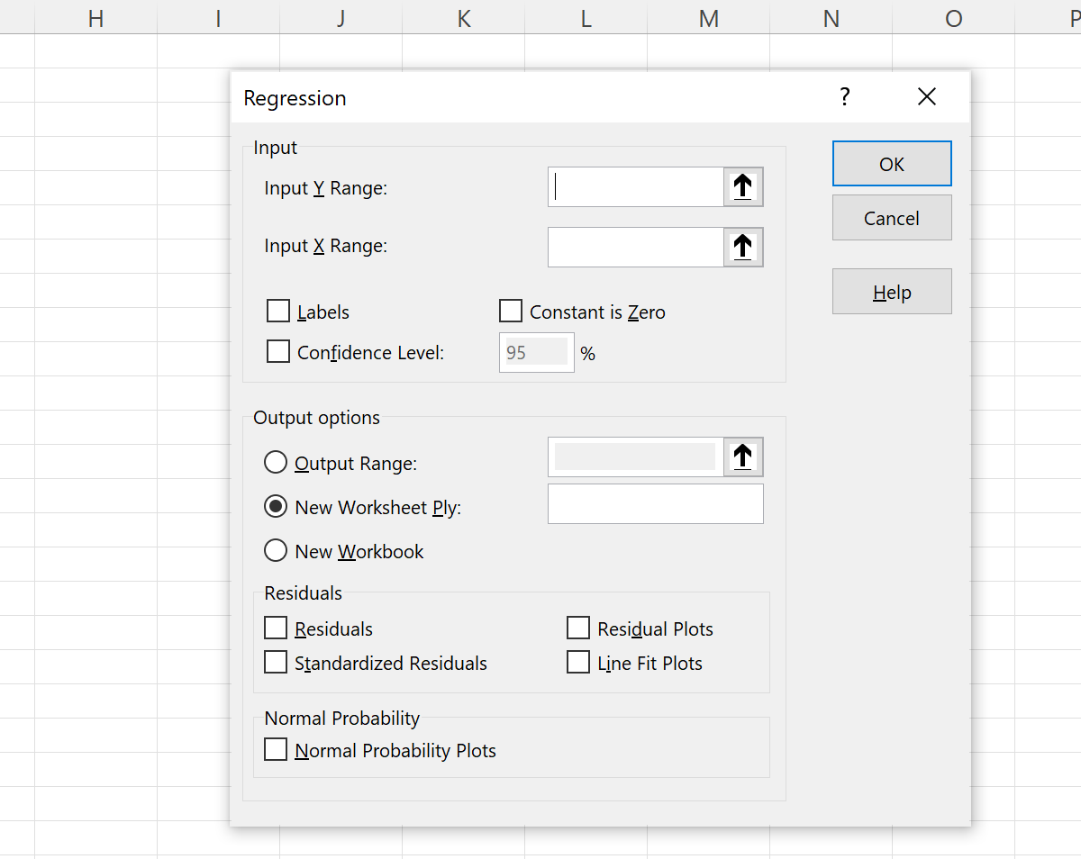
Select the range
Result will appear on new sheet

Slide 11
R
dt = read.csv("C:/Users/Teoh Teik Teo/OneDrive - TSS Global Pte. Ltd/TT Library/AI Model/Data/DBS_SingDollar.csv") #alternatively read.csv
model=lm(dt$DBS ~ dt$SGD)
summary(model)
pred = predict(model)
err = dt$DBS - pred
rmse=(mean(err^2)^0.5)
print(rmse)
dt$SGD2 = dt$SGD^2
model=lm(dt$DBS ~ dt$SGD + dt$SGD2)
summary(model)
pred = predict(model, newdata = dt)
err=dt$DBS - pred
rmse = (mean(err^2)^0.5)
print(rmse)
plot(dt$SGD, dt$DBS, main="Regression", xlab = "SGD", ylab="DBS")
abline(model)

Slide 12
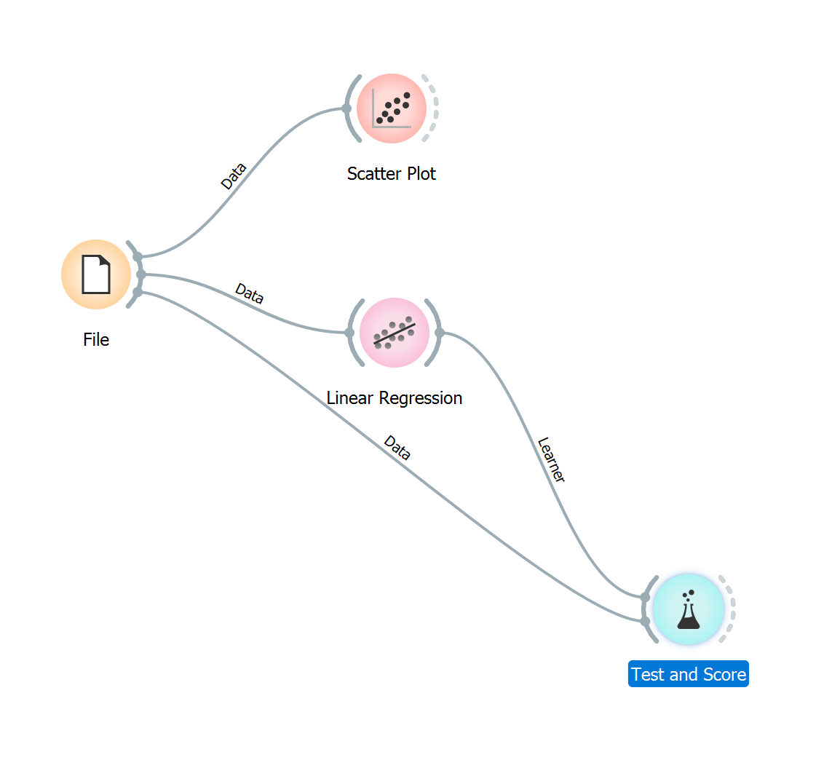
Orange

Slide 13
Python
#save model
import joblib
joblib.dump(model,”dbs.jl”)
#load model
model = joblib.load(“dbs.jl”)
import pandas as pd
df = pd.read_csv("DBS_SingDollar.csv")
X = df.loc[:,["SGD"]]
Y = df.loc[:,['DBS']]
print(X)
from sklearn import linear_model
model = linear_model.LinearRegression()
model.fit(X,Y)
pred = model.predict(X)
from sklearn.metrics import mean_squared_error
rmse = mean_squared_error(Y,pred)**0.5
print(rmse)
#print(rmse/Y.mean(axis=0)*100)
model.coef_
model.intercept_
#to add polynomial
df["SGD2"] = df["SGD"] ** 2

Slide 14
Front End HTML
<html>
<body>
<form action = "/" method = "post">
<p>Enter Sing to US:</p>
<p><input type = "number" step="0.01" name = "rates"></p>
<p><input type = "submit" value = "submit"></p>
</form>
<p> the predicted DBS share price is {{result}} </p>
</body>
</html>

Slide 15
Flask (Back End)
from flask import Flask
app = Flask(__name__)
from flask import request, render_template
@app.route("/", methods = ["GET", "POST"])
def i():
if request.method == "POST":
num = float(request.form.get("rates"))
return(render_template("index.html", result = 90.2-(50.6*num)))
else:
return render_template("index.html", result ="Waiting……….")
if __name__=="__main__":
app.run()

Slide 16
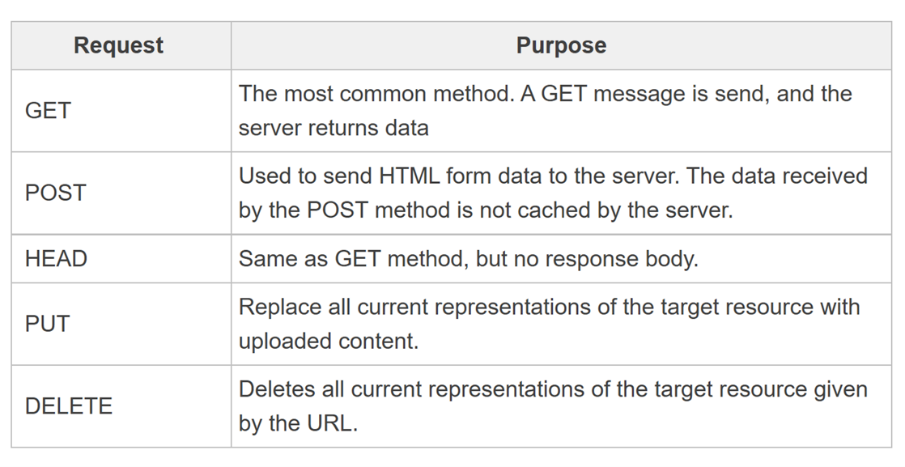
GET and POST

Slide 17
If you wanted to split into form and result 2 pages
Index.html remove local host when in cloud “/result”:
<html>
<h1>My First Machine Learning Model in Cloud: DBS price prediction</h1>
<form action="http://localhost:5000/result" method="post">
<p>Please enter the exchange rate usd to sgd (eg 1.34)</p>
<p><input type="number" step="0.01" name="rate"></p>
<p><input type="submit" value="Enter"></p>
</form>
</html>
from flask import Flask, request, render_template
app = Flask(__name__)
@app.route("/",methods=["GET","POST"])
def index():
return(render_template("index.html",result="index: waiting for rate..........."))
@app.route("/result",methods=["GET","POST"])
def result():
r = float(request.form.get("rate"))
return(render_template("result.html",result=-50.6*r + 90.2))
if __name__ == "__main__":
app.run()
result.html:
<html>
<h1>Result</h1>
<p>The predicted DBS share price is {{result}}</p>
</html>

Slide 18
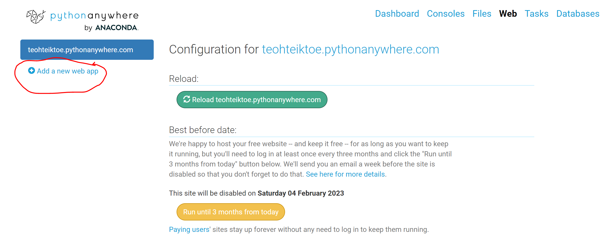
Cloud: PythonAnywhere
Add your new app to PythonAnyWhere:
Click on Add a New Web App button
Next -> Flask -> Python 3.10

Slide 19
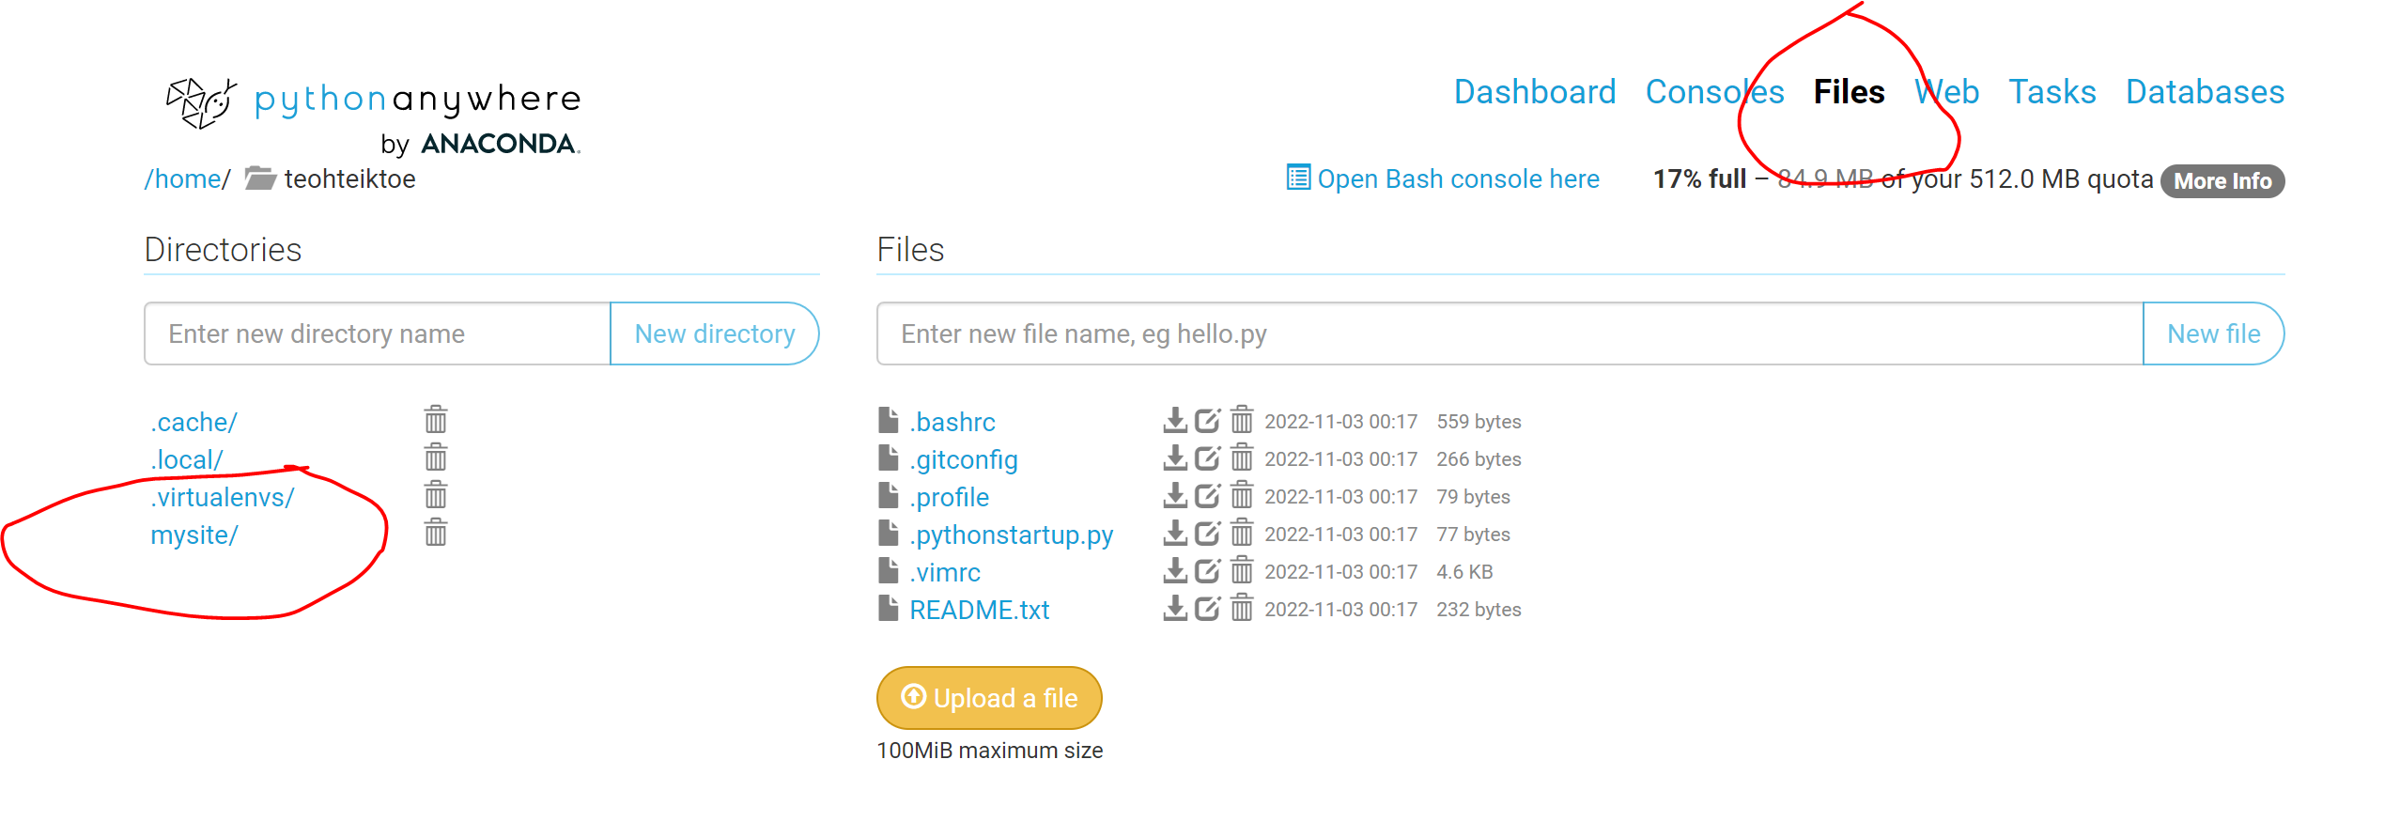
Upload your file

Slide 20
Upload your file Change flask_app.py – cut and paste your python program Create Directory call templates Upload index.html in templates directory

Slide 21
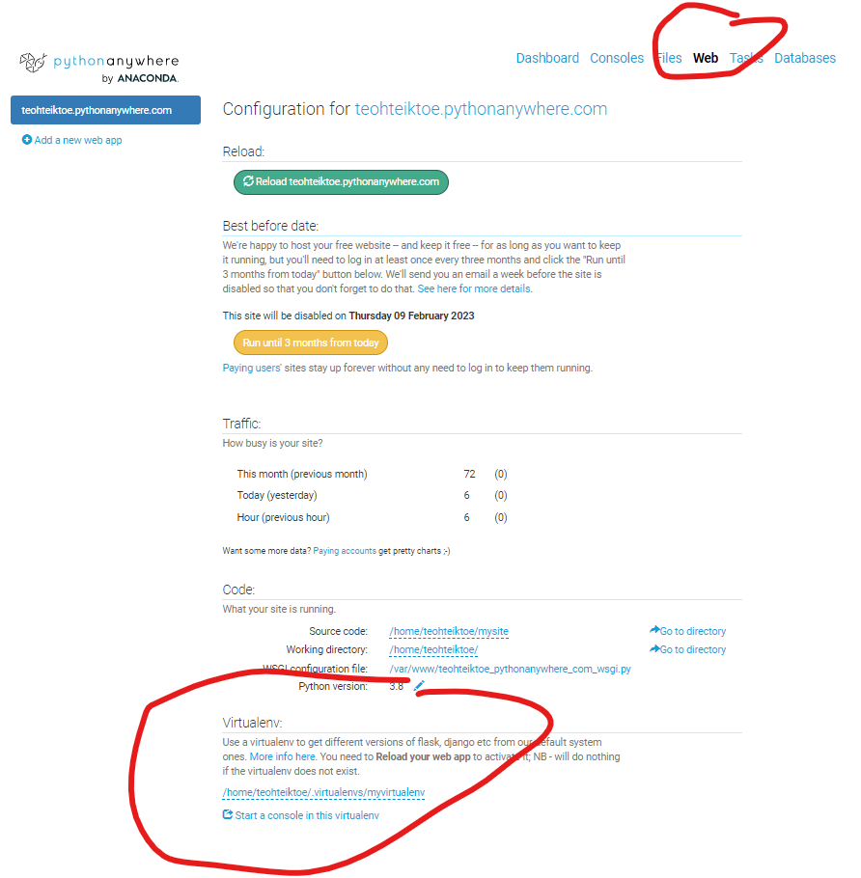
myvirtualenv

Slide 22
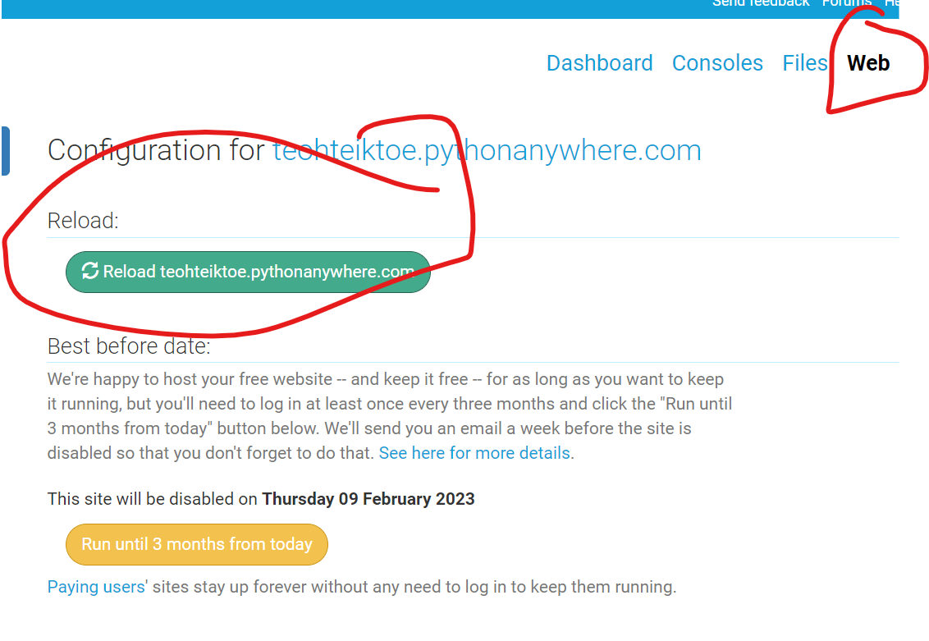
Run the program https://teohteiktoe.pythonanywhere.com/

Slide 23
Virtual environment
To remove: rmvirtualenv myvirtualenv
Go to bash
mkvirtualenv myvirtualenv --python=/usr/bin/python3.10
pip install flask
pip install textblob

Slide 24
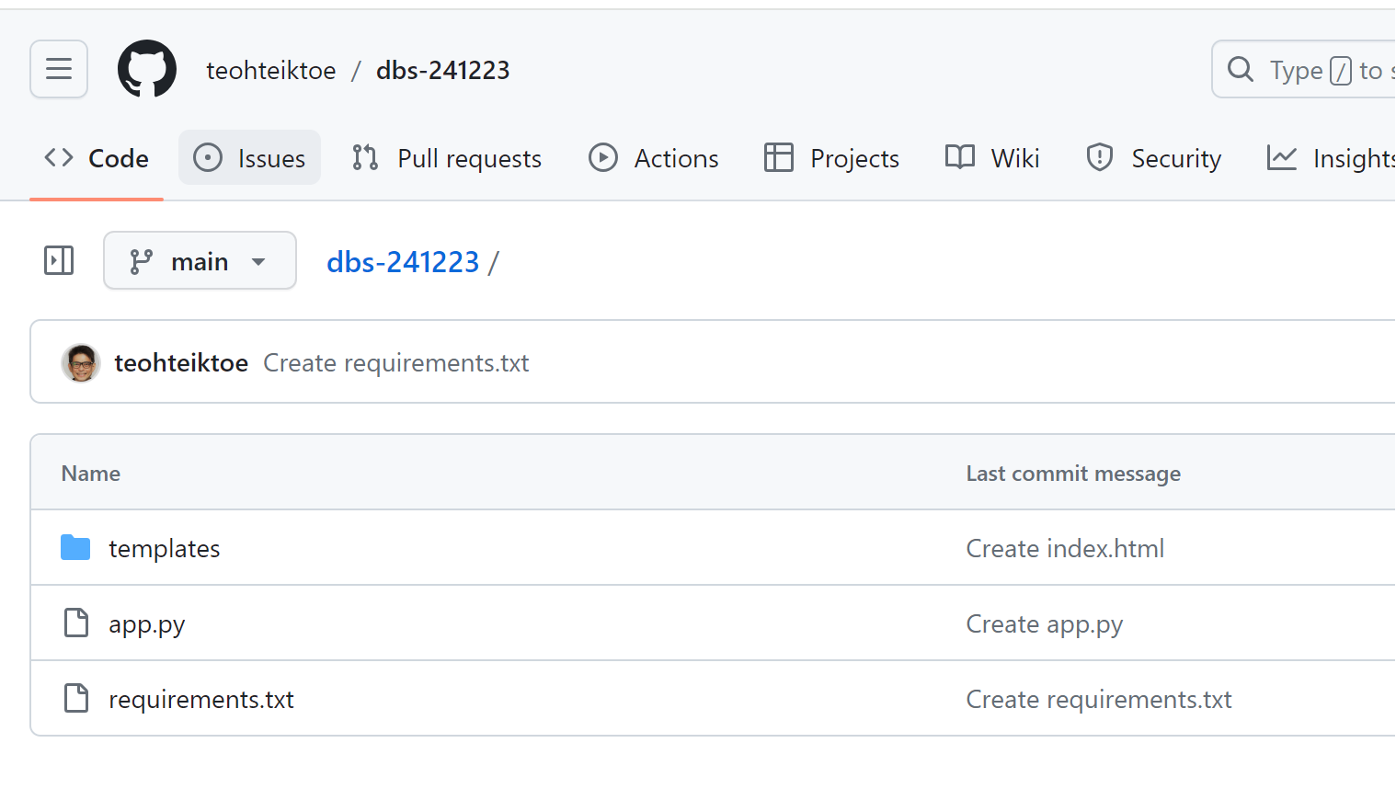
Github – create repository
requirements.txt
gunicorn
flask

Slide 25
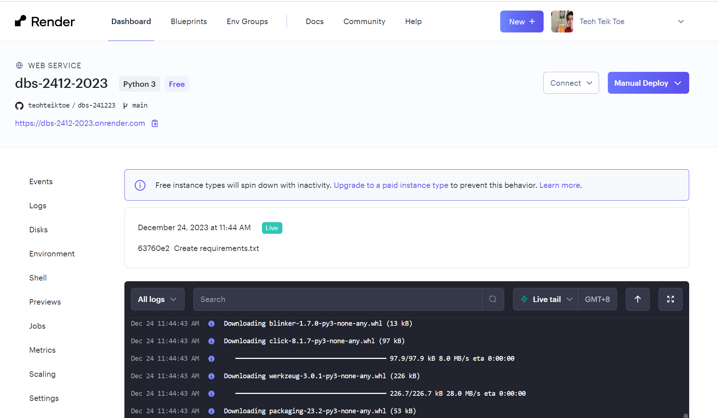
Render.com – create web services

Slide 26
3 pages – submit buttons
from flask import Flask,request,render_template
from textblob import TextBlob
app = Flask(__name__)
@app.route("/",methods=["GET","POST"])
def index():
return(render_template("index.html"))
@app.route("/result",methods=["GET","POST"])
def result():
t = request.form.get("t")
result = TextBlob(t).sentiment
return(render_template("result.html",result=result))
@app.route("/next", methods=["GET","POST"])
def next():
return(render_template("index.html"))
@app.route("/end", methods=["GET","POST"])
def end():
return(render_template("end.html"))
if __name__ == "__main__":
app.run()
Index.html
<html>
<h1>My second ML cloud based model: Text Sentiment</h1>
<form action="/result" method="post">
<p>Please enter the text</p>
<p><input type="text" name="t"></p>
<p><input type="submit" value="Enter"></p>
</form>
</html>
result.html
<html>
<p><h2>6 The sentiment of the text {{result}}</h2></p>
<form action="/next" method="post">
<p><input type=submit value=Next></p>
</form>
<form action="/end" method="post">
<p><input type=submit value=End></p>
</form>
</html>
End.html
<html>
<h1>Thank you</h1>
</html>

Slide 27
Flask with responsive
<style>
.container {
width: 100%;
margin: auto;
}
@media (min-width: 600px) {
.container {
width: 80%;
}
}
@media (min-width: 768px) {
.container {
width: 60%;
}
}
@media (min-width: 1024px) {
.container {
width: 50%;
}
}
</style>
<div class="container">
<h1>Thank you</h1>
</div>

Slide 28
Size button and picture
<img src="“ width="300" height="200">
<form action="/result" method="post">
<p>Please enter the text</p>
<p><input type="text" name="t"></p>
<p><input type="submit" value="Enter" style="width:100px;height:100px;"></p>
</form>

Slide 29
sqllite
import sqlite3
conn = sqlite3.connect('/content/drive/MyDrive/Colab Notebooks/sqllite/database.db')
conn.execute('''CREATE TABLE employee (name varchar(255))''')
conn.close()
conn = sqlite3.connect('/content/drive/MyDrive/Colab Notebooks/sqllite/database.db')
c = conn.execute('SELECT * From employee')
print(c.description)
c.close()
conn.close()
name= input("Enter name: ")
conn = sqlite3.connect('/content/drive/MyDrive/Colab Notebooks/sqllite/database.db')
c = conn.cursor()
c.execute('INSERT INTO employee (name) VALUES(?)',(name,))
conn.commit()
c.close()
conn.close()
conn = sqlite3.connect('/content/drive/MyDrive/Colab Notebooks/sqllite/database.db')
c = conn.execute('''select *
from employee''')
for row in c:
print(row)
c.close()
conn.close()
https://colab.research.google.com/drive/1cqxSAaPmQnFWhp7ie9DpHMmxgewmlQAZ?usp=drive_link

Slide 30
delete
conn = sqlite3.connect('/content/drive/MyDrive/Colab Notebooks/sqllite/database.db')
c = conn.cursor()
c.execute('DELETE FROM employee;',);
conn.commit()
c.close()
conn.close()

Slide 31
Flask with sqllite
requirements.txt
gunicorn
flask
pysqlite3
#create
import sqlite3
conn = sqlite3.connect(r'C:\Users\teoht\OneDrive\Library\AI\Flask\sqllite/data.db')
conn.execute('CREATE TABLE employee (name TEXT)')
conn.close()
#check
conn = sqlite3.connect(r'C:\Users\teoht\OneDrive\Library\AI\Flask\sqllite/database1.db')
c = conn.execute('select * from employee')
print(c.description)
c.close
conn.close()
#query
import sqlite3
conn = sqlite3.connect(r'C:\Users\teoht\OneDrive\Library\AI\Flask\sqllite/data.db')
for row in conn.execute("select * from employee"):
print(row)
conn.close

Slide 32
flask
from flask import Flask, render_template, request
import sqlite3
app = Flask(__name__)
@app.route("/",methods=["GET","POST"])
def index():
return(render_template("index.html"))
@app.route("/log",methods=["GET","POST"])
def log():
name = request.form.get("name")
print(name)
conn = sqlite3.connect(r'C:\Users\teoht\OneDrive\Library\AI\Flask\sqllite/data.db')
c = conn.cursor()
c.execute("""
insert into employee (name)
values(?)
""", (name,))
conn.commit()
c.close()
conn.close()
return(render_template("end.html"))
@app.route("/query",methods=["GET","POST"])
def query():
conn = sqlite3.connect(r'C:\Users\teoht\OneDrive\Library\AI\Flask\sqllite/data.db')
r = ""
for row in conn.execute("select * from employee"):
print(row)
r = r + str(row)
conn.close
print(r)
return(render_template("query.html",r=r))
if __name__ == "__main__":
app.run()

Slide 33
index.html
<h1>Welcome to SQL</h1>
<form action="/log" method="post">
<p>Add Name</p>
<input type = "text" name="name">
<p><input type = "submit" value="Enter"></p>
</form>
<form action="/query" method="post">
<p><input type = "submit" value="Query"></p>
</form>
query.html
<h1>Data is {{r}}</h1>
end.html
<h1>Thank you</h1>

Slide 34
Flask Radio Button – back end
from flask import Flask,request,render_template
app = Flask(__name__)
@app.route("/",methods=["GET","POST"])
def index():
if request.method == "POST":
a = request.form['options']
print(a)
return(render_template("index.html"))
if __name__ == "__main__":
app.run()
@app.route("/answer",methods=["GET","POST"])
def answer():
a = request.form["options"]
print(a)
if a == "true":
print("wrong answer")
elif a=="false":
print("right answer")
return(render_template("end.html"))

Slide 35
Radio button
For back end
For display
<html>
<h1>radio button 5</h1>
<form action="/" method="post" >
<p>
<input type="radio" name="options" id="option1" value="option1"> Option1 </input><br>
<input type="radio" name="options" id="option2" value="option2"> Option2 </input><br>
<input type="radio" name="options" id="option3" value="option3"> Option3 </input><br>
</p>
<p><input type=submit value="Next"></p>
</form>
</html>
<h2>Accepting gifts from a client in a competitive bidding process is ethically permissible.</h2>
<form action="/answer" method="post">
<p><input type ="radio" name="options" id="True" value="True">True</input></p>
<p><input type ="radio" name="options" id="false1" value="false2">false3</input></p>
<p><input type="submit" value="Enter"></p>
</form>

Slide 36
Declare global
first_time = 1
name = ""
@app.route("/",methods=["GET","POST"])
def index():
return(render_template("index.html"))
@app.route("/main",methods=["GET","POST"])
def main():
global first_time, name
if first_time == 1:
name = request.form.get("name")
first_time = 0
return(render_template("main.html",r=name))

Slide 37
timestamp
import sqlite3
import datetime
conn = sqlite3.connect('/content/drive/MyDrive/Colab Notebooks/sqllite/database1.db')
conn.execute('CREATE TABLE employee (name text, timestamp timestamp)')
conn.close()
import sqlite3
import datetime
conn = sqlite3.connect('/content/drive/MyDrive/Colab Notebooks/sqllite/database1.db')
conn.execute('CREATE TABLE employee (name text, timestamp timestamp)')
conn.close()
name= input("Enter name: ")
currentDateTime = datetime.datetime.now()
currentDateTime
conn = sqlite3.connect('/content/drive/MyDrive/Colab Notebooks/sqllite/database1.db')
c = conn.cursor()
c.execute('INSERT INTO employee (name,timestamp) VALUES(?,?)',(name,currentDateTime))
conn.commit()
c.close()
conn.close()
conn = sqlite3.connect('database1.db')
c = conn.execute('''select *
from employee''')
r=""
for row in c:
print(row)
r = r + str(row)
c.close()
conn.close()

Slide 38
git?
We need to first configure our name and email git config --global user.email “Email Address” (eg git config --global user.email "teohteiktoe@gmail.com") git config --global user.name "Name"
To check:
git config –-global user.name
git init
git add README.md
git commit -m "first commit"
git branch -M main
git remote add origin https://github.com/teohteiktoe/test.git
git push -u origin main

