Slide 1
ChatBot Snatchbot
Teoh Teik Toe
ITOM/NBS
ttteoh@ntu.edu.sg
97905202

Slide 2
Recording
https://1drv.ms/v/s!Aik2a4x7tvLyi6xKkuR_JWNK9Ejl3w?e=7ADniB
https://1drv.ms/v/s!Aik2a4x7tvLyi6xJAMQVDLgknlp0sw?e=qXz1uJ

Slide 3
Agenda
Create a simple Course FAQ chatbot using Snatchbot
Launch the chatbot in Telegram
Understand the ecosystem of Chatbot with Snatchbot

Slide 4
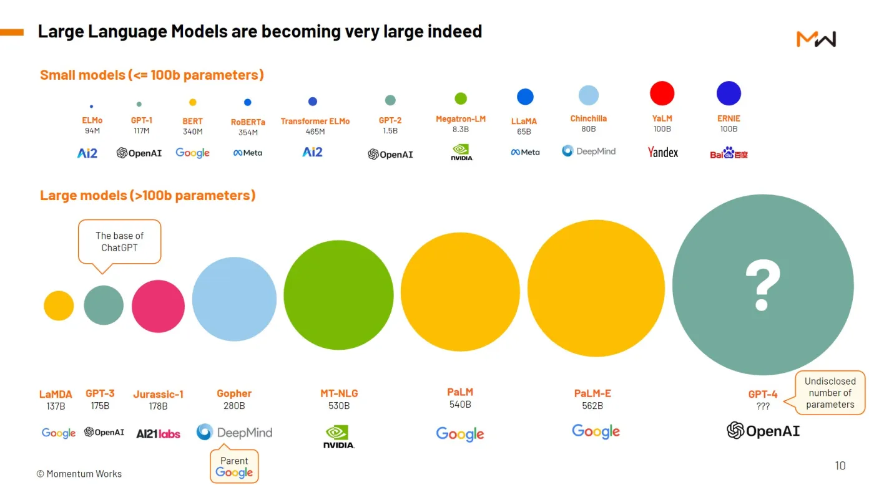
Large Language Model (LLM)

Slide 5
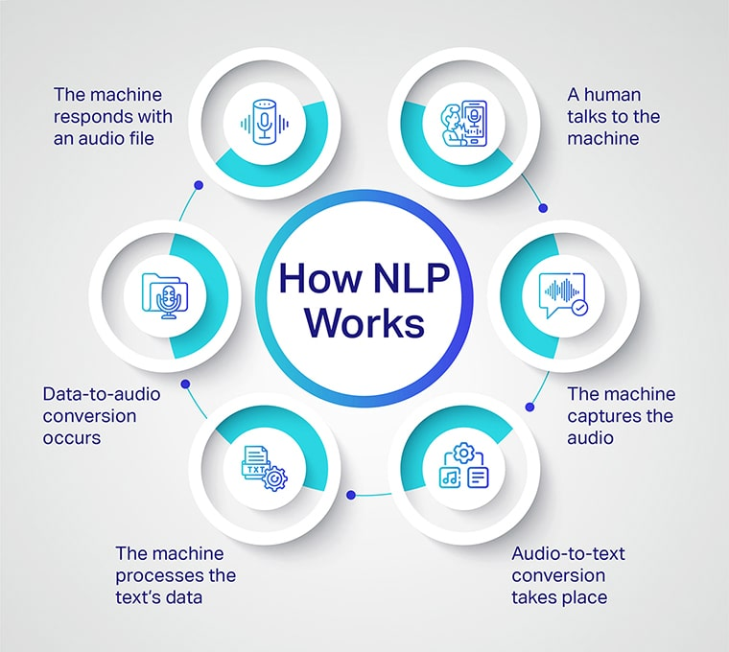

Slide 6
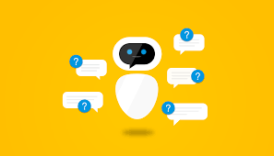
Chatbot
A chatbot is a software application used to conduct an on-line chat conversation via text or text-to-speech, in lieu of providing direct contact with a live human agent.

Slide 7
Snatchbot
SnatchBot was founded in 2015 by Henri Ben Ezra and Avi Ben Ezra as part of the flood of technological innovations and startups that come from Israel , more precisely Herzlia Pituach .
In July 2017, Snatchbot was one of the sponsors of the Chatbot summit in Berlin . By December 2017, more than 30 million users had contacted chatbots that were created on the SnatchBot platform.

Slide 8
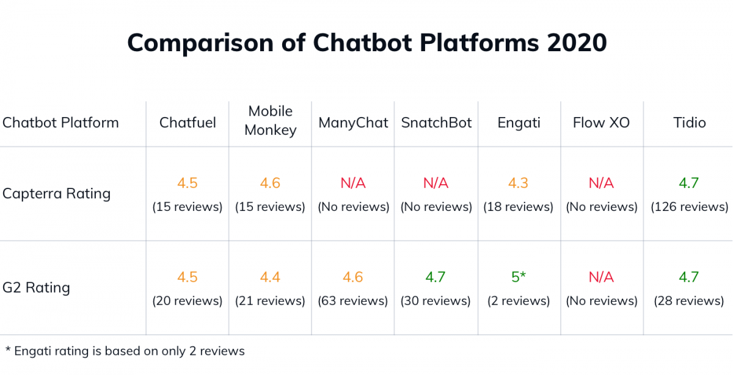
G2 Rating

Slide 9
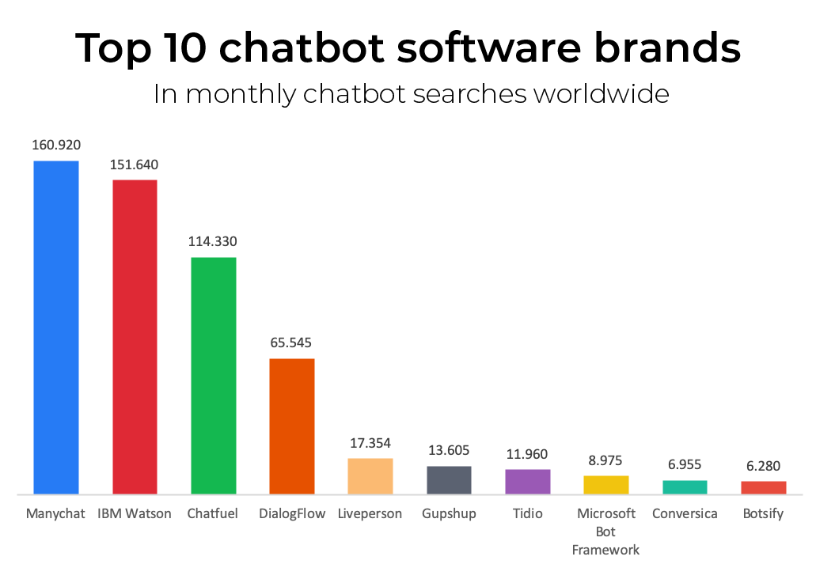
types of chatbot
https://images.app.goo.gl/qkzwk27jzj7Nx8B59

Slide 10
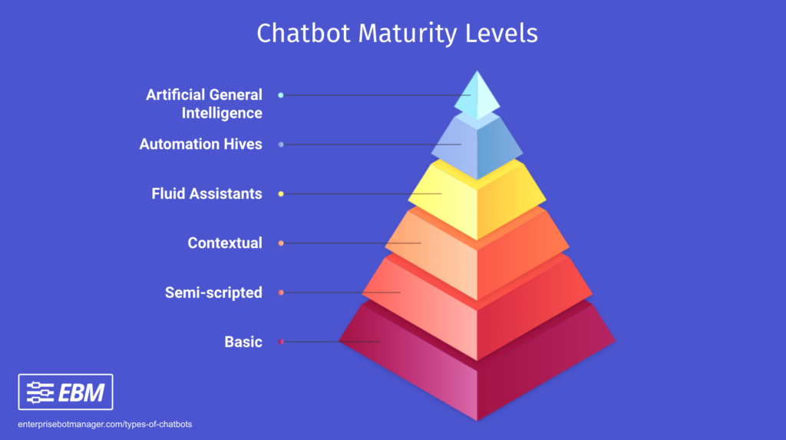
types of chatbot
https://images.app.goo.gl/MJSsjL1mHdUY2FRs5

Slide 11
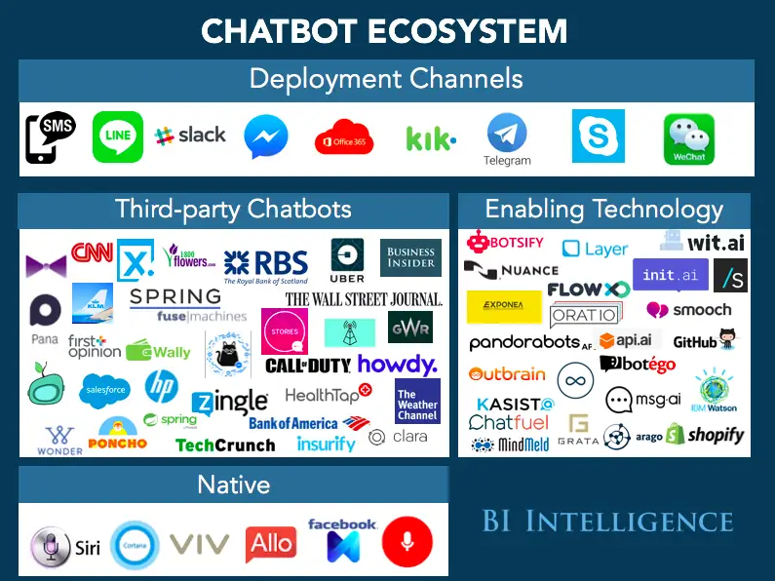
ChatBOT ECOSYSTEM
https://images.app.goo.gl/eM2g3SE9ZXuVyY9k7

Slide 12
Creating Chatbot

Slide 13
Risk Management Chatbot
Create Chatbot for Risk Management
Depending on the age, suggest different profile

Slide 14
Create a chatbot (Add Interaction, Add Connection, remember?)
Picture (Welcome)
Save chatbot
Input (Main)
Synonyms
Weblink
Email
Set Variable
Conditional Statement (if)
NLP
Email Address Interaction

Slide 15
Snatchbot registration
Use browser navigate to https://snatchbot.me/
Click Register to Sign Up.
Open your mailbox to activate the account and Log in to snatchbot.me

Slide 16
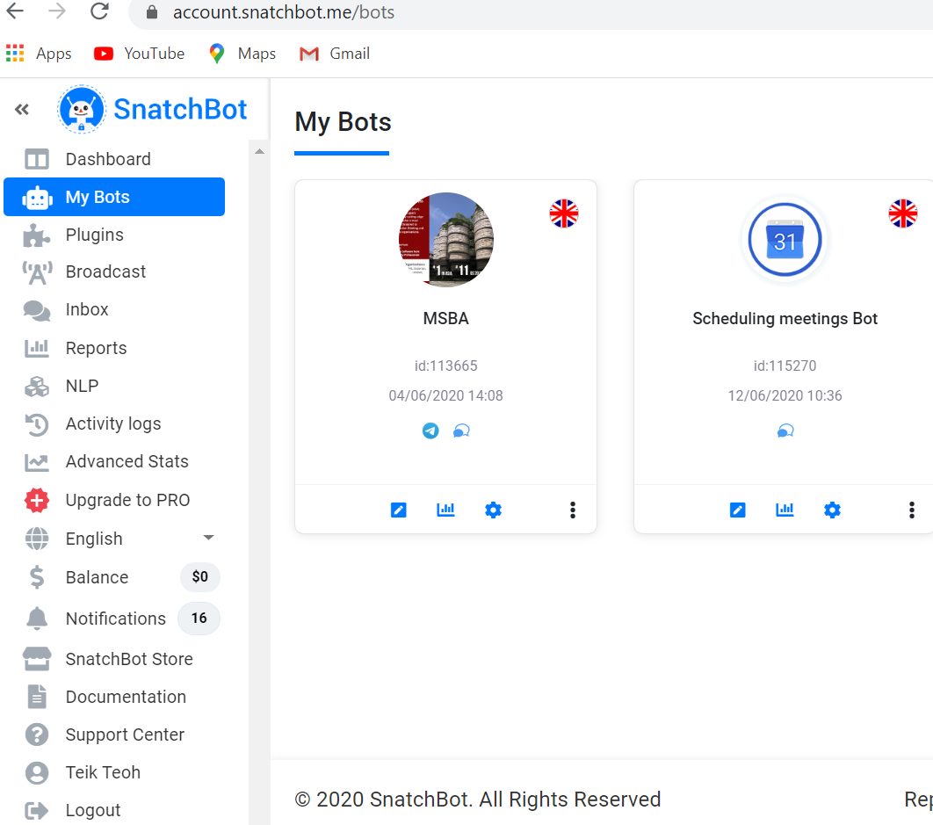

Slide 17
Creating a simple chatbot
Click on Blank Bot

Slide 18
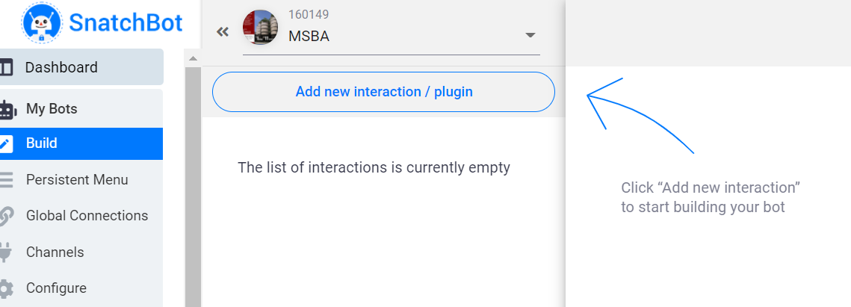
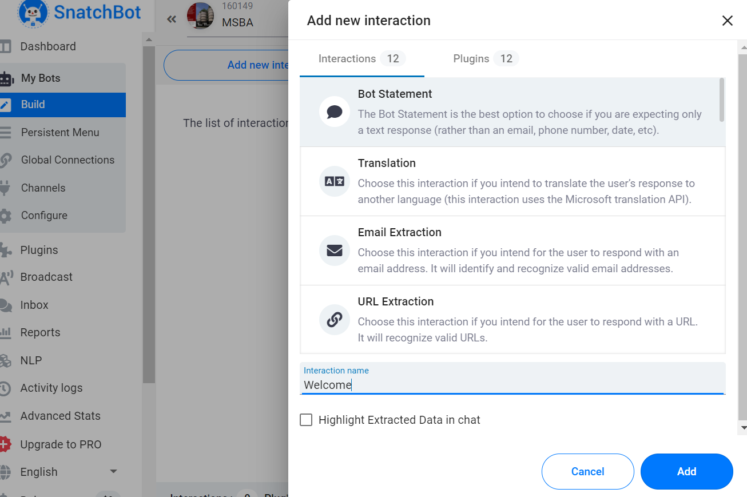
Add new interaction - Welcome

Slide 19
Bot Message – Welcome to MSBA, please enter your name

Slide 20
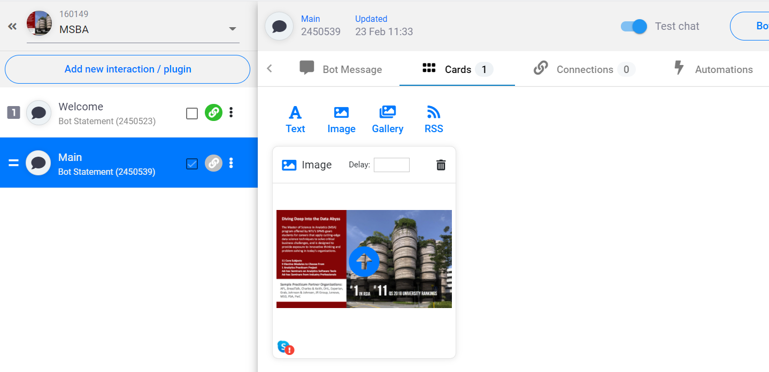
Add a photo in Welcome

Slide 21
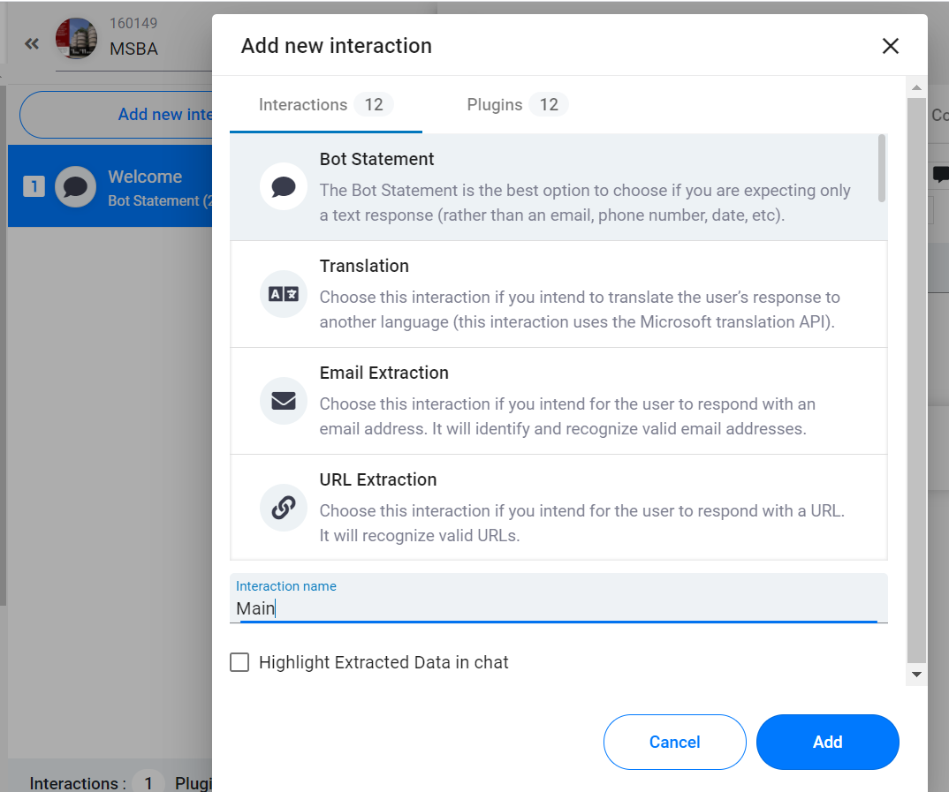
Add another interaction - Main

Slide 22
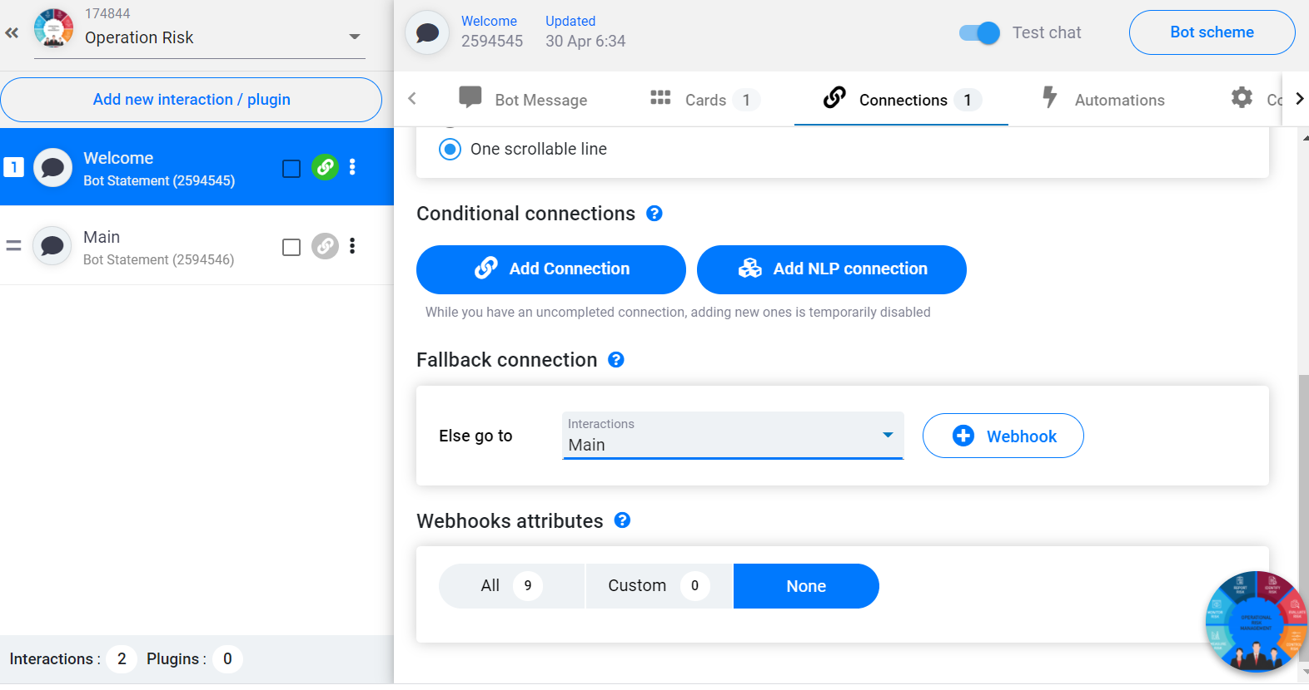
In Welcome Connection, Select Fall Back to Main

Slide 23
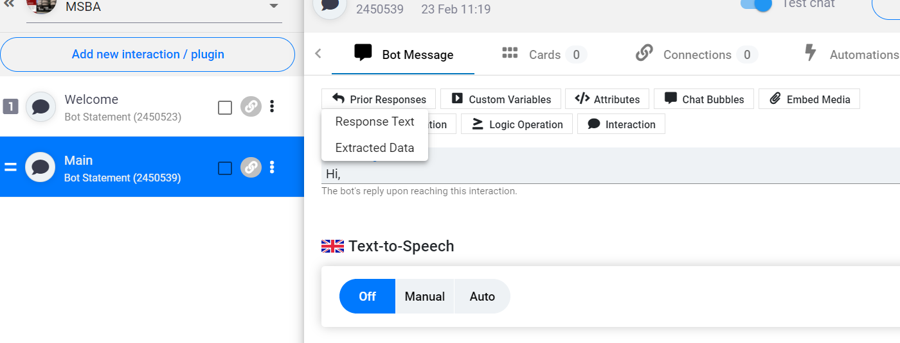
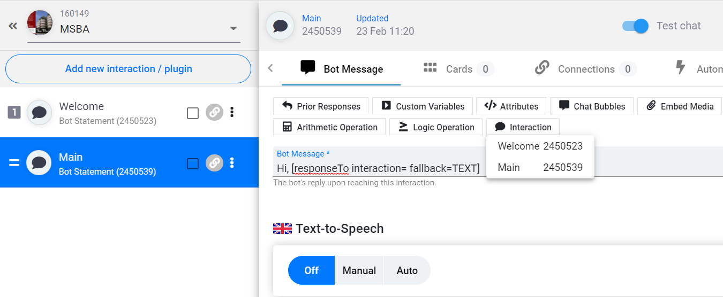
Use prior response and then replace ID with interaction from welcome
Hi, [responseTo interaction=2450523 fallback=TEXT]. MSBA is a Programme to take you into the World of Data Analytics.

Slide 24
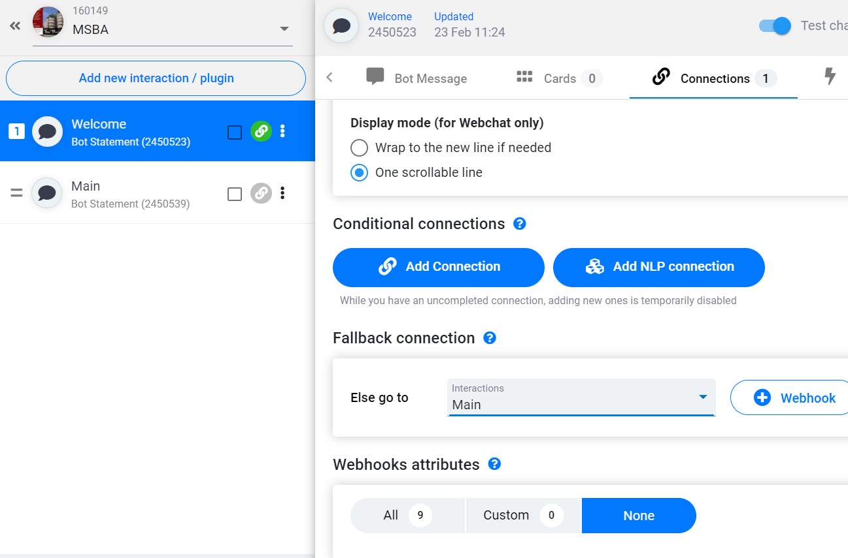
Connect Welcome to Main Using Fall Back Connection

Slide 25
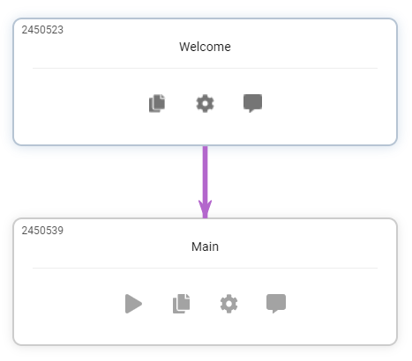
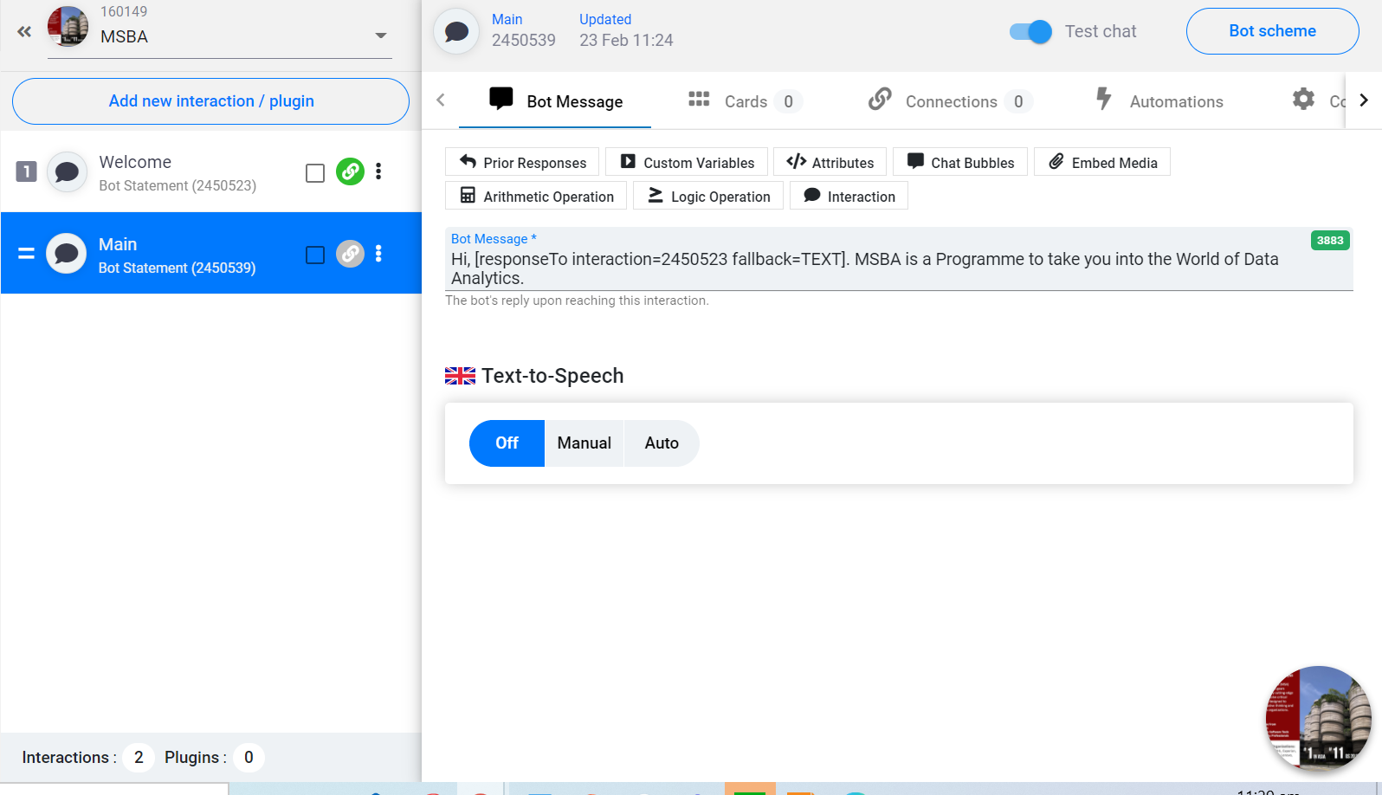
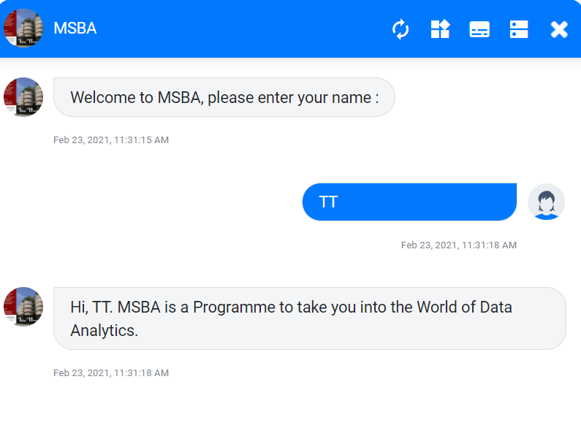
Test Run & Bot Scheme

Slide 26
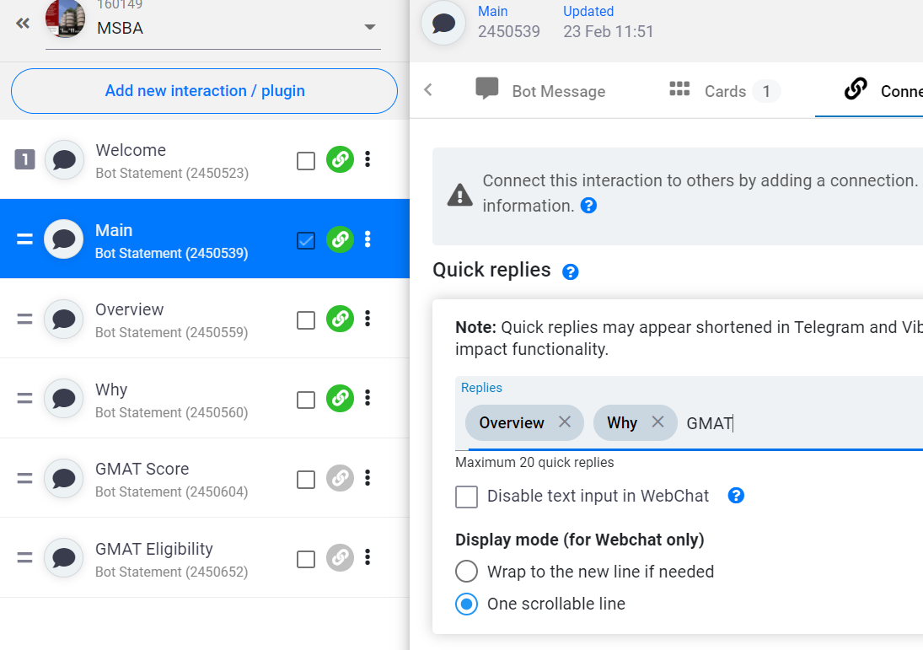
Variable and If Statement Crete 2 new interaction, GMAT Score and GMAT Eligibility and link main to GMAT

Slide 27
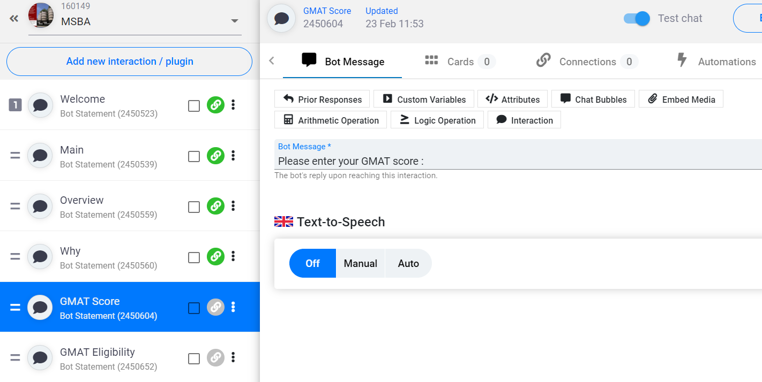
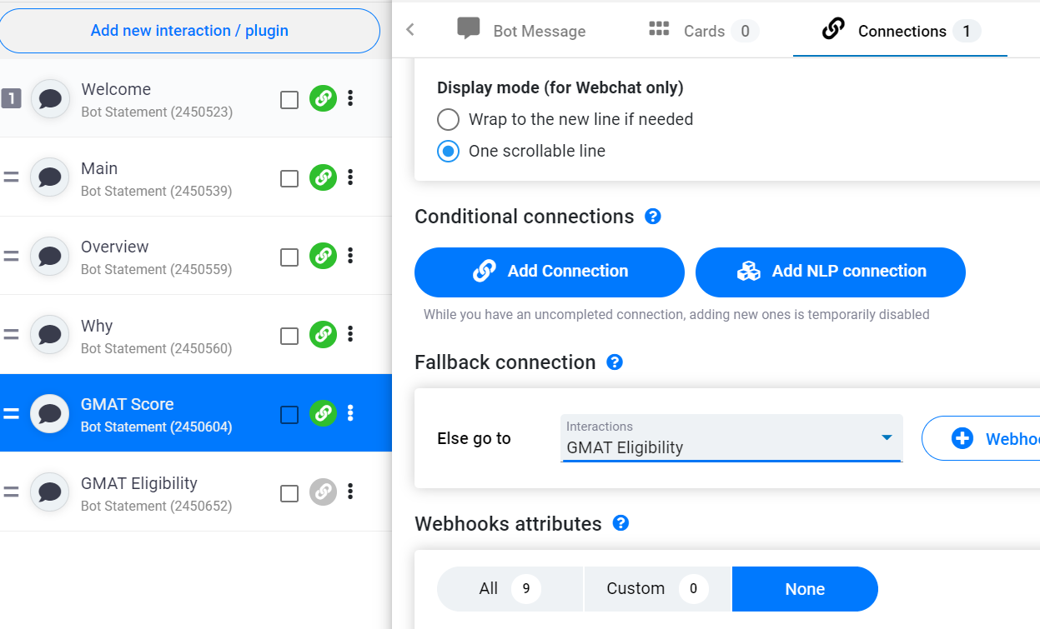
GMAT Score, Fall Back Connection to GMAT Eligibility

Slide 28
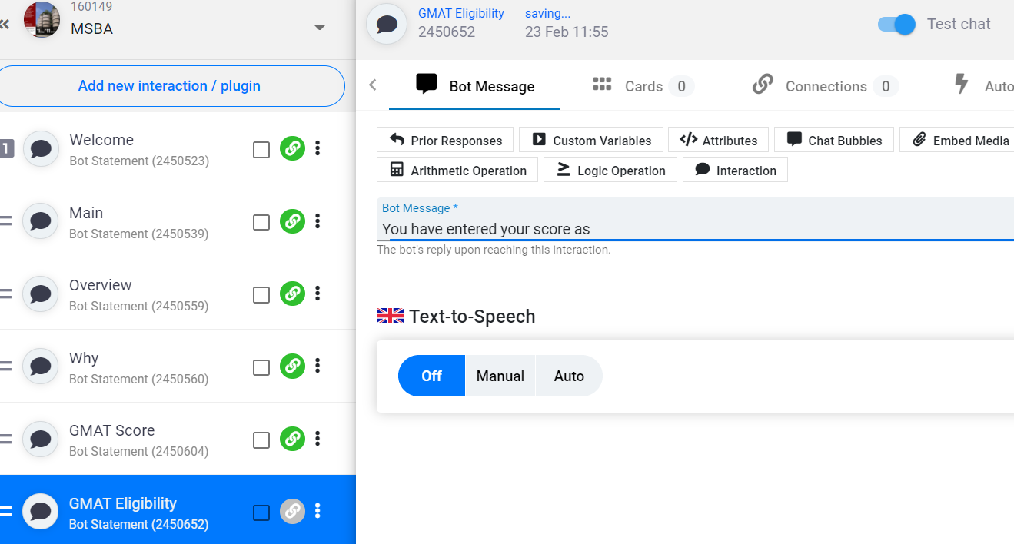
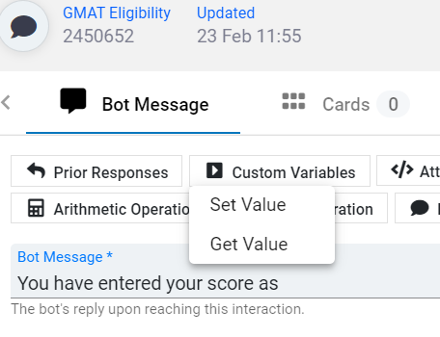
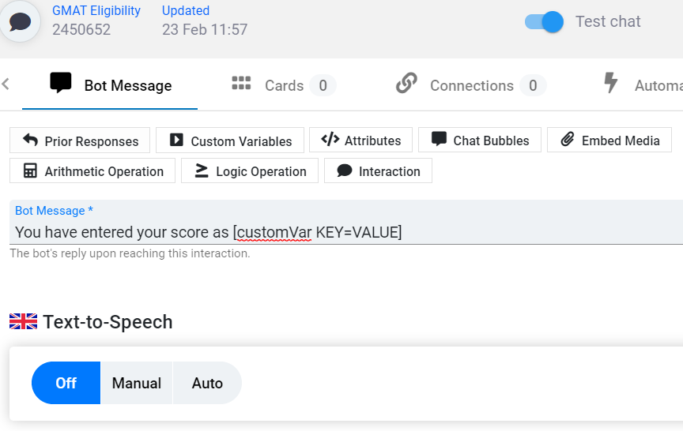
SET Variable: value change to prior response (remember to change the ID to GMAT Score) show variable using Get Value in Custom Variable (Change to GMAT)
Bot Message:
You have entered your score as [customVar GMAT=[responseTo interaction=2450604 fallback=TEXT]][showVar=GMAT]

Slide 29
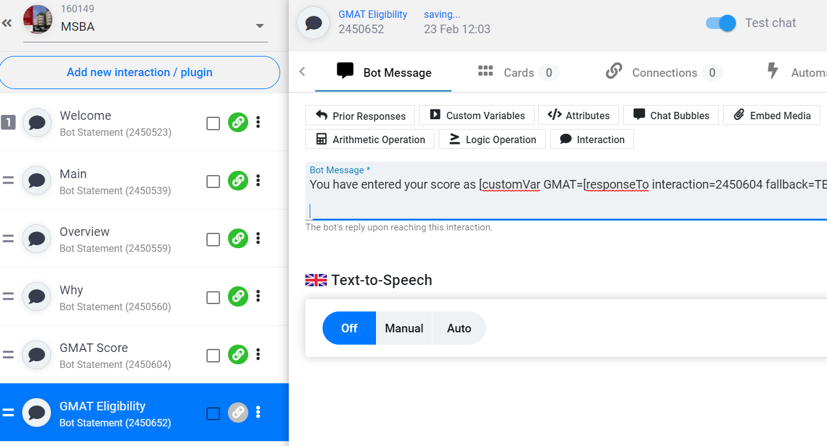
After creating GMAT variable, use the if statement
Use Logic Operation
[IF([showVar=GMAT]=700){Congratulation, you are eligible.}]
[IF([showVar=GMAT]>700){Congratulation, you are eligible}]
[IF([showVar=GMAT]<700){Sorry, please take another GMAT test, we need a score of 700 and above.}]
Bot Message:
You have entered your score as [customVar GMAT=[responseTo interaction=2450604 fallback=TEXT]][showVar=GMAT]
[IF([showVar=GMAT]=700){Congratulation, you are eligible.}]
[IF([showVar=GMAT]>700){Congratulation, you are eligible}]
[IF([showVar=GMAT]<700){Sorry, please take another GMAT test, we need a score of 700 and above.}]

Slide 30
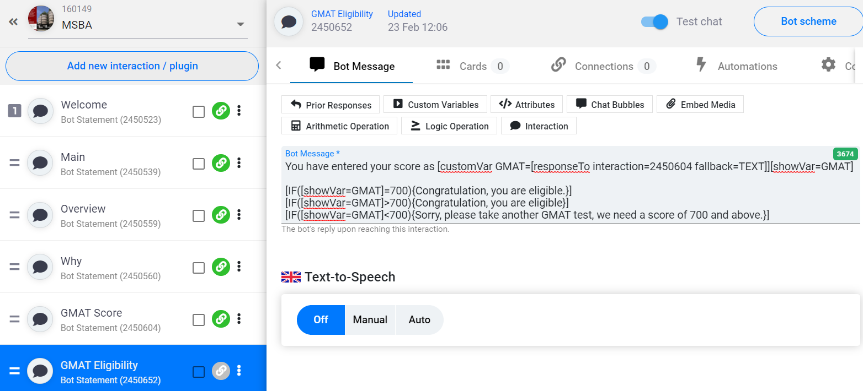
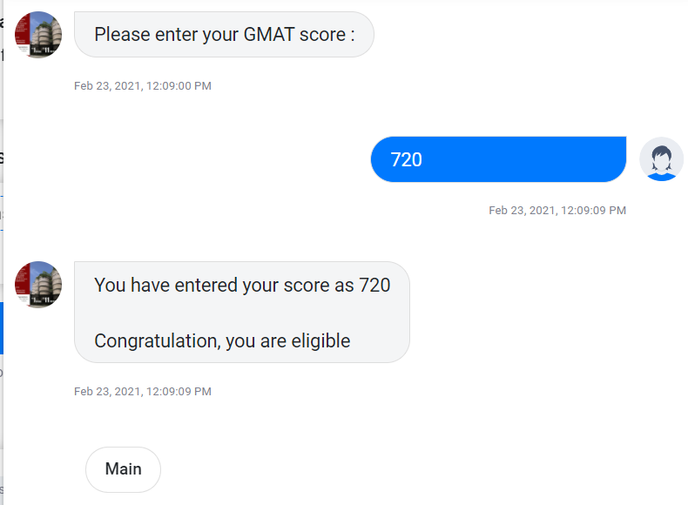
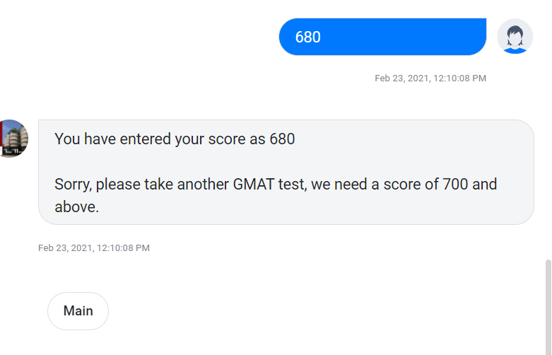
Connect GMAT Eligibility to Main and Run

Slide 31
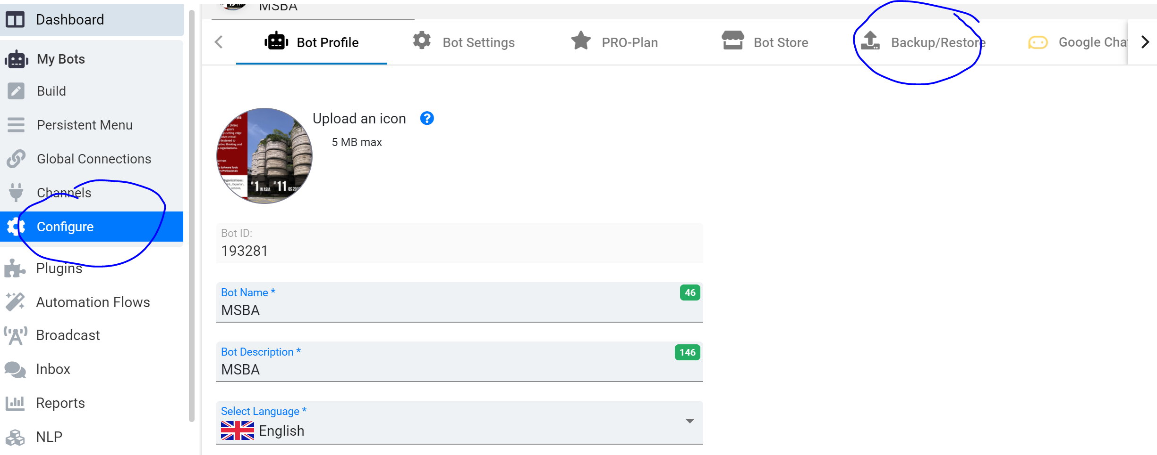
Save as a file

Slide 32
Deploying the chatbot on telegram
Click on channels
Click on telegram

Slide 33
Deploying the chatbot on telegram
Download telegram
Create an account
Go to telegram web at https://web.telegram.org/
Type BotFather in the search bar

Slide 34
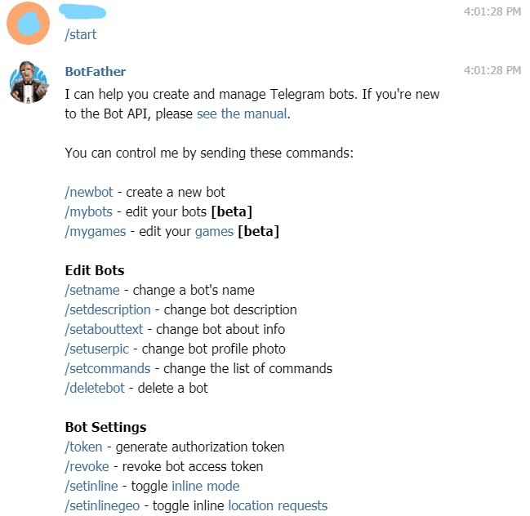
Deploying the chatbot on telegram
Click on the start button or press /start

Slide 35
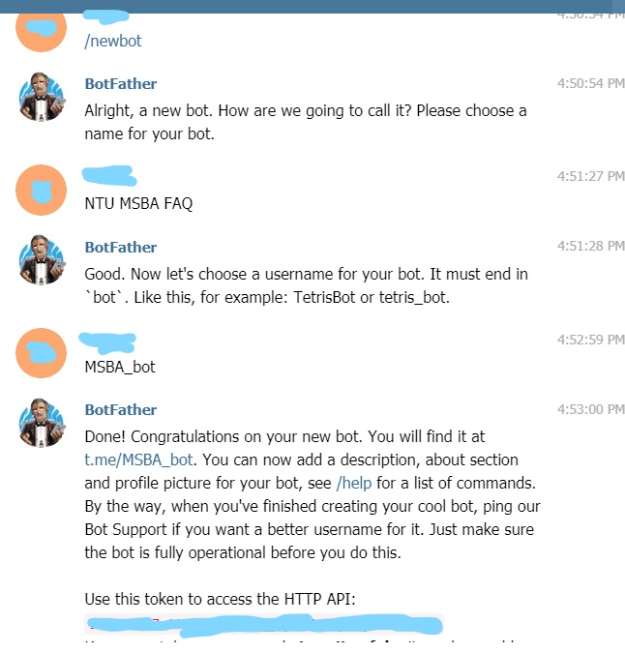
Deploying the chatbot on telegram
Type /newbot
Type the name of your telegram bot in our example it is “NTU MSBA FAQ”
Type the unique telegram username for your bot in our example it is “MSBA_bot”
Copy the token

Slide 36
Deploying the chatbot on telegram
Go back to snatchbot and scroll down to click on step 3.
Paste the Telegram API token

Slide 37
Deploying the chatbot on telegram
Click Deploy

Slide 38
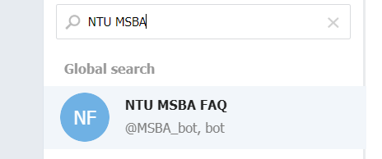
Finding chatbot on telegram
In the telegram search bar type in the name of your telegram bot and find it.
Click on your telegram bot
Press start to begin chatting

