Slide 1
Robotic Process Automation
Teoh Teik Toe
ITOM/NBS
ttteoh@ntu.edu.sg
97905202

Slide 2
Recording: https://1drv.ms/v/s!Aik2a4x7tvLyi6xHOOZ2Mrv7Sa1LBA?e=fLNNyf

Slide 3
Youtube: RPA: https://youtu.be/9URSbTOE4YI?si=MQli4rNKDdE1egbs UiPath https://youtu.be/S8vyutaQgZ8?si=RX470cHY4eHFhqSg https://youtu.be/5i5CJsFnEj0?si=JoM1o_Bm6RFpWiHG https://youtu.be/5i5CJsFnEj0?si=k2QEKuaKPcbAV5d3 https://youtu.be/5i5CJsFnEj0?si=Bqv7r0ONIdnYp958 https://youtu.be/IejDU8U63mY?si=J1sREYIMo2wjiVm- login https://youtu.be/pYdnE6dc_Bk?si=erejKRgnD2DY3Q6t Recording: https://1drv.ms/v/s!Aik2a4x7tvLyi6xHOOZ2Mrv7Sa1LBA?e=fLNNyf

Slide 4
Objective
To know about Robotic Process Automation and able to use UiPath to automate processes
To create a simple automated process using UiPath
To develop RPA programming skill

Slide 5
Agenda
Intro to RPA
UiPath
Exercise
Discussion
Review
Examples of RPA:https://mindmajix.com/30-rpa-examples

Slide 6
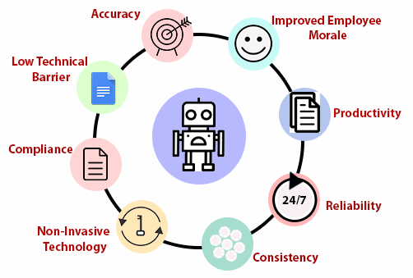
Why RPA

Slide 7
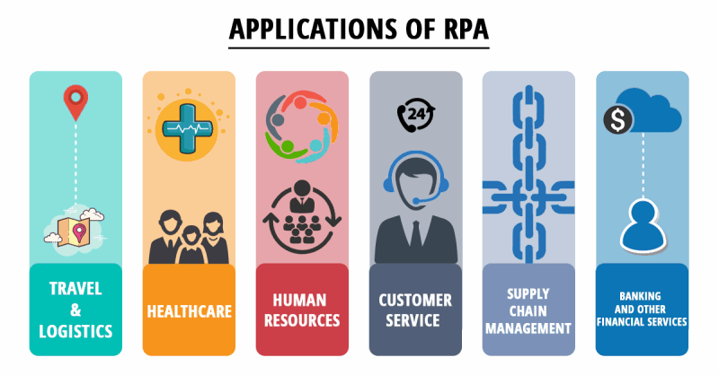

Slide 10
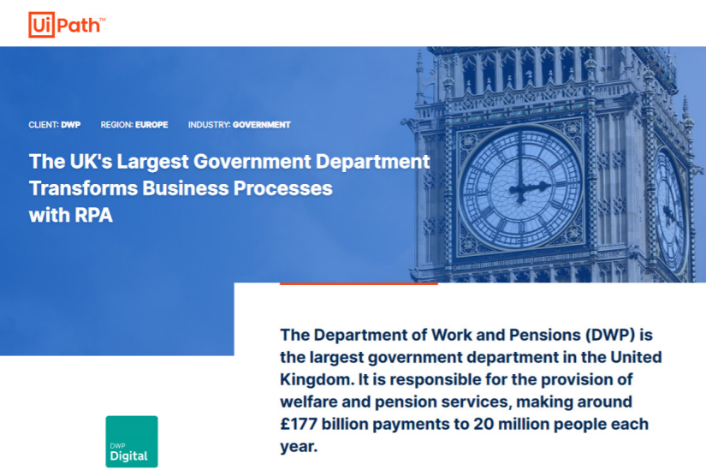
Used Case in RPA
https://cdn.featuredcustomers.com/CustomerCaseStudy.document/Department_for_Work_and_Pensions_4VRL0kX.pdf

Slide 11
Processes can be automated with RPA
Word
Email
Excel
Browser
Other application such as Calculator

Slide 14
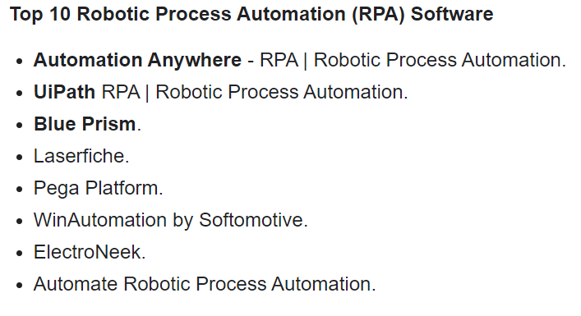
Why we choose UiPATH (Rank #2 by G2)
https://www.g2.com/categories/robotic-process-automation-rpa

Slide 15
RPA Studio Web

Slide 16
Basic programming – Only application to certain function
Variable
Operator
Control Statement
Basic Syntax:
Write line
$”{Z}” print variable for both text and number
“Hi, ” + “how are you”
"B is " + $"{B}“ combine
string.Format("X is {0}, Y is {1} and Z is {2}", X,Y,Z)

Slide 17
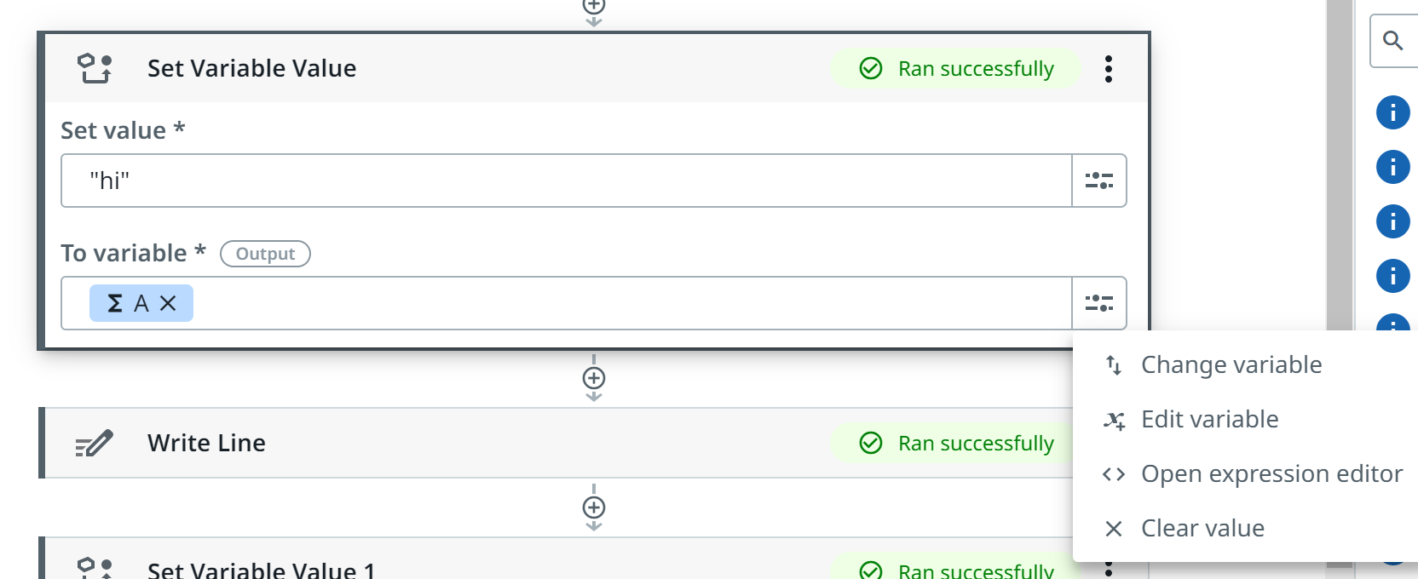
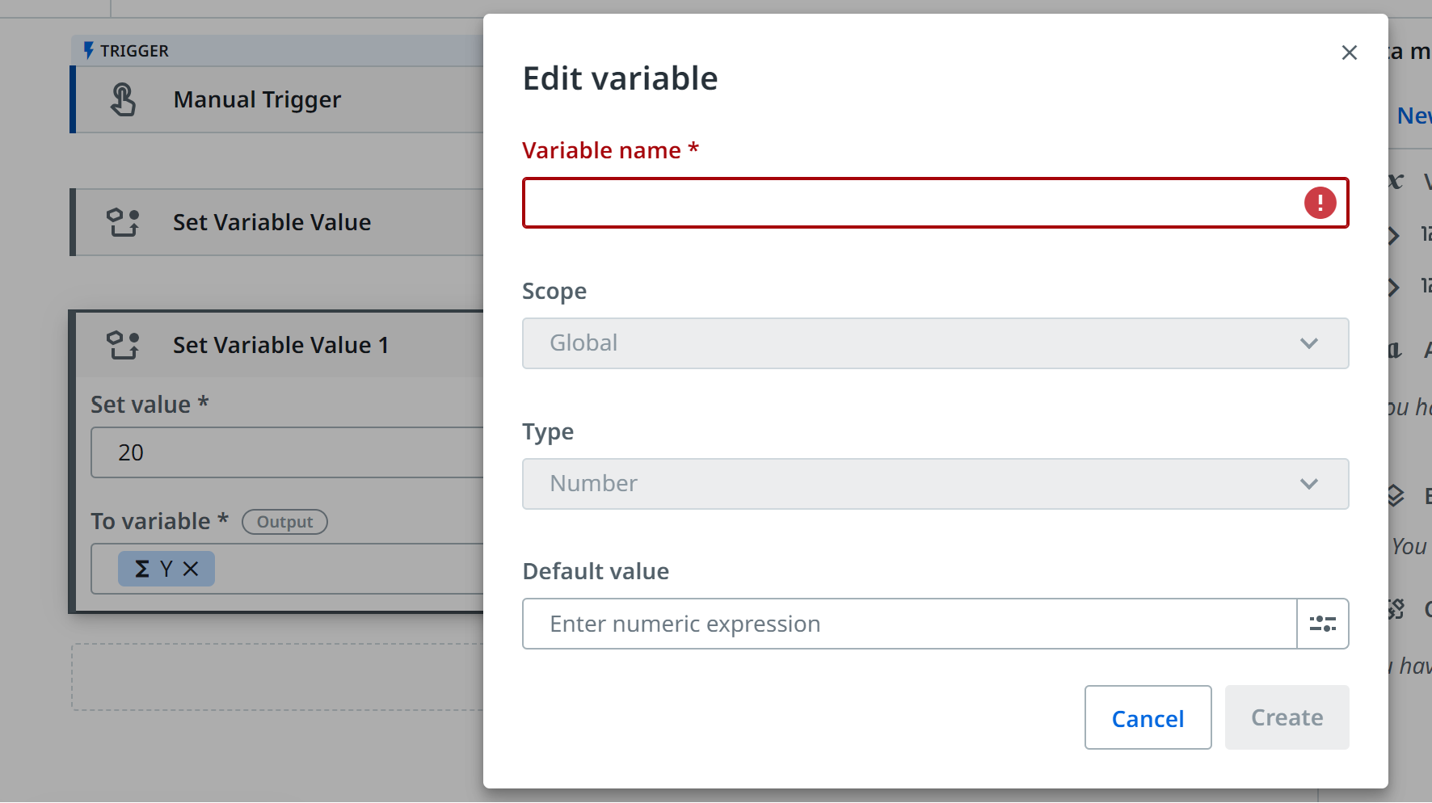
Set variable – string use “”

Slide 18
Practise
Set NAME as XXX
Set Age as xx
Write line

Slide 19
Number operator +-/*
Set
X as 10
Y as 20
Write line
Expression editor
"total is " + $"{X+Y}“
Try store in Z and write line
string.Format("X is {0}, Y is {1} and Z is {2}", X,Y,Z)

Slide 20
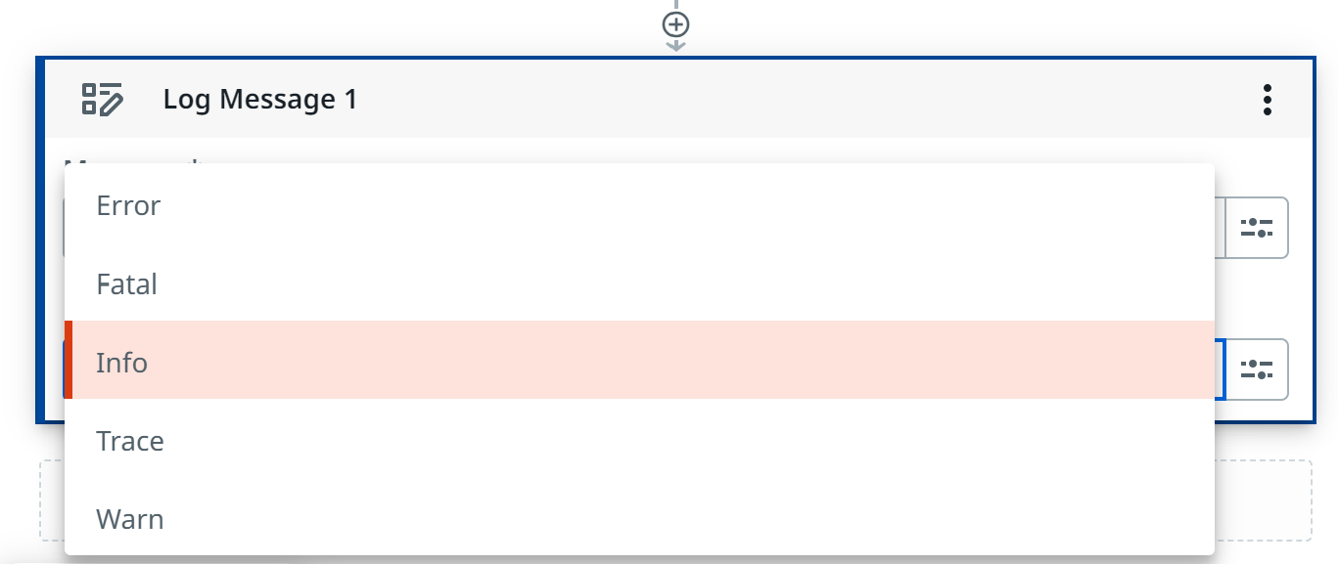
For log (same as write line) – use Info

Slide 21
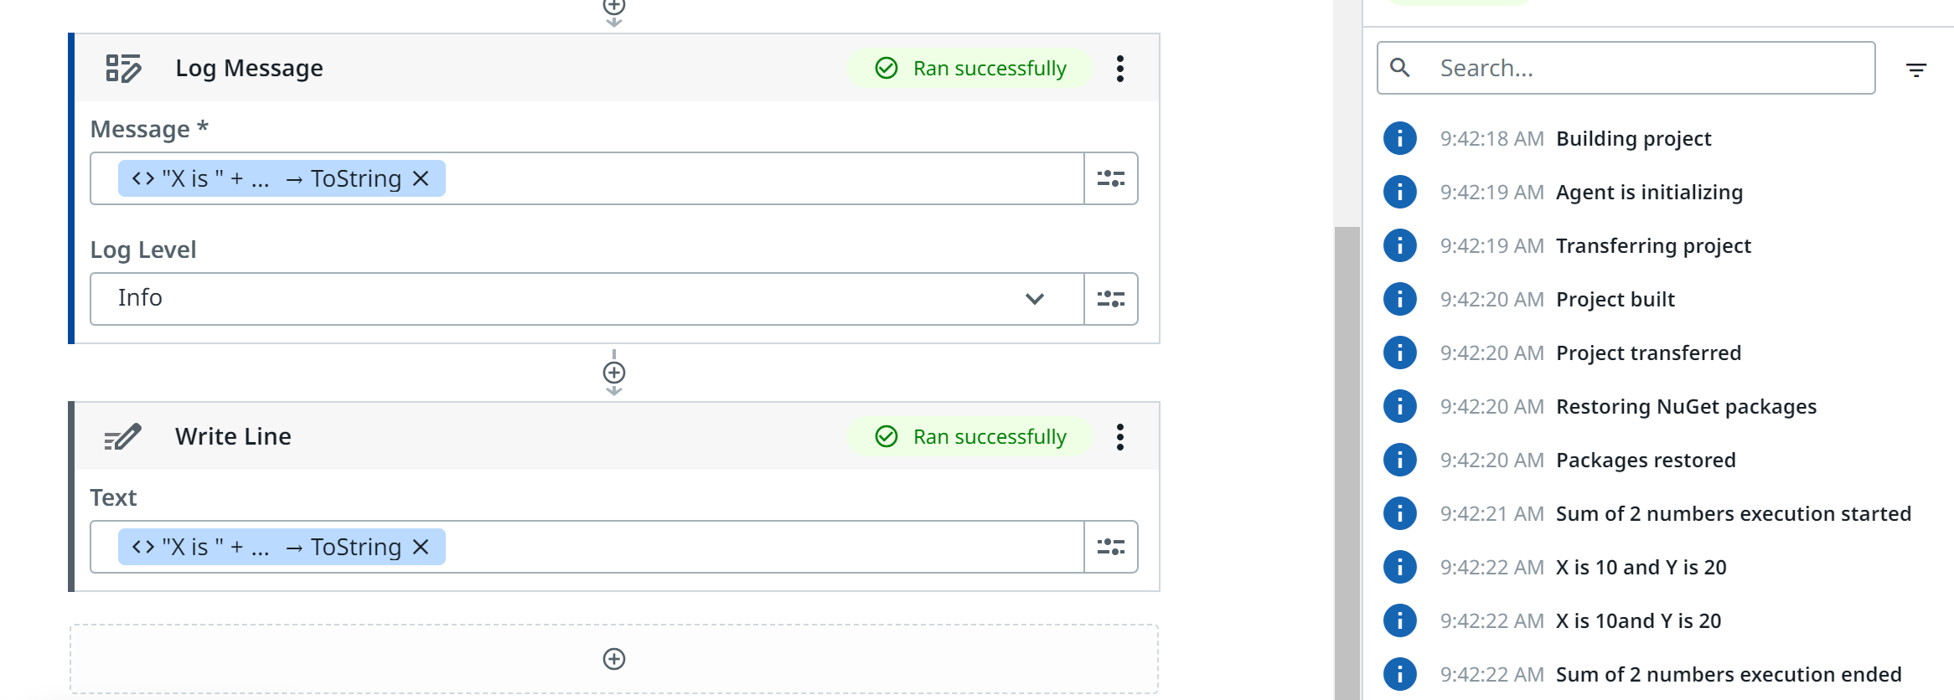
Write lines give you the same effect

Slide 22
Practise 1+2=3 (sum)
Set variable X=1,Y=2
Log message (open expression editor) “x is” string.Format("{0}", X)
Log message (open expression editor) "total is " + $"{X+Y}“
Set variable A=“Hi”
Log message string.Format("{0}", A)

Slide 23
Practise
Exercise | Description | Code | Output
1 | Calculate the sum of two numbers | x = 10<br/>y = 20<br/>sum = x + y<br/>print("The sum of", x, "and", y, "is", sum) | The sum of 10 and 20 is 30
2 | Calculate the difference of two numbers | x = 50<br/>y = 30<br/>difference = x - y<br/>print("The difference of", x, "and", y, "is", difference) | The difference of 50 and 30 is 20
3 | Calculate the product of two numbers | x = 8<br/>y = 7<br/>product = x * y<br/>print("The product of", x, "and", y, "is", product) | The product of 8 and 7 is 56
4 | Calculate the quotient of two numbers | x = 40<br/>y = 8<br/>quotient = x // y<br/>print("The quotient of", x, "and", y, "is", quotient) | The quotient of 40 and 8 is 5
5 | Calculate the remainder of two numbers | x = 25<br/>y = 4<br/>remainder = x % y<br/>print("The remainder of", x, "and", y, "is", remainder) | The remainder of 25 and 4 is 1
6 | Calculate the square of a number | x = 6<br/>square = x * x<br/>print("The square of", x, "is", square) | The square of 6 is 36
7 | Calculate the cube of a number | x = 3<br/>cube = x * x * x<br/>print("The cube of", x, "is", cube) | The cube of 3 is 27
8 | Calculate the absolute value of a number | x = -15<br/>absolute_value = abs(x)<br/>print("The absolute value of", x, "is", absolute_value) | The absolute value of -15 is 15
9 | Calculate the power of a number | x = 2<br/>y = 3<br/>power = x ** y<br/>print(x, "raised to the power of", y, "is", power) | 2 raised to the power of 3 is 8
10 | Calculate the square root of a number | x = 16<br/>square_root = x ** 0.5<br/>print("The square root of", x, "is", square_root) | The square root of 16 is 4.0

Slide 24
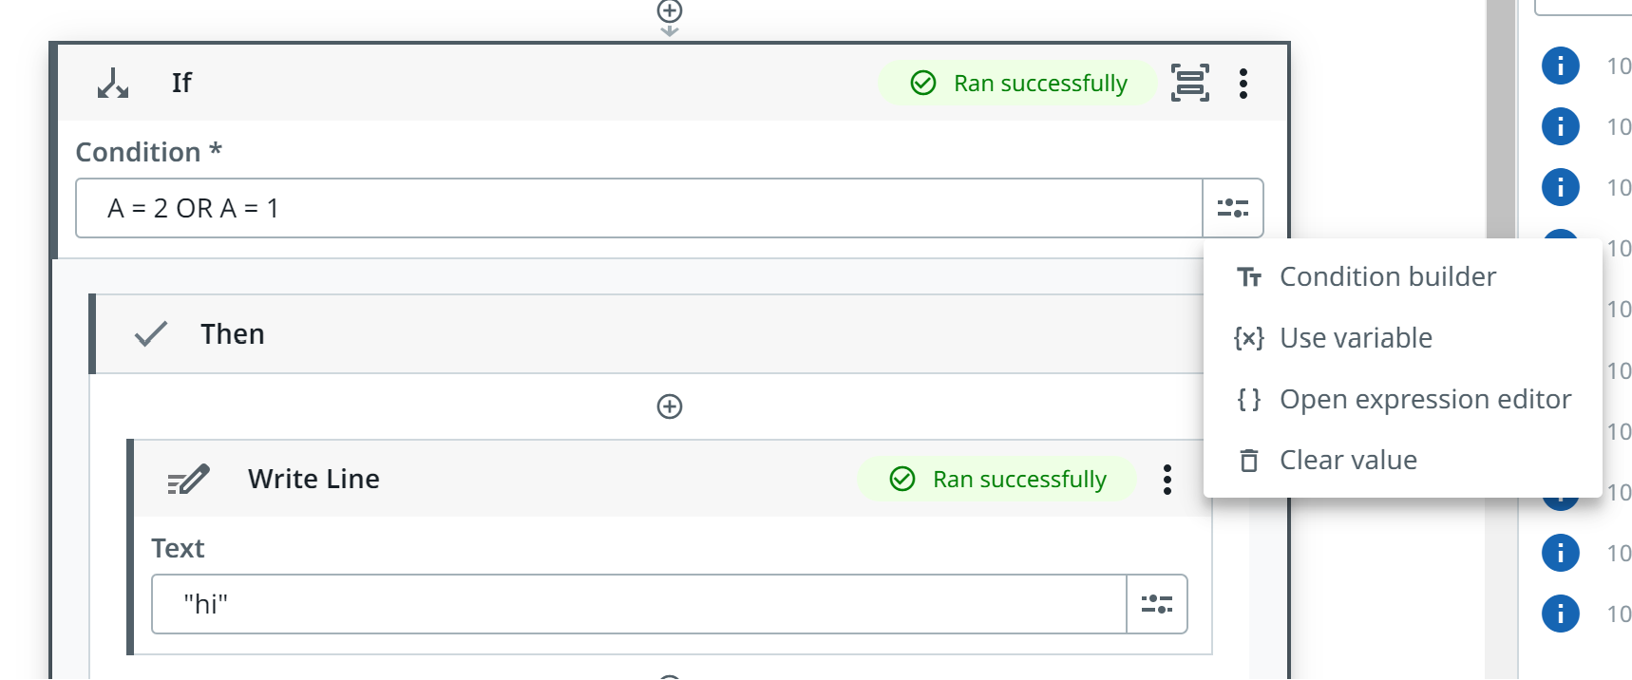
If then else
Basic command
A = 1
A = 2 OR A = 1

Slide 25
If you wanted more condition

Slide 26
Practise
Create a variable A and set A to 10
Set the condition > 5 then and else condition
Note: use if-then-else

Slide 27
Practise
Check if a number is even or odd
number = 10 if number % 2 == 0: print(number, "is even") else: print(number, "is odd")
Check if a number is positive, negative, or zero
python number = -5 if number > 0: print(number, "is positive") elif number == 0: print(number, "is zero") else: print(number, "is negative") ``` | -5 is negative | |
Check if a character is a vowel or consonant
python character = "a" vowels = "aeiouAEIOU" if character in vowels: print(character, "is a vowel") else: print(character, "is a consonant") ``` | a is a vowel | |
Check if a year is a leap year
python year = 2024 if year % 4 == 0 and (year % 100 != 0 or year % 400 == 0): print(year, "is a leap year") else: print(year, "is not a leap year") ``` | 2024 is a leap year | |

Slide 28
5. Check if a student is eligible for a scholarship
python marks = 85 attendance = 90 if marks >= 90 and attendance >= 80: print("The student is eligible for a scholarship") else: print("The student is not eligible for a scholarship") ``` | The student is not eligible for a scholarship
6. Check if a customer is eligible for a discount
python customer_type = "Gold" purchase_amount = 100 if customer_type == "Gold" and purchase_amount >= 50: print("The customer is eligible for a discount") else: print("The customer is not eligible for a discount") ``` | The customer is eligible for a discount | These are just a few examples of how to use simple if-then-else conditions in Python.

Slide 29
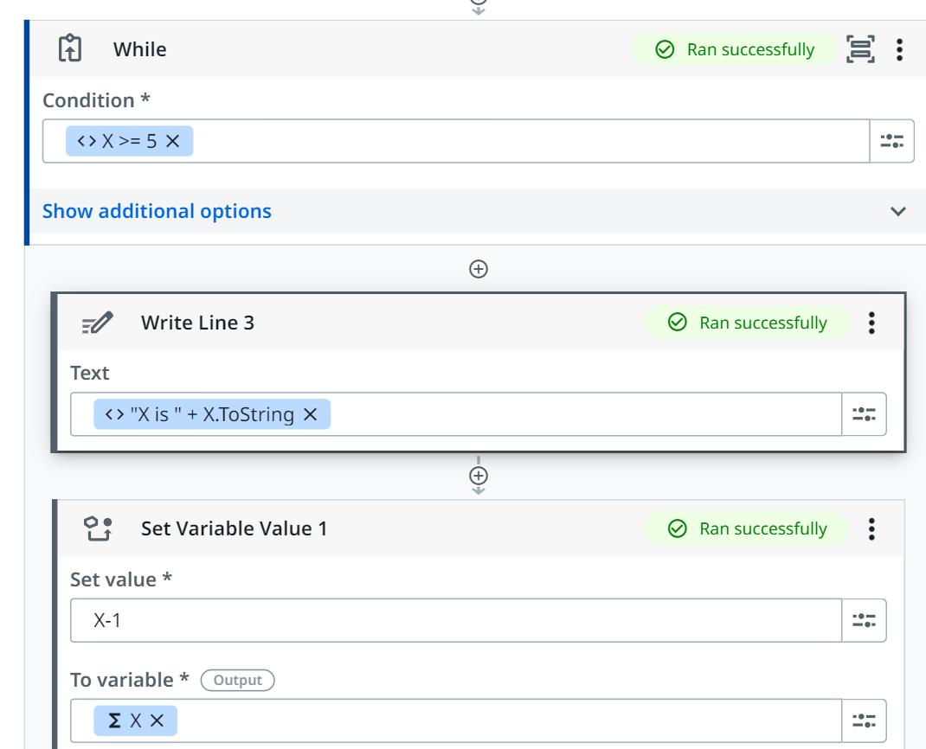
While loop
Same as if then else
B < 15
B+1

Slide 30
Practise
Set variable a = 1,
Print 1 to 10
While loop
Note: remember set variable value -> a+1

Slide 31
Print the numbers from 1 to 100.
Python
i = 1
while i <= 10:
print(i)
i += 1
Calculate the sum of the first 10 natural numbers.
Python
sum = 0
i = 1
while i <= 10:
sum += i
i += 1
print(sum)
Print the multiplication table of a given number.
Python
num = int(input("Enter a number: "))
i = 1
while i <= 10:
print(num, "*", i, "=", num * i)
i += 1
contain at least

Slide 32
Example: Google sheet

Slide 33
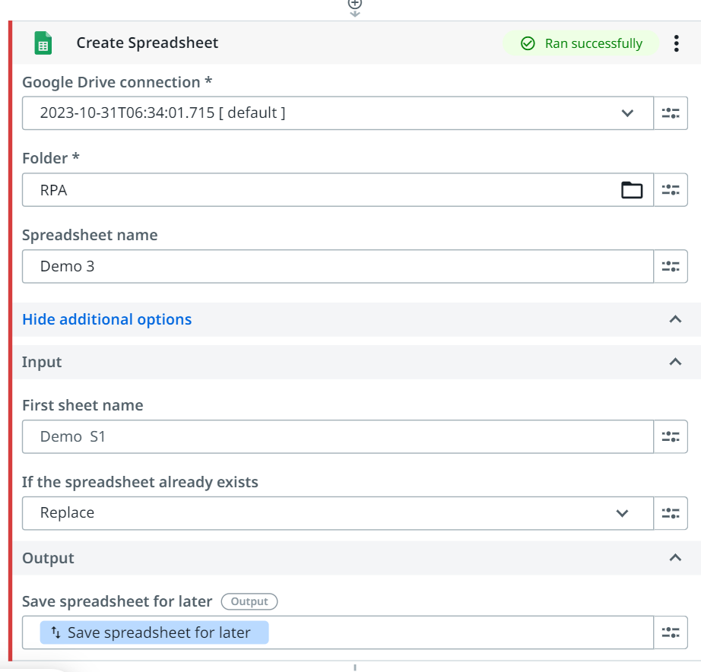
Create

Slide 34
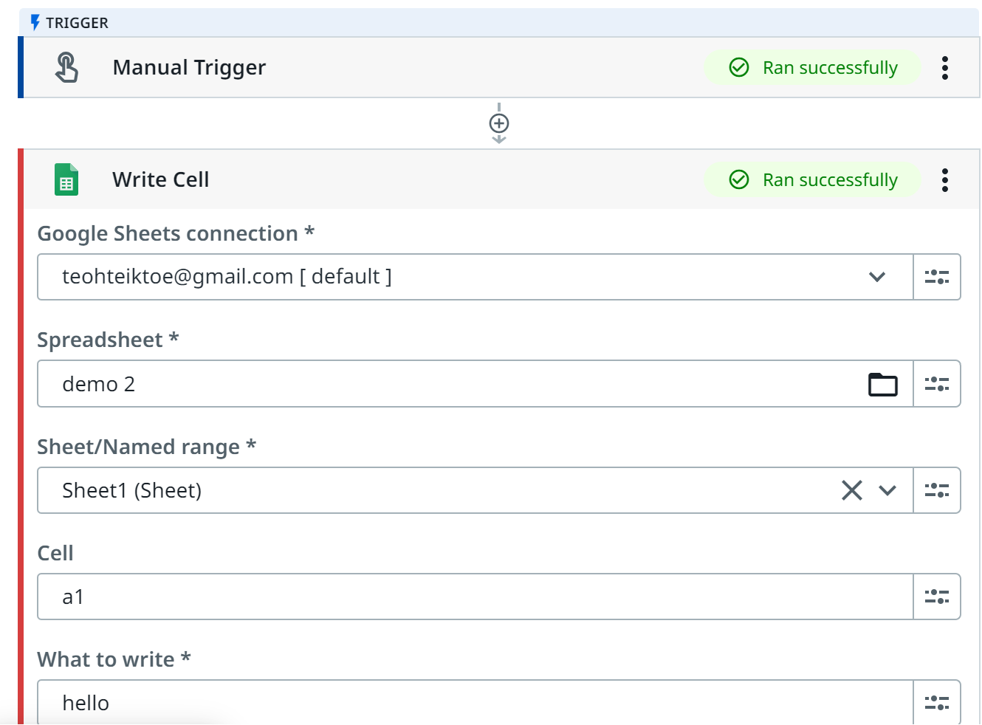
Write cell

Slide 35
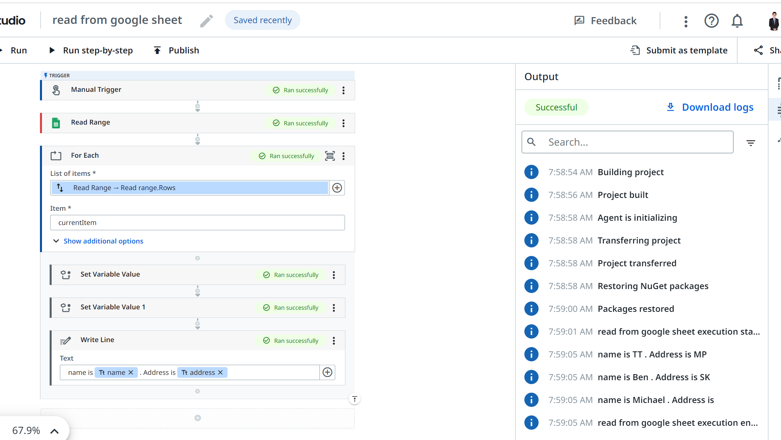
Read range

Slide 36
Example : Web simple calculator https://www.calculatorsoup.com/calculators/math/basic.php

Slide 37
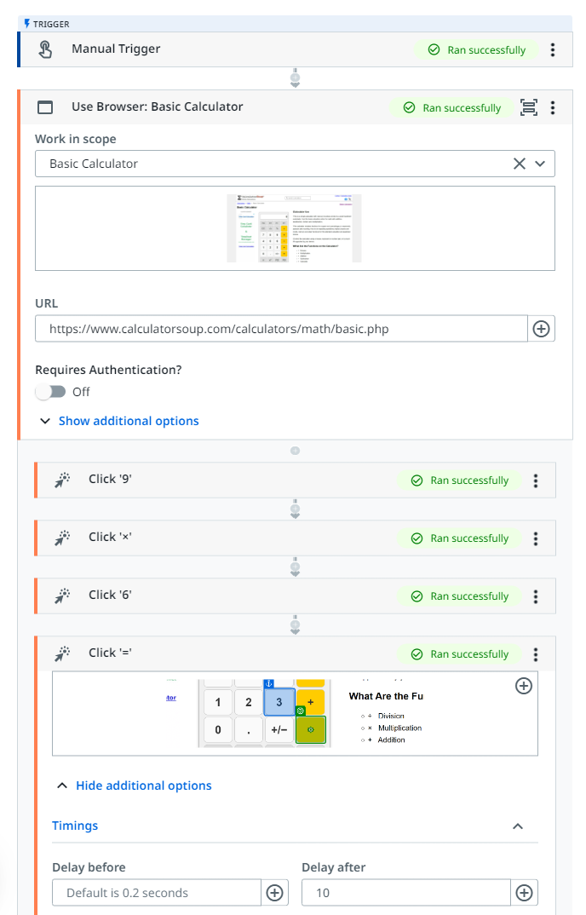

Slide 38
Example: Key into google form

Slide 39
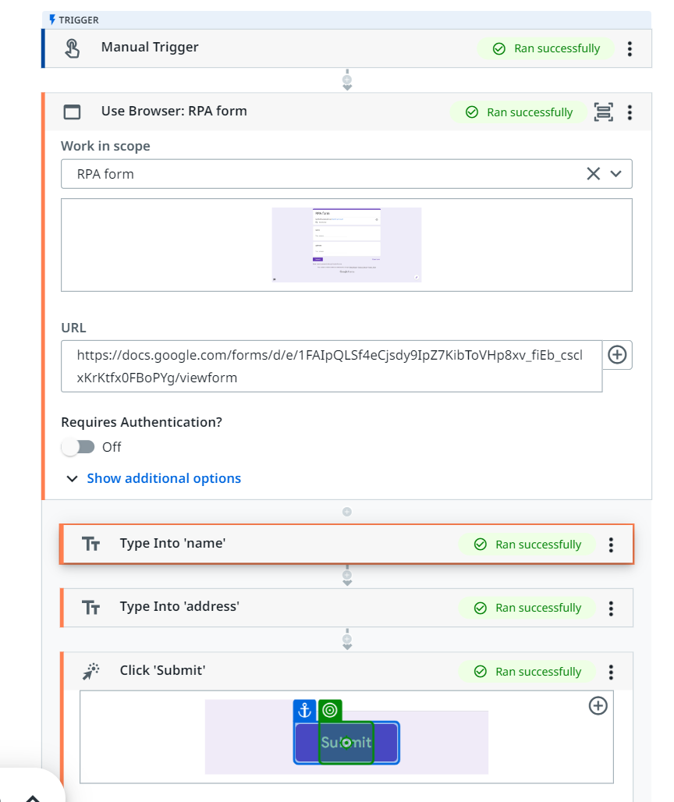

Slide 40
Practice:
Website used: https://the-internet.herokuapp.com/login

Slide 41
Example : Read from google sheet and write to google form

Slide 42
Practise - Simple Task
Read from google sheet and write to google form
REMEMBER TO NAME THE SHEET and FORM differently to avoid tab name CONFUSION

Slide 43
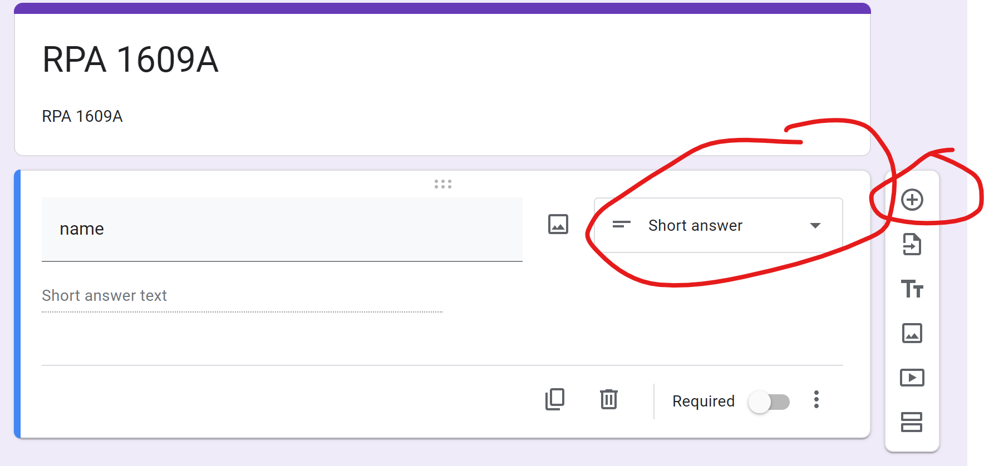
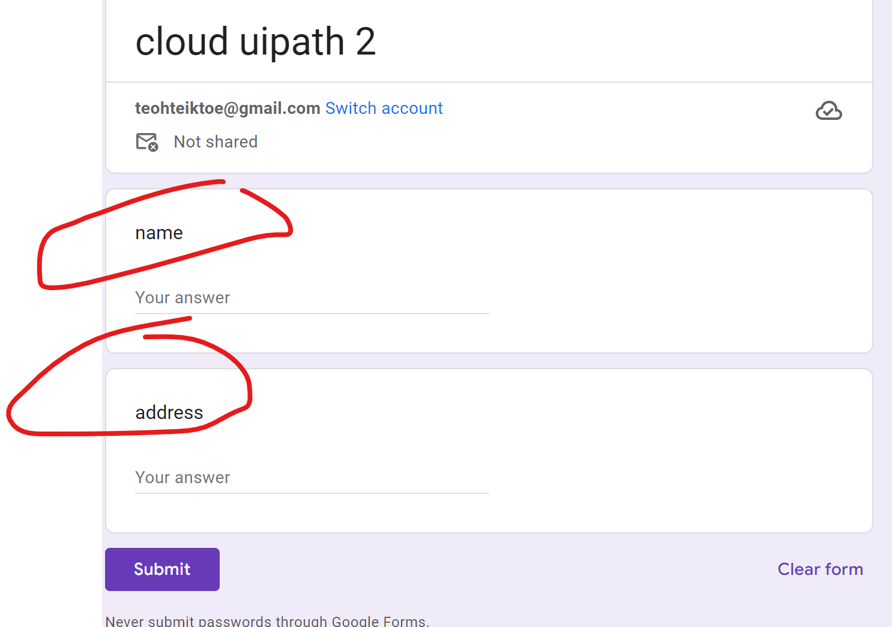
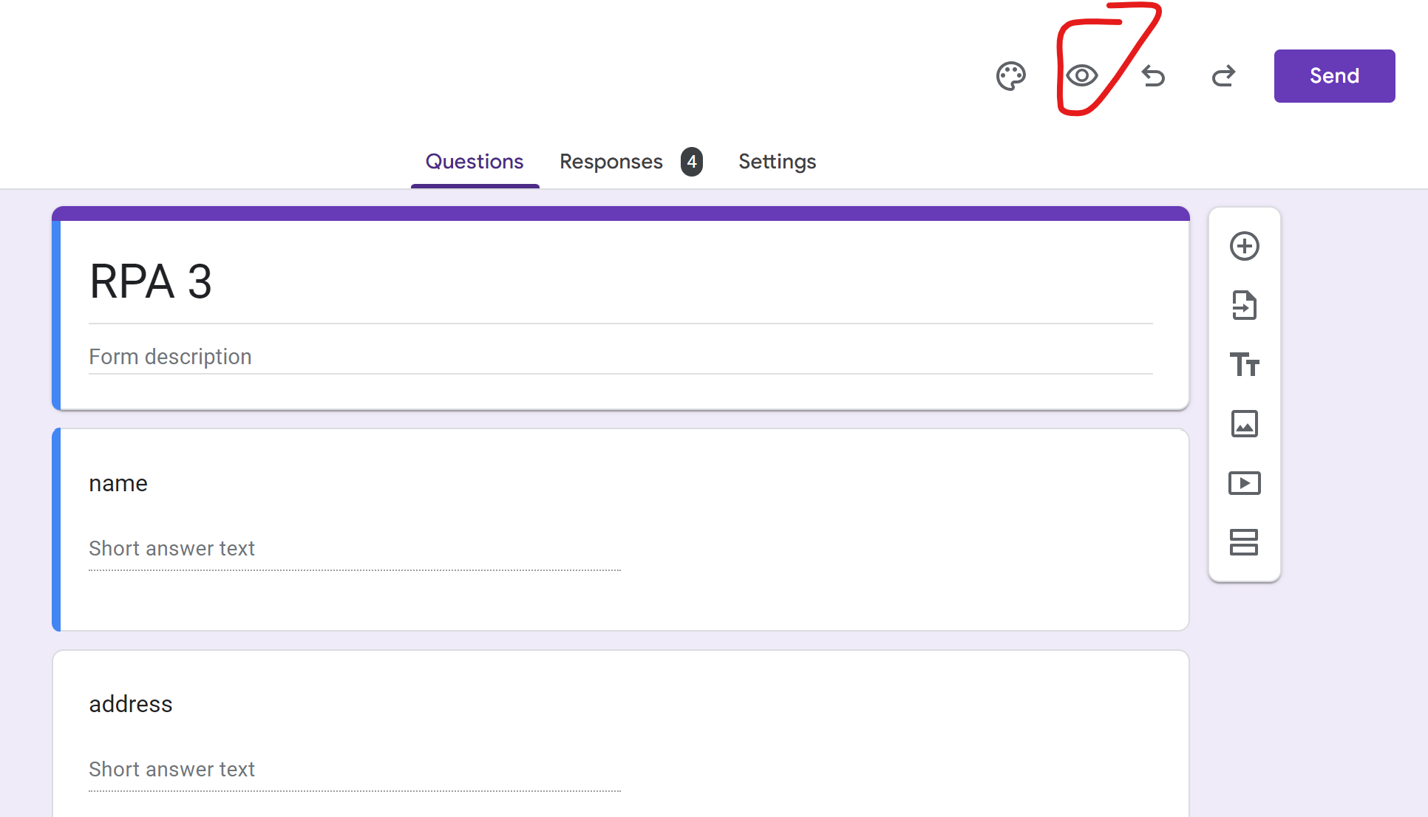
Register https://cloud.uipath.com/
Create google form https://docs.google.com/forms/
Create 2 question using short answer
Go to preview

Slide 44
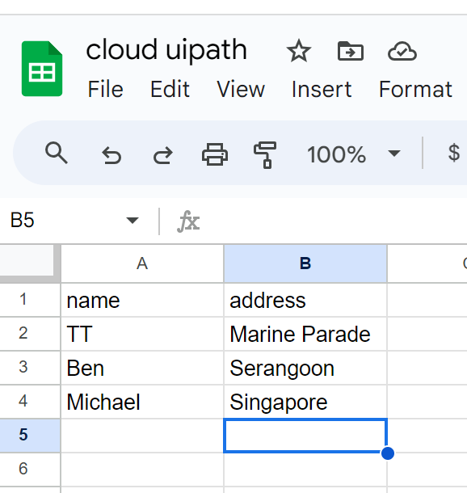
Create googlesheet - https://docs.google.com/spreadsheets (IT SHOULD BE SAVED IN GOOGLE DRIVE)

Slide 45
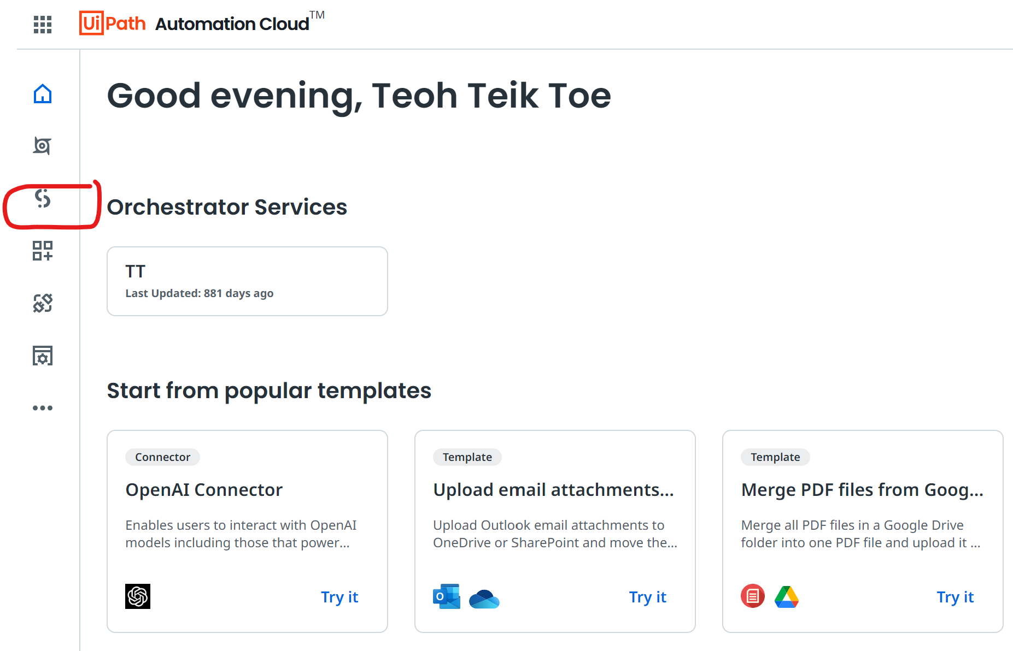
Register https://cloud.uipath.com/ select studio -> Project -> New Project

Slide 47
UiPath Steps
Use browser – select tab – ensure link end with viewform
Read range (google workspace) – select sheet (should be in your mydrive) – range select spreadsheet1 – click show addition – data should be in read range
For each – List of items (Read range.rows) – Use variable – read range – read range – row => Item in currentDataRow
Set Variable – use variable – for each – currentDataRow – name (repeat for all other features) – write lines
Type into – select tab – select entry and anchor – type this – use variable name
Click -> submit -> (then create a test form so that you can click submit another form) -> click -> submit another form
Check the result -> go to google form -> responses -> individual

Slide 48
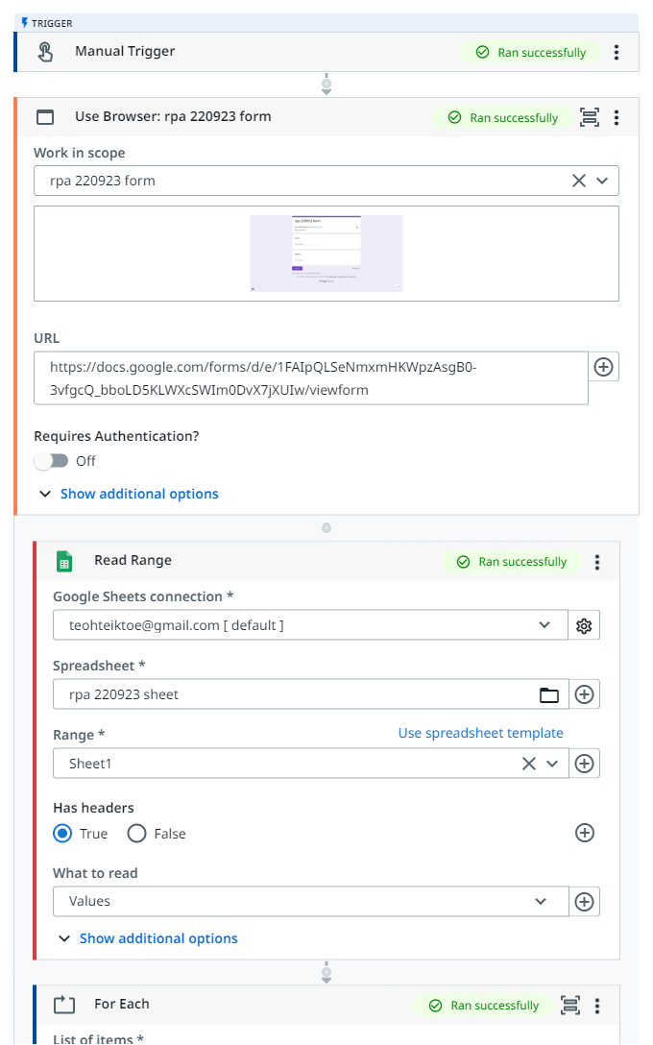
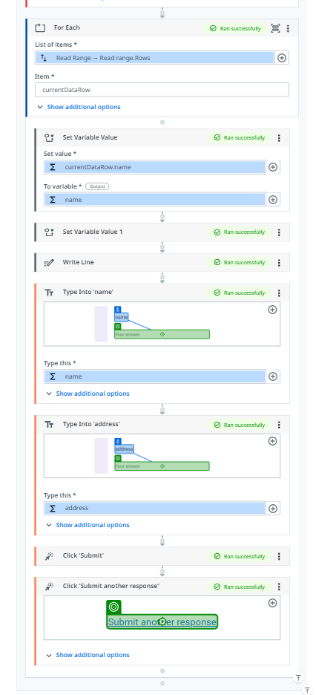

Slide 49
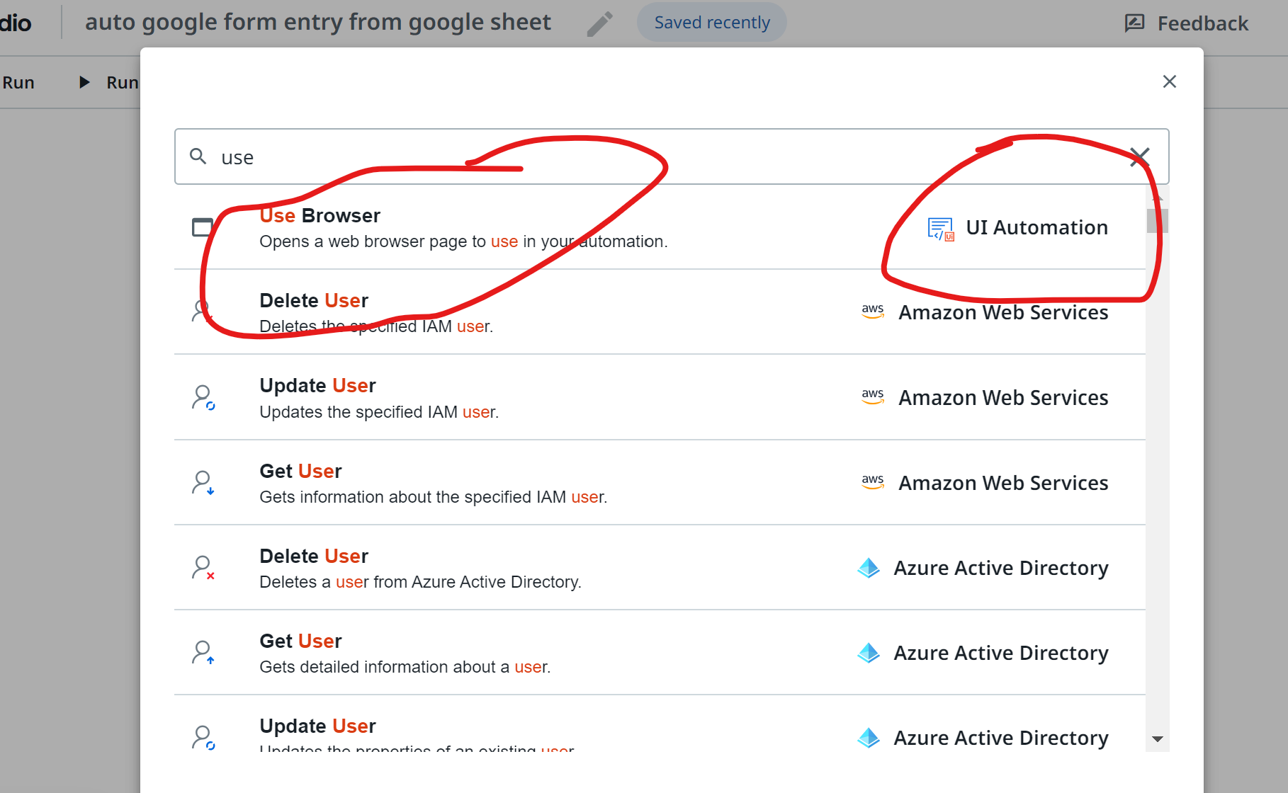
(1) Use browser

Slide 50
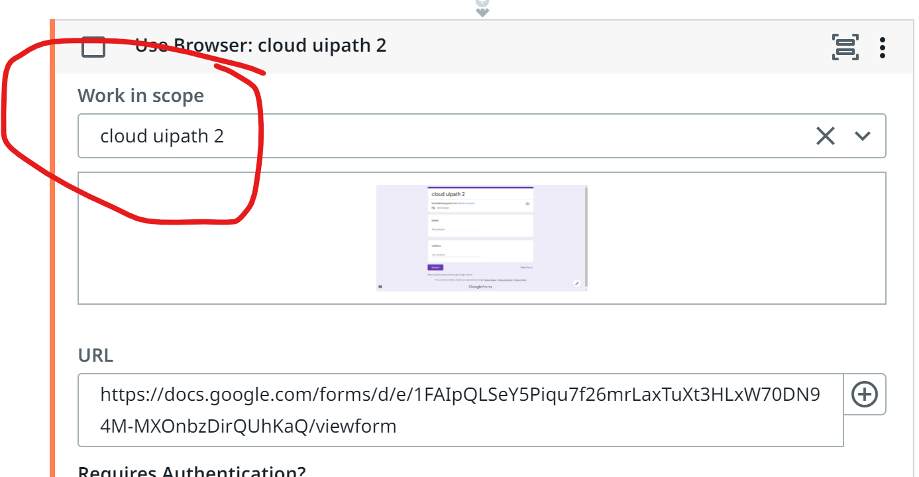
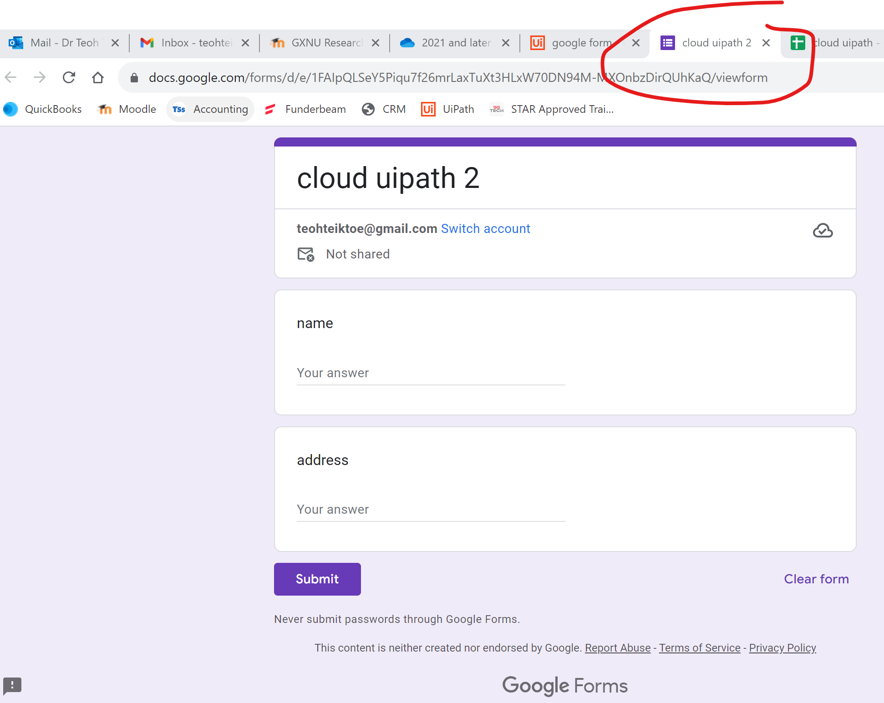
In Work in Scope -> Select tab -> make sure the link end with viewform

Slide 51
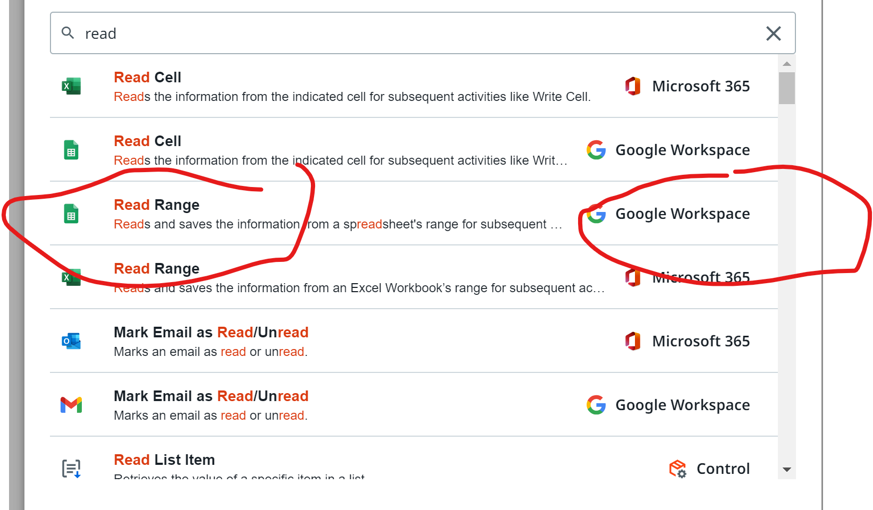
click on + -> (2) Read range – google workspace

Slide 52
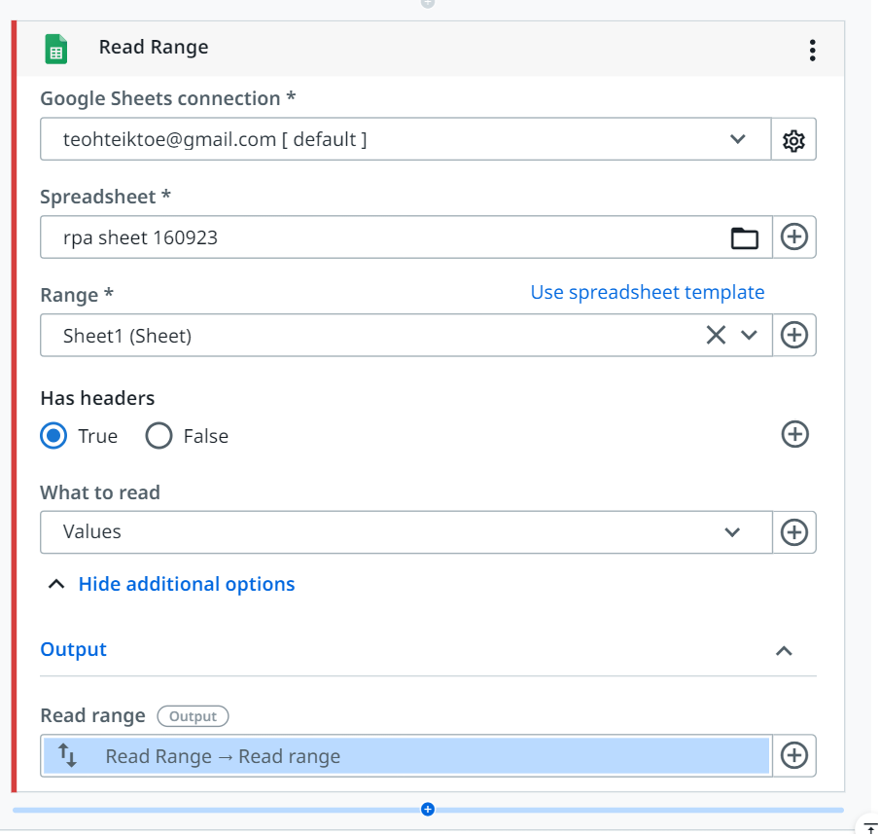

Slide 53
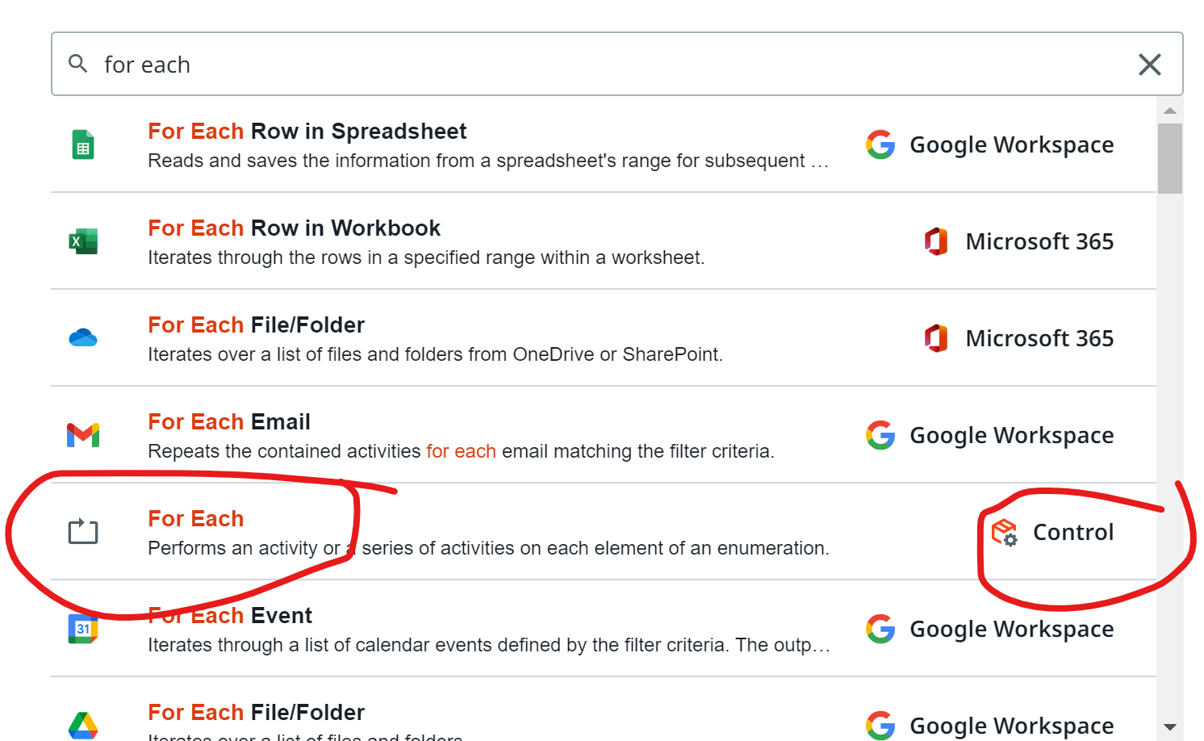
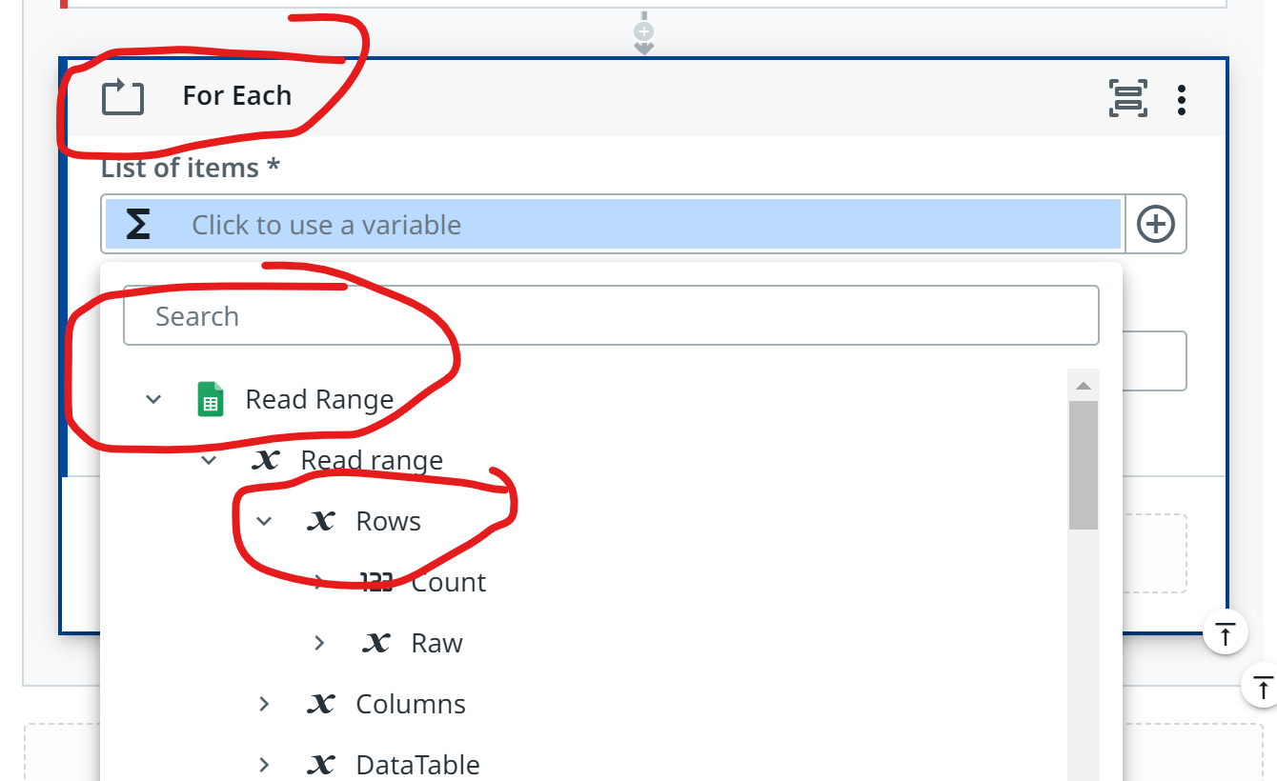
3. For each

Slide 54
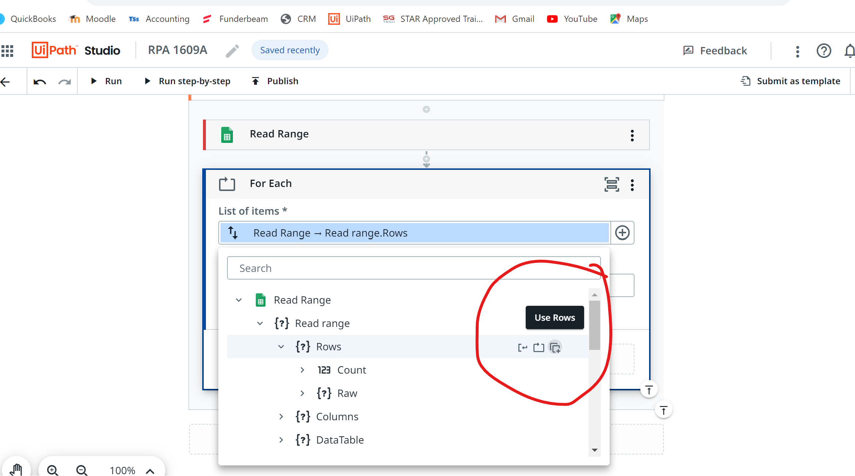
List of items -> read range -> Use rows

Slide 55
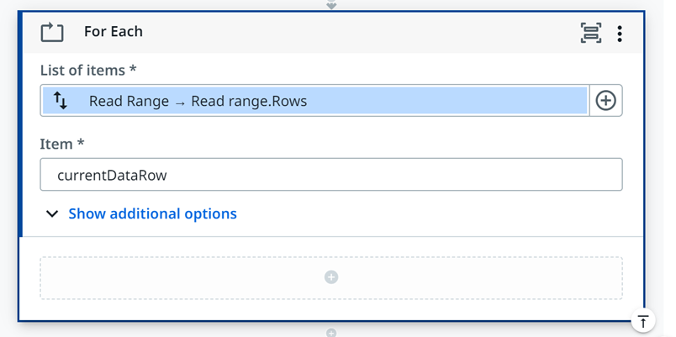

Slide 56
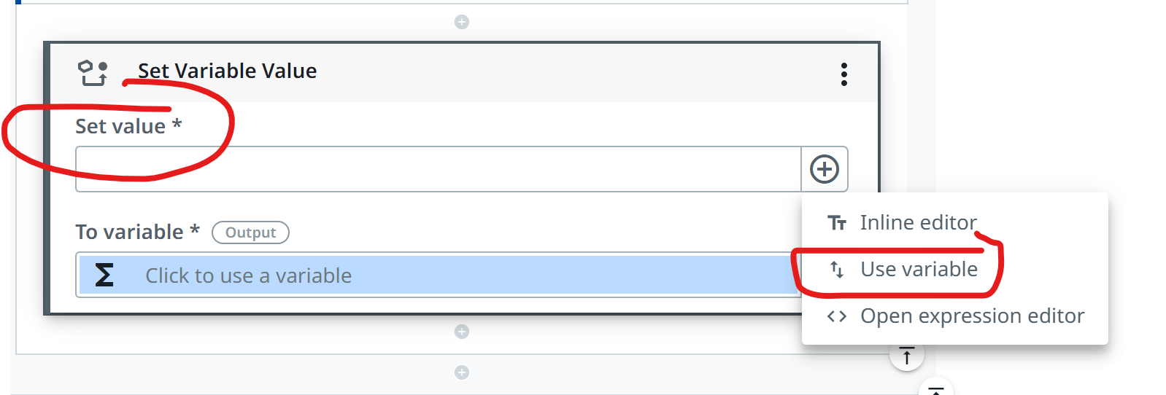
4. Set variable value Set Value – use variable -> for each -> currentDataRow -> Name To variable -> create new variable

Slide 57
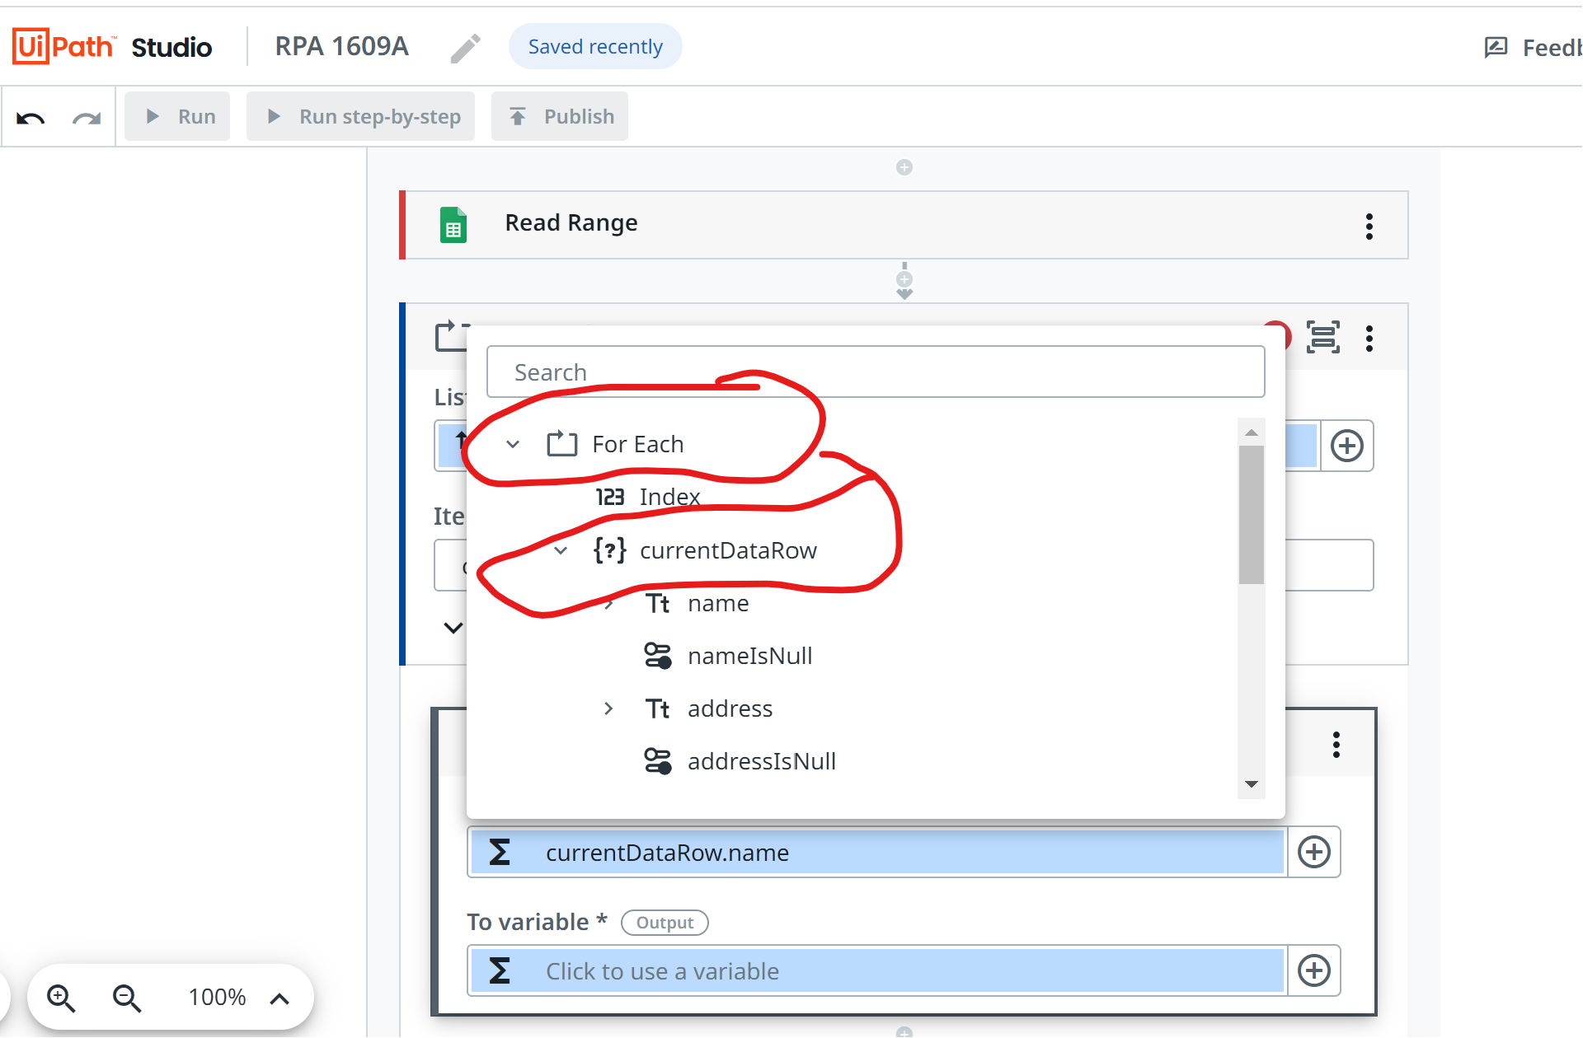

Slide 58
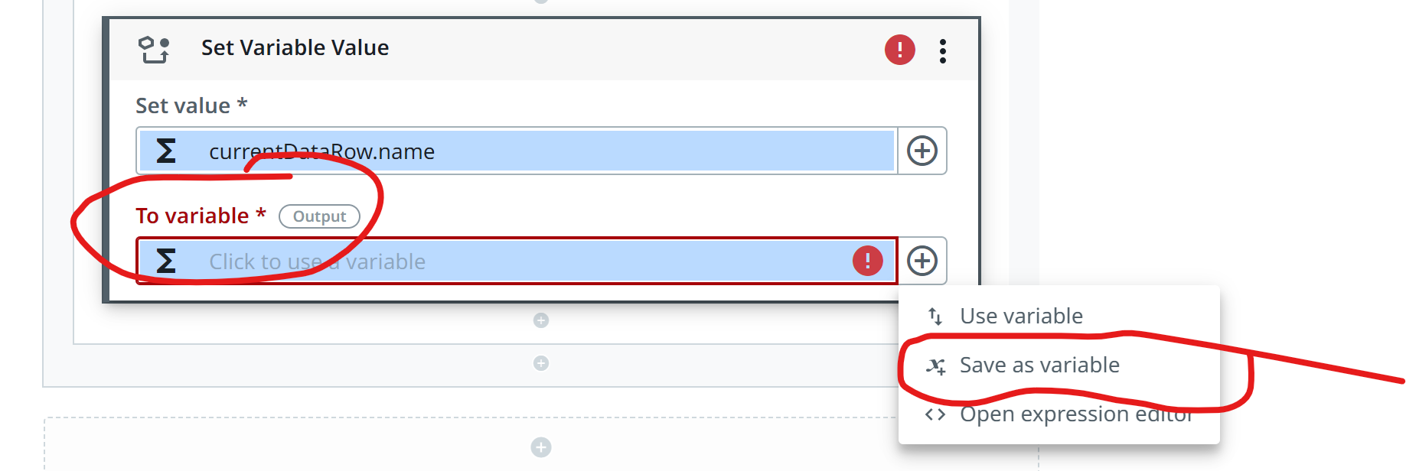
Save as variable

Slide 59
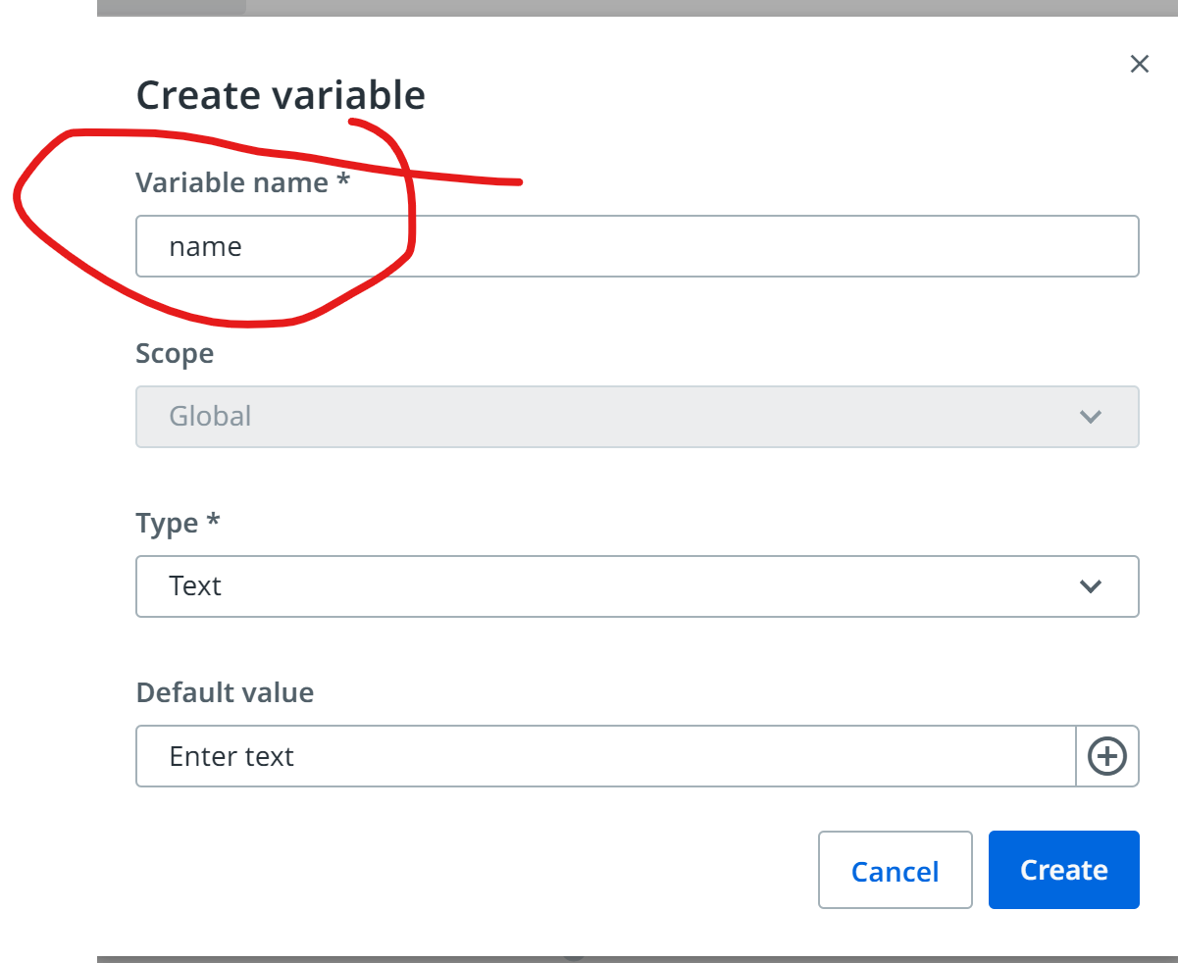

Slide 60
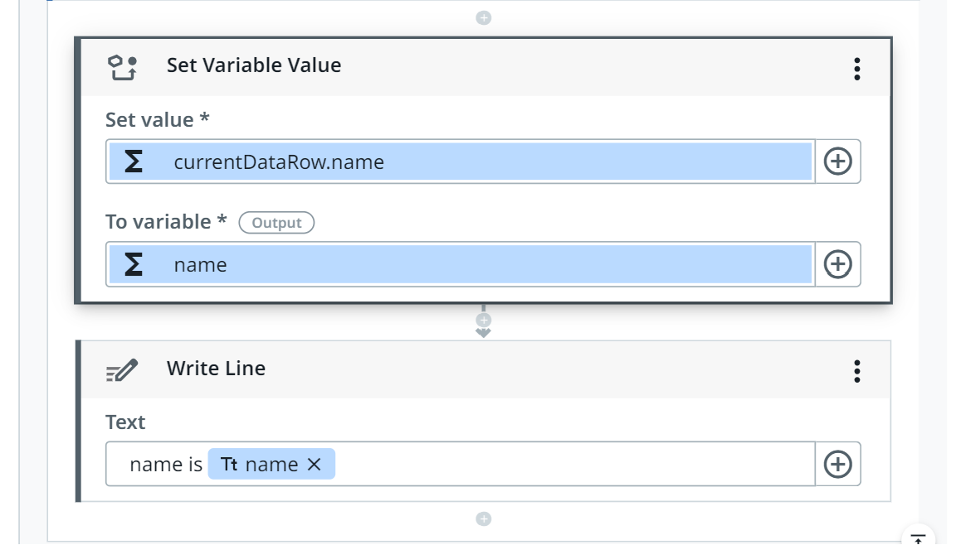
Write line

Slide 61
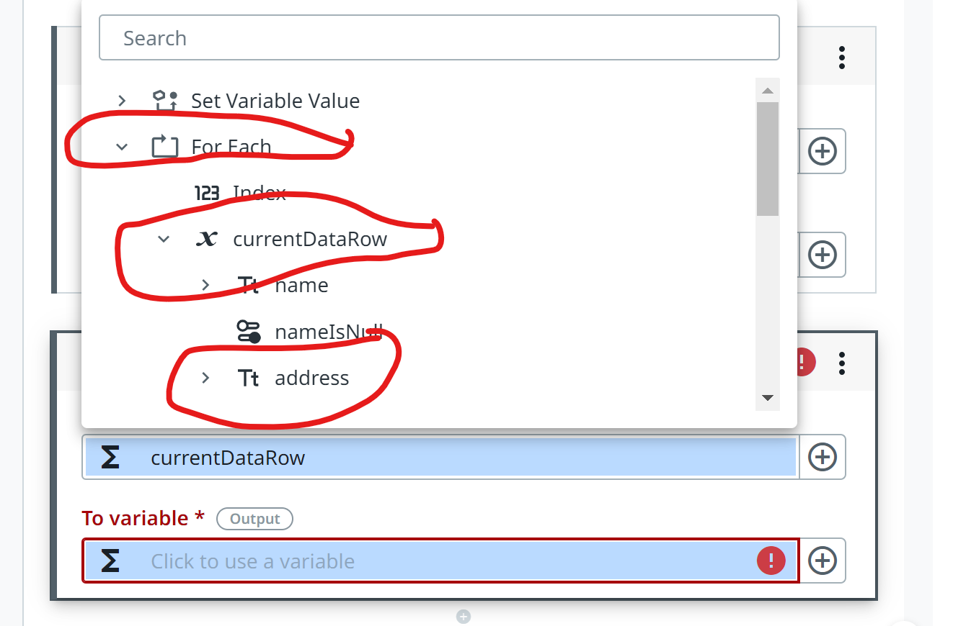
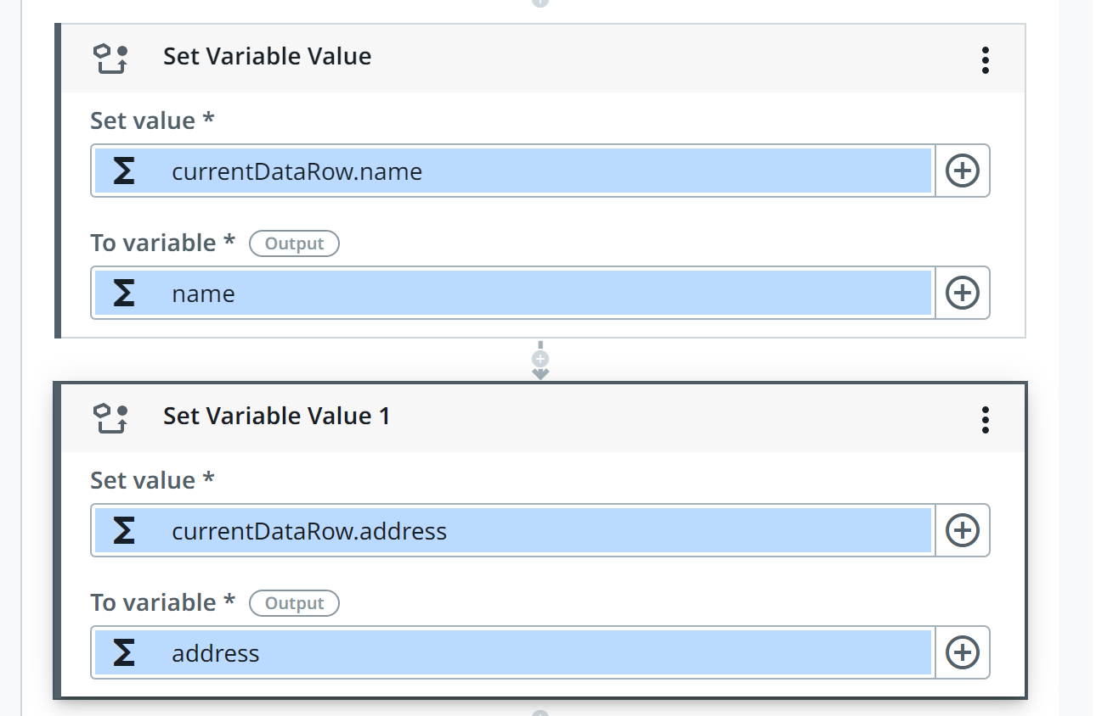
DO the same for address

Slide 62
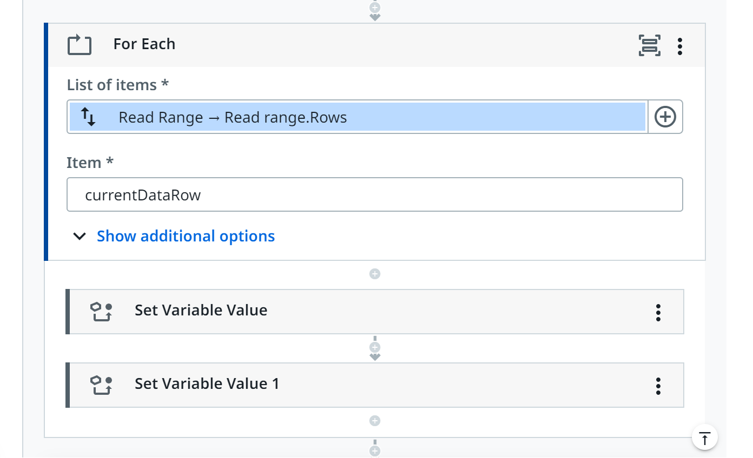
2xSet variable (name and address) in with for each

Slide 63
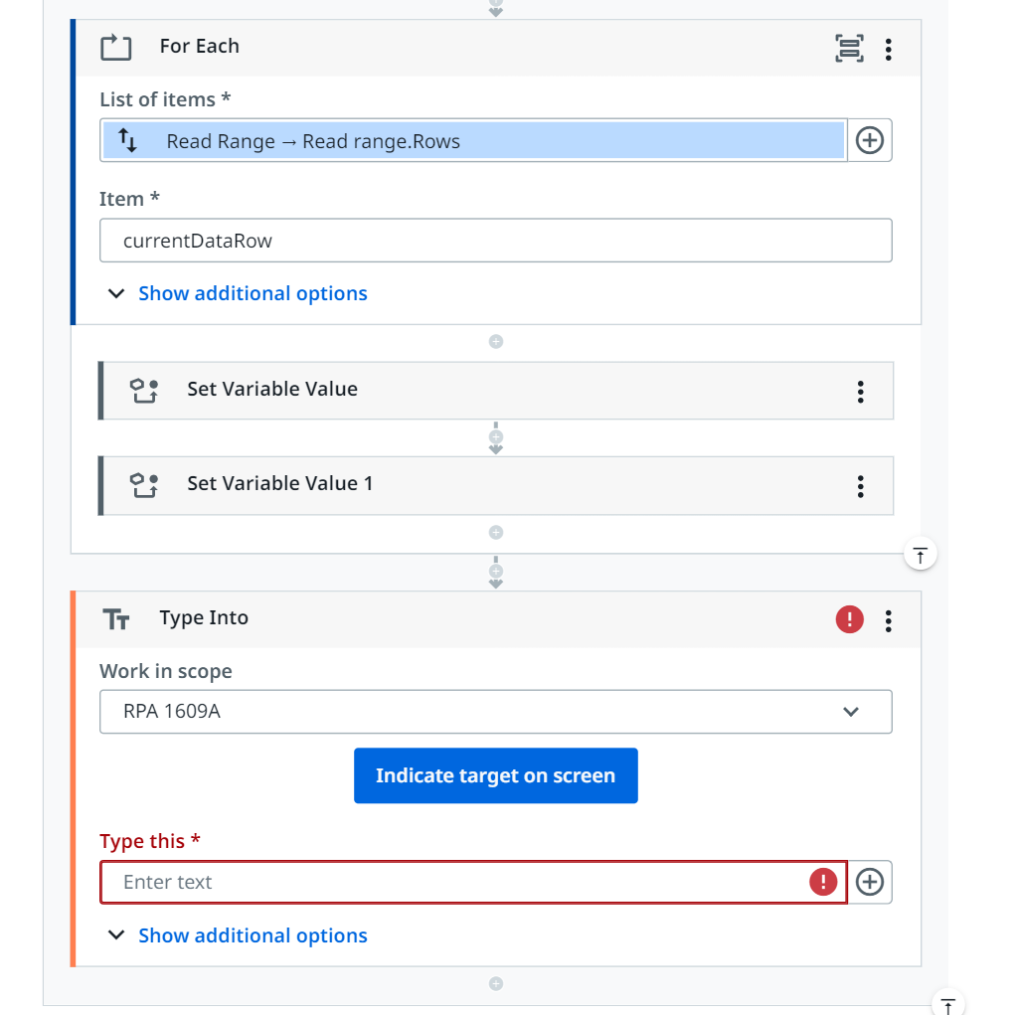
Step 5 type into MUST BE INSIDE of for each

Slide 64
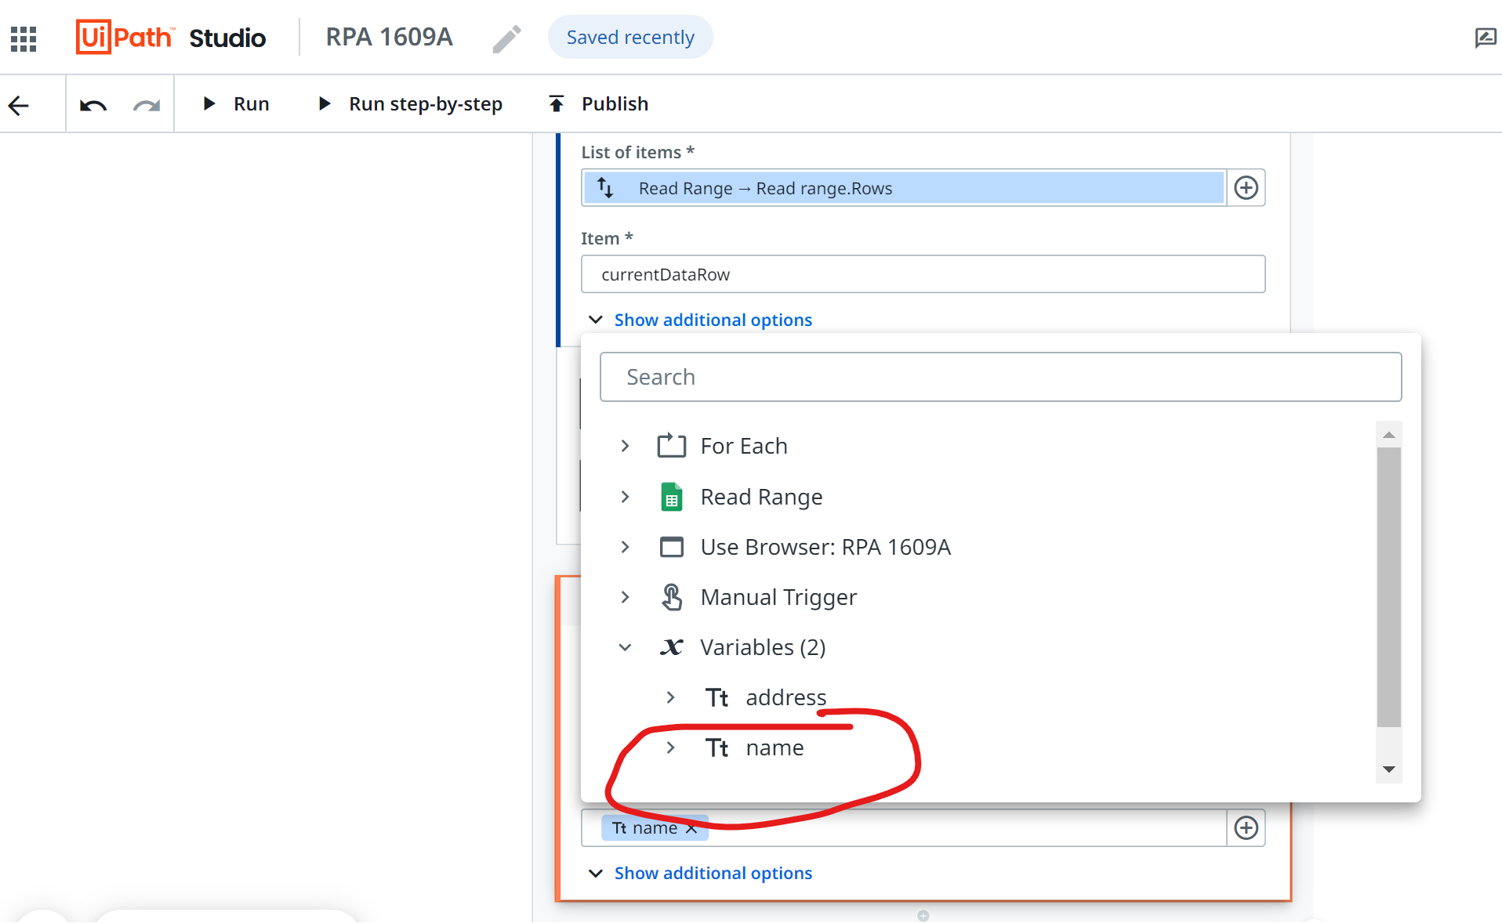
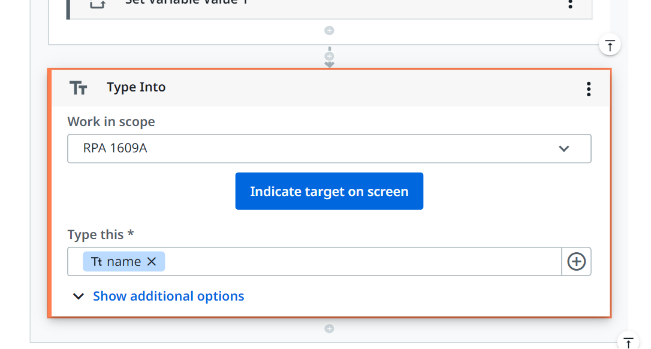
Step 5: in type this – select name as variable

Slide 65
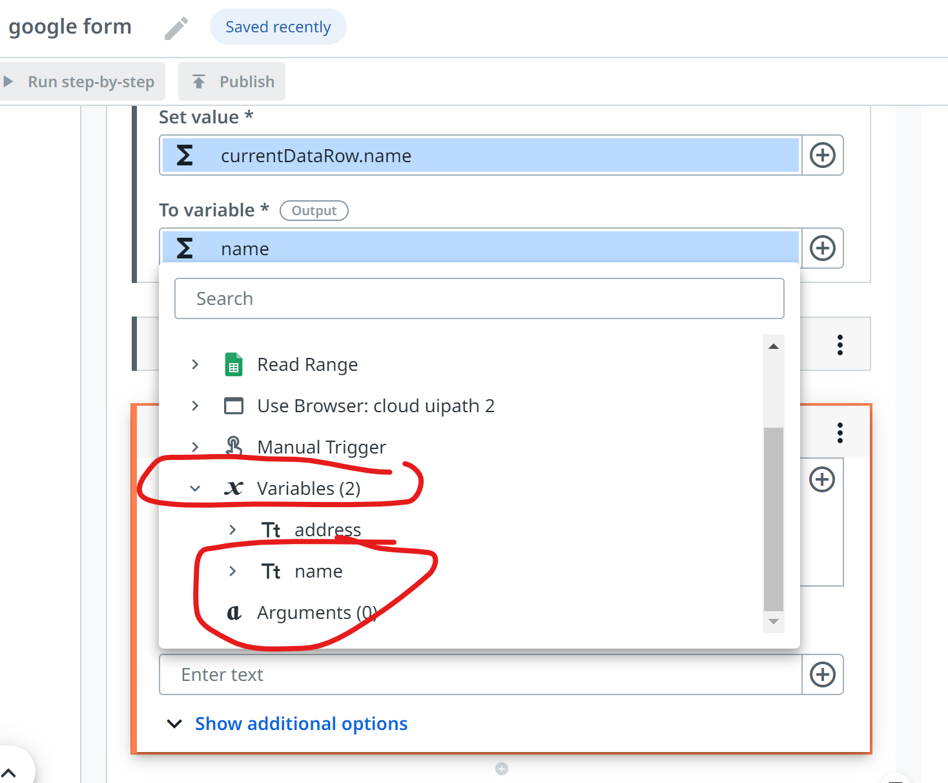

Slide 66
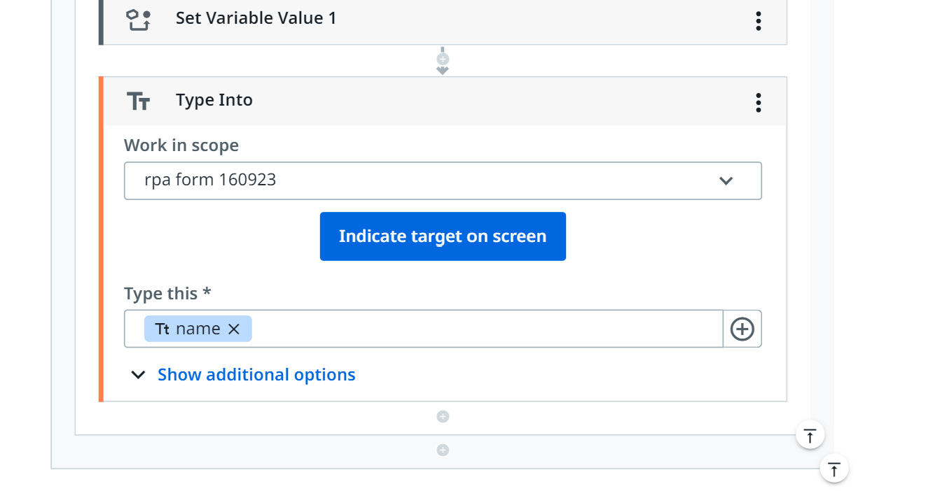
In indicate target on screen

Slide 67
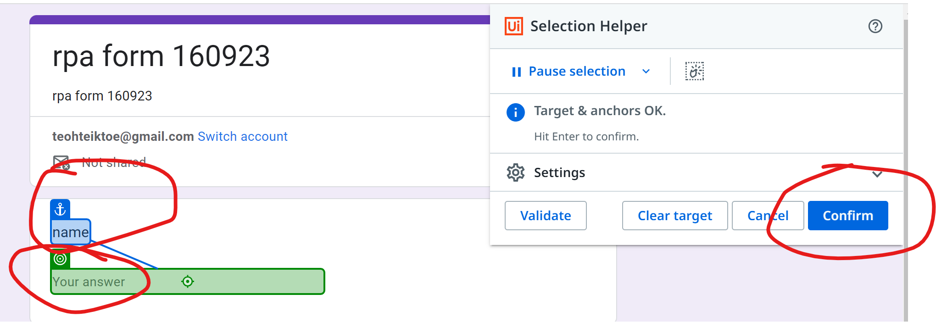
First, second (anchor) then Select confirm

Slide 68
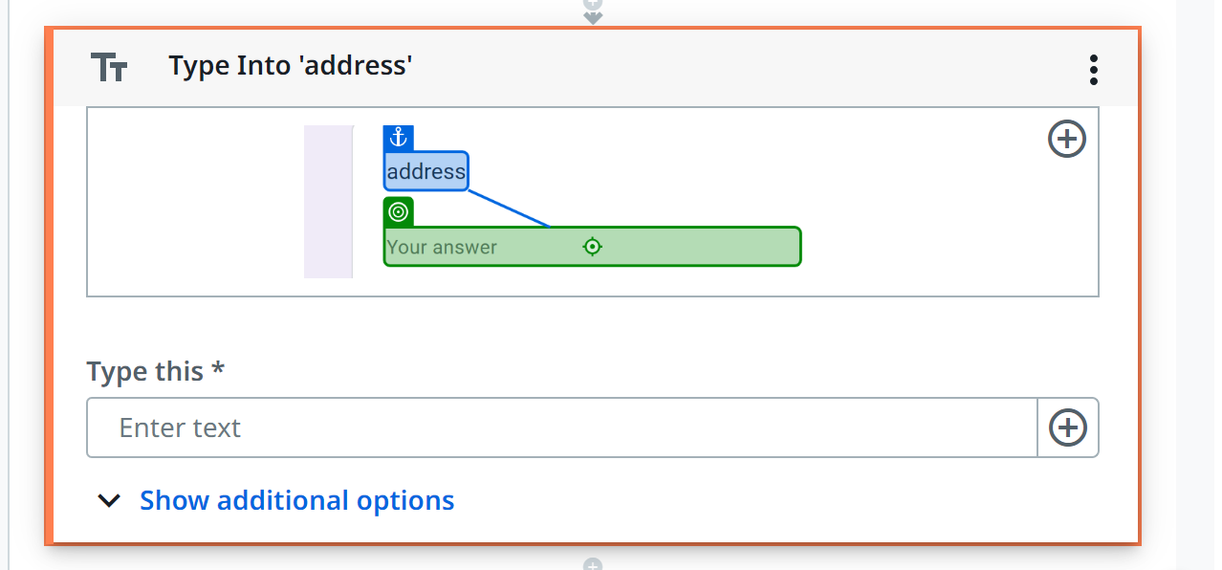
Do the same for address

Slide 69
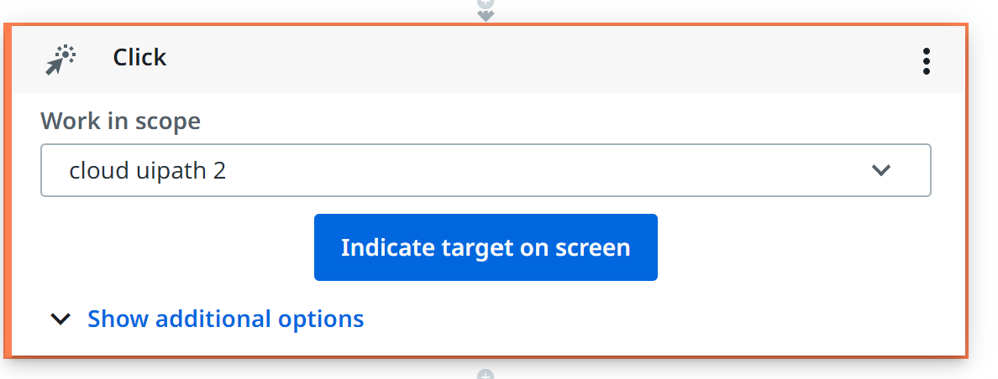
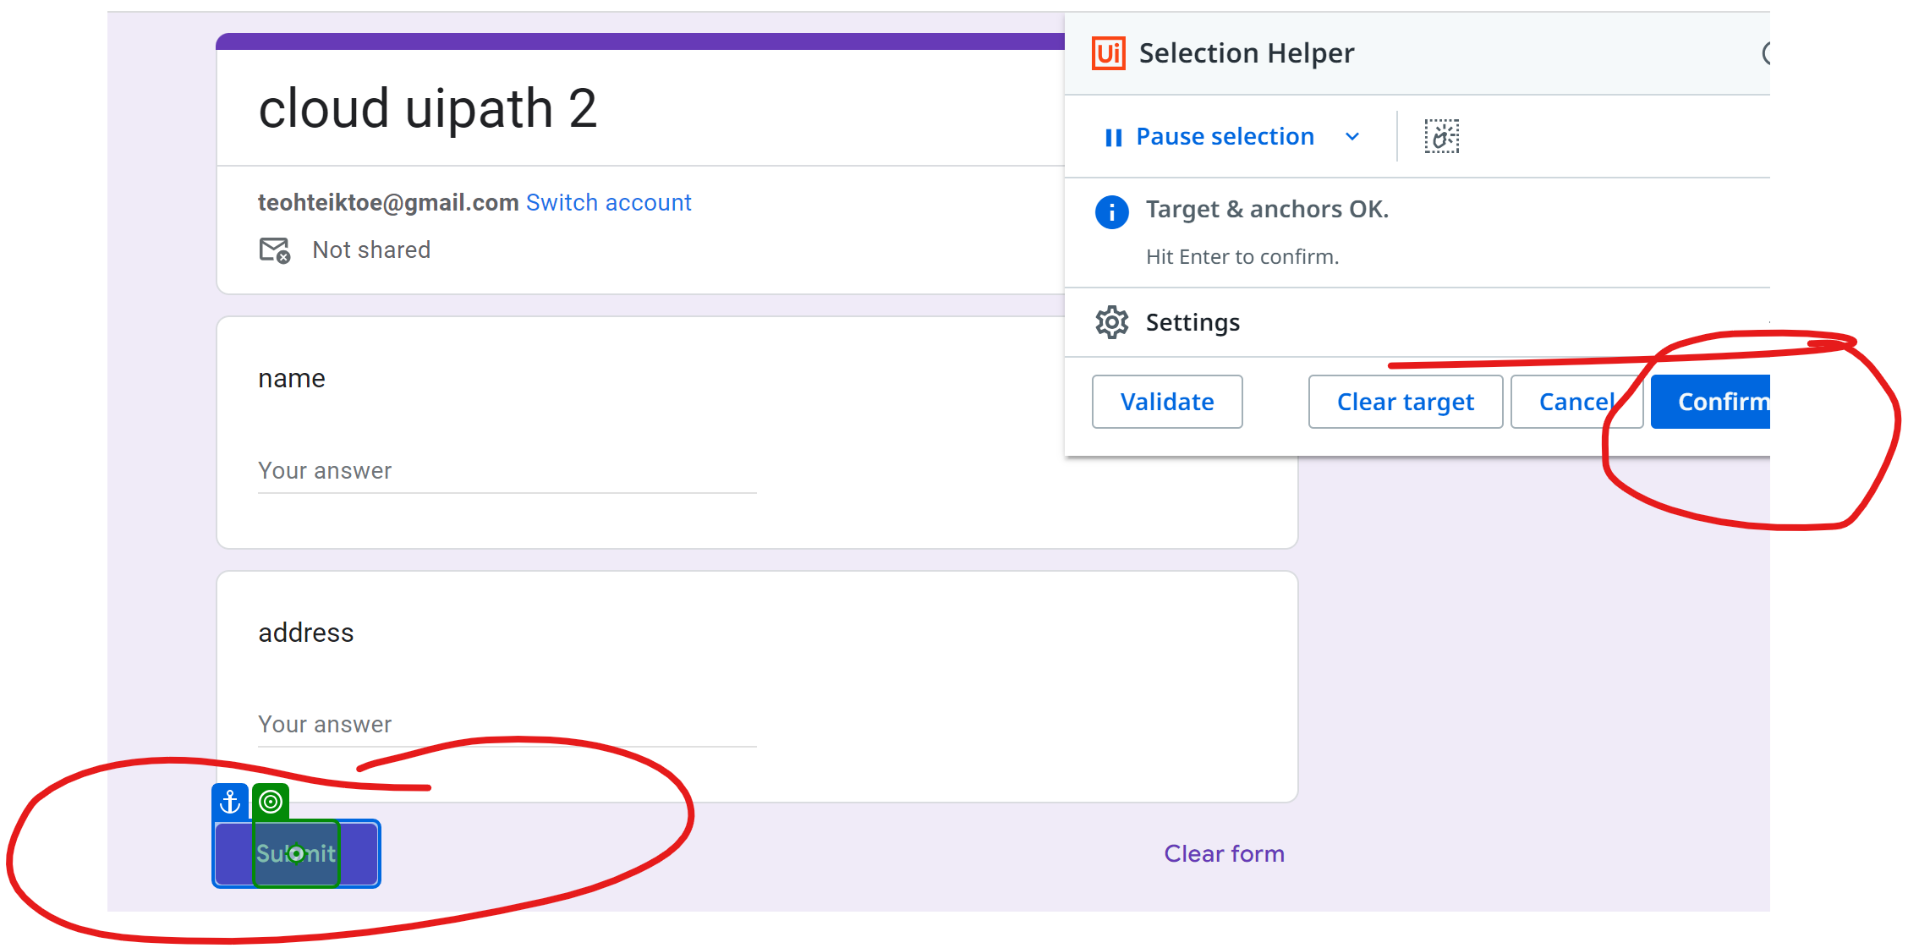
Click - submit

Slide 70
Click – submit another form – BEFORE YOU DO THIS, YOU NEED TO ENTER DUMMY DATA in form TO REACH HERE

Slide 71
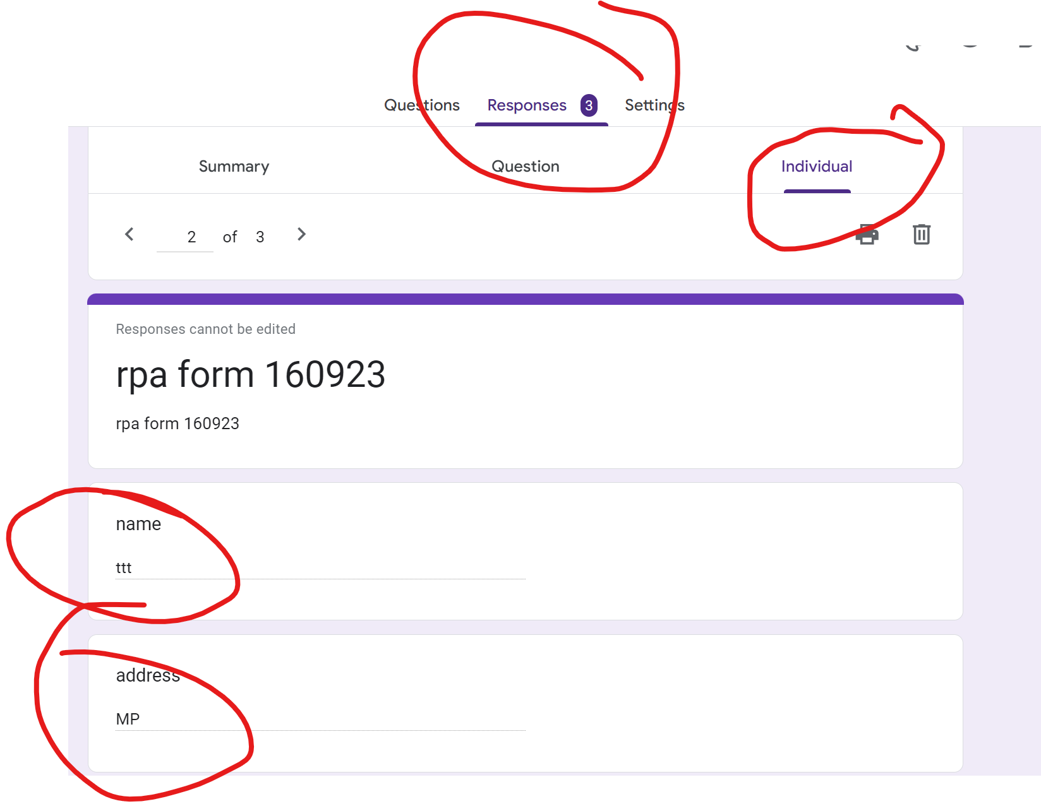
Run and Check the result

Slide 72
Exercise
Create a google form to accept : Name, Email, Hobbies, Education
For google sheet: Either download csv or cut and paste into google form
Automate the process of entering the 5 data from google sheet to google form using uipath cloud
Name | Email | Hobbies | Education
William Grayson | wgrayson94@fakemail.com | Mountain biking, photography, board games, reading sci-fi novels | B.A. in Communications
Mariah Vazquez | mariah.v88@fakemail.com | Gardening, yoga, and baking | BSN
Samuel Lipton | s.lipton75@fakemail.com | Chess, astronomy, and playing the saxophone | M.Ed. in Secondary Education
Ayesha Patel | ayesha.p99@fakemail.com | Painting, blogging, and hiking | B.Tech in Computer Science
Clara Gonzales | clara.g81@fakemail.com | Scuba diving, wildlife photography, and bird watching | Ph.D. in Marine Biology

Slide 73
Example: Auto reply email – send from ntu to gmail for testing

Slide 74
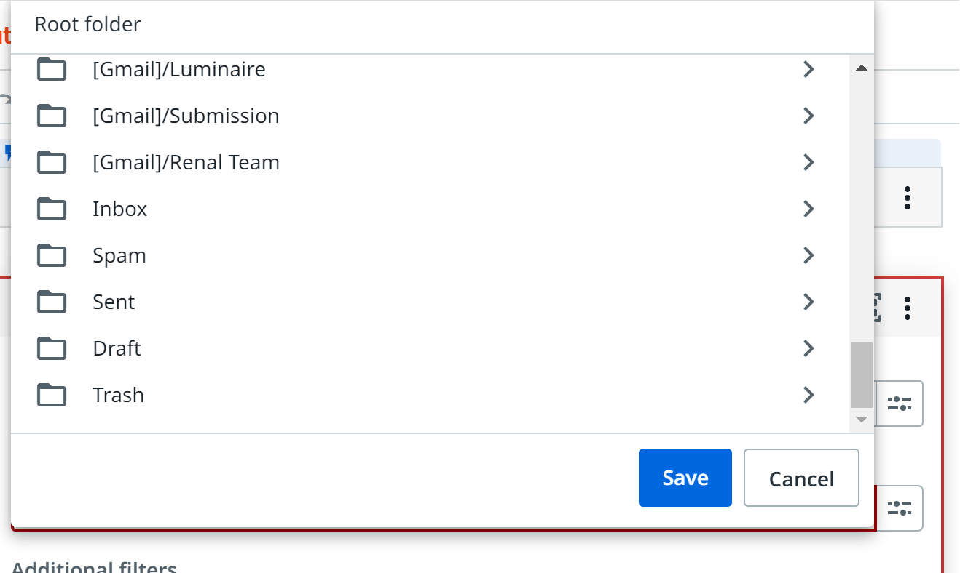

Slide 75
No double code needed

Slide 76
Example: Auto scrap for exchange rate from website

Slide 77
HTTP request
https://open.er-api.com/v6/latest/USD

Slide 78
Print Response content

Slide 79
content
2023-12-13 21:54:32.189 GMT+8: Information: {"result":"success","provider":"https://www.exchangerate-api.com","documentation":"https://www.exchangerate-api.com/docs/free","terms_of_use":"https://www.exchangerate-api.com/terms","time_last_update_unix":1702425751,"time_last_update_utc":"Wed, 13 Dec 2023 00:02:31 +0000","time_next_update_unix":1702513261,"time_next_update_utc":"Thu, 14 Dec 2023 00:21:01 +0000","time_eol_unix":0,"base_code":"USD","rates":{"USD":1,"AED":3.6725,"AFN":71.280422,"ALL":96.192913,"AMD":403.470612,"ANG":1.79,"AOA":841.73436,"ARS":366.5,"AUD":1.523006,"AWG":1.79,"AZN":1.700806,"BAM":1.811856,"BBD":2,"BDT":109.842606,"BGN":1.811684,"BHD":0.376,"BIF":2841.761575,"BMD":1,"BND":1.341725,"BOB":6.84533,"BRL":4.938201,"BSD":1,"BTN":83.40877,"BWP":13.739394,"BYN":3.235241,"BZD":2,"CAD":1.357927,"CDF":2664.270546,"CHF":0.875612,"CLP":887.211046,"CNY":7.181712,"COP":4023.890336,"CRC":524.289192,"CUP":24,"CVE":102.148088,"CZK":22.668214,"DJF":177.721,"DKK":6.909112,"DOP":56.342439,"DZD":134.332574,"EGP":30.946935,"ERN":15,"ETB":56.230219,"EUR":0.926388,"FJD":2.235688,"FKP":0.795821,"FOK":6.909146,"GBP":0.795815,"GEL":2.671775,"GGP":0.795821,"GHS":12.142088,"GIP":0.795821,"GMD":65.772437,"GNF":8580.77539,"GTQ":7.752235,"GYD":209.327575,"HKD":7.810027,"HNL":24.428821,"HRK":6.979865,"HTG":132.595453,"HUF":353.993711,"IDR":15601.429795,"ILS":3.706346,"IMP":0.795821,"INR":83.408795,"IQD":1311.17148,"IRR":42019.379333,"ISK":139.820168,"JEP":0.795821,"JMD":155.618232,"JOD":0.709,"JPY":145.396249,"KES":154.079468,"KGS":89.429271,"KHR":4108.49693,"KID":1.523063,"KMF":455.752639,"KRW":1313.02684,"KWD":0.306272,"KYD":0.833333,"KZT":457.152477,"LAK":20404.285142,"LBP":15000,"LKR":326.189124,"LRD":189.002342,"LSL":18.952426,"LYD":4.833262,"MAD":10.164441,"MDL":17.802562,"MGA":4569.638709,"MKD":57.163731,"MMK":2076.572624,"MNT":3454.116483,"MOP":8.044328,"MRU":39.542229,"MUR":43.966956,"MVR":15.434875,"MWK":1692.912653,"MXN":17.318622,"MYR":4.6843,"MZN":63.885257,"NAD":18.952426,"NGN":815.987448,"NIO":36.223608,"NOK":10.958153,"NPR":133.454032,"NZD":1.629714,"OMR":0.384497,"PAB":1,"PEN":3.778295,"PGK":3.678984,"PHP":55.566958,"PKR":284.027615,"PLN":4.013089,"PYG":7304.112307,"QAR":3.64,"RON":4.604853,"RSD":108.589315,"RUB":90.27073,"RWF":1245.621421,"SAR":3.75,"SBD":8.507918,"SCR":14.150424,"SDG":540.525386,"SEK":10.44447,"SGD":1.341725,"SHP":0.795821,"SLE":22.966952,"SLL":22966.951817,"SOS":571.672478,"SRD":37.49794,"SSP":1072.915593,"STN":22.696487,"SYP":12781.595228,"SZL":18.952426,"THB":35.692649,"TJS":10.934679,"TMT":3.49986,"TND":3.130705,"TOP":2.361182,"TRY":29.037819,"TTD":6.724636,"TVD":1.523063,"TWD":31.44195,"TZS":2512.016349,"UAH":36.973849,"UGX":3804.100911,"UYU":39.198111,"UZS":12325.23569,"VES":35.5724,"VND":24216.251801,"VUV":119.171326,"WST":2.738564,"XAF":607.670186,"XCD":2.7,"XDR":0.751771,"XOF":607.670186,"XPF":110.547641,"YER":247.628429,"ZAR":18.952451,"ZMW":24.425847,"ZWL":5840.820637}}

Slide 80
Deserialize json

Slide 82
Create a variable to store the exchange rate

Slide 83
Set variable – CUT and PASTE to Set value
Convert.ToDouble(_out_DeserializeJson_Generic_1_1__JsonObject.SelectToken("rates").SelectToken("EUR").ToString)

Slide 85
Data Extraction 1. use browser 2. Extract data table 3. Create google sheet 4. write range Sample data: https://www.rpasamples.com/opportunities

Slide 86
Use browser

Slide 87
Extract data table, select data to export then point to export, and store in variable

Slide 88
Highlight all columns header – indicate 9 columns and 18 rows

Slide 89
Create a variable data table

Slide 90
Create google spreadsheet

Slide 91
Write range

Slide 92
Range select sheet1, what to write select the variable

Slide 93
Try………………

Slide 94
Example: Save word file (use one drive as google drive document not ready) to pdf

Slide 96
Merge pdf

