Slide 1
GPT
Teoh Teik Toe
ITOM/NBS
ttteoh@ntu.edu.sg
97905202

Slide 2
Recording: https://1drv.ms/v/s!Aik2a4x7tvLyi_A-WJA6f3RZerLyng?e=z2zvQg

Slide 3
Agenda
Introduction to GPT
ChatGPT
  OpenAI ChatGPT
  Google Bard and PaLM
ImageGPT
  Dalle e2
  Midjourney
Music GPT
  https://youtu.be/d_7EsKcn8nw?si=1Uq1FziXUNQ6vuMd
  https://youtu.be/eMrKj3goxAM?si=zJ7MdSa1F2P5TvzE
Video GPT
  https://youtu.be/yyGGI9WP3qs?si=ugBzu5Ag7vP6sDTV

Slide 4
Video
Top 8 ChatGPT Productivity Tips for Work!
(9 mins)
https://youtu.be/Q07rFZtc2Ao?si=0t7n86MrDngOfXTm
The next step: Co Pilot
https://youtu.be/S7xTBa93TX8?si=FcY5q0pUH3HcovkD

Slide 5

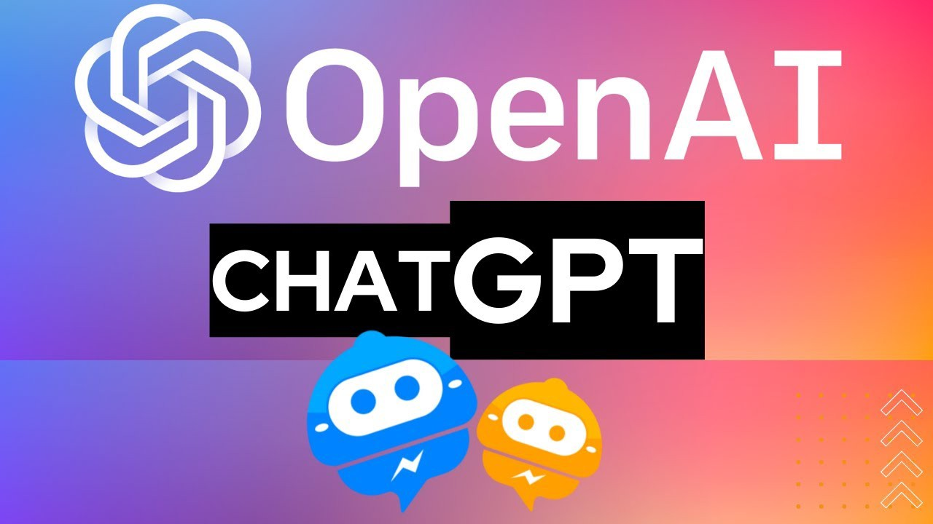
What is OpenAI
The organization was founded in San Francisco in late 2015 by Elon Musk, and others, who collectively pledged US$1 billion.
OpenAI LP received a $1 billion investment from Microsoft in 2019 and a second multi-year investment in January 2023 reported to be $10 billion.
OpenAI is headquartered at the Pioneer Building in Mission District, San Francisco.

Slide 6
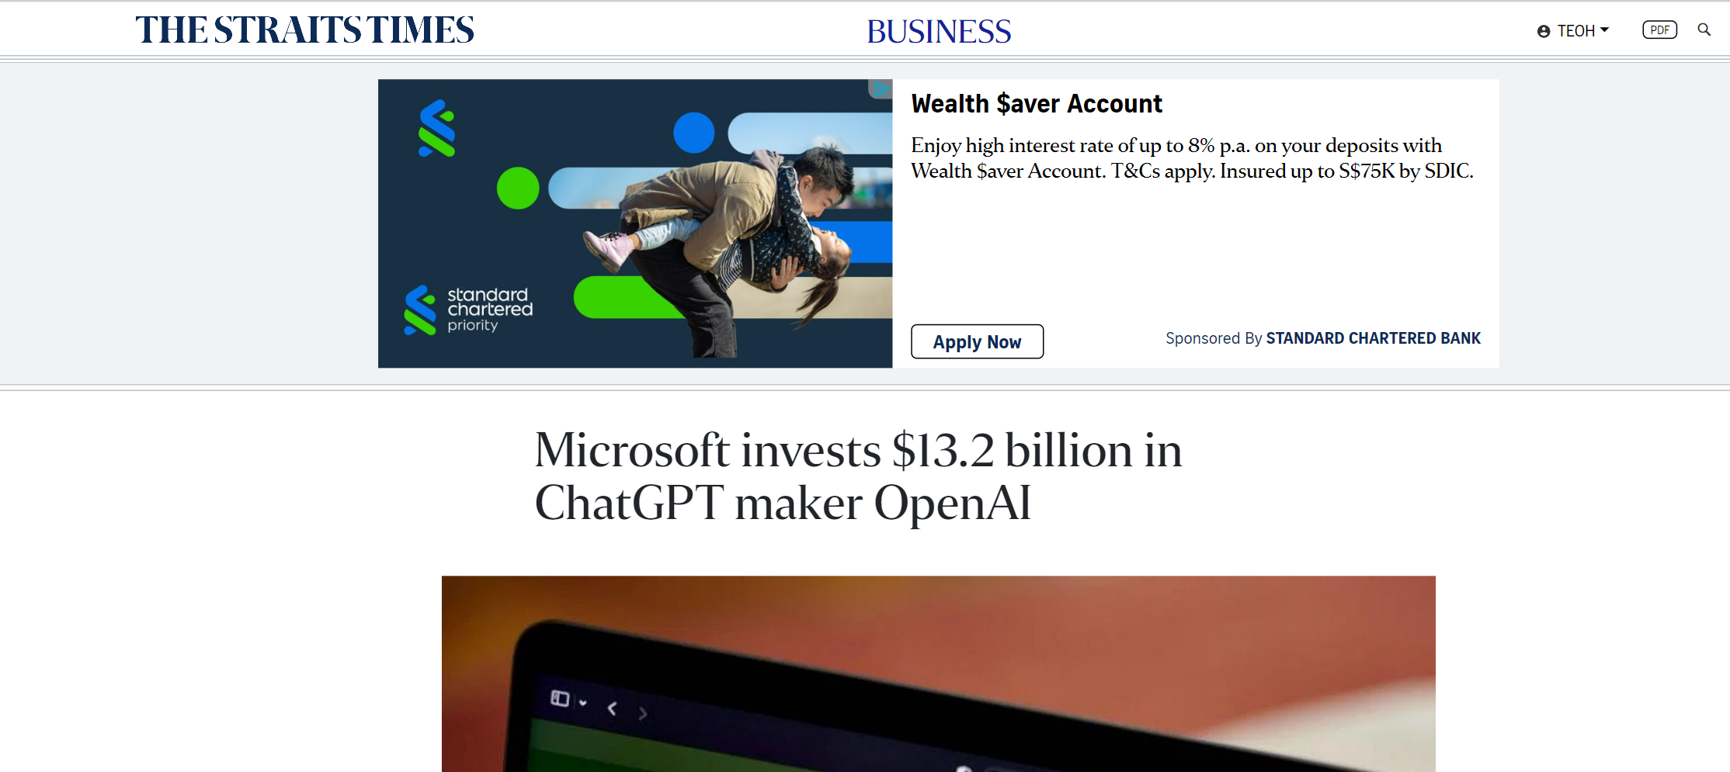
https://www.straitstimes.com/business/microsoft-invests-13-billion-in-chatgpt-maker-openai

Slide 7
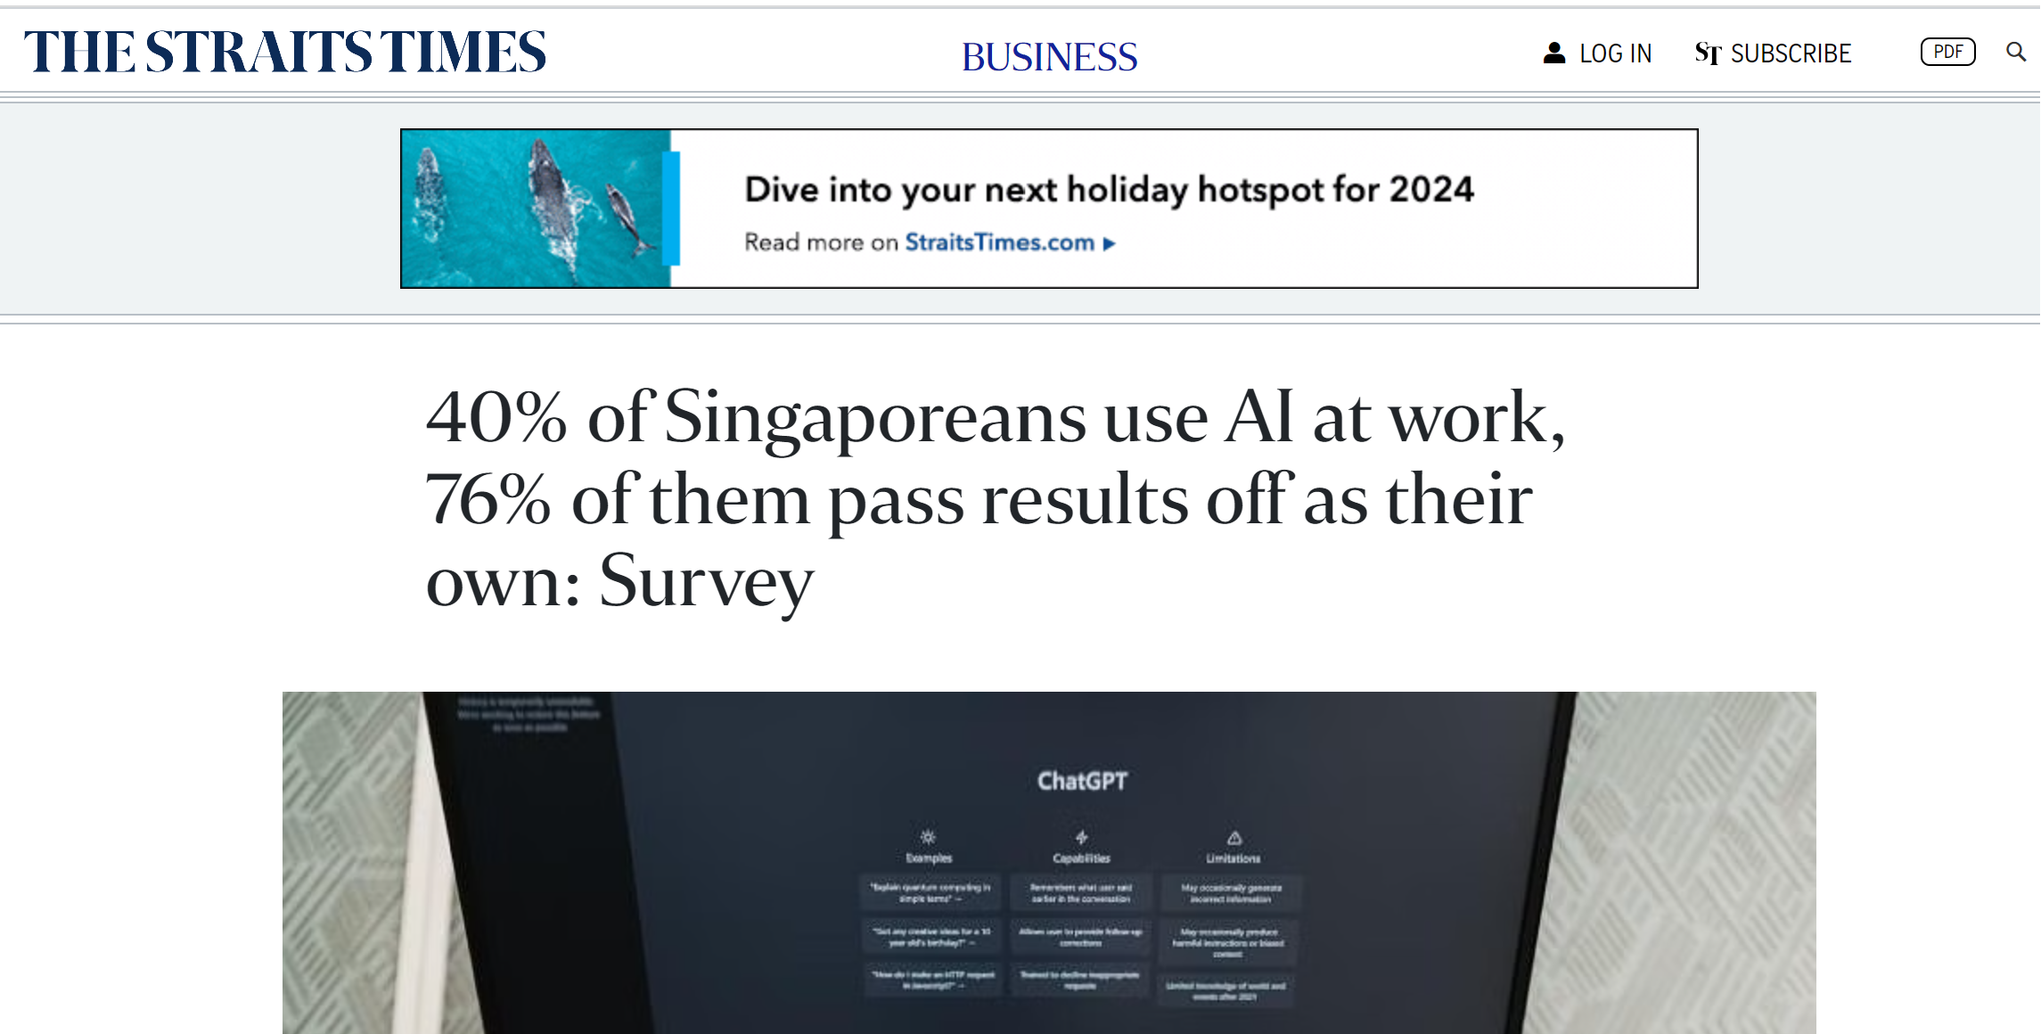
https://www.straitstimes.com/business/40-of-singaporeans-use-ai-at-work-75-of-them-pass-it-off-as-their-own-survey

Slide 8
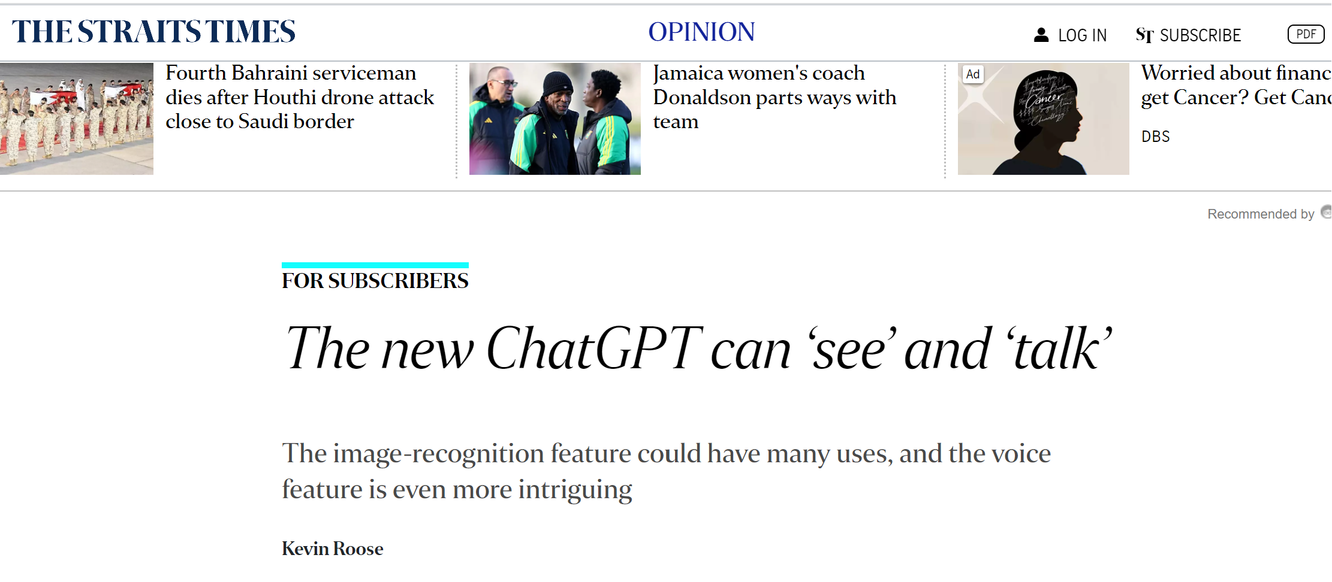
The new ChatGPT can ‘see’ and ‘talk’ | The Straits Times

Slide 9
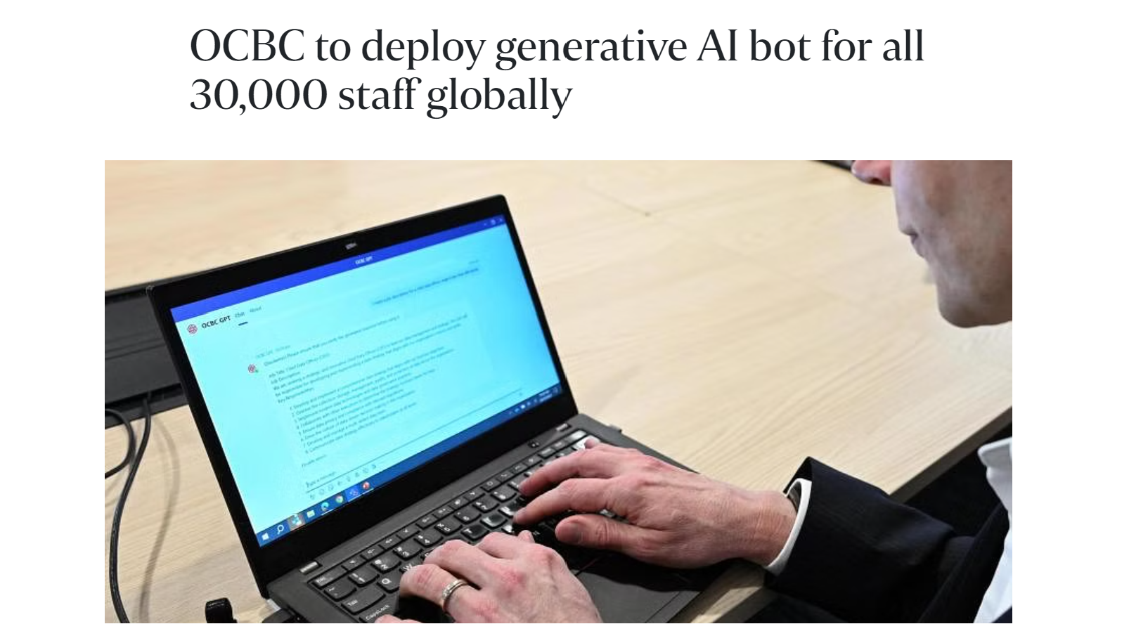
OCBC to deploy generative AI bot for all 30,000 staff globally
https://www.straitstimes.com/business/ocbc-to-deploy-generative-ai-bot-for-all-30000-staff-globally

Slide 10
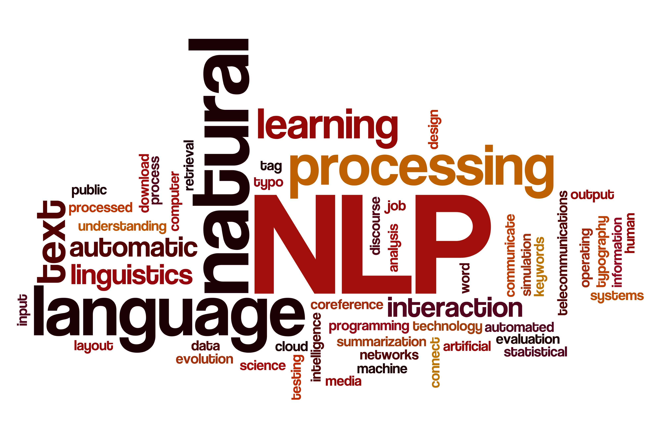
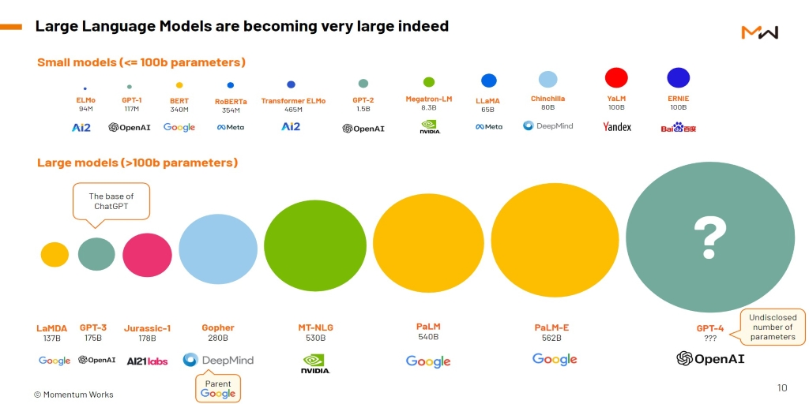
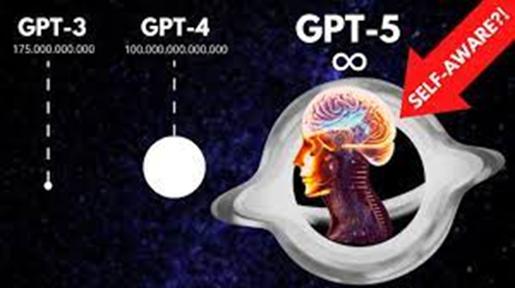
NLP & LLM
(natural language Processing &
Large Language Model)

Slide 11
LLM vs GPT
LLM
GPT
imageGPT
videoGPT
musicGPT
Google PaLM
chatGPT
Most of LLM are not using GPT https://www.techtarget.com/whatis/feature/12-of-the-best-large-language-models

Slide 12
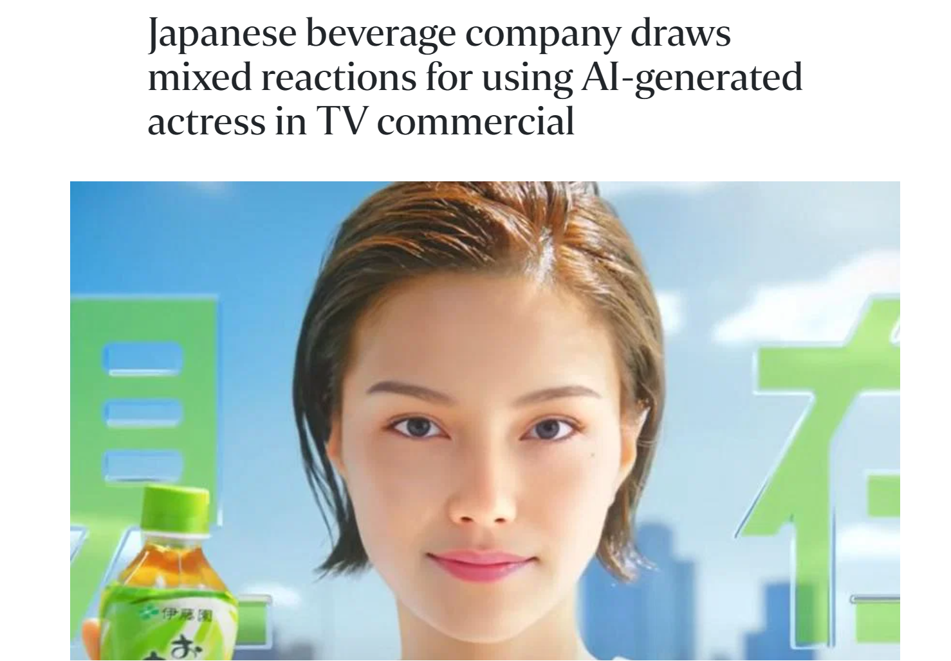
https://www.straitstimes.com/asia/east-asia/japanese-beverage-company-draws-mixed-reactions-for-using-ai-generated-actress-in-tv-commercial

Slide 13
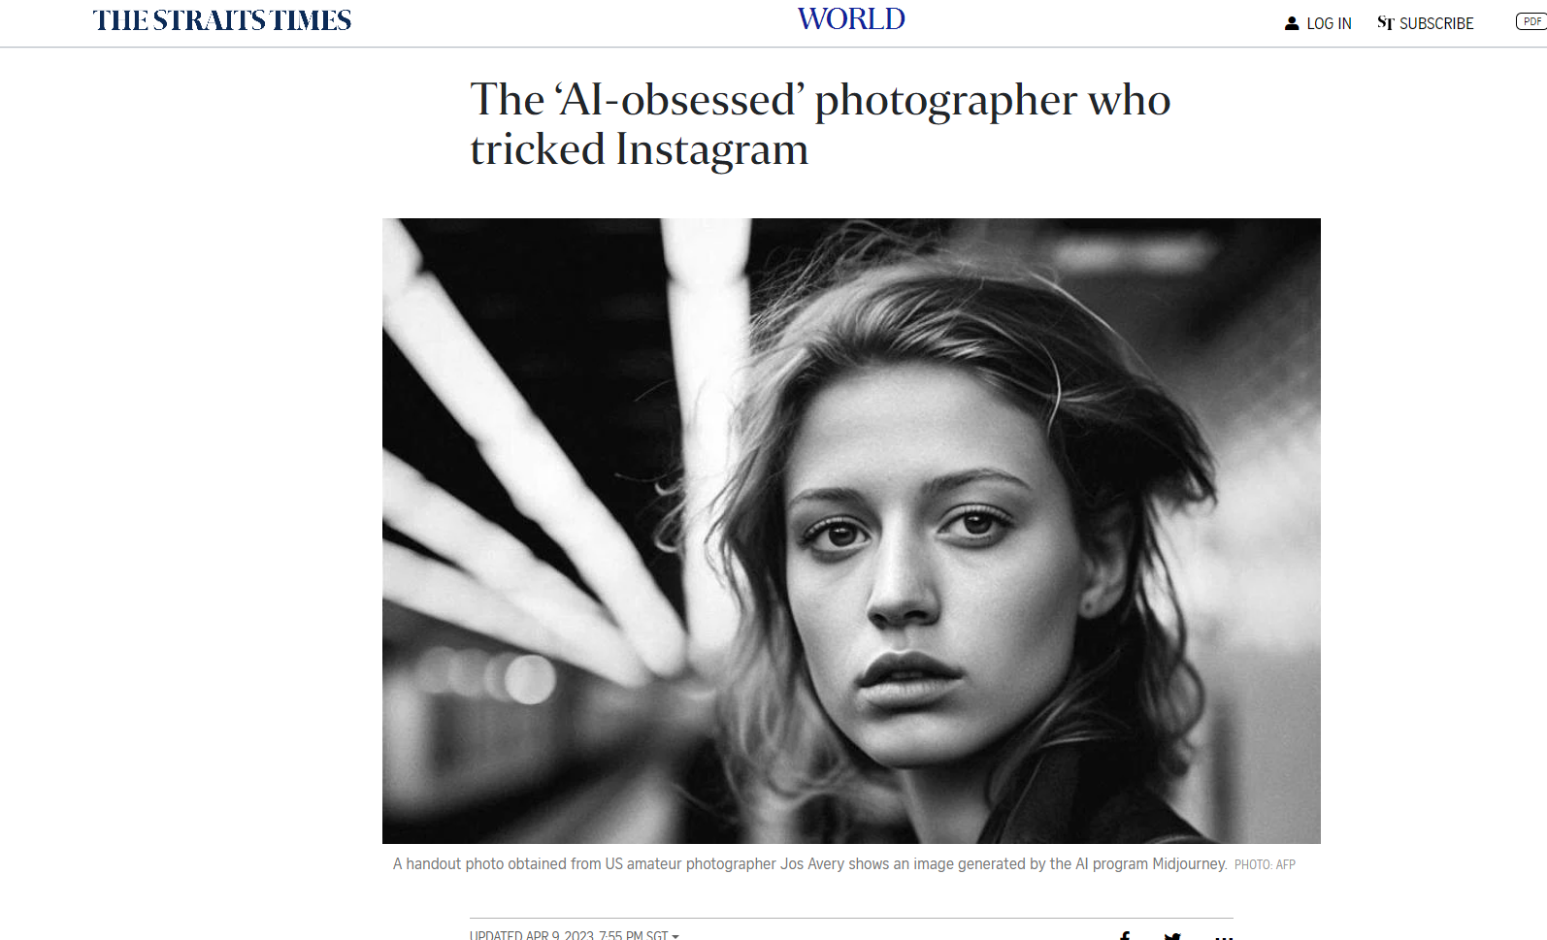
Midjourney (9th April)
https://www.straitstimes.com/world/europe/the-ai-obsessed-photographer-who-tricked-instagram

Slide 14
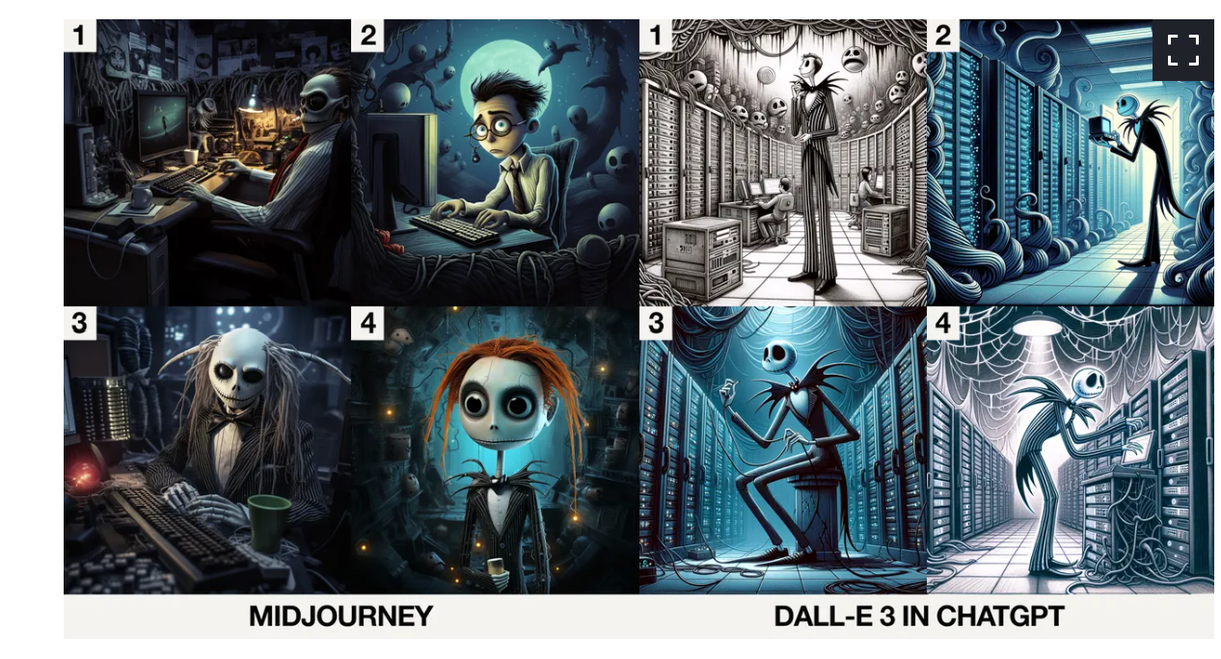
Image – Dalle vs MidJourney
https://www.google.com/amp/s/www.zdnet.com/google-amp/article/midjourney-vs-dall-e-3-in-chatgpt-which-ai-does-halloween-better/

Slide 15
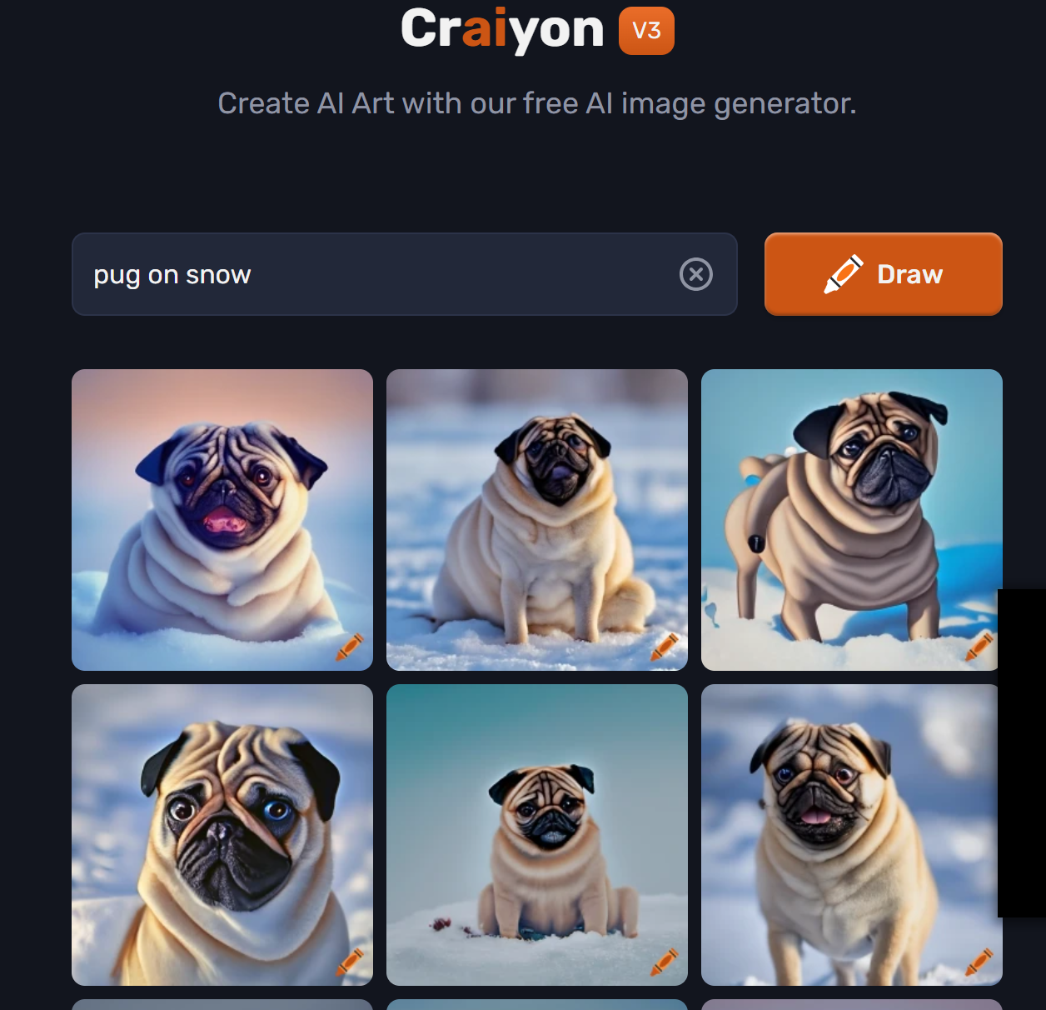
Try https://www.craiyon.com/

Slide 16
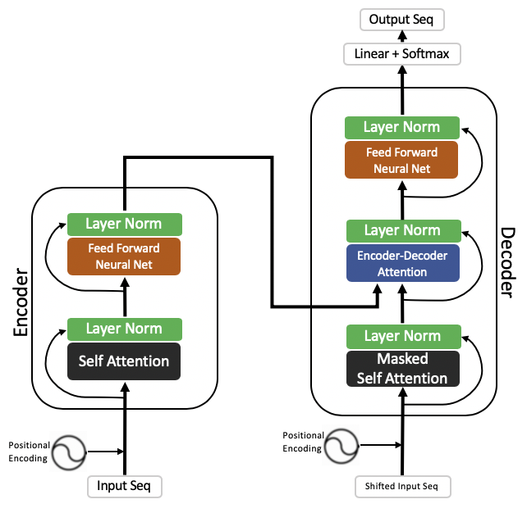
Transformer, Encoder, Attention
How encoder decoder works in Transformer: https://jalammar.github.io/illustrated-transformer/
The transformer is the model, while the attention is a technique used by the model.

Slide 17
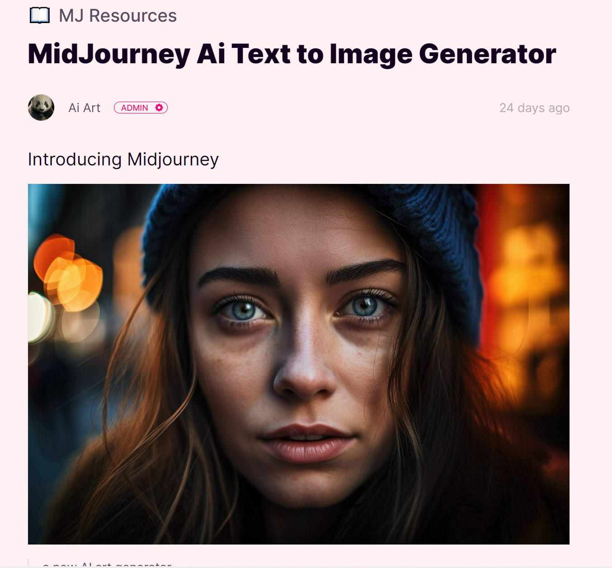
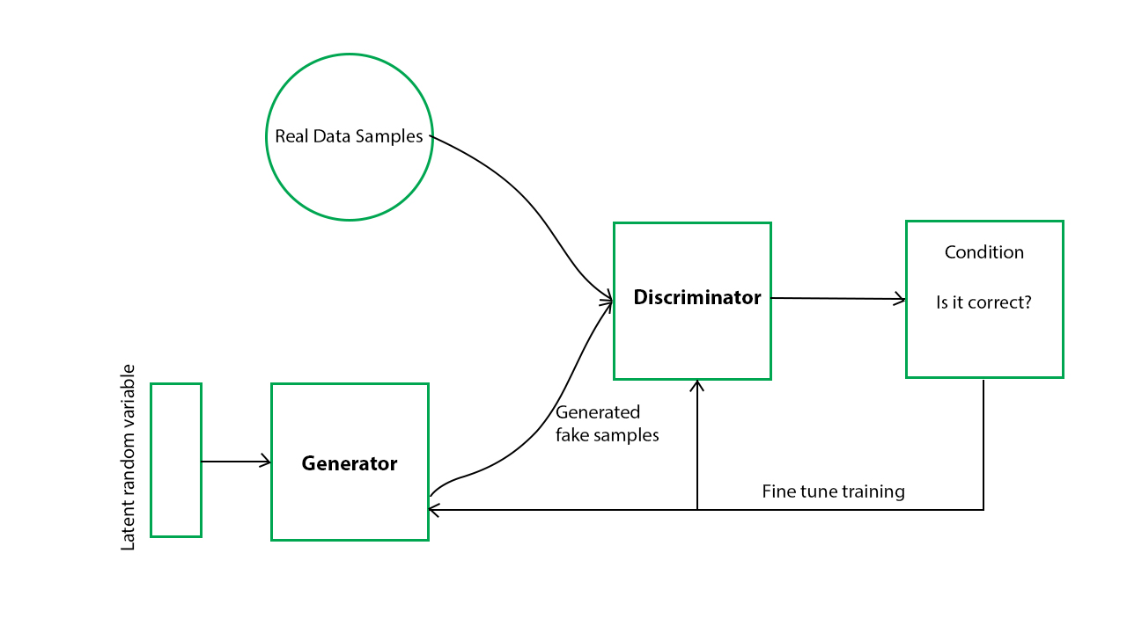
GAN – Used by Midjourney
Midjourney is a new artificial intelligence (AI) art generator that can turn text into images. It is based on the principle of Generative Adversarial Networks (GANs), which are a type of neural network that can generate new data from scratch.
https://gratisgraphics.com/community/post/1030373305
Alternative to Midjourney:
Dall-E2 using GPT3
https://openai.com/product/dall-e-2

Slide 18
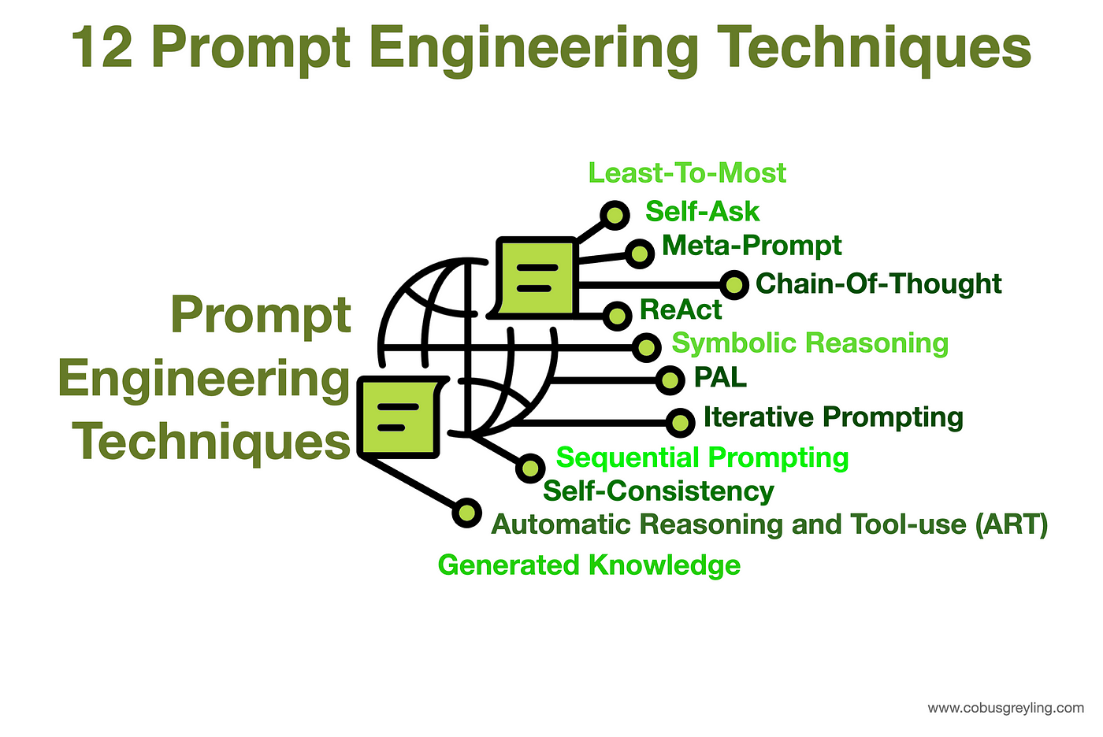

Slide 19
Prompt Engineering
1. **Identify the Objective**:
- Example: Generate ideas, answer a question, create content, etc.
2. **Specify the Context**:
- Example: If it’s an essay, what’s the topic? If it’s a program, what’s the desired function?
3. **Detail the Requirements**:
- Example: Length of text, format of response, language style, or technical specifications.
4. **Include Constraints**:
- Example: Avoid certain topics, use only certain sources of information,or comply with a specific tone.

Slide 20
Prompt Engineering
Task | Bad Prompt | Good Prompt
Writing a News Article | "Write about the economy." | "Compose a 500-word news article on the impact of recent trade policies on the global economy, suitable for publication in a business news section."
Preparing Interview Questions | "Questions for interview." | "List 10 insightful interview questions for a software engineer with a focus on problem-solving and teamwork, to assess suitability for a leadership role."
Creating a Meal Plan | "I need food for the week." | "Generate a 7-day vegetarian meal plan for one person that includes breakfast, lunch, and dinner, ensuring each meal is under 500 calories and high in protein."
Generating Code | "Make an app." | "Write a Python script that takes user input and outputs a graph displaying the input data. The script should include comments explaining the code."
Writing Poem | "Do a poem." | "Craft a four-stanza poem about the sea reflecting the theme of change, using a rhyming ABAB pattern and vivid imagery to evoke the sense of motion."
Product Description | "Describe this product." | "Provide a 150-word product description for a new eco-friendly water bottle designed for athletes, highlighting its durability, portability, and insulation capabilities."

Slide 21

Fine Tuning
https://medium.com/@iryna230520/fine-tune-google-palm-2-with-scikit-llm-d41b0aa673a5

Slide 22
Fine Tuning – teach chatGPT
https://www.shiksha.com/online-courses/articles/how-to-fine-tune-chatgpt-for-specific-use-case/
import openai
import json
import time
# Set your API key
openai.api_key = "YOUR_API_KEY"
# Load your training data
with open("training_data.json", "r") as f:
training_data = json.load(f)
# Initialize a new model with the base model you want to fine-tune
model = "text-davinci-002"
fine_tuned_model = openai.Model.create(
model=model,
fine_tune=True,
training_data=training_data
)
# Wait for the model to finish fine-tuning
while fine_tuned_model.status()["data"]["ready"] is False:
time.sleep(30)
fine_tuned_model = openai.Model.retrieve(fine_tuned_model.id)
print("Fine-tuning complete")

Slide 23
Programming

Slide 24
openAI api need to pay – hence, skip the next 3 slides

Slide 25
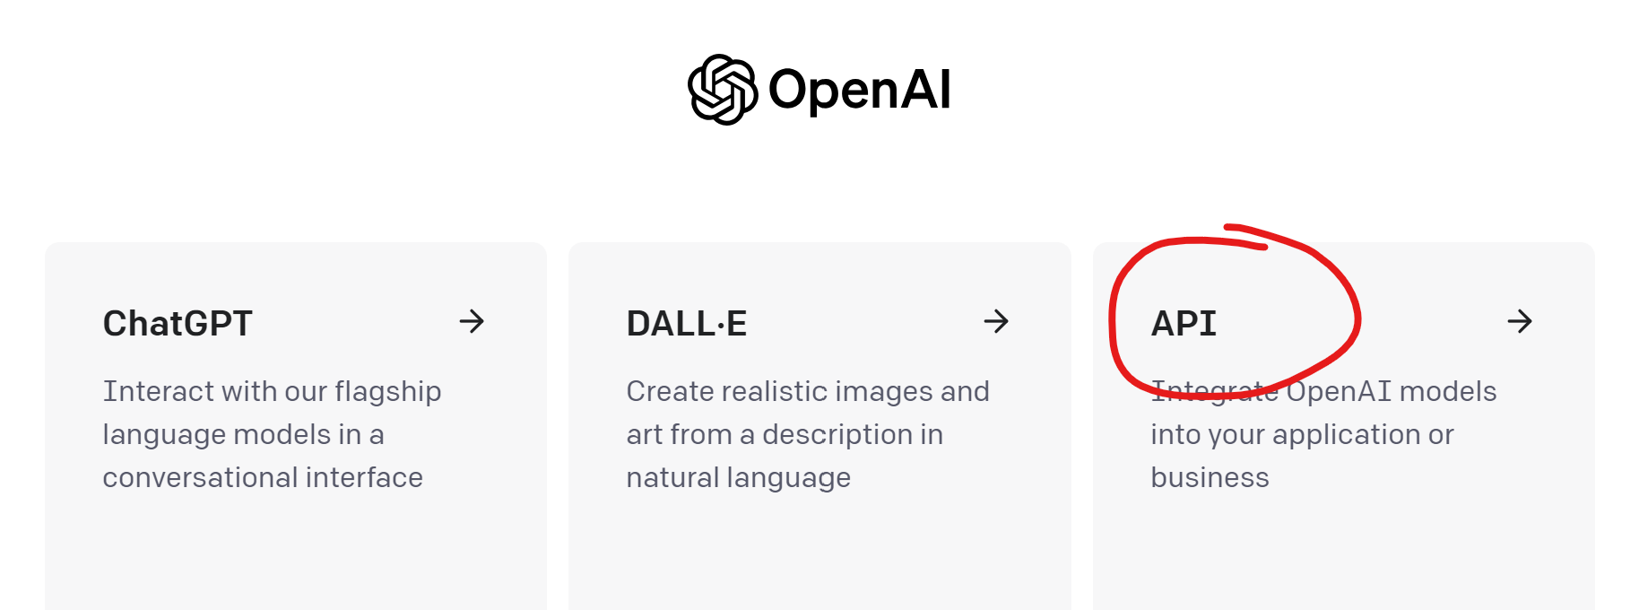
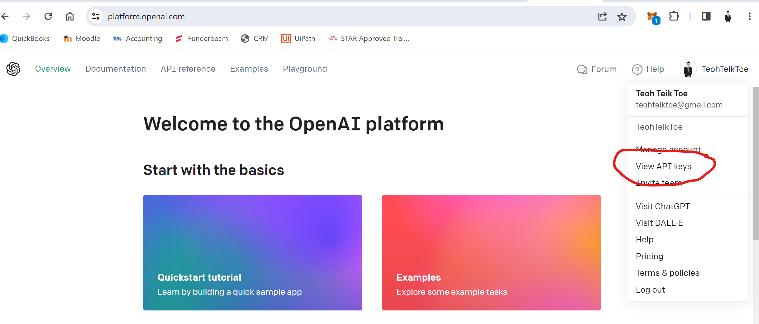
Register openai API - https://openai.com/ - Generate API

Slide 26
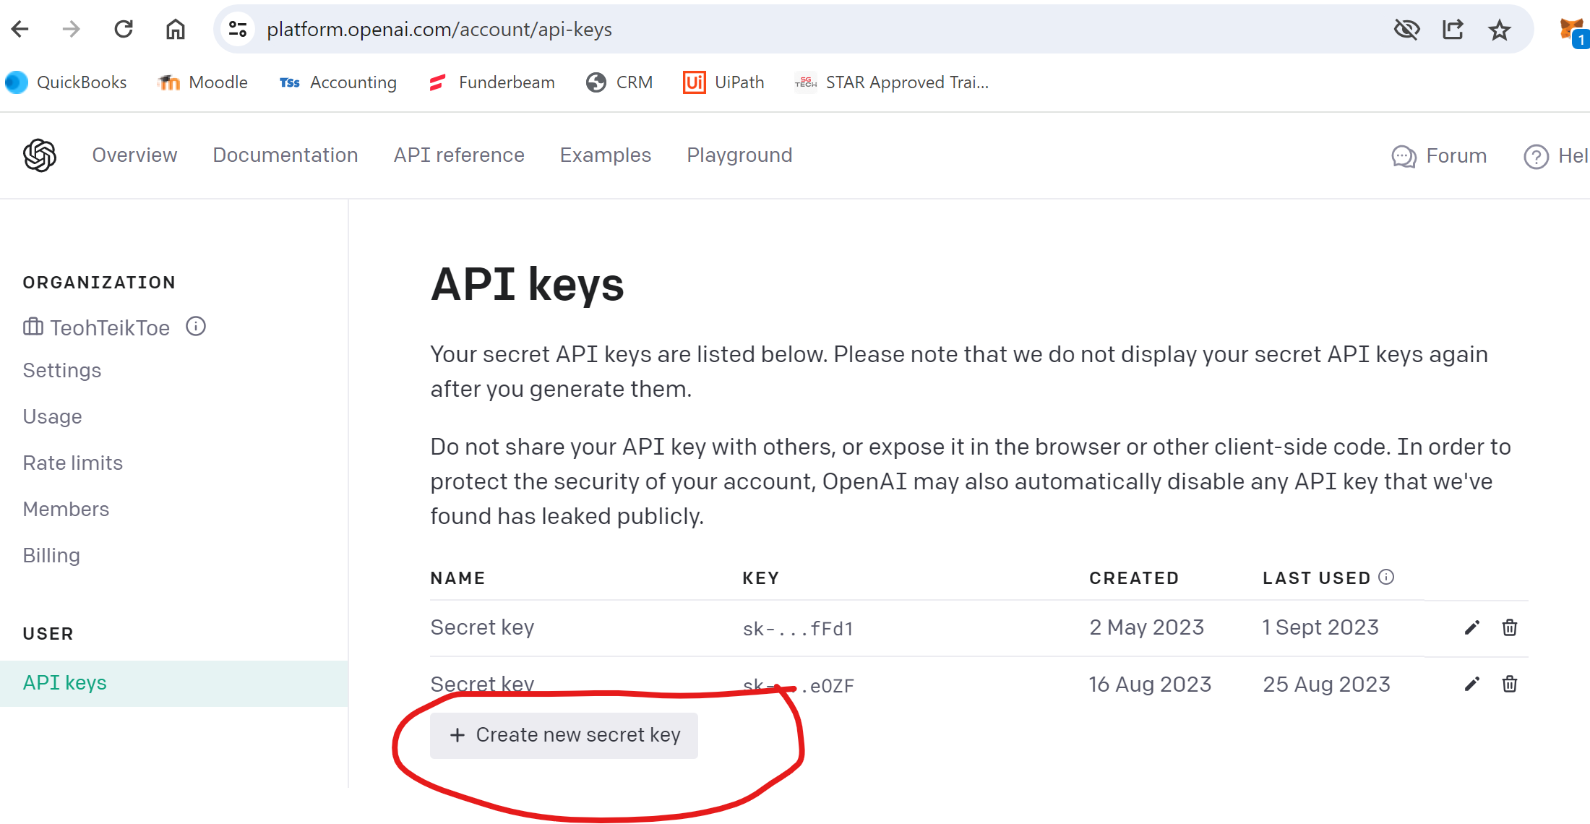
Generate API

Slide 27
ChatGPT – Need to pay
pip install openai
from openai import OpenAI
client = OpenAI(
api_key="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",
)
q = input("Please enter your question: ")
r = client.chat.completions.create(
model="gpt-3.5-turbo",
messages=[{"role": "user", "content": q}],
)
print(r.choices[0].message.content)
https://colab.research.google.com/drive/17C128ZA2H1gOpxo7XVwSUqlKB3K3o25V?usp=drive_link

Slide 28
PaLM & Makersuite (March 14, 2023)
PaLM (Pathways Language Model) is a 540 billion parameter transformer-based large language model developed by Google AI.
MakerSuite. A fast, easy way to start prototyping generative AI ideas and access the PaLM API.
Create API:
https://makersuite.google.com/

Slide 29
PaLM (LLM) & Bard (chatbot)
PaLM 2 is a large language model (LLM) developed by Google AI. Palm 2 is trained on a massive dataset of text and code, and it can perform a wide range of tasks, including generating text.
Bard AI is a conversational AI chatbot developed by Google AI. It is powered by PaLM 2.

Slide 30
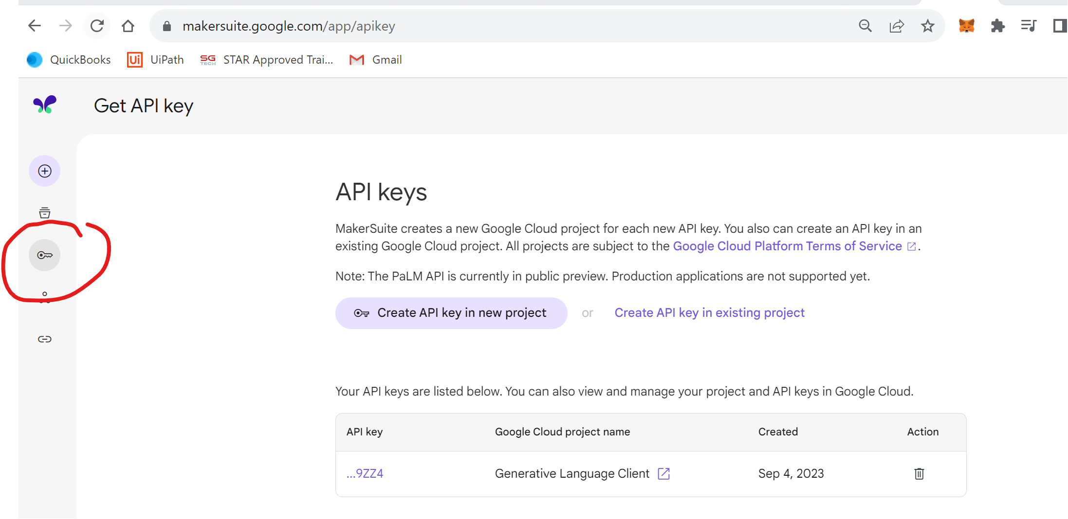
API

Slide 31
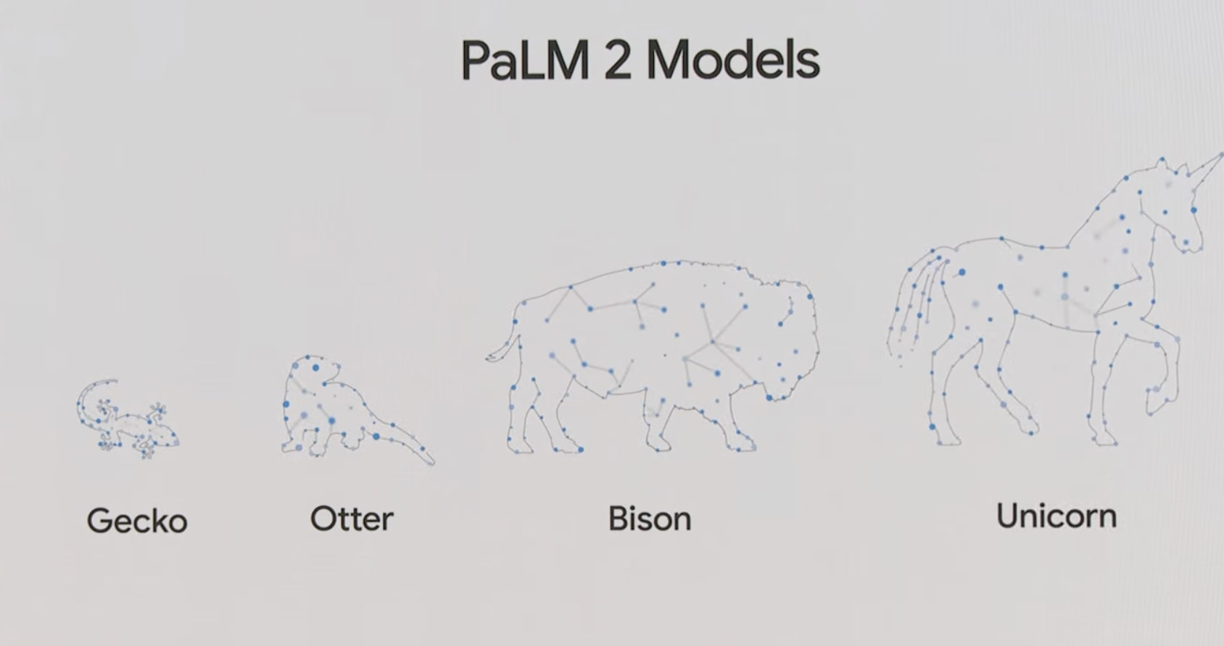
Bison
30 Sept 2023 — Infact, Bison was better than Google Bard.

Slide 32
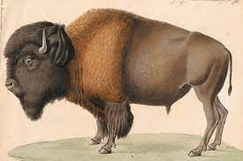
Google - PaLM – makersuite
Code: https://colab.research.google.com/drive/1feZjGp5zT8b2eyMputRJ3weZWXnqKm9Y
pip install google-generativeai
import google.generativeai as palm
palm.configure(api_key="AIzaSyCCT1K99BJ1JbLwhCE7qOcQ5KOZcPJ9ZZ4")
model = { 'model': "models/chat-bison-001"}
messages = input("please enter your text : ")
response = palm.chat(
**model,
messages=messages
)
print(response.last)
Bison: Best value in terms of capability and cost.
Gecko: Smallest and lowest cost model for simple tasks.
Model: https://cloud.google.com/vertex-ai/docs/generative-ai/learn/models

Slide 33
Back End
from flask import Flask,render_template,request
import google.generativeai as palm
palm.configure(api_key="AIzaSyCCT1K99BJ1JbLwhCE7qOcQ5KOZcPJ9ZZ4")
defaults = { 'model': "models/chat-bison-001"}
app = Flask(__name__)
@app.route("/",methods=["GET","POST"])
def index():
if request.method == "POST":
t = request.form.get("txt")
r = palm.chat(**defaults,messages=t)
return(render_template("index.html",result=r.last))
else:
return(render_template("index.html",result="waiting"))
if __name__ == "__main__":
app.run()

Slide 34
Front End
<html>
<h1>My First chat in Cloud</h1>
<form action="/" method="post">
<p>Please enter the your question : </p>
<p><input type="text" name="txt"></p>
<p><input type="submit" value="Enter"></p>
</form>
<p>The reply is {{result}}</p>
</html>

Slide 35
Responsive
<style>
.container {
width: 100%;
margin: auto;
}
@media (min-width: 600px) {
.container {
width: 80%;
}
}
@media (min-width: 768px) {
.container {
width: 60%;
}
}
@media (min-width: 1024px) {
.container {
width: 50%;
}
}
</style>
<div class="container">
<h1>Chatbot</h1>
<form action="/result" method="post">
<img src="https://images.unsplash.com/photo-1707305318944-0dd559c12789?q=80&w=2574&auto=format&fit=crop&ixlib=rb-4.0.3&ixid=M3wxMjA3fDB8MHxwaG90by1wYWdlfHx8fGVufDB8fHx8fA%3D%3D"
width="300" height="200">
<p>Please enter the your question : </p>
<p><input type="text" name="txt"></p>
<p><input type="submit" value="Enter" style="width:100px;height:50px"></p>
</form>
</div>
from flask import Flask,render_template,request
import google.generativeai as palm
palm.configure(api_key="AIzaSyCCT1K99BJ1JbLwhCE7qOcQ5KOZcPJ9ZZ4")
defaults = { 'model': "models/chat-bison-001"}
app = Flask(__name__)
@app.route("/",methods=["GET","POST"])
def index():
return(render_template("index.html"))
@app.route("/result",methods=["GET","POST"])
def result():
t = request.form.get("txt")
r = palm.chat(**defaults,messages=t)
return(render_template("result.html",result=r.last))
@app.route("/end",methods=["GET","POST"])
def end():
print("end")
return(render_template("end.html"))
if __name__ == "__main__":
app.run()
<div class="container">
<p><h6>The reply is {{result}}</h6></p>
<form action="/" method="post">
<p><input type="submit" value="Another Query" style="width:100px;height:50px;"></p>
</form>
<form action="/end" method="post">
<p><input type="submit" value="End" style="width:100px;height:50px;"></p>
</form>
</div>
<div class="container">
<h1>Thank you, Good Bye</h1>
</div>

Slide 36
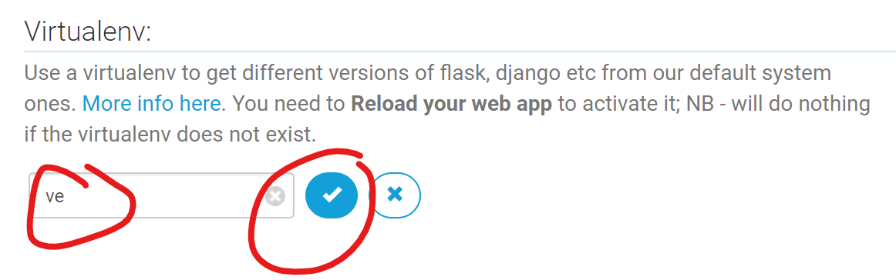
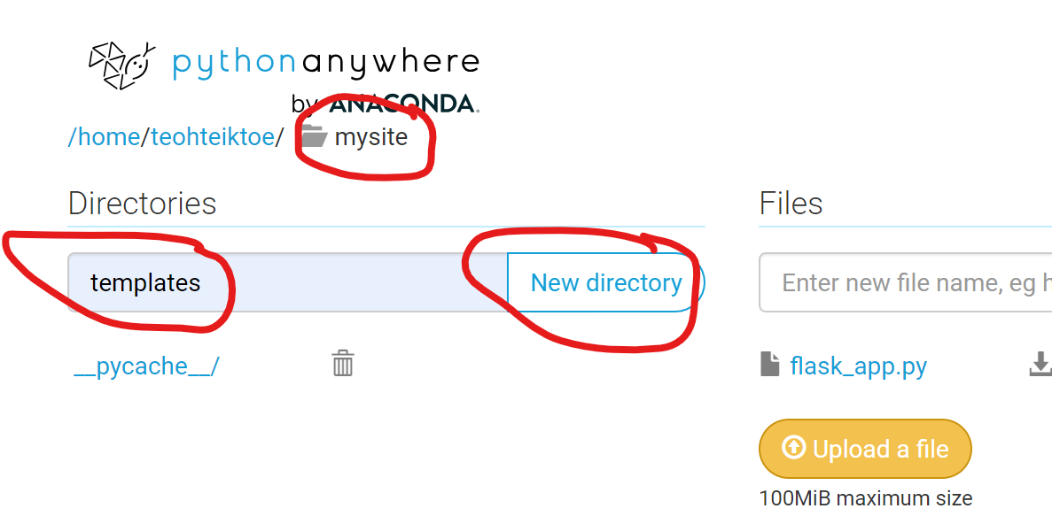
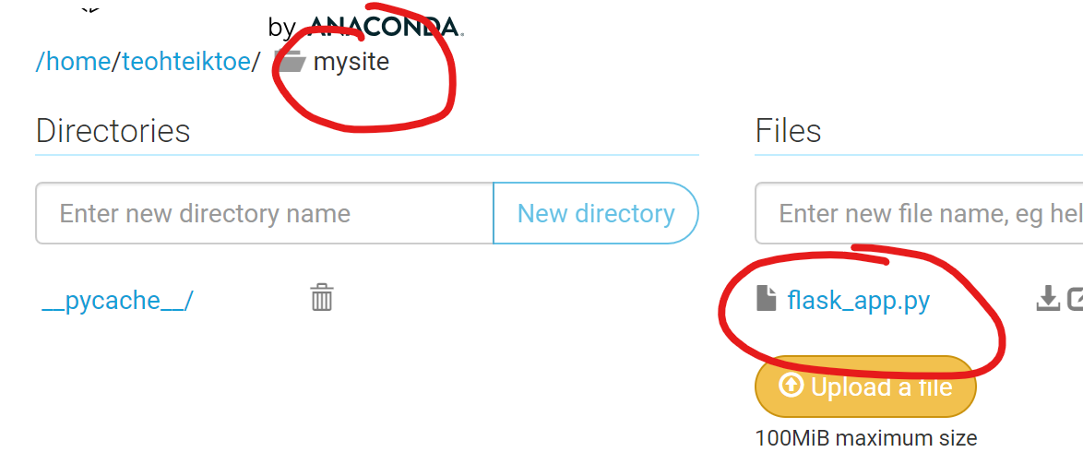
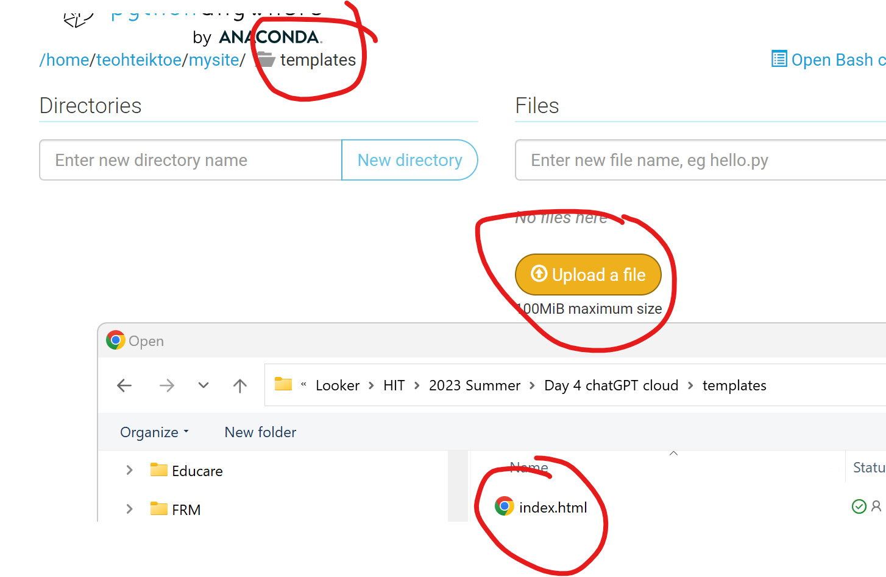
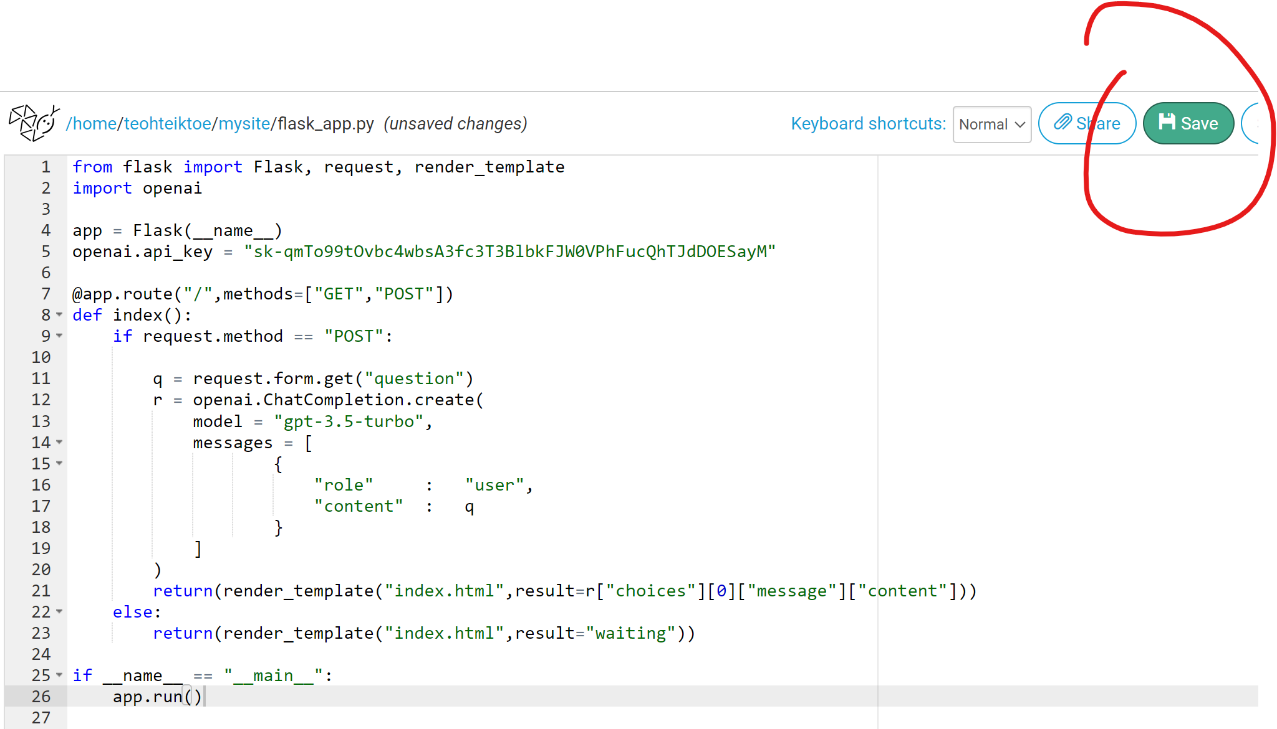
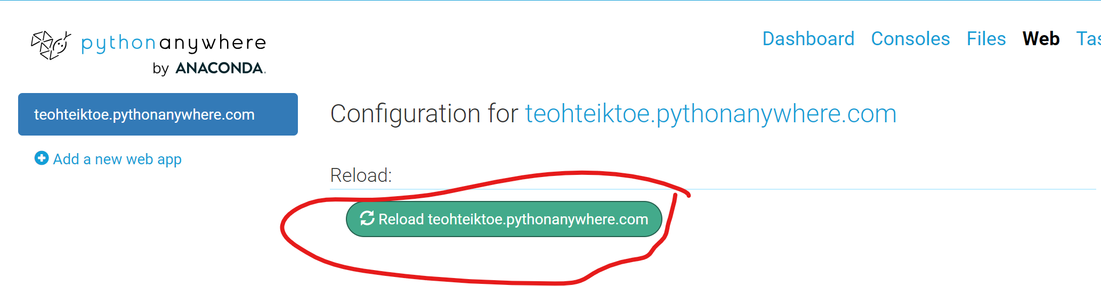
Deploy in pythonwhere.com

Slide 37
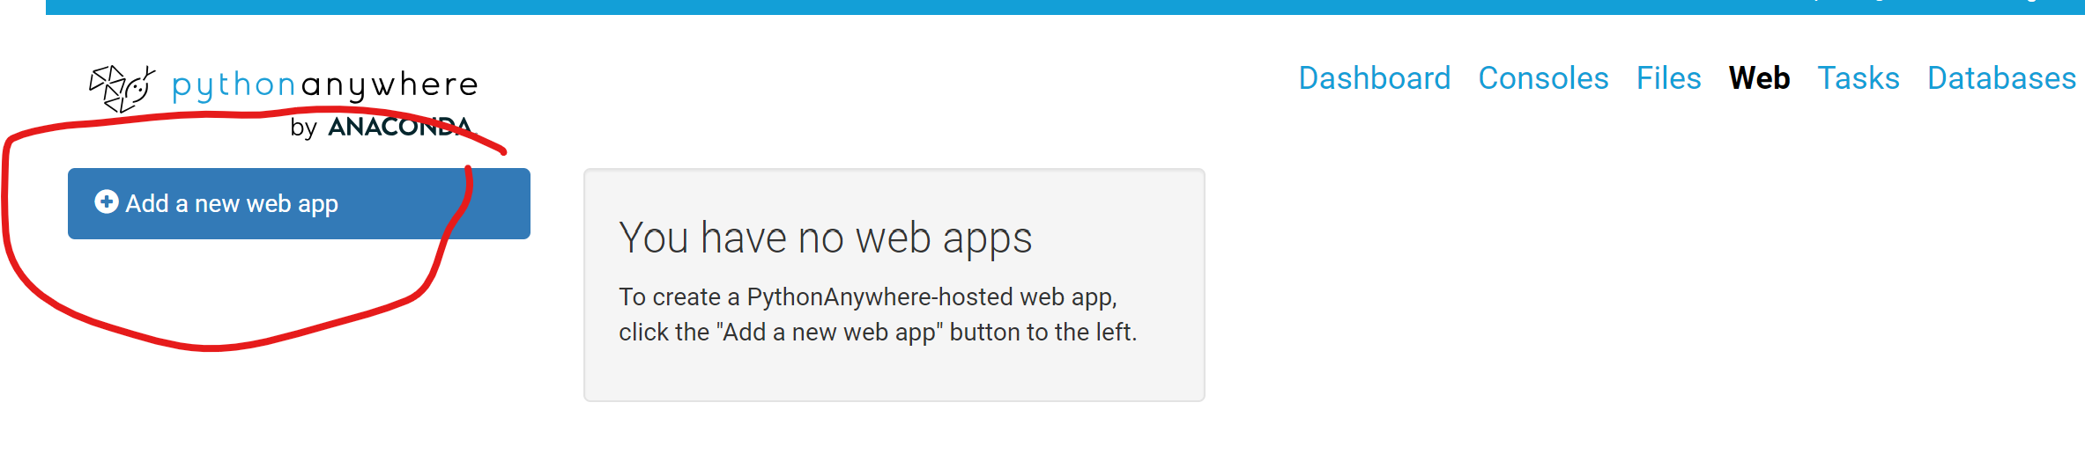
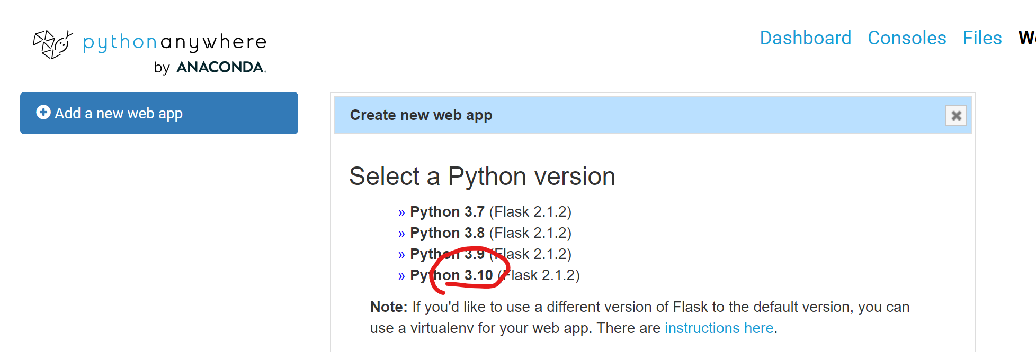
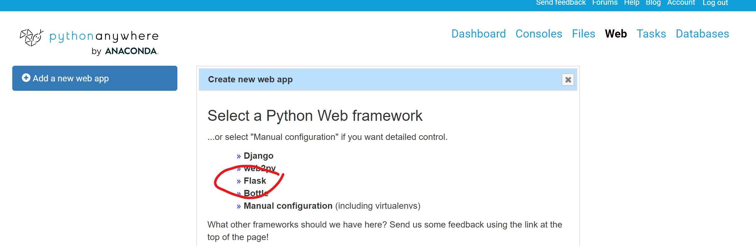
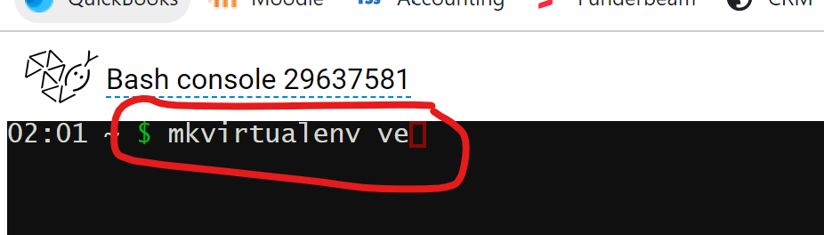
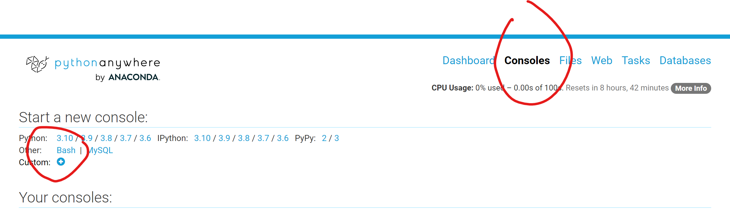
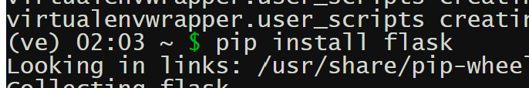
For chatGPT Cloud use Python anywhere – pip install openai and flask
Add a new web

Slide 38
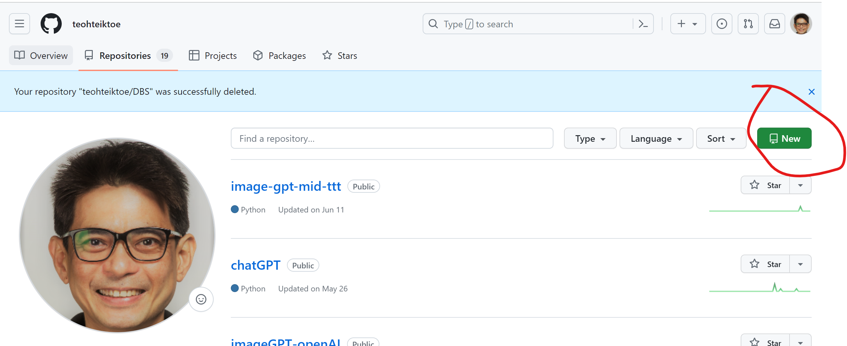
Deploy in render - need to create new repository in github
requirements.txt
flask
replicate
gunicorn

Slide 39
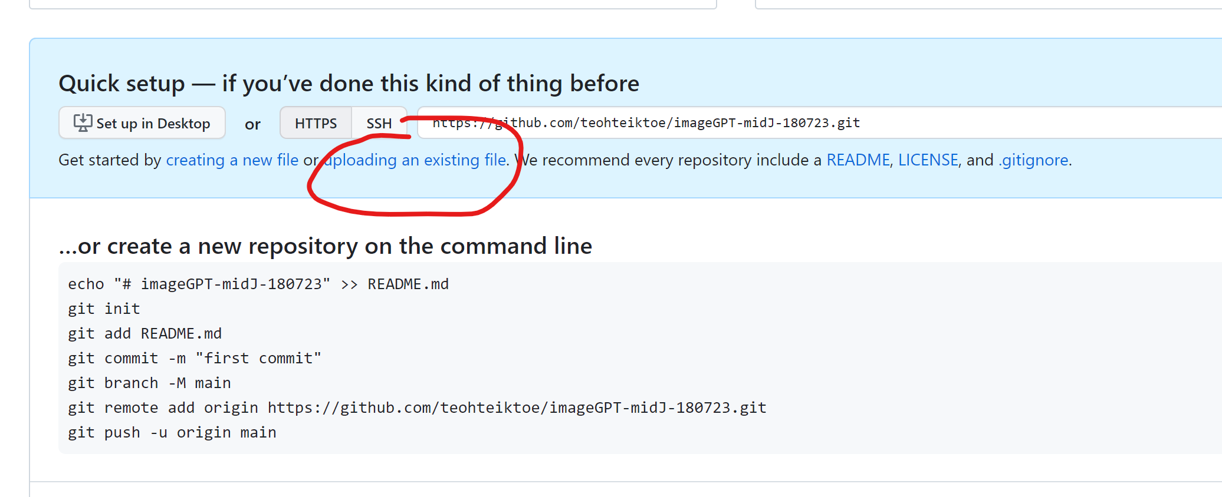

Slide 40
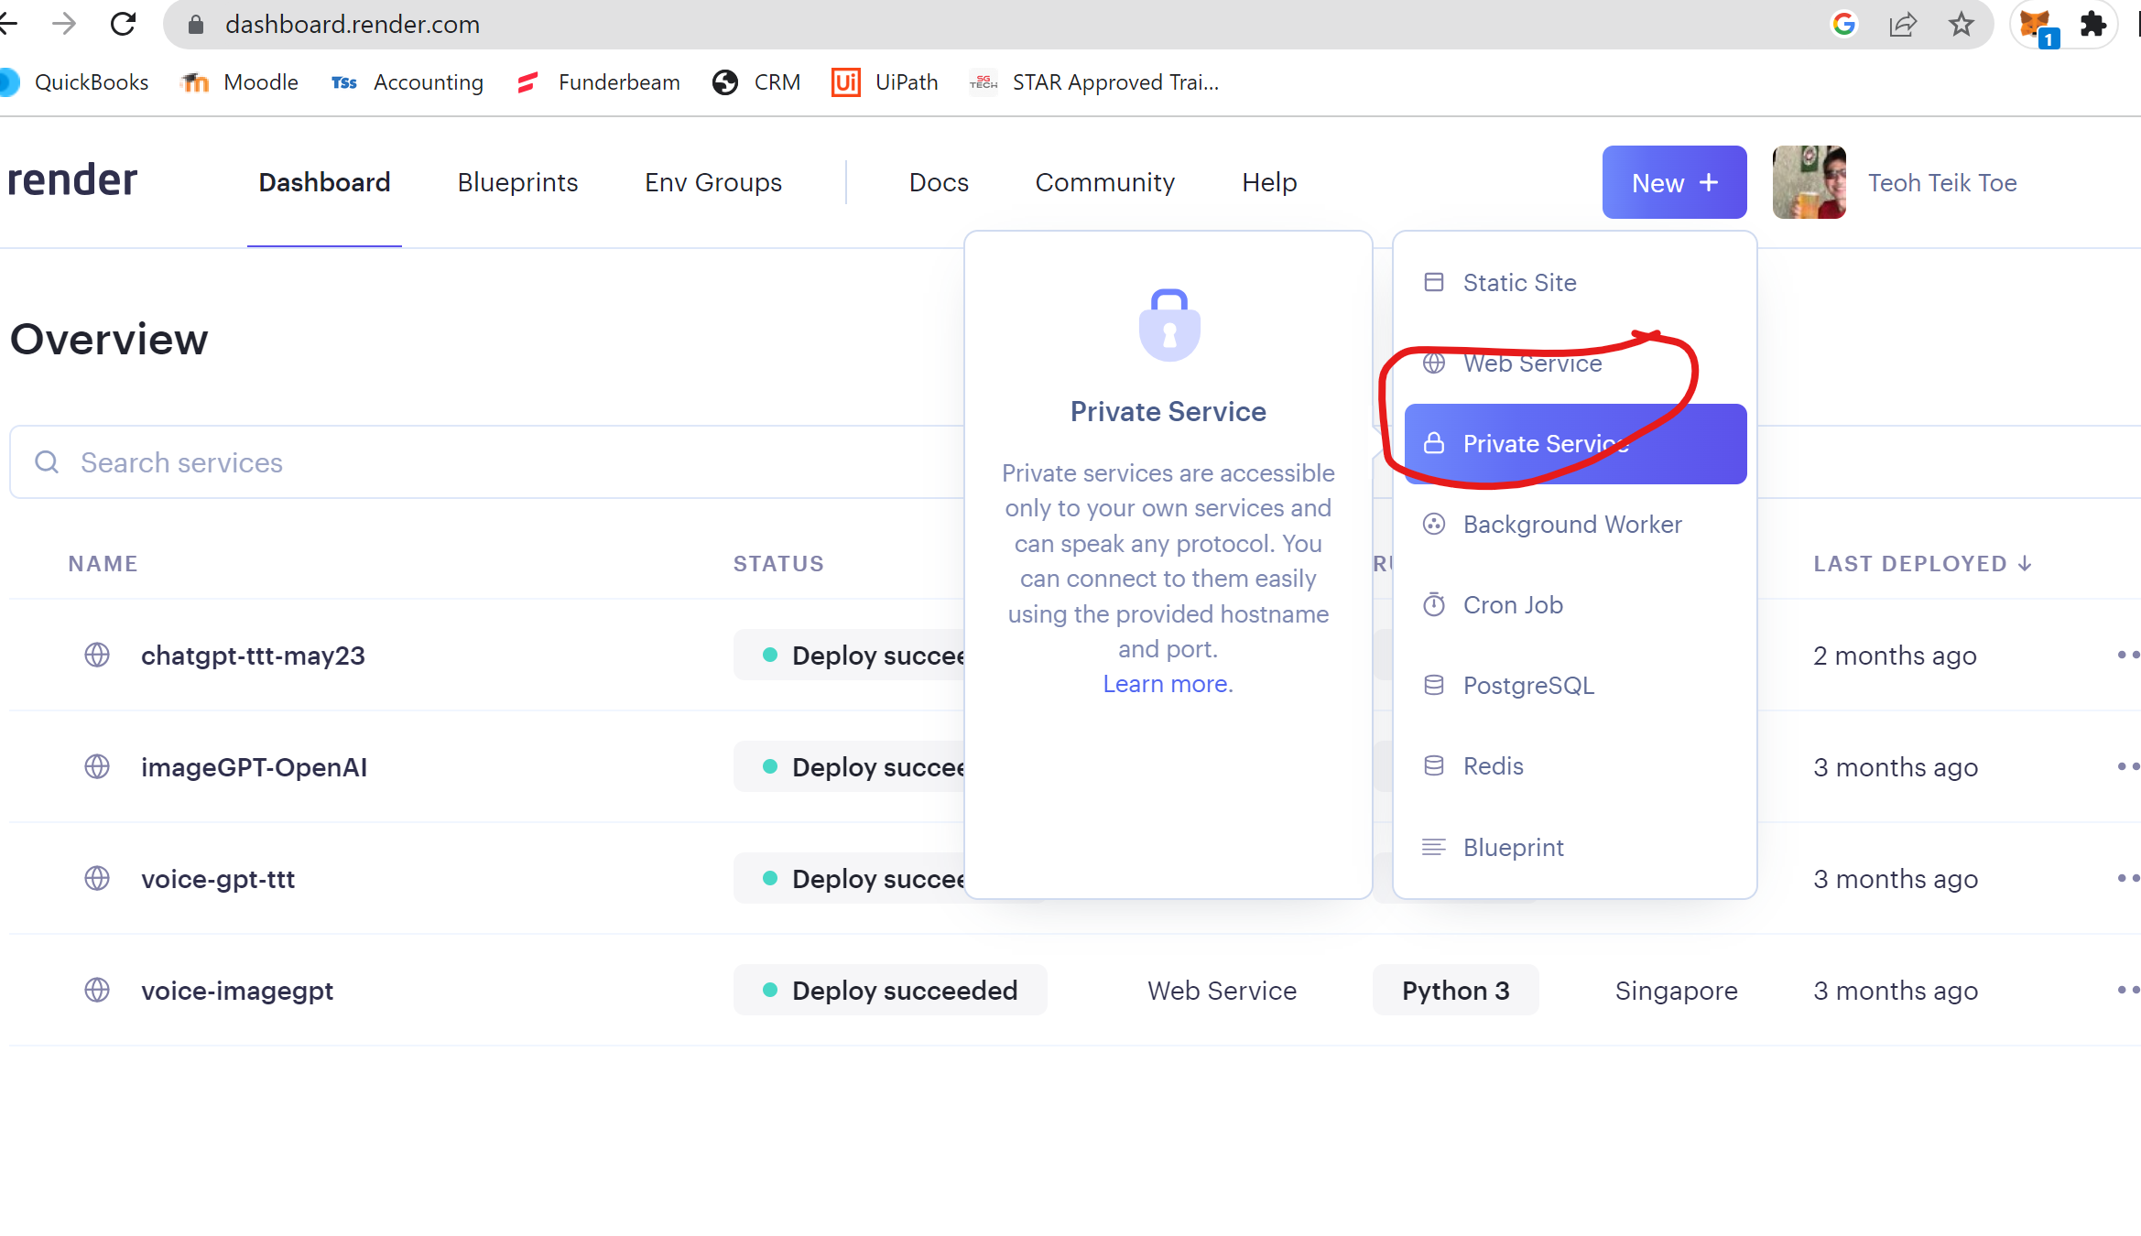
Render.com – need to create web service and link to github remember to select runtime as python3 start command - gunicorn app:app

Slide 41
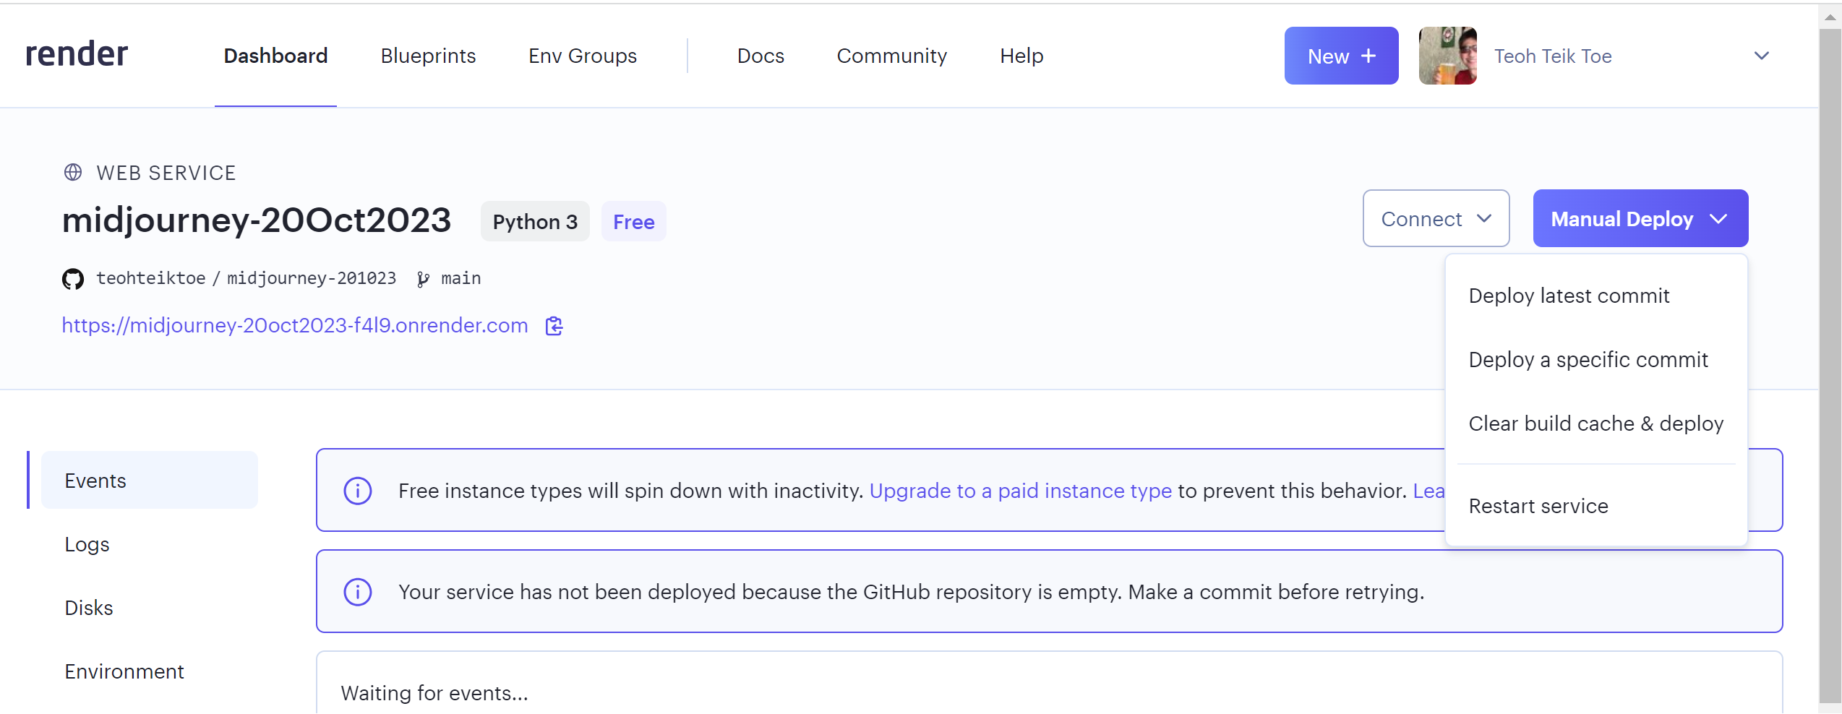
Deploy Latest Commit

Slide 42
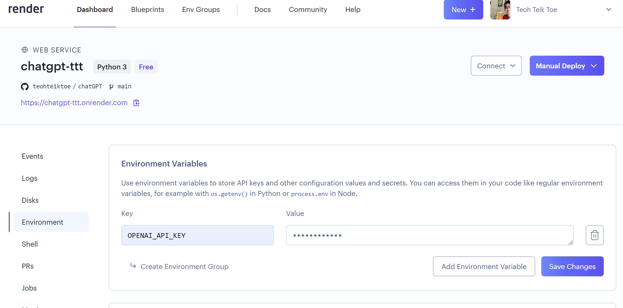
Deploy in render, need to change
requirements.txt
flask
google-generativeai
gunicorn

Slide 43
ImageGPT use Midjourney (need to register replicate.com first to get the API, but replicate.com use github, need to register github also)

Slide 44
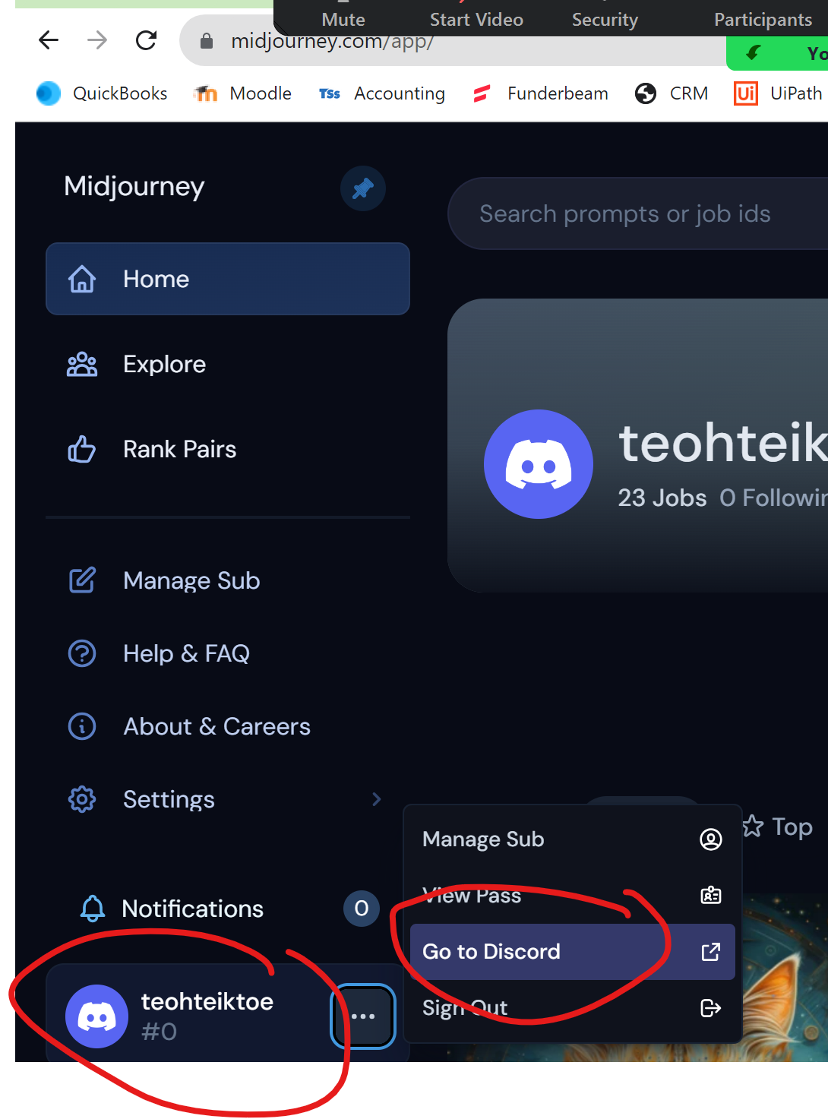
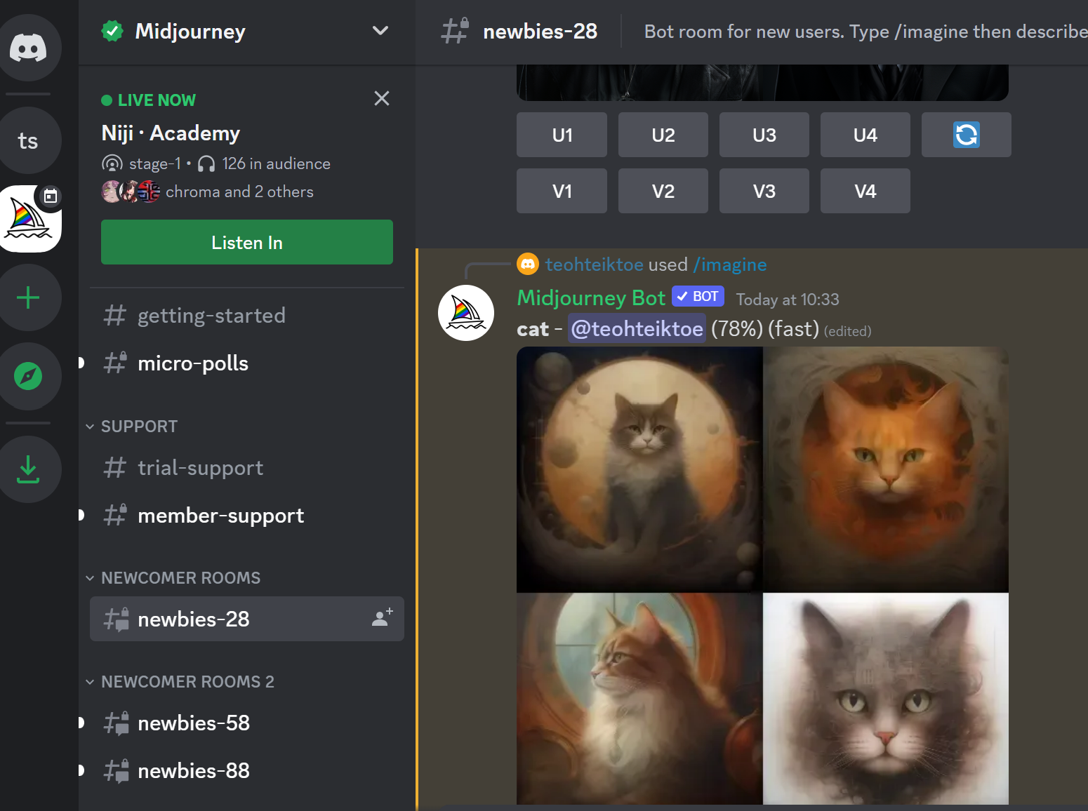
Discord – from Midjourney to discord -> /image to draw

Slide 45
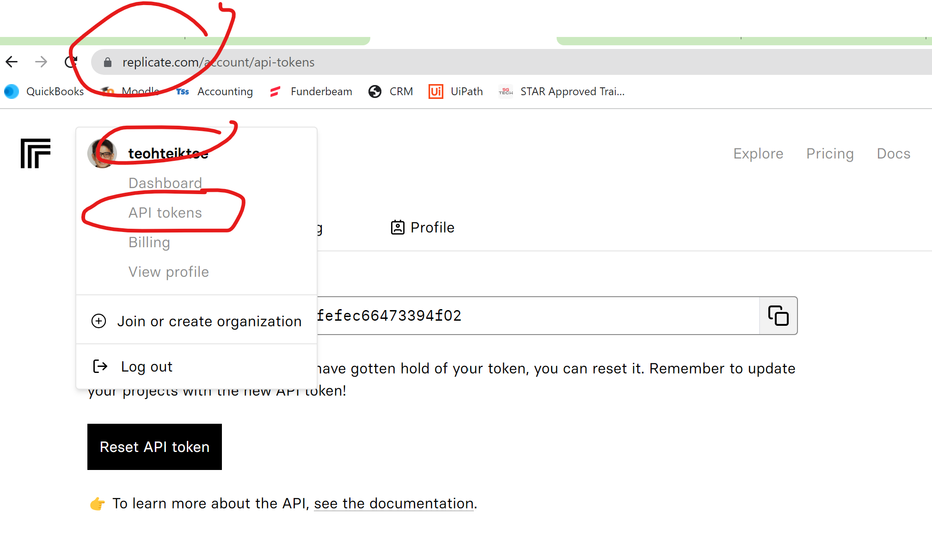
Replicate.com

Slide 46
Replicate.com
https://colab.research.google.com/drive/1MONXHbUv9aNVYn3_--g6yiBj_OdrQsGZ?usp=drive_link
pip install replicate
import replicate
import os
os.environ["REPLICATE_API_TOKEN"]="787f515cb0624813736c11e7fefec66473394f02"
inputs = input("Enter : ")
r = replicate.run(
"stability-ai/stable-diffusion:db21e45d3f7023abc2a46ee38a23973f6dce16bb082a930b0c49861f96d1e5bf",
input={
"prompt": inputs,
}
)
print(r)
import requests
from PIL import Image
r = Image.open(requests.get(r[0], stream=True).raw)
r

Slide 47
Image GPT using Midjourney
https://colab.research.google.com/drive/1S2nzSE2XXAEsdaQOvjmAQw_w64mO2Sbm?usp=drive_link
import json
import time
import requests
q = input("Enter your picture request : ")
data = json.dumps(
{
"version": "db21e45d3f7023abc2a46ee38a23973f6dce16bb082a930b0c49861f96d1e5bf",
"input": { "prompt": q }
}
)
headers = {
'Authorization': 'Token 787f515cb0624813736c11e7fefec66473394f02',
'Content-Type': 'application/json'
}
r = requests.post('https://api.replicate.com/v1/predictions',data=data,headers=headers)
time.sleep(10)
r = r.json()['urls']['get']
r = requests.post(r,headers=headers).json()['output']
#print image
from PIL import Image
r = Image.open(requests.get(r[0], stream=True).raw)
r

Slide 48
Back End (FOR CLOUD, CANNOT RUN ON PYTHONANYWHERE BECAUSE replicate.com not in the white list, MUST run on render.com -> Need github
https://github.com/teohteiktoe/midjourney-201023.git
from flask import Flask, render_template, request
import os
import requests
import json
import time
os.environ["REPLICATE_API_TOKEN"] = "787f515cb0624813736c11e7fefec66473394f02"
app = Flask(__name__)
@app.route("/", methods=["GET","POST"])
def index():
if request.method == "POST":
q = request.form.get("q")
body = json.dumps({"version": "db21e45d3f7023abc2a46ee38a23973f6dce16bb082a930b0c49861f96d1e5bf", "input": { "prompt": q } })
headers = {'Authorization': 'Token 787f515cb0624813736c11e7fefec66473394f02','Content-Type': 'application/json'}
output = requests.post('https://api.replicate.com/v1/predictions',data=body,headers=headers)
time.sleep(10)
get_url = output.json()['urls']['get']
print(get_url)
get_result = requests.post(get_url,headers=headers).json()['output']
print(get_result)
return(render_template("index.html", result=get_result[0]))
else:
return(render_template("index.html", result="waiting"))
if __name__ == "__main__" :
app.run()

Slide 49
Front End
<html>
<h1>My First photo generator in Cloud</h1>
<form action="/" method="post">
<p>Please enter the photo you wanted to generate (eg a photo of mars)</p>
<p><input type="text" name="txt"></p>
<p><input type="submit" value="Enter"></p>
</form>
<p>Reply : {{result}}</p>
<p><img src={{result}}></p>
</html>

Slide 50
For cloud, need to use render.com which need github
requirements.txt:
flask
requests
gunicorn
replicate

Slide 51
3 pages – submit buttons
from flask import Flask,request,render_template
from textblob import TextBlob
app = Flask(__name__)
@app.route("/",methods=["GET","POST"])
def index():
return(render_template("index.html"))
@app.route("/result",methods=["GET","POST"])
def result():
t = request.form.get("t")
result = TextBlob(t).sentiment
return(render_template("result.html",result=result))
@app.route("/next", methods=["GET","POST"])
def next():
return(render_template("index.html"))
@app.route("/end", methods=["GET","POST"])
def end():
return(render_template("end.html"))
if __name__ == "__main__":
app.run()
Index.html
<html>
<h1>My second ML cloud based model: Text Sentiment</h1>
<form action="/result" method="post">
<p>Please enter the text</p>
<p><input type="text" name="t"></p>
<p><input type="submit" value="Enter"></p>
</form>
</html>
result.html
<html>
<p><h2>6 The sentiment of the text {{result}}</h2></p>
<form action="/next" method="post">
<p><input type=submit value=Next></p>
</form>
<form action="/end" method="post">
<p><input type=submit value=End></p>
</form>
</html>
End.html
<html>
<h1>Thank you</h1>
</html>

Slide 52
Flask with responsive
<style>
.container {
width: 100%;
margin: auto;
}
@media (min-width: 600px) {
.container {
width: 80%;
}
}
@media (min-width: 768px) {
.container {
width: 60%;
}
}
@media (min-width: 1024px) {
.container {
width: 50%;
}
}
</style>
<div class="container">
<h1>Thank you</h1>
</div>

Slide 53
Size button and picture
<img src="“ width="300" height="200">
<form action="/result" method="post">
<p>Please enter the text</p>
<p><input type="text" name="t"></p>
<p><input type="submit" value="Enter" style="width:100px;height:100px;"></p>
</form>

Slide 54
Final Apps (merge 2 applications)

