Slide 1
Flask
Teoh Teik Toe
ITOM/NBS
ttteoh@ntu.edu.sg
97905202

Slide 2
Flask Example

Slide 3
chatbot
from flask import Flask,request,render_template
app = Flask(__name__)
first_time = 1
name = ""
@app.route("/",methods=["GET","POST"])
def index():
return(render_template("index.html"))
@app.route("/main",methods=["GET","POST"])
def main():
global first_time, name
if first_time == 1:
name = request.form.get("name")
first_time = 0
return(render_template("main.html",r=name))
@app.route("/faq1",methods=["GET","POST"])
def faq1():
return(render_template("faq1.html"))
@app.route("/quiz",methods=["GET","POST"])
def quiz():
return(render_template("quiz.html"))
@app.route("/quiz_answer",methods=["GET","POST"])
def quiz_answer():
a = request.form["option"]
if a=="yes":
return(render_template("quiz_correct.html"))
else:
return(render_template("quiz_wrong.html"))
@app.route("/end",methods=["GET","POST"])
def end():
return(render_template("end.html"))
if __name__ == "__main__":
app.run()
Index
<style>
.container{width: 100%; margin:auto}
@media (min-width:600px){.container{width: 80%;}}
@media (min-width:768px){.container{width: 60%;}}
@media (min-width:1024px){.container{width:50%;}}
</style>
<div class="container">
<h1>Welcome to chatbot</h1>
<form action="/main" method="post">
<h2>Please enter your name</h2>
<input type="text" name="name">
<input type="submit" value="Enter">
</form>
</div>
FAQ1
<style>
.container{width: 100%; margin:auto}
@media (min-width:600px){.container{width: 80%;}}
@media (min-width:768px){.container{width: 60%;}}
@media (min-width:1024px){.container{width:50%;}}
</style>
<div class="container">
<h1>FAQ1</h1>
<form action="/main" method="post">
<input type="submit" value="Main">
</form>
</div>
Main <style>
.container{width: 100%; margin:auto}
@media (min-width:600px){.container{width: 80%;}}
@media (min-width:768px){.container{width: 60%;}}
@media (min-width:1024px){.container{width:50%;}}
</style>
<div class="container">
<h1>Hi, {{r}}. Main Menu</h1>
<form action="/faq1" method="post">
<input type="submit" value="FAQ1">
</form>
<form action="/quiz" method="post">
<input type="submit" value="Quiz">
</form>
<form action="/end" method="post">
<input type="submit" value="End">
</form>
</div>

Slide 4
Quiz
<style>
.container{width: 100%; margin:auto}
@media (min-width:600px){.container{width: 80%;}}
@media (min-width:768px){.container{width: 60%;}}
@media (min-width:1024px){.container{width:50%;}}
</style>
<div class="container">
<h1>Quiz: Answer is yes</h1>
<form action="/quiz_answer" method="post">
<input type="radio" name="option" value="yes">yes</input>
<input type="radio" name="option" value="no">no</input>
<input type="submit" value="Enter">
</form>
</div>
Quiz Wrong
<style>
.container{width: 100%; margin:auto}
@media (min-width:600px){.container{width: 80%;}}
@media (min-width:768px){.container{width: 60%;}}
@media (min-width:1024px){.container{width:50%;}}
</style>
<div class="container">
<h1>You answer is wrong</h1>
<form action="/main" method="post">
<input type="submit" value="Main">
</form>
</div>
Quiz Correct
<style>
.container{width: 100%; margin:auto}
@media (min-width:600px){.container{width: 80%;}}
@media (min-width:768px){.container{width: 60%;}}
@media (min-width:1024px){.container{width:50%;}}
</style>
<div class="container">
<h1>Your answer is correct</h1>
<form action="/main" method="post">
<input type="submit" value="main">
</form>
</div>
End
<style>
.container{width: 100%; margin:auto}
@media (min-width:600px){.container{width: 80%;}}
@media (min-width:768px){.container{width: 60%;}}
@media (min-width:1024px){.container{width:50%;}}
</style>
<div class="container">
<h1>Thank you, good bye!!</h1>
</div>

Slide 5
Text Sentiment - 3 pages – submit buttons
Index.html
<html>
<h1>My second ML cloud based model: Text Sentiment</h1>
<form action="/result" method="post">
<p>Please enter the text</p>
<p><input type="text" name="t"></p>
<p><input type="submit" value="Enter"></p>
</form>
</html>
from flask import Flask,request,render_template
from textblob import TextBlob
app = Flask(__name__)
@app.route("/",methods=["GET","POST"])
def index():
return(render_template("index.html"))
@app.route("/result",methods=["GET","POST"])
def result():
t = request.form.get("t")
result = TextBlob(t).sentiment
return(render_template("result.html",result=result))
@app.route("/next", methods=["GET","POST"])
def next():
return(render_template("index.html"))
@app.route("/end", methods=["GET","POST"])
def end():
return(render_template("end.html"))
if __name__ == "__main__":
app.run()
result.html
<html>
<p><h2>6 The sentiment of the text {{result}}</h2></p>
<form action="/next" method="post">
<p><input type=submit value=Next></p>
</form>
<form action="/end" method="post">
<p><input type=submit value=End></p>
</form>
</html>
End.html
<html>
<h1>Thank you</h1>
</html>

Slide 6
Flask with responsive
<style>
.container{width: 100%; margin:auto}
@media (min-width:600px){.container{width: 80%;}}
@media (min-width:768px){.container{width: 60%;}}
@media (min-width:1024px){.container{width:50%;}}
</style>
<div class="container">
<h1>Thank you</h1>
</div>

Slide 7
Size button and picture
<img src="“ width="300" height="200">
<form action="/result" method="post">
<p>Please enter the text</p>
<p><input type="text" name="t"></p>
<p><input type="submit" value="Enter" style="width:100px;height:100px;"></p>
</form>

Slide 8
Flask Radio Button – back end
from flask import Flask,request,render_template
app = Flask(__name__)
@app.route("/",methods=["GET","POST"])
def index():
if request.method == "POST":
a = request.form['options']
print(a)
return(render_template("index.html"))
if __name__ == "__main__":
app.run()

Slide 9
Radio button
<html>
<h1>radio button 5</h1>
<form action="/" method="post" >
<p>
<input type="radio" name="options" id="option1" value="option1"> Option1 </input><br>
<input type="radio" name="options" id="option2" value="option2"> Option2 </input><br>
<input type="radio" name="options" id="option3" value="option3"> Option3 </input><br>
</p>
<p><input type=submit value="Next"></p>
</form>
</html>

Slide 10
Flask
Back End for Web Development
Competitor is Node (js)

Slide 11
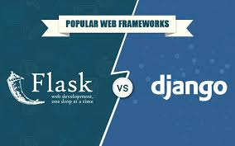
Competitor in Python Backend

Slide 12
Flask Basic
# create 2 directories – static and template
from flask import Flask
app = Flask(__name__)
@app.route("/")
def index():
return "Hello world!"
app.run()

Slide 13
Add one Link (Add <h1> <h1> to increase font size
@app.route("/Welcome")
def wel():
return “<h1>Welcome to Flask!<h1>"
Basic html
https://www.w3schools.com/html/html_intro.asp

Slide 14
Using html templates – Open VS code (open new file)
# create a html file in folder “templates”
from flask import render_template
@app.route("/html")
def h1():
return render_template("h.html")

Slide 15
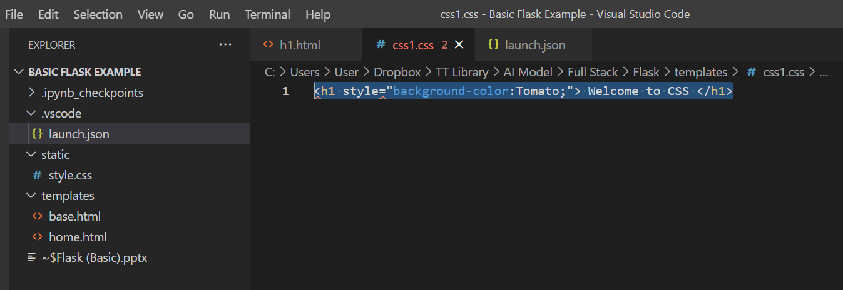
CSS same as html file
@app.route("/css")
def css():
return render_template("css.html")

Slide 16
Flask run js file
@app.route("/js")
def js():
return render_template("HTML_JS_Flask.html")
<h1>This is the html that call JS</h1>
<script src = "{{url_for('static', filename = 'js1.js')}}"></script>
document.write("Welcome to Js");

Slide 17
Running JS in html
<!DOCTYPE html>
<html>
<body>
<h1>My First JavaScript</h1>
<p>JavaScript can change the content of an HTML element:</p>
<button type="button" onclick="myFunction()">Click Me!</button>
<p id="demo">This is a demonstration.</p>
<script>
function myFunction() {
document.getElementById("demo").innerHTML = "Hello JavaScript!";
}
</script>
</body>
</html>

Slide 18
ML Example

Slide 19
Build & Load Model
import pandas as pd
df = pd.read_csv("DBS_SingDollar.csv")
X = df.loc[:, ["SGD"]]
Y = df.loc[:, ["DBS"]]
from sklearn import linear_model
model = linear_model.LinearRegression().fit(X,Y)
pred = model.predict(X)
from sklearn.metrics import mean_squared_error
print(mean_squared_error(Y, pred)**0.5)
import joblib
joblib.dump(model, "DBS Regression Model")

Slide 20
Flask
from flask import Flask
app = Flask(__name__)
from flask import request, render_template
import joblib
@app.route("/", methods = ["GET", "POST"])
def i():
if request.method == "POST":
name = request.form.get("name")
print(name)
num = request.form.get("rates")
print(num)
model = joblib.load("DBS Regression Model")
pred = model.predict([[num]])
print(pred)
s = "Predicted DBS Share Price : " + str(pred)
print(s)
return(render_template(“main.html", result = s))
else:
return render_template(“main.html", result ="DBS Share Price Prediction")
#if run on command line
if __name__=="__main__":
app.run(debug=True)
app.run()

Slide 21
HTML Basic Syntax
The <!DOCTYPE html> declaration defines that this document is an HTML5 document
The <html> element is the root element of an HTML page
The <head> element contains meta information about the HTML page
The <title> element specifies a title for the HTML page (which is shown in the browser's title bar or in the page's tab)
The <body> element defines the document's body, and is a container for all the visible contents, such as headings, paragraphs, images, hyperlinks, tables, lists, etc.
The <h1> element defines a large heading
The <p> element defines a paragraph
<!DOCTYPE html>
<html>
<head>
<title>Page Title</title>
</head>
<body>
<h1>My First Heading</h1>
<p>My first paragraph.</p>
</body>
</html>
https://www.w3schools.com/html/html_intro.asp

Slide 22
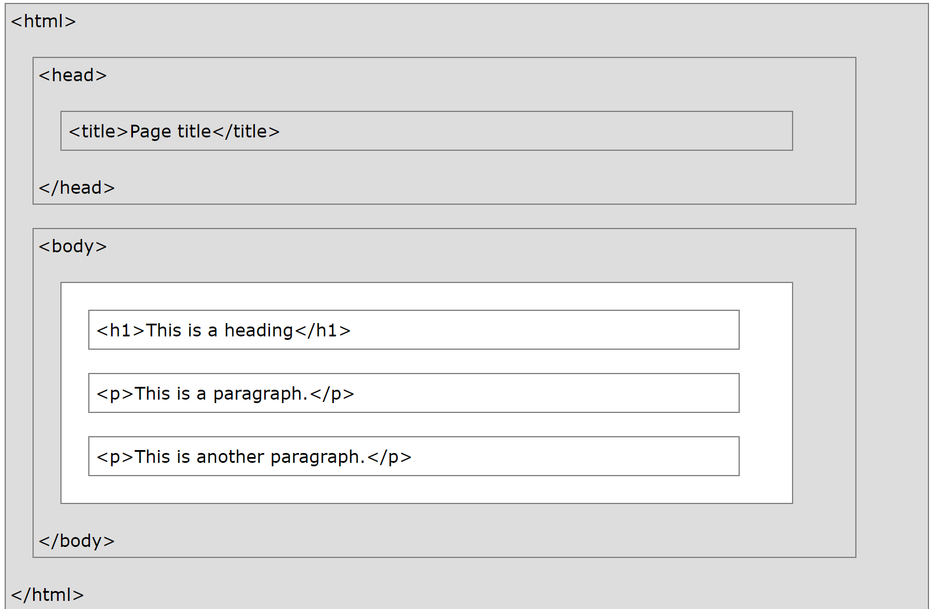
HTML
What is an HTML Element?
An HTML element is defined by a start tag, some content, and an end tag:
<tagname>Content goes here...</tagname>
The HTML element is everything from the start tag to the end tag:
<h1>My First Heading</h1>
<p>My first paragraph.</p>

Slide 23
Html - form
<form>: The Form element
The <form> HTML element represents a document section containing interactive controls for submitting information.
POST vs. GET Methods
We can use either the post or get method with a form.
Use the get method to request, or get, data from a resource.
Use the post method to submit data to be processed by a resource.
Read more: https://html.com/forms/tutorial/#ixzz7JmmNbrz4
<html>
<body>
<form action = "http://localhost:5000/" method = "post">
<p>Enter Name:</p>
<p><input type = "text" name = "name" /></p>
<p>Enter exchange rate:</p>
<p><input type = “number" step = “0.01” name = "rates" /></p>
<p><input type = "submit" value = "submit" /></p>
</form>
{{result}}
</body>
</html>
https://developer.mozilla.org/en-US/docs/Web/HTML/Element/form

Slide 24
Input type
<input type="button">
<input type="checkbox">
<input type="color">
<input type="date">
<input type="datetime-local">
<input type="email">
<input type="file">
<input type="hidden">
<input type="image">
<input type="month">
<input type="number">
<input type="password">
<input type="radio">
<input type="range">
<input type="reset">
<input type="search">
<input type="submit">
<input type="tel">
<input type="text">
<input type="time">
<input type="url">
<input type="week">
https://www.w3schools.com/html/html_form_input_types.asp

Slide 25
Flask with SQLLite

Slide 26
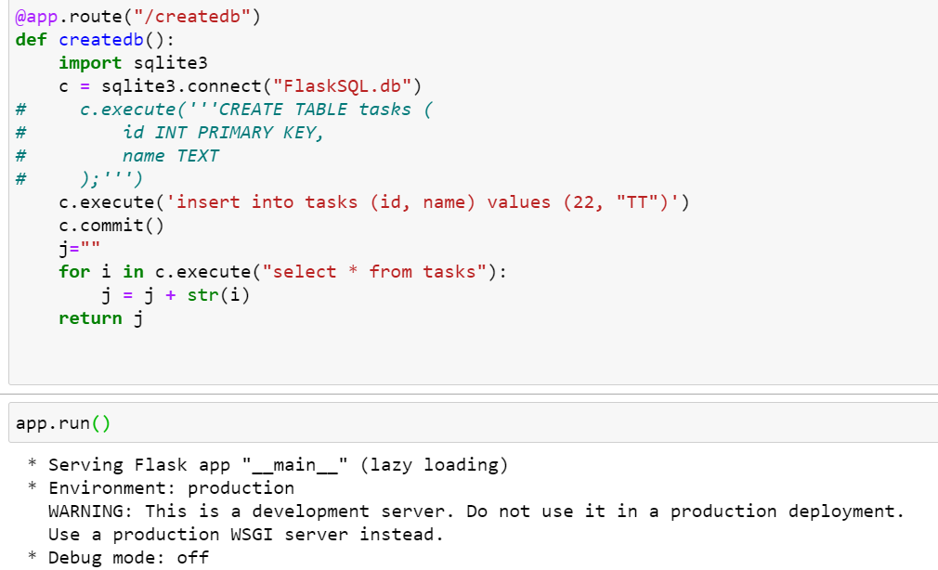
Create db, table, insert data and select

Slide 27
HTML style (Jinja) is frontend, we use Flask for backend

Slide 28
Flask
from flask import Flask, render_template, request
app = Flask(__name__)
@app.route('/')
def main():
return render_template('query.html')
@app.route('/process', methods=['POST'])
def process():
# Retrieve the HTTP POST request parameter value from 'request.form' dictionary
_username = request.form.get('username') # get(attr) returns None if attr is not present
return render_template('response.html', username=_username)
app.run()

Slide 29
HTML as front end, save in templates (query and response)
<html>
<head>
<title>Entry Page</title>
</head>
<body>
<form action="process" method="post">
<label for="username">Please enter your name: </label>
<input type="text" id="username" name="username"><br>
<input type="submit" value="SEND">
</form>
</body>
</html>
<html>
<head>
<title>Response Page</title>
</head>
<body>
<h1>Hello, {{ username }}</h1>
</body>
</html>

Slide 30
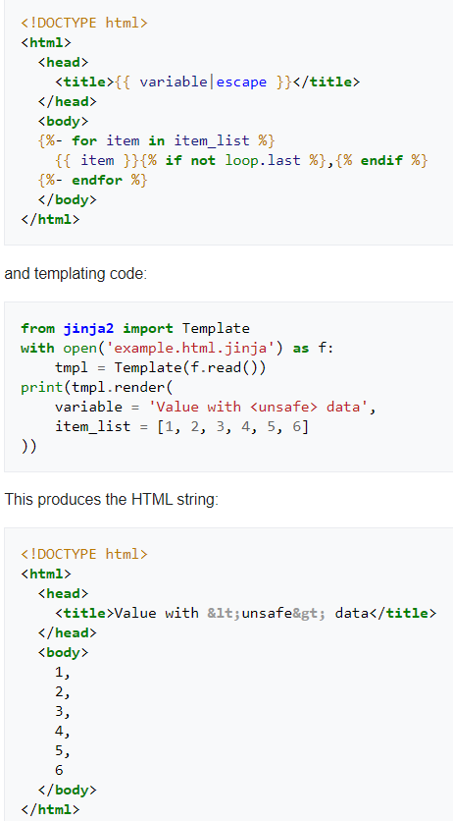
What is Jinja
Jinja is a web template engine for the Python programming language.

