Slide 1
4 Convergence & Future Outlook
Teoh Teik Toe
ITOM/NBS
ttteoh@ntu.edu.sg
97905202

Slide 2
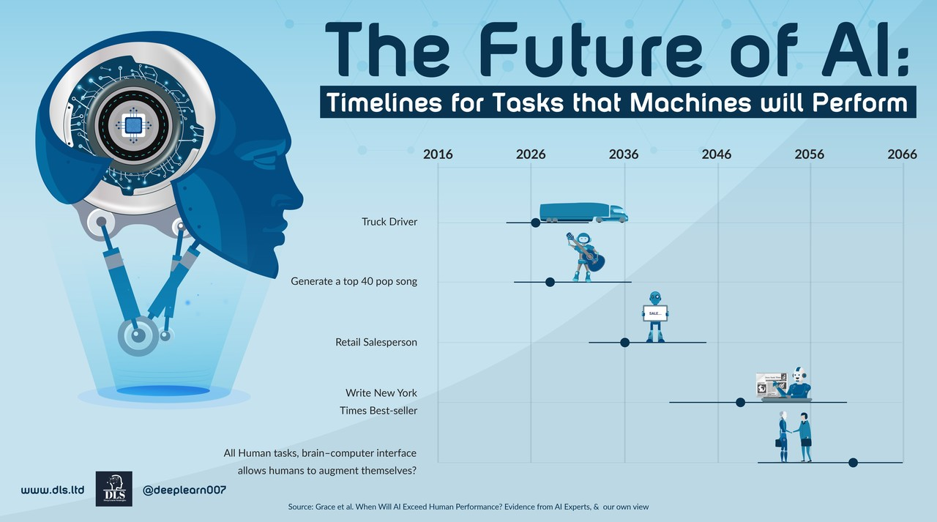
Convergence & Future Outlook

Slide 3
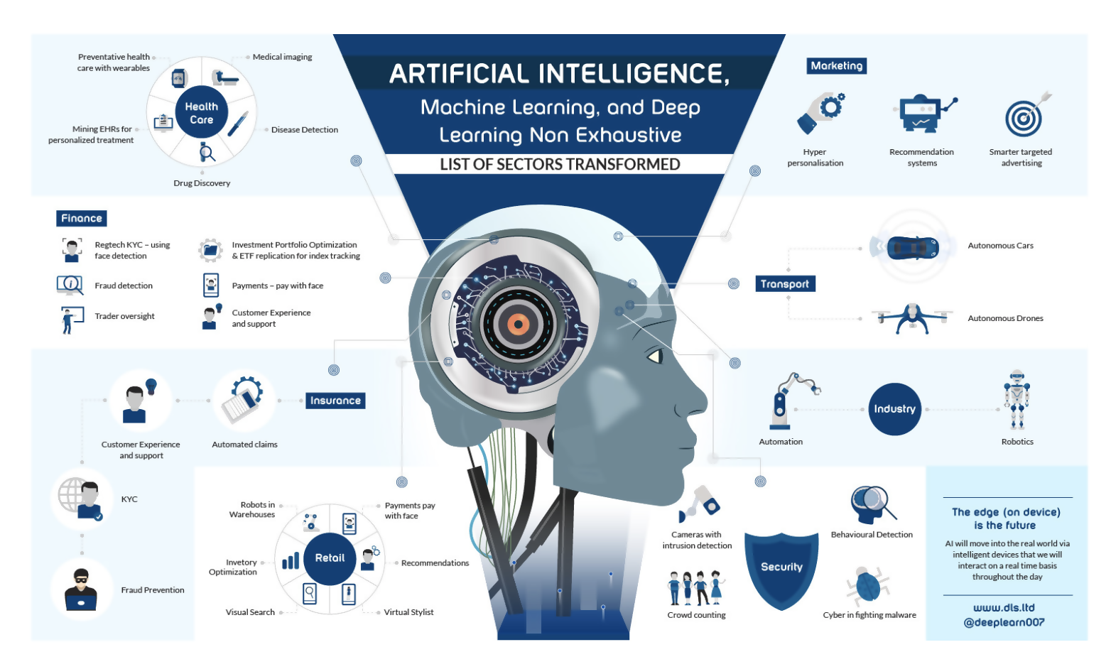
Convergence & Future Outlook

Slide 4
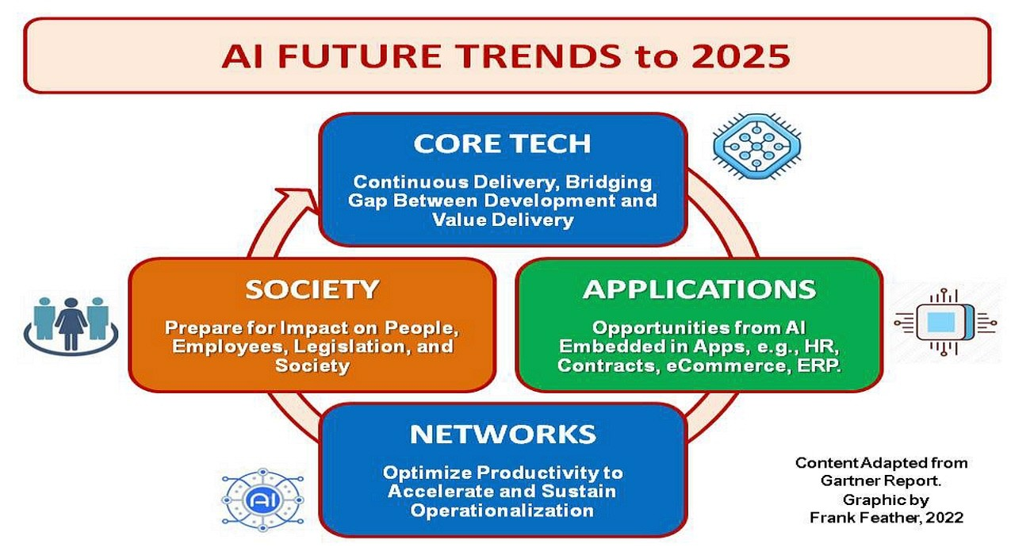
Convergence & Future Outlook

Slide 5
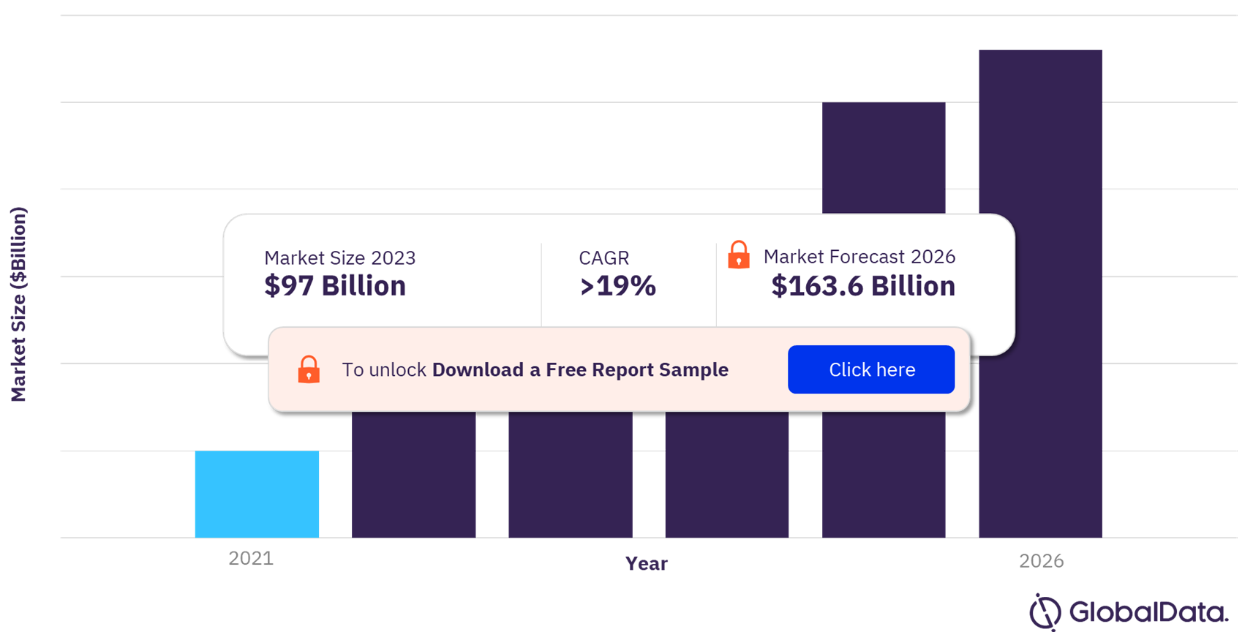
Convergence & Future Outlook

Slide 6
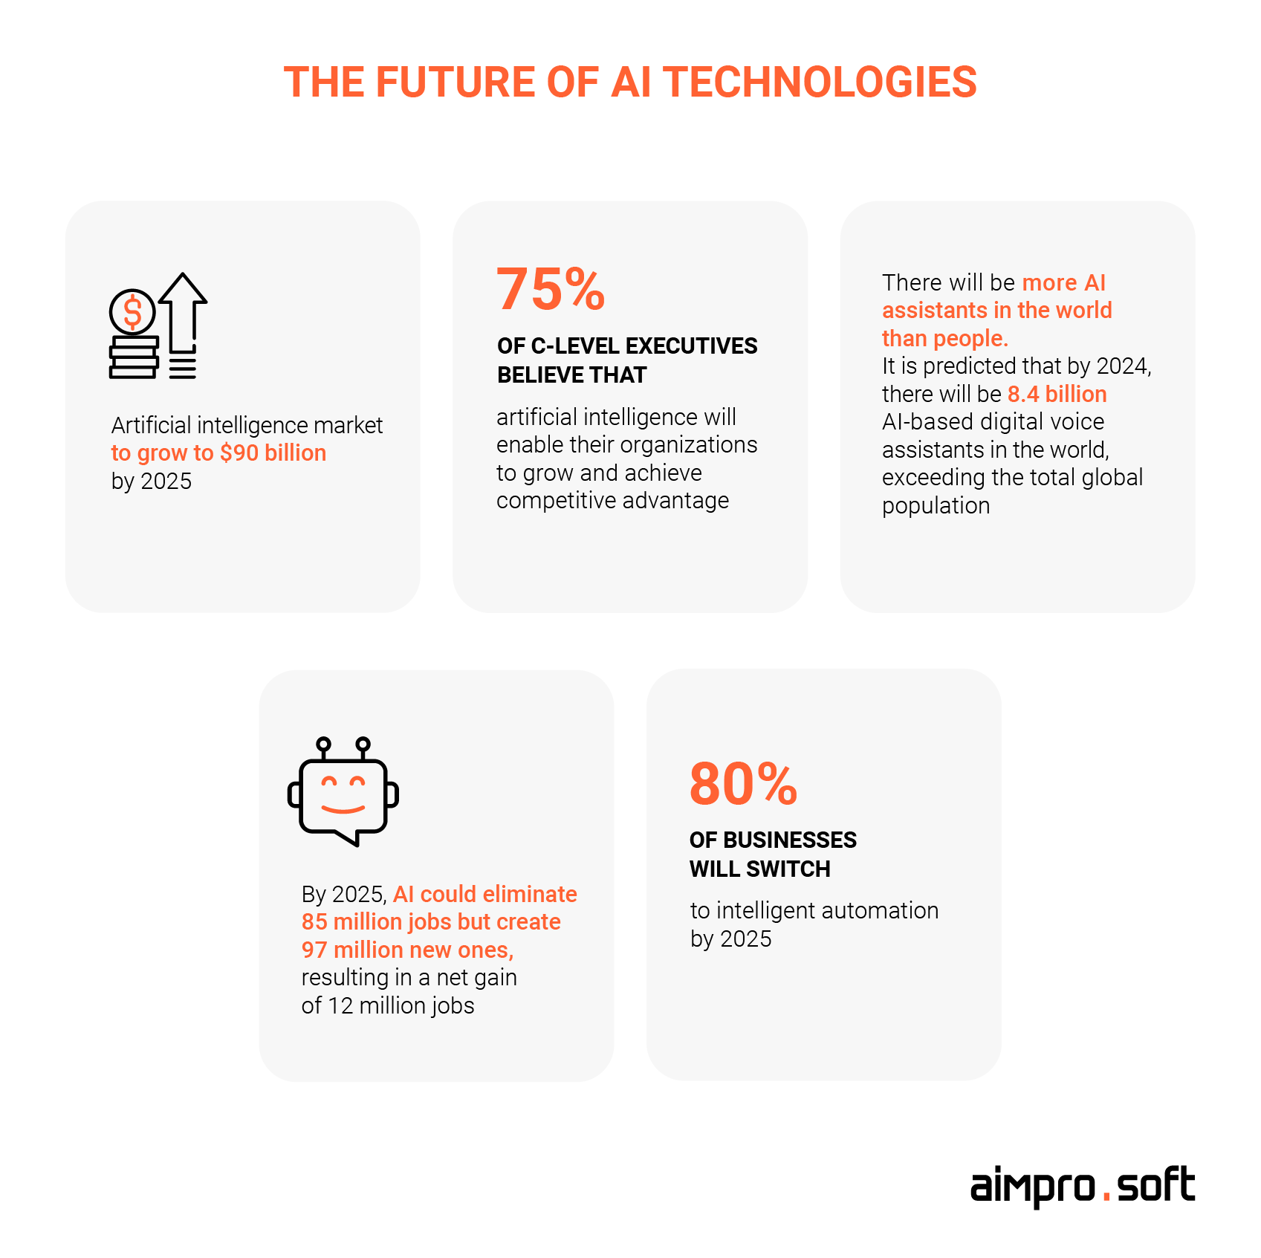
Convergence & Future Outlook

Slide 7
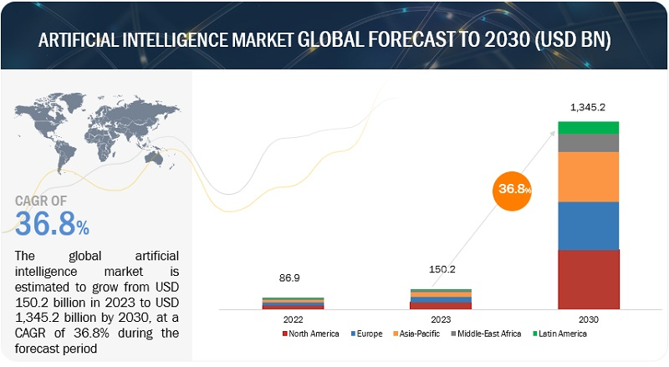
Convergence & Future Outlook

Slide 8
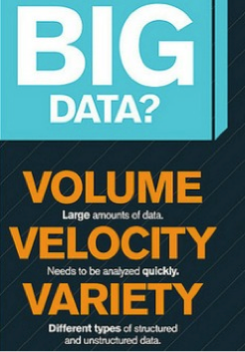
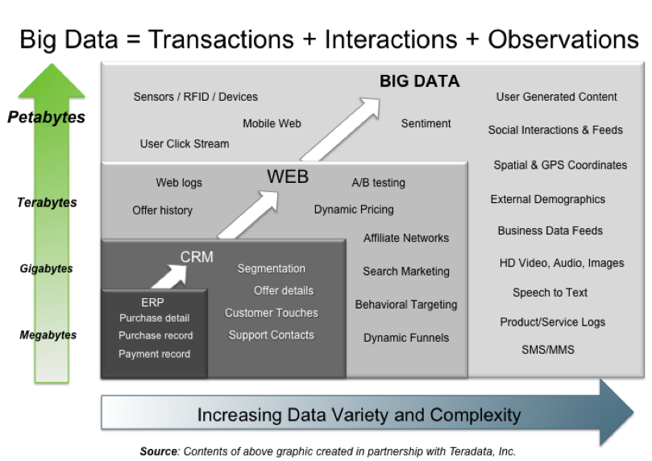
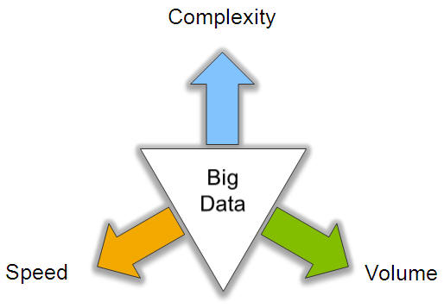
Big Data: 3V’s

Slide 9
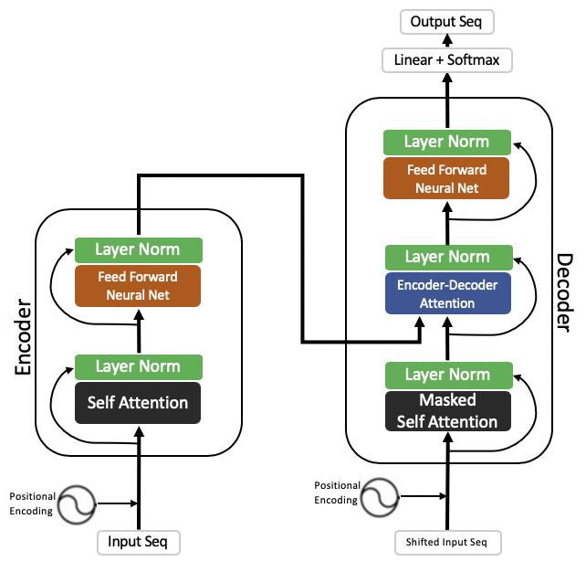
Transformer, Encoder, Attention
How encoder decoder works in Transformer: https://jalammar.github.io/illustrated-transformer/
The transformer is the model, while the attention is a technique used by the model.

Slide 10
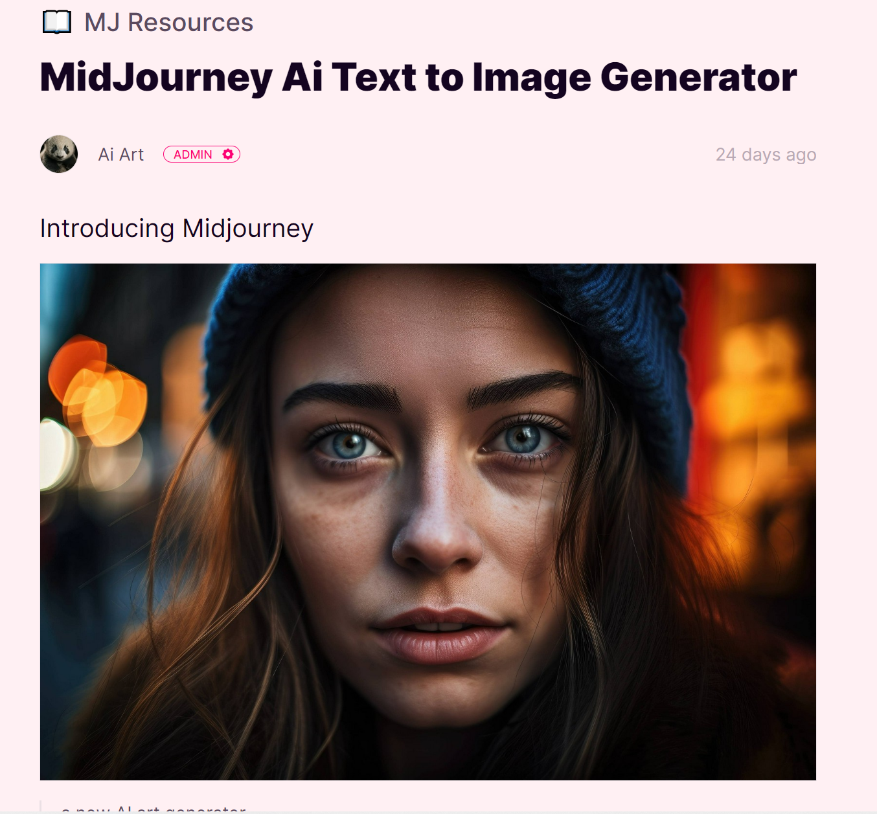
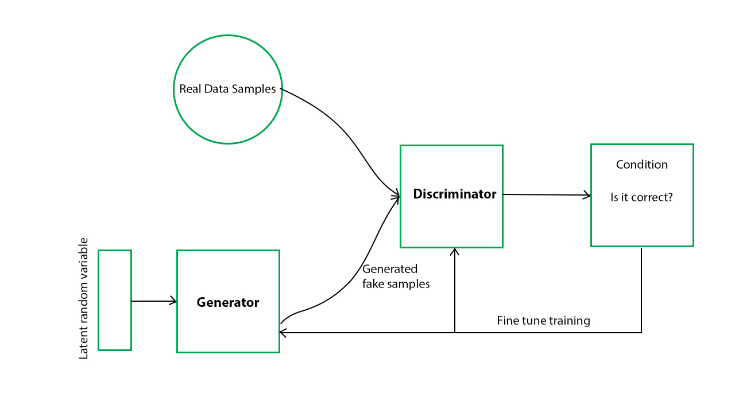
GAN – Used by Midjourney
Midjourney is a new artificial intelligence (AI) art generator that can turn text into images. It is based on the principle of Generative Adversarial Networks (GANs), which are a type of neural network that can generate new data from scratch.
https://gratisgraphics.com/community/post/1030373305
Alternative to Midjourney:
Dall-E2 using GPT3
https://openai.com/product/dall-e-2

Slide 11
State of the Art – 2022 - Transfer Learning

Slide 12
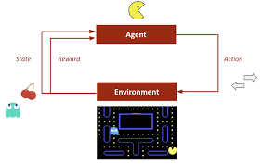
Reinforcement Learning

Slide 13
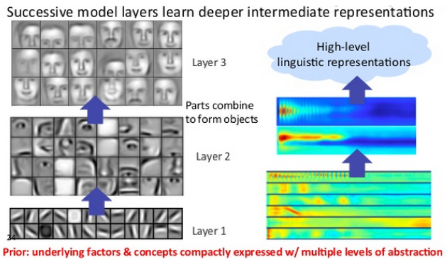
What can deep learning do (CNN)?

Slide 14
Thank You

