Slide 1
3 Objective of AI
Teoh Teik Toe
ITOM/NBS
ttteoh@ntu.edu.sg
97905202

Slide 2
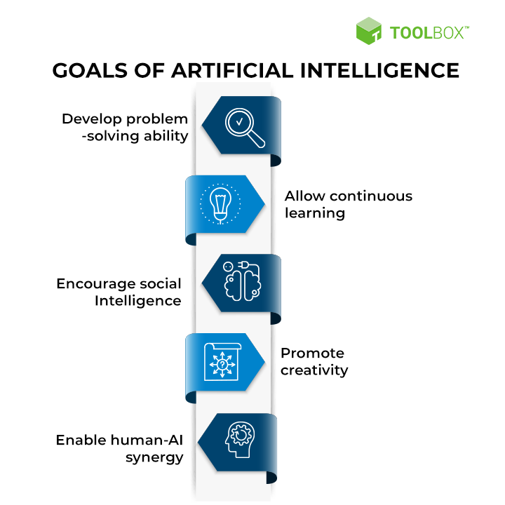
Objective of AI

Slide 3
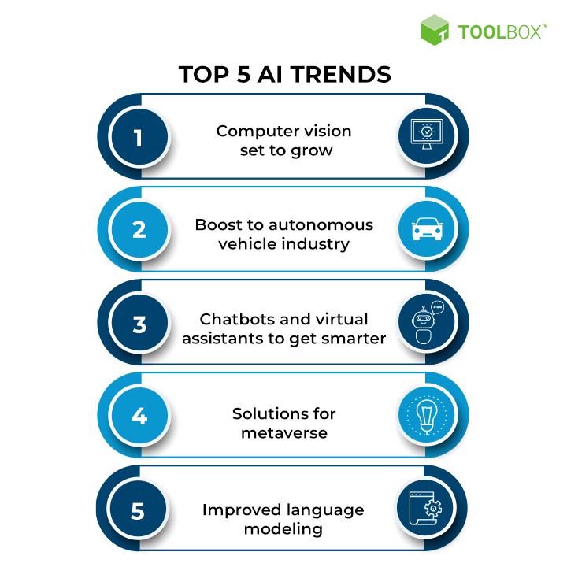
Objective of AI

Slide 4
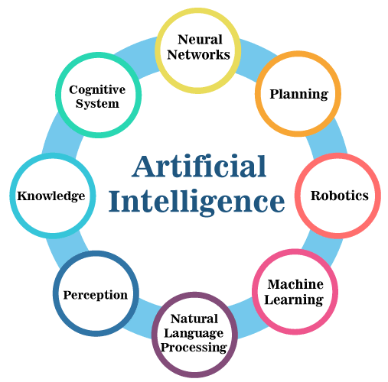
Objective of AI

Slide 5
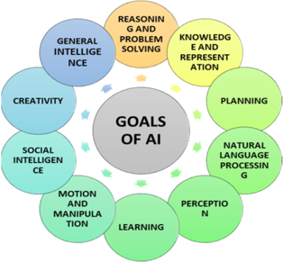
Objective of AI

Slide 6
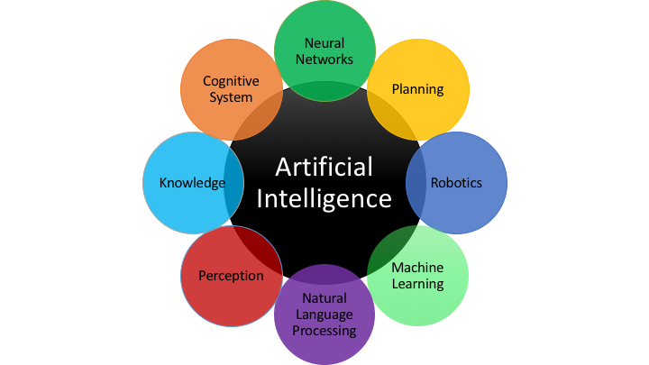
Objective of AI

Slide 7
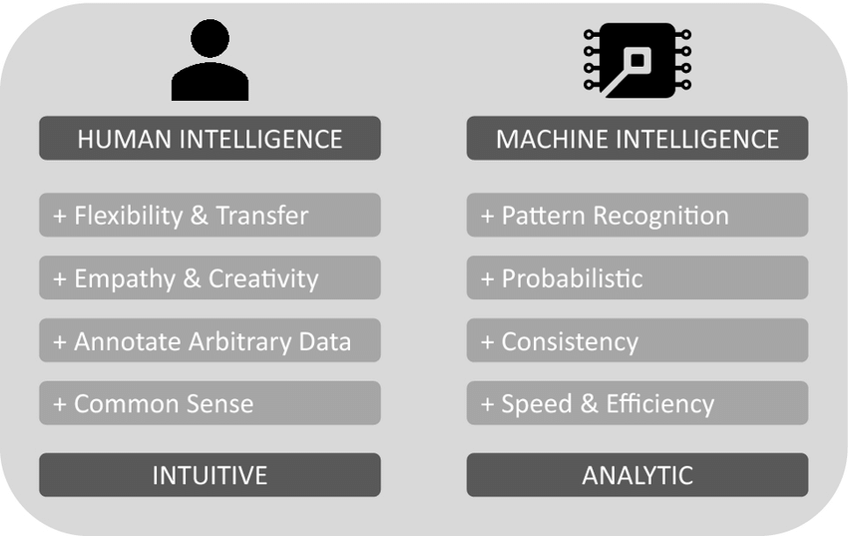
Human vs Machine

Slide 8
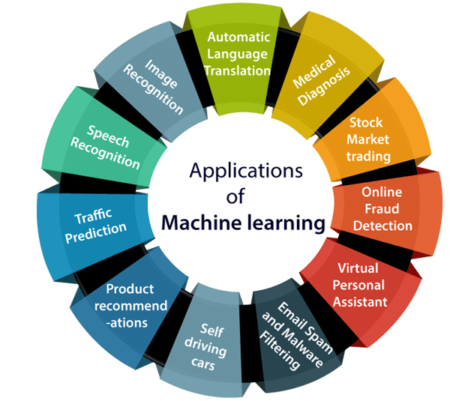

Slide 9
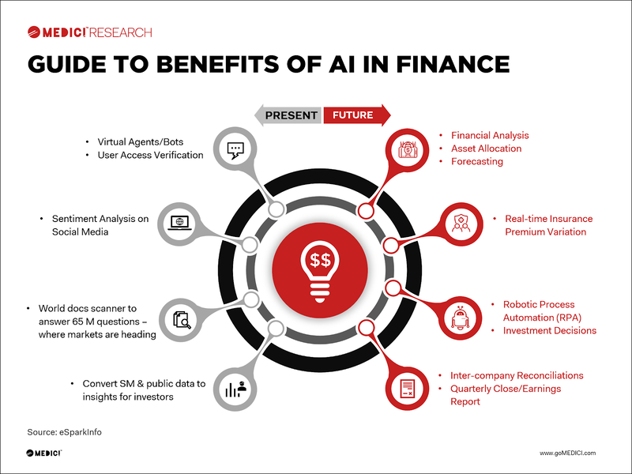

Slide 10
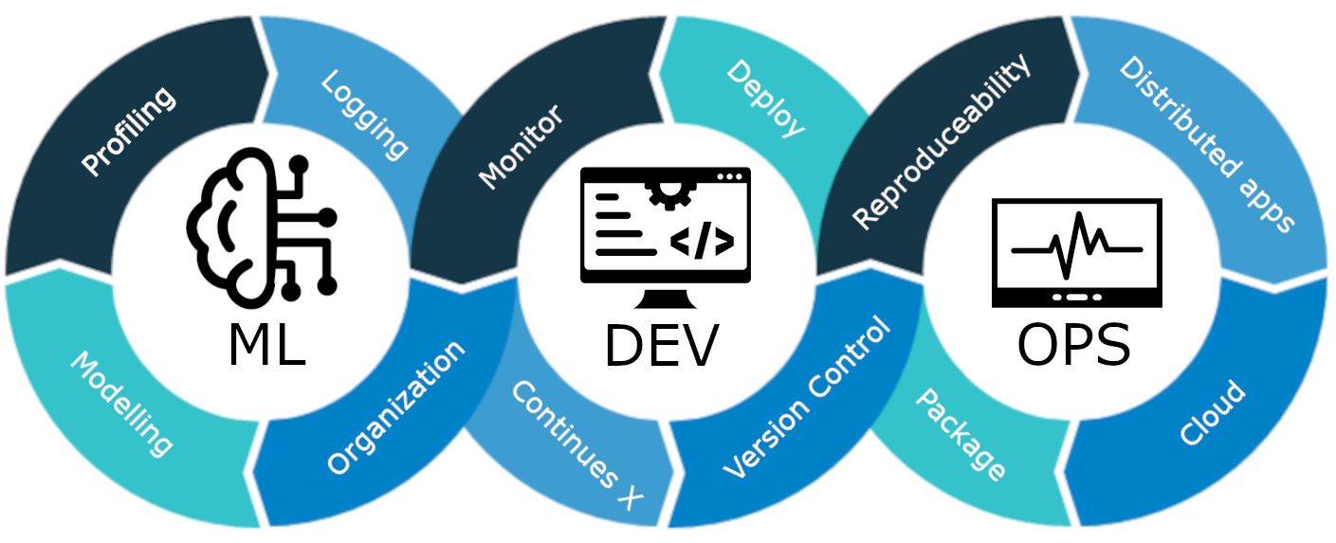
MLOps

Slide 11
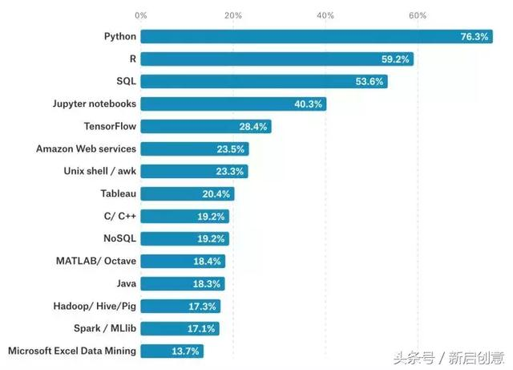
Programming Language for AI

Slide 12
Thank You

