Slide 1
2 Role of AI
Teoh Teik Toe
ITOM/NBS
ttteoh@ntu.edu.sg
97905202

Slide 2
Recording
https://1drv.ms/v/s!Aik2a4x7tvLyi_YLBjRRJ-qBbuzc_A?e=CqVyj9

Slide 3
Agenda
Intro to AI
AI Models
Library: https://1drv.ms/f/s!Aik2a4x7tvLygrcOVnorwa6X7zBxTg?e=g8dRKk

Slide 4
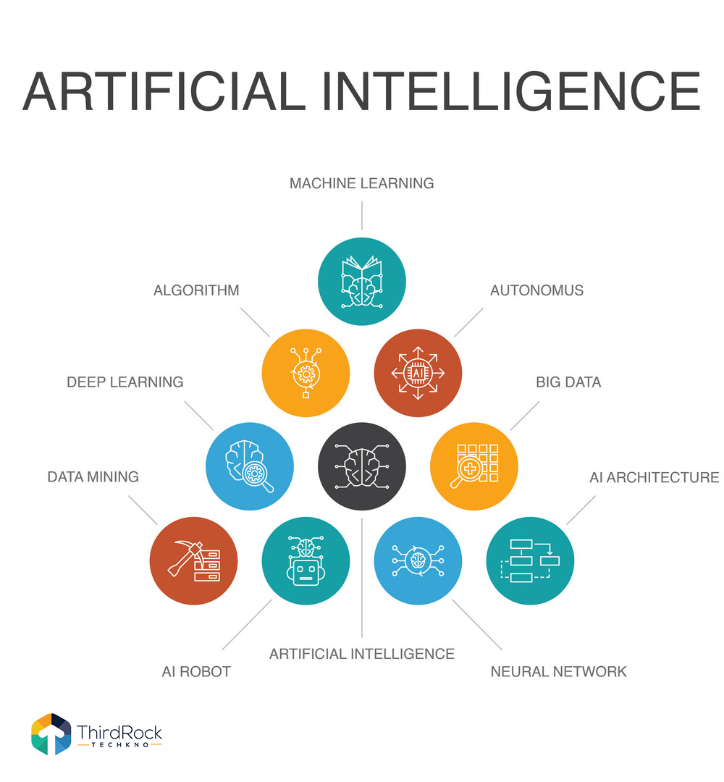
Role of AI

Slide 5
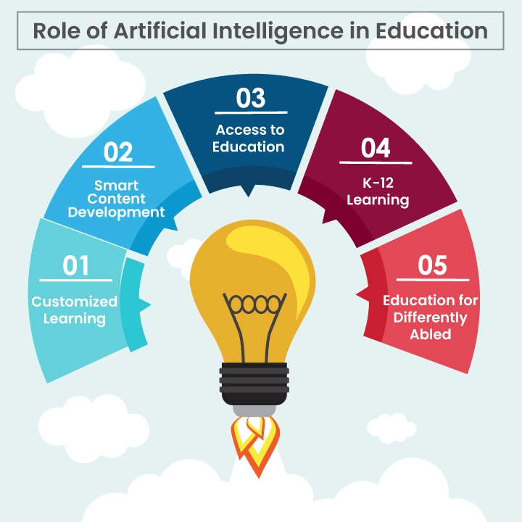
Role of AI

Slide 6
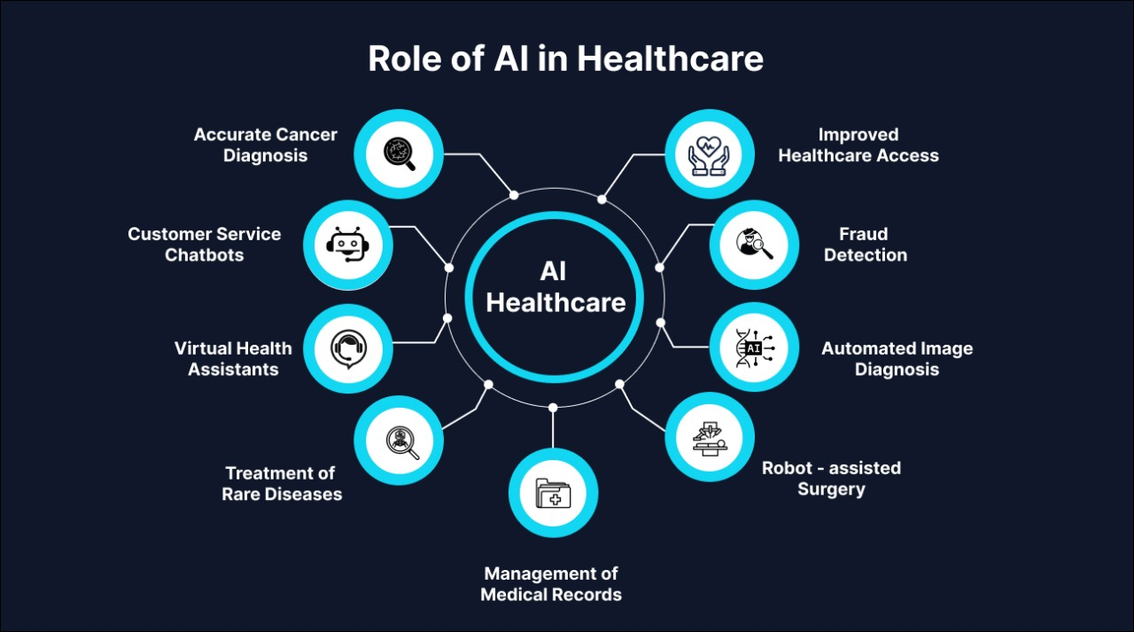
Role of AI

Slide 7
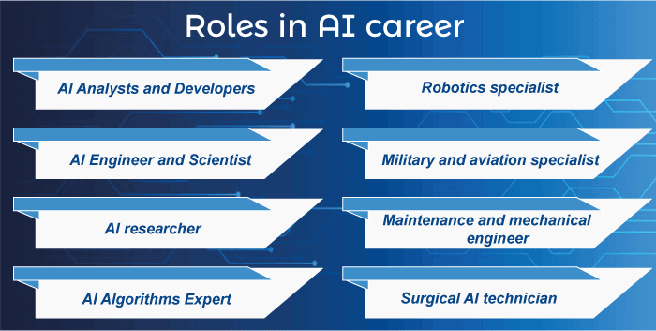
Role of AI

Slide 8
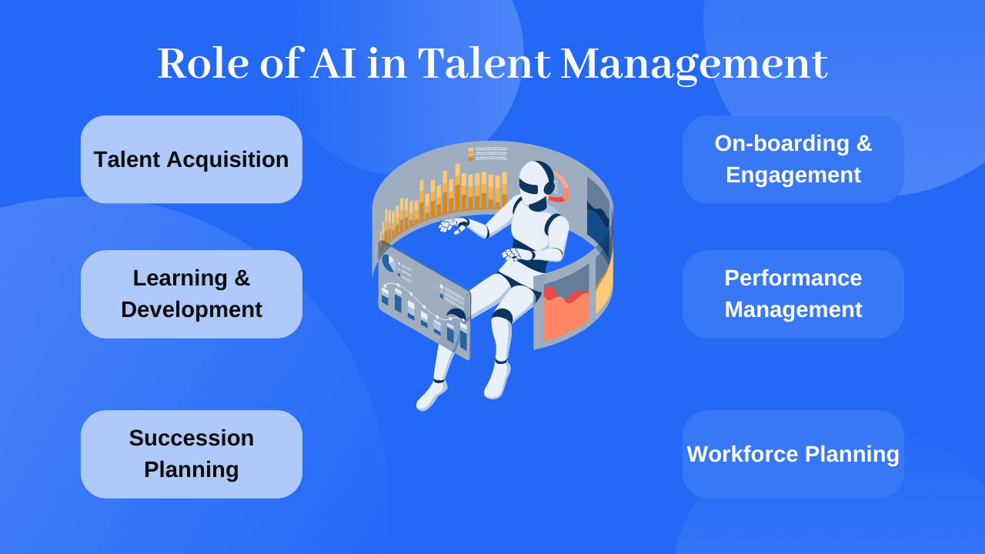
Role of AI

Slide 9
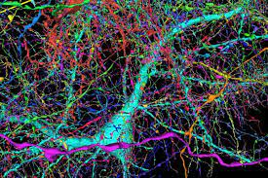
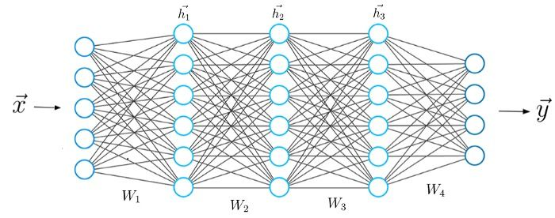
Machine (100 trillion) vs Human (0.086 trillion) => about 10,000 times more
GPT-4 parameter around 100 trillion
Human brain — Approximately 86 billion neurons
https://www.nature.com/scitable/blog/brain-metrics/are_thcere_really_as_many/

Slide 10
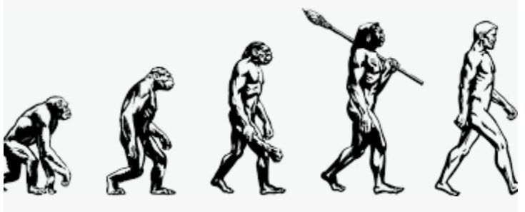
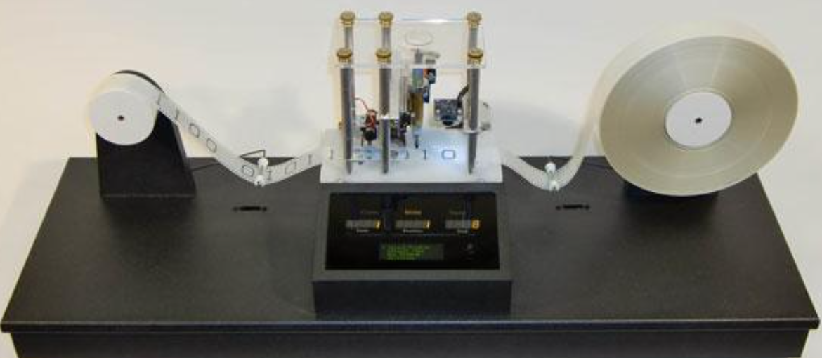
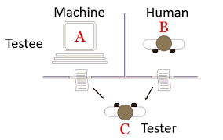
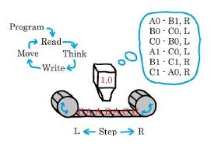
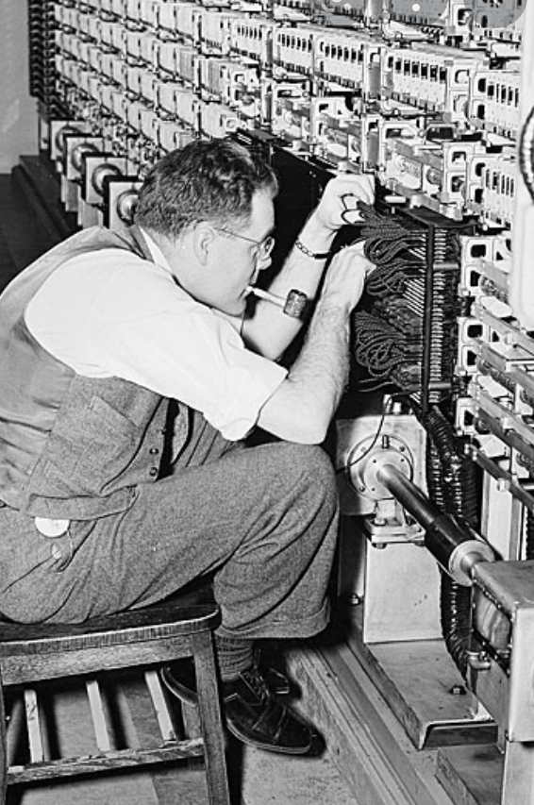
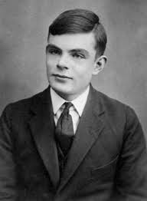
The beginning - Can machines think? 1936 Alan Turing – Turing Machine 1950 Turing Test
Turing test, in which a computer tries to fool the system into thinking that it is a human

Slide 11
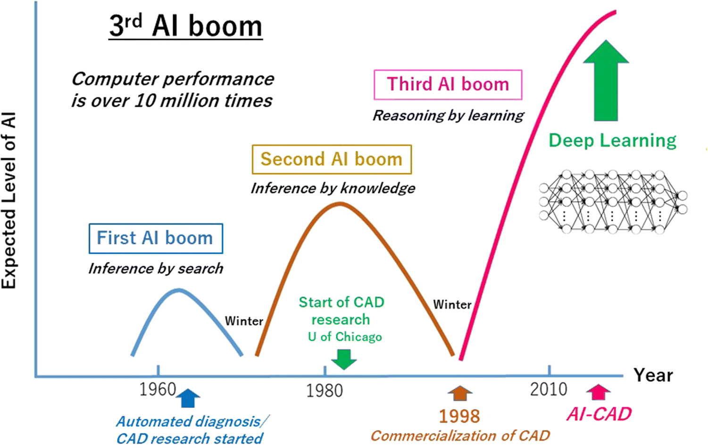
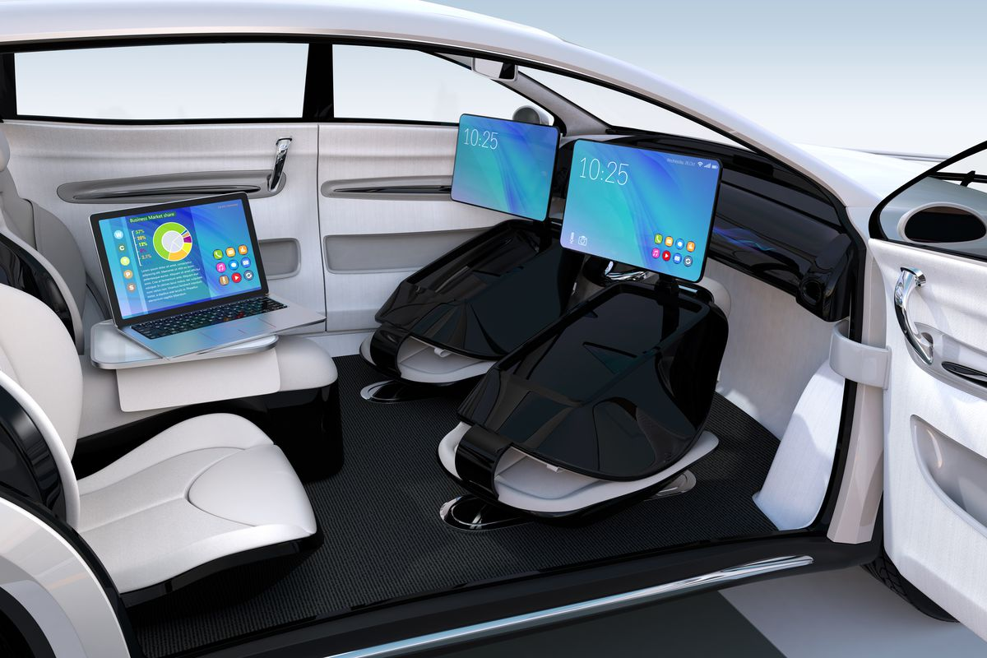
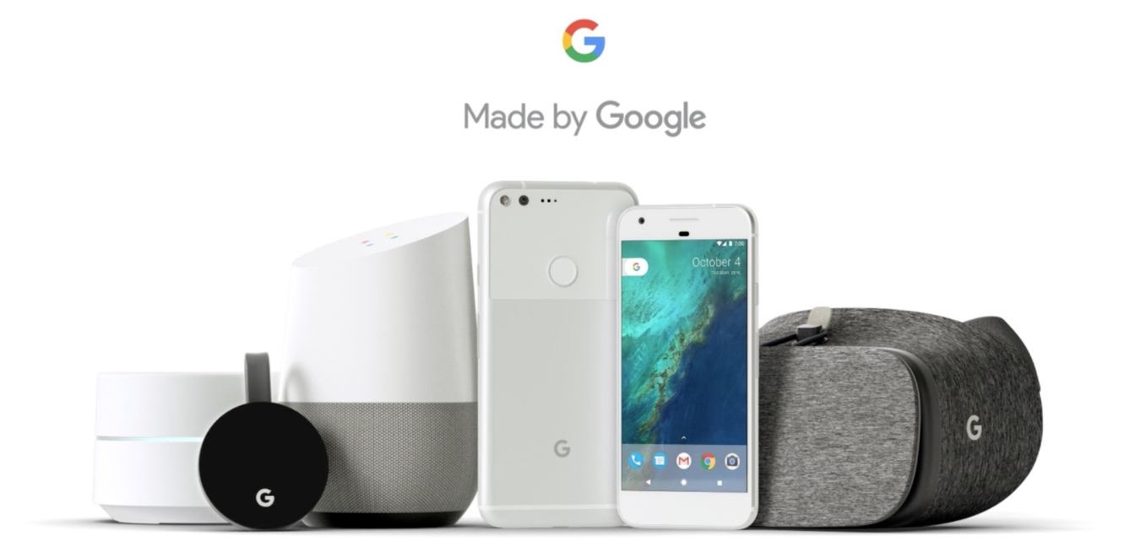
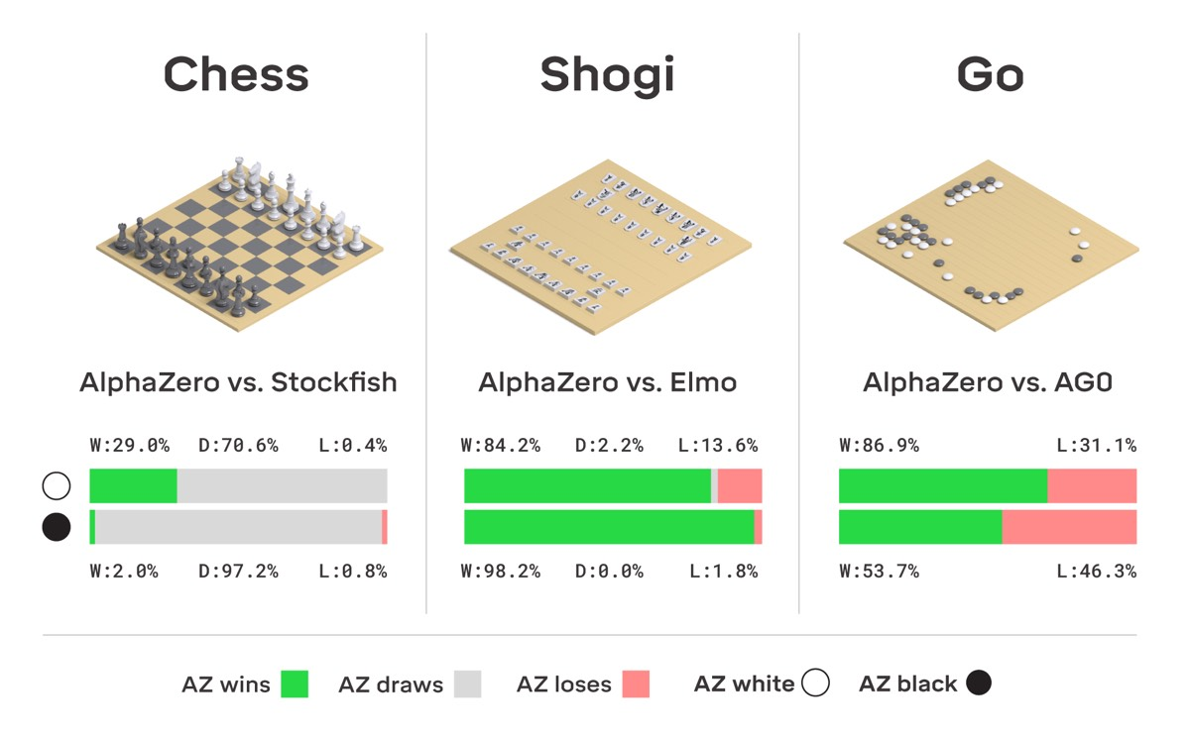
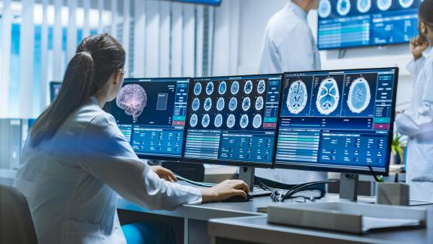
Now & Future

Slide 12
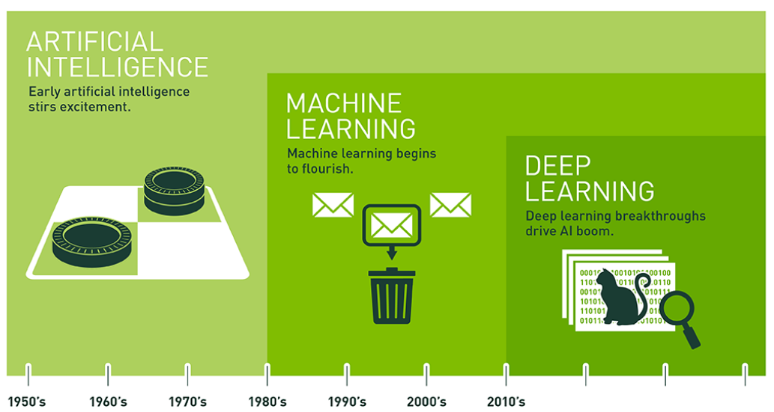
AI terminology
https://blogs.nvidia.com/blog/2016/07/29/whats-difference-artificial-intelligence-machine-learning-deep-learning-ai/

Slide 13
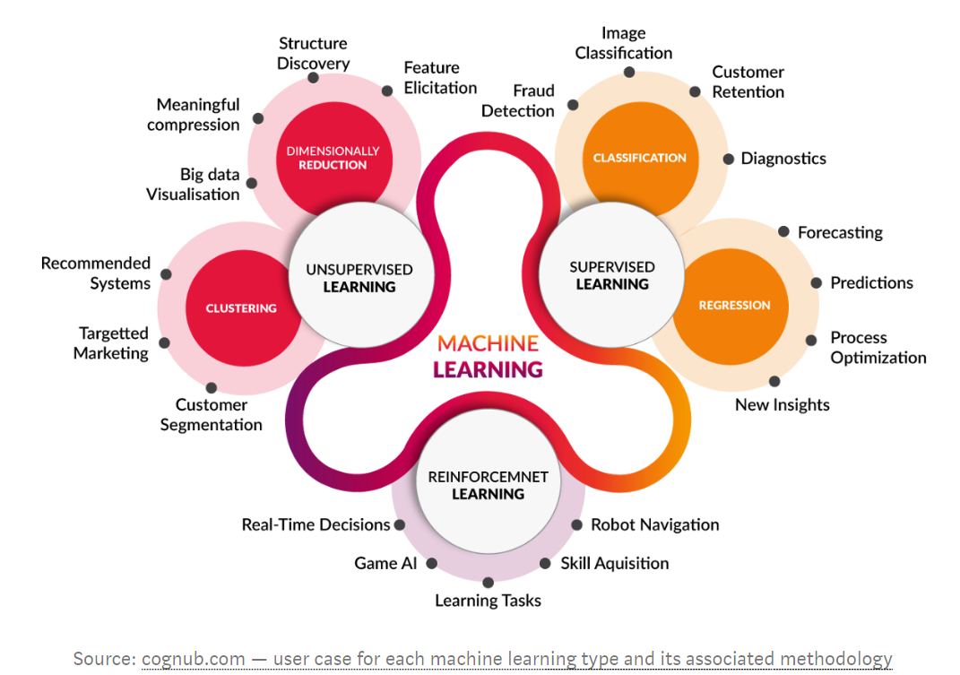
Machine Learning types

Slide 14
AI and other technology
AI and Big Data
Internet of Thing
Robotic Process Engineering
Block Chain
AI & Big Data
Cloud
Natural Language Processing
Web 3
Automation

Slide 15
Thank You

